Slide 1
Launch of
NERC Centres for Atmospheric Science
Science, Environment and Government
Professor David King
Government Chief Scientific Adviser
29 May

Slide 2
The Montreal Protocol on Substances that deplete the Ozone Layer
Agreed upon on 16 September 1987
Constructively flexible
Final objective: elimination of all ozone-depleting substances
29 original Parties, now over 180 Signatories to the Protocol
Notes:
After a series of rigorous meetings and negotiations, the Montreal Protocol on Substances that Deplete the Ozone Layer was finally agreed upon on 16 september 1987 at the Headquarters of the International Civil Aviation Organization in Montreal, and proved to be far tougher than anyone had thought possible only a few months before.
The delicacy of the negotiations is reflected in the final agreement, which contains clauses to cover the special circumstances of several groups of countries, especially developing countries with low consumption rates who do not want the Protocol to hinder their development. But the Protocol is constructively flexible: it can be tightened or "adjusted" as the scientific evidence strengthes, without having to be completely renegotiated. Indeed, it sets the "elimination" of ozone-depleting substances as its "final objective." The Protocol came into force, on time, on January 1st, 1989, by when 29 countries and the EEC representing approximately 82 percent of world consumption had ratified it. Since then several other countries have joined.
The Protocol was only a first step, as was realised at the time. But once it was agreed, events developed with astonishing speed. New scientific evidence showed that very much tighter and greater controls would be needed, and Governments and industry moved further, and faster, than anyone would have believed possible.

Slide 3
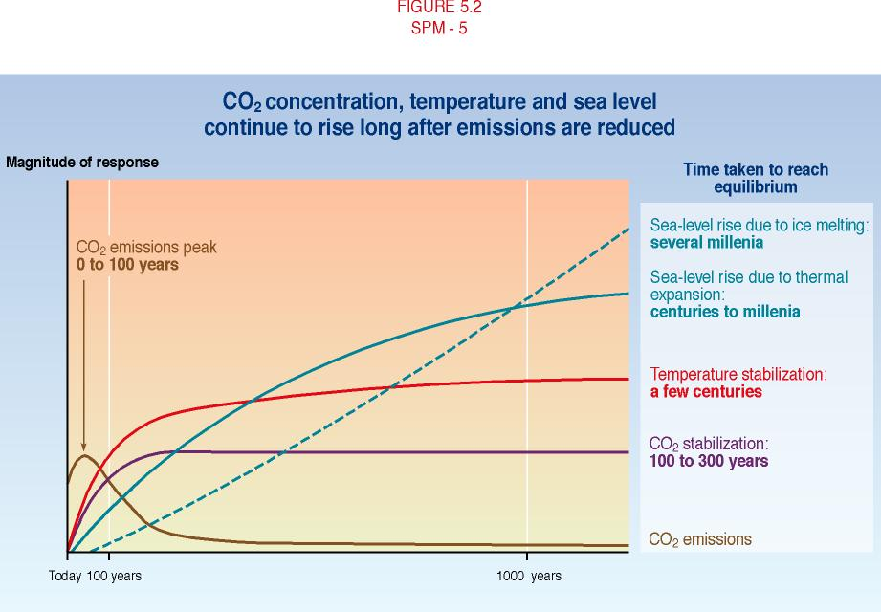

Slide 4
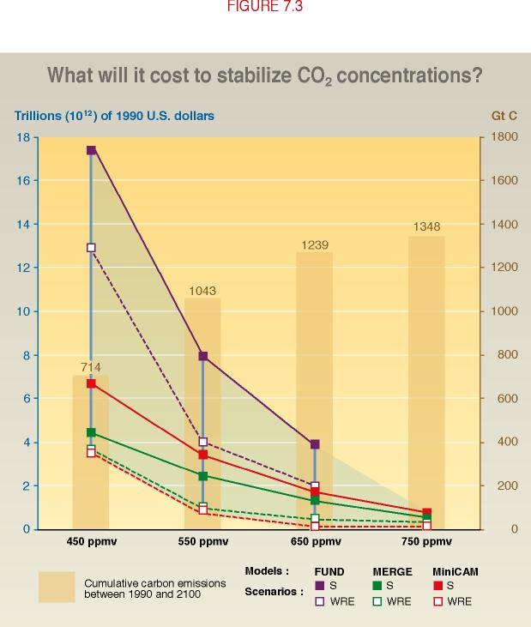

Slide 5
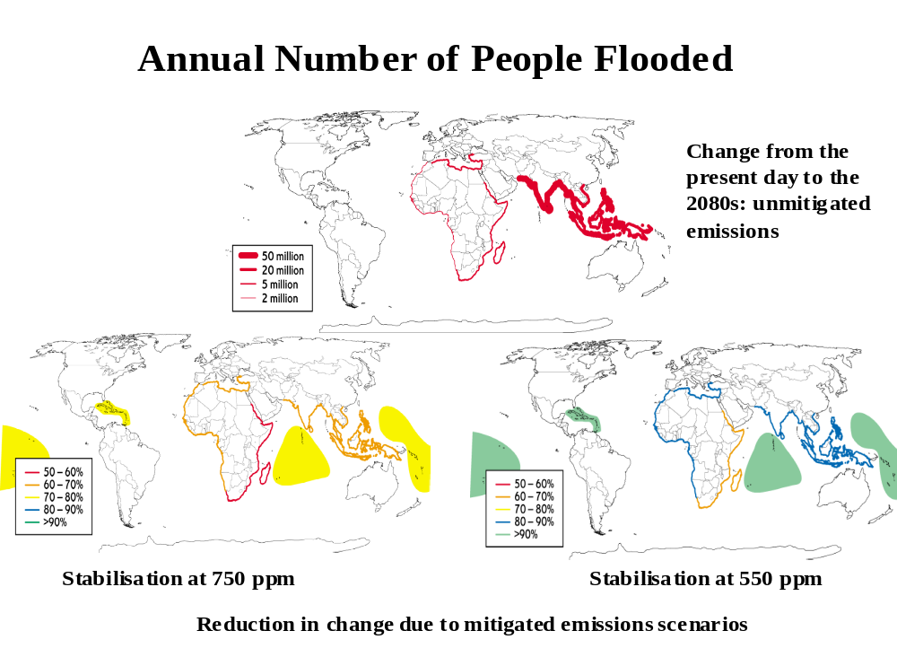

Slide 6
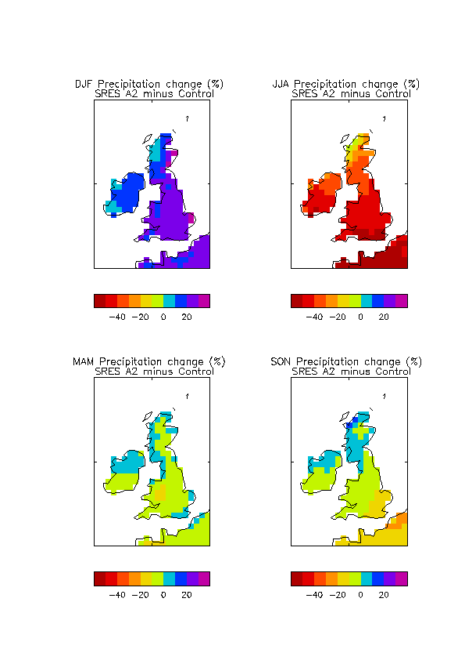

Change in Precipitation By 2080s
(UKCIP02 scenarios - published April 2002)
winter
summer
%
Hadley Centre for Climate Prediction and Research

Slide 7
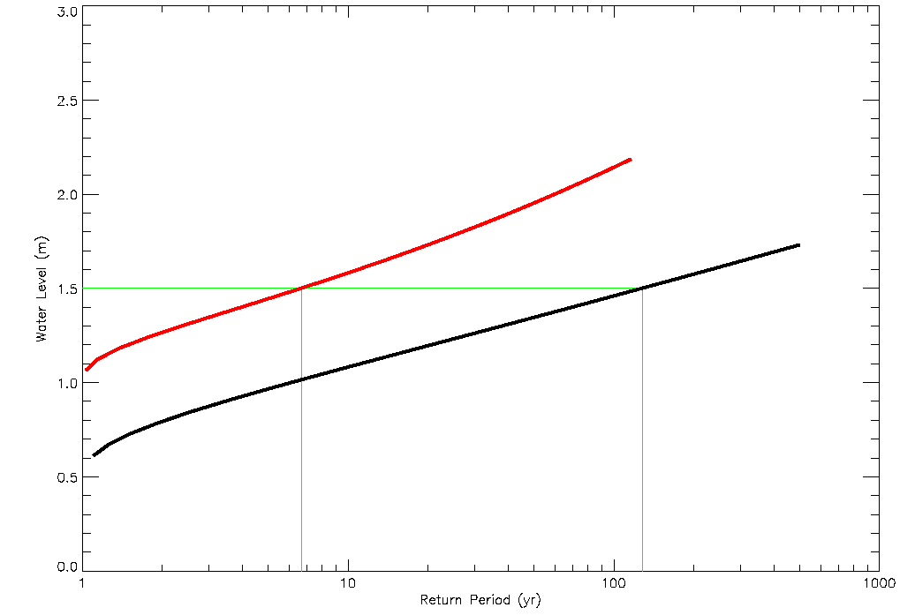
Change in the return periods of extreme water levels for Immingham on the east coast of England
2080s
Current climate
The 2080s climate includes a rise in mean sea level (30 cm),
changes in storminess and vertical land movements.
Published April 2002 as part of UKCIP02
Notes:
NOTES
The green lines show that a 1.5m event occurs less than once a century at present. In the future climate we expect it to occur more than once per decade.
The future (2080s) results differ from the present day because of a rise in mean sea level, changes in storminess and the vertical movement of land.
Source: Met Office
Water level is measured relative to tide.
In the example, future greenhouse gas emissions follow the SRES A2 scenario.

Slide 8
Climate Change: The International Policy Making Agenda
Kyoto Protocol: developed countries to cut greenhouse gases by 5.2% below 1990 levels by 2008-2012
EU has agreed to cut its emissions by 8% - UK’s contribution will be a cut of 12.5%
UK has domestic target to cut CO₂ by 20% below 1990 levels by 2010
Royal Commission of Environmental Pollution has said that CO₂ emissions must be reduced by 60% by 2050

Slide 9
Climate Change: The International Policy Making Agenda
7th Conference of the Parties (COP7, Marrakesh, November 2001)
  Over 160 countries agreed the rules for implementing the Kyoto Protocol
Kyoto Protocol must be ratified by at least 55 countries for it to enter into force

Slide 10
Climate Change: The International Policy Making Agenda
  UK and all other EU Member States will have completed ratification procedures by 31 May 2002
  US remains outside of Kyoto process following their announcement in February of a voluntary greenhouse gas emissions limitation policy
  Without US on board, it is essential for both Russia and Japan to ratify as well as EU

Slide 11
Energy Strategy
Not trying to pick winners
Must create broad menu of sustainable options
Importance of cross-cutting technologies
Context
Performance and Innovation Unit Review of Energy Policy: Report recently published
Review of Energy Research, chaired by CSA, also recently published

Slide 12
Key Recommendations From The Energy Review Research Review Report
Spending on energy research should be brought more in line with that of our nearest industrial competitors in Europe
Six key areas for increased R&D investment identified:
  Carbon sequestration
  Energy efficiency
  Hydrogen
  Nuclear
  Solar PV
  Wave and Tidal
Consideration should be given to the establishment of a national energy research centre to boost research in the UK – Research Councils are working up proposals

Slide 13
Follow-up to the PIU Review
Publication of PIU review is first step in wider debate about energy policy
Next step is consultation to help draw up White Paper towards end of year
  Stakeholder consultation via internet-launched document (14 May)
  Wider process engaging public – mix of methods seeking genuine public involvement in policy-making

Slide 14

Primary Energy
1500
1250
Solar
Geothermal
Wind
1000
Biomass
Hydro
World Energy Demand (Exajoules)
750
Nuclear
Gas and
Coal CH₄/H₂
500
250
Oil
Coal
0
Traditional
1850
1875
1900
1925
1950
1975
2000
2025
2050
Copyright – Shell International Ltd
Notes:
In their book “Energy Needs, Choices and Possibilities: Scenarios to 2050”, published last year, Shell International present two scenarios, Dynamics as Usual and The Spirit of the Coming Age which consider different energy futures.
In The Spirit of the Coming Age superior ways of meeting energy needs are developed to meet consumer preferences. This is a world of experimentation and many failures. It is the story of a solution that triggers a technology revolution and a reminder that discontinuities can arise from seemingly mundane parts of the energy system.
Dynamics as Usual is a world where social priorities for ‘clean’, ‘secure’ and, ultimately, ‘sustainable’ energy shape the system. But it is a world of shifting social priorities, of conflicting interests, intense competition among suppliers, and a wide range of maturing and emerging technologies. The transition to a sustainable, but increasingly diverse and complex, energy system is far from smooth.

Slide 15
One Size Fits All
PEM Fuel Cell $ per kW
100,000
10,000
1,000
Gas turbine
100
10
1960
1980
2000
2020
Source: Powering the Future, Koppel, 1999
Copyright – Shell International Ltd
Notes:
In The Spirit of the Coming Age scenario, fuel cell sales start with stationary applications to businesses willing to pay a premium to ensure highly reliable power without voltage fluctuations or outages. After extraordinary cost reductions for PEM fuel cells over the past decade, this demand helps drive fuel costs below $500 per kW by 2006, providing a platform for transport uses and stimulating further cost reductions to a level where they become directly competitive with internal combustion engines shortly after 2010.

Slide 16
The Hydrogen Economy
How would we best produce hydrogen? – One possible route could be to use nuclear-generated electricity to electrolyse water.
Nuclear
Power
Electricity
Hydrogen?

Slide 17
The Hydrogen Economy and Air Quality
Hydrogen is ‘clean’. When used as a fuel for running cars, or for heating or providing electricity to homes and businesses, it releases only water vapour into the atmosphere
Creating and using hydrogen results in zero emissions if it is created using electrolysis, and the electricity is generated by renewable (e.g. wind, wave and solar) or nuclear sources

Slide 18
The Hydrogen Economy and Air Quality
Hydrogen vehicles will lead to air quality improvements in town centres, even if creation of hydrogen results in emissions. This is because:
  Using hydrogen to power vehicles is completely clean
  Emissions will move from urban centres, where the worst pollution problems are, to other areas

