Slide 1
Data Curation and Facilitation
Bryan Lawrence
Head, British Atmospheric Data Centre
Rutherford-Appleton Laboratory
CLRC

Slide 2
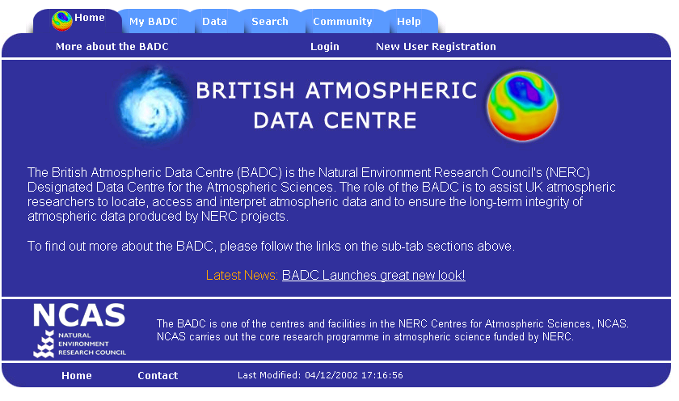
BADC: Web based data delivery
The Role - Curation and Facilitation!

Slide 3
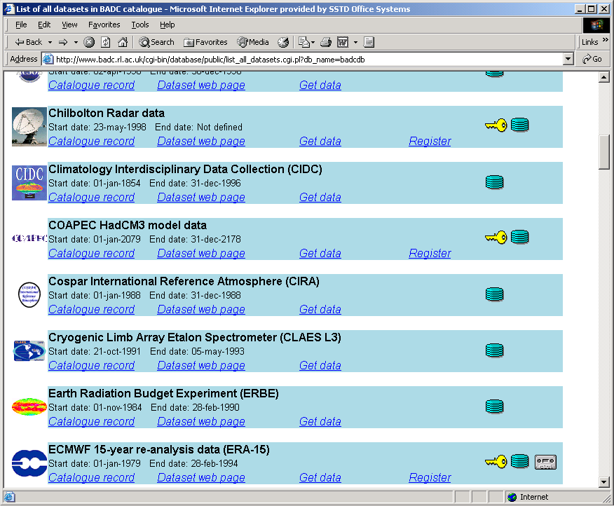
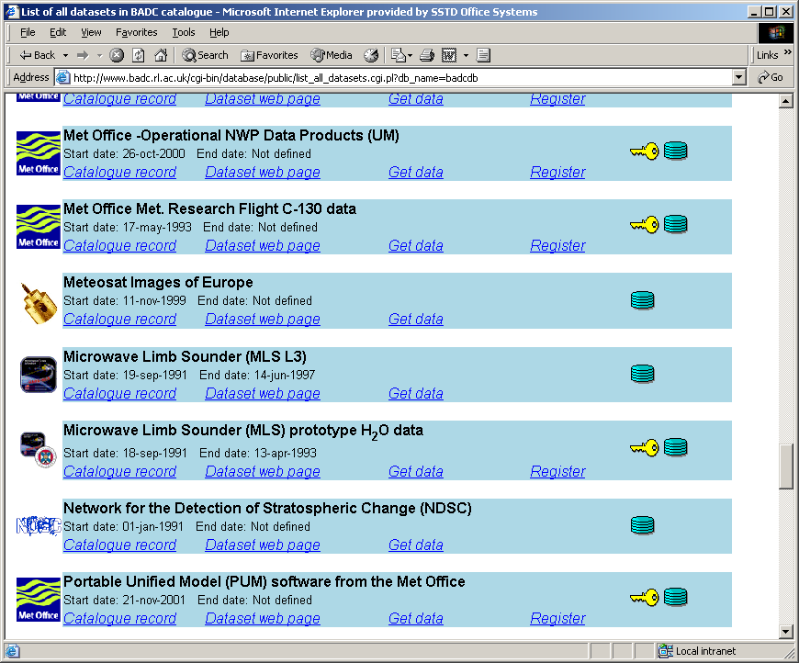
Data Sets

Slide 4
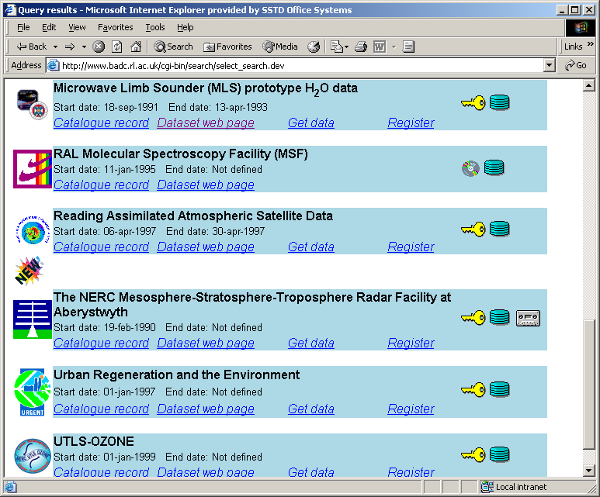
Example: NERC datasets

Slide 5
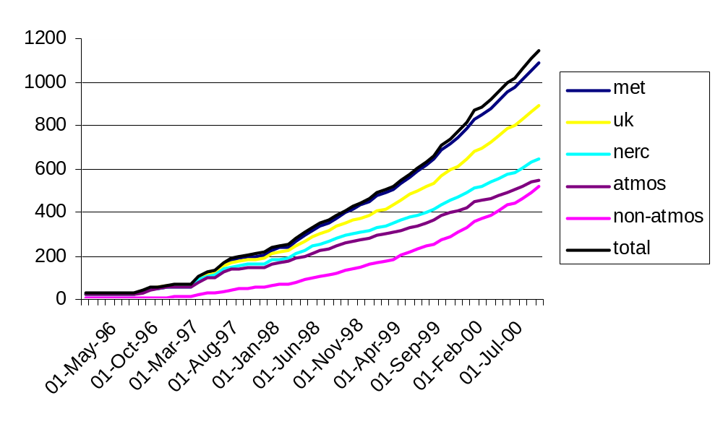
BADC Registered Users
1850 registered users as of May 2002!
Over 1000 users during 2001-02 and over 1 TB of data was delivered to users (equivalent to 1500 CDs).

Slide 6
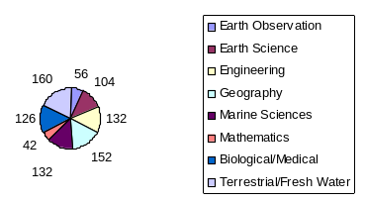
BADC Users Profile
Just under half of our users are NOT atmospheric scientists and include:

Slide 7
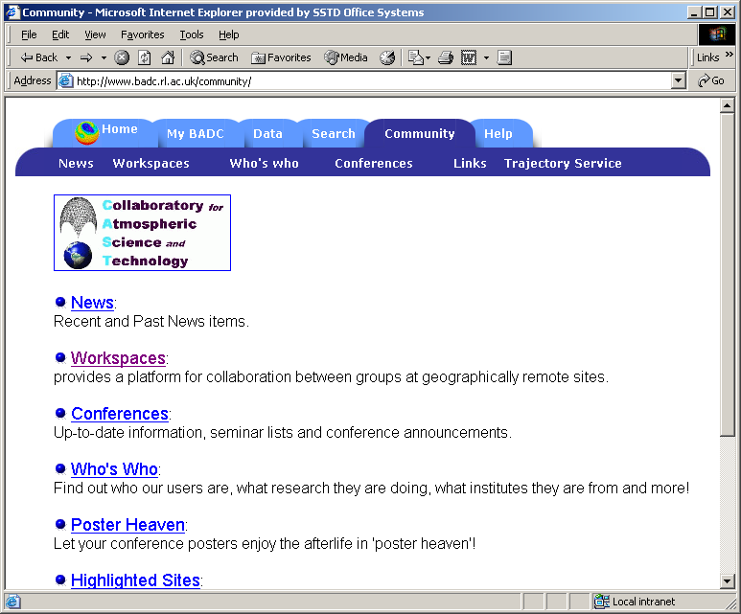
Collaboratory for Atmospheric Science and Technology, CAST

Slide 8
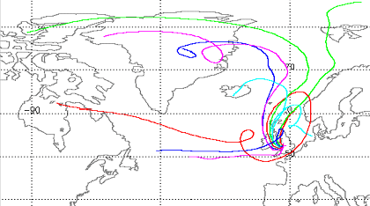
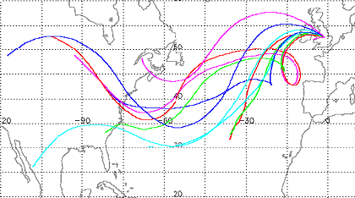
CAST: On-Demand Trajectories
Back-trajectories over 5 days for two PUMA events. Colours give arrival pressure levels.
PUMA - Pollution in the Urban Midlands Atmosphere – campaigns are part of the URGENT (Urban Regeneration and the Environment) thematic programme.

Slide 9
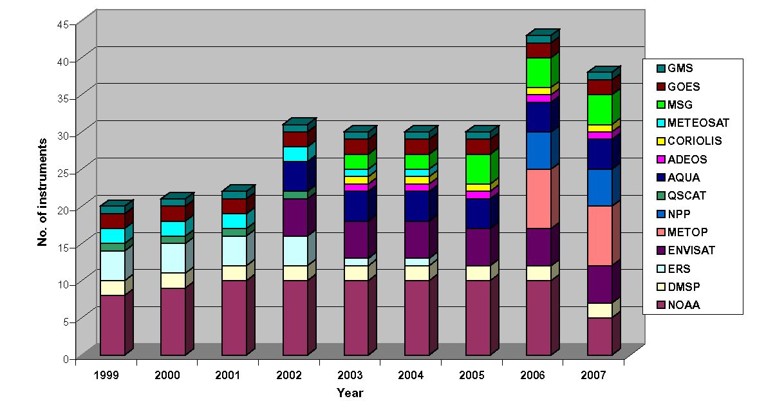
Challenges: Instrument Proliferation
Number of meteorological satellite instruments
Figure courtesy of the Met Office

Slide 10
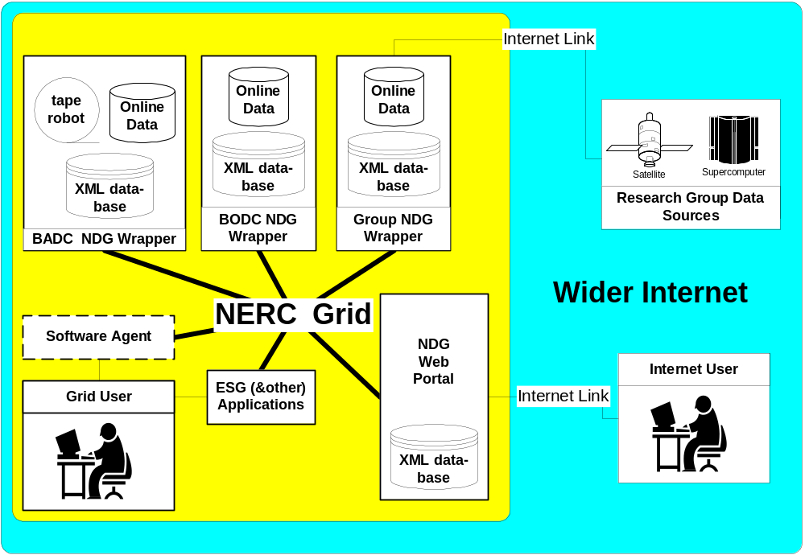
Challenges: Managing data using the Grid
Using e-Science to organise and find data: the NERC DataGrid

Slide 11
Summary
The British Atmospheric Data Centre facilitates access to atmospheric data and curates NERC atmospheric data sets both within NCAS and across the wider community.
The next few years will bring new challenges with the explosion in both the number of datasets in use, and the volume of data they produce.
BADC will enhance collaboration within NCAS and with the wider community, by developing CAST and the NERC DataGrid.

