Slide 1

Observing Facilities
Peter Jonas
Head, Facility for Airborne Atmospheric Measurements
UMIST

Slide 2
Major facilities include two recent enhancements largely funded initially by Joint Infrastructure Fund and HEFCE
a pool of instruments for surface based in-situ and remote sensing of the atmosphere
a modified BAE Systems 146-300 aircraft equipped with in-situ and remote sensing instruments and with the capability to fit additional instruments
Access to observational facilities of Met Office via collaboration

Slide 3
Ground-based instrumentation
Lidar for profiling atmosphere, complementing existing MST radar at Aberystwyth
Sodar for boundary layer structure, meteorological & chemical sampling instruments in Leeds
Radar and other cloud probing instruments based at Reading and complementing facility at Chilbolton
Doppler lidar for boundary layer winds at Salford
Absorption spectrometer and other chemistry instruments at UEA
Microphysics and aerosol instrumentation for ground and light aircraft based sampling at UMIST
Laboratory simulation of airflow at Surrey

Slide 4
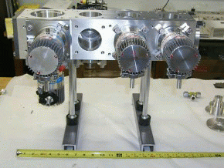
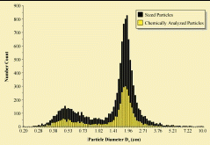
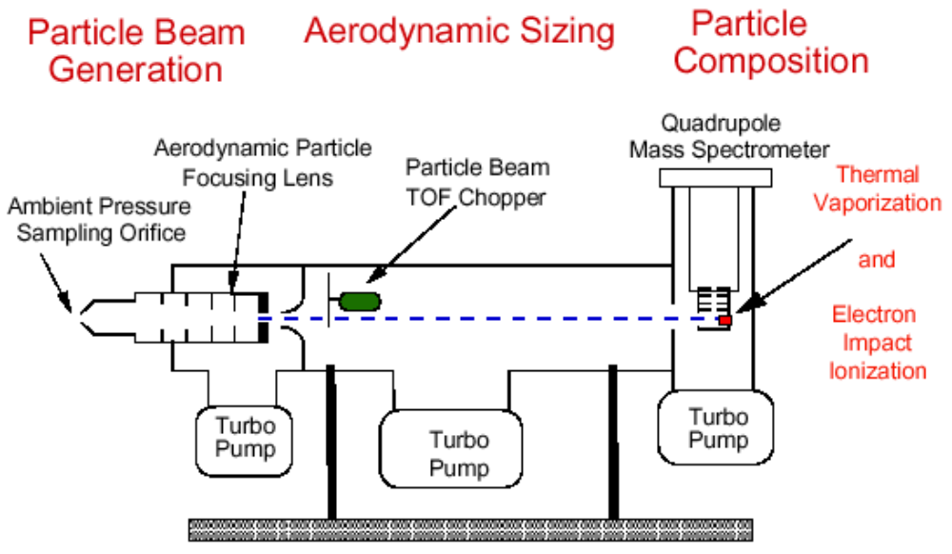
Time of Flight Aerosol Mass Spectrometer
Field measurements of size segregated compositional analysis of in-situ airborne aerosol from 70 nm to 5 µm in diameter.
Schematic of the Aerosol Mass Spectrometer:
0.2 µm
~1.5 µm
Particle size distribution

Slide 5
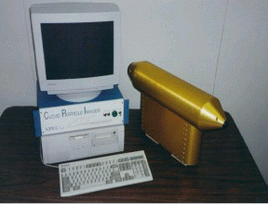
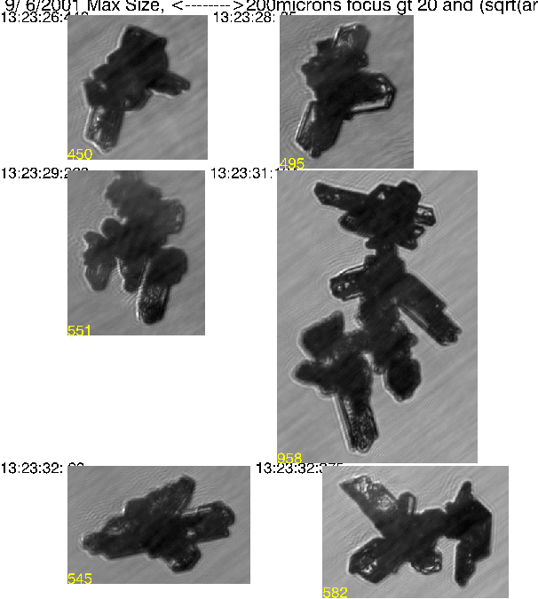
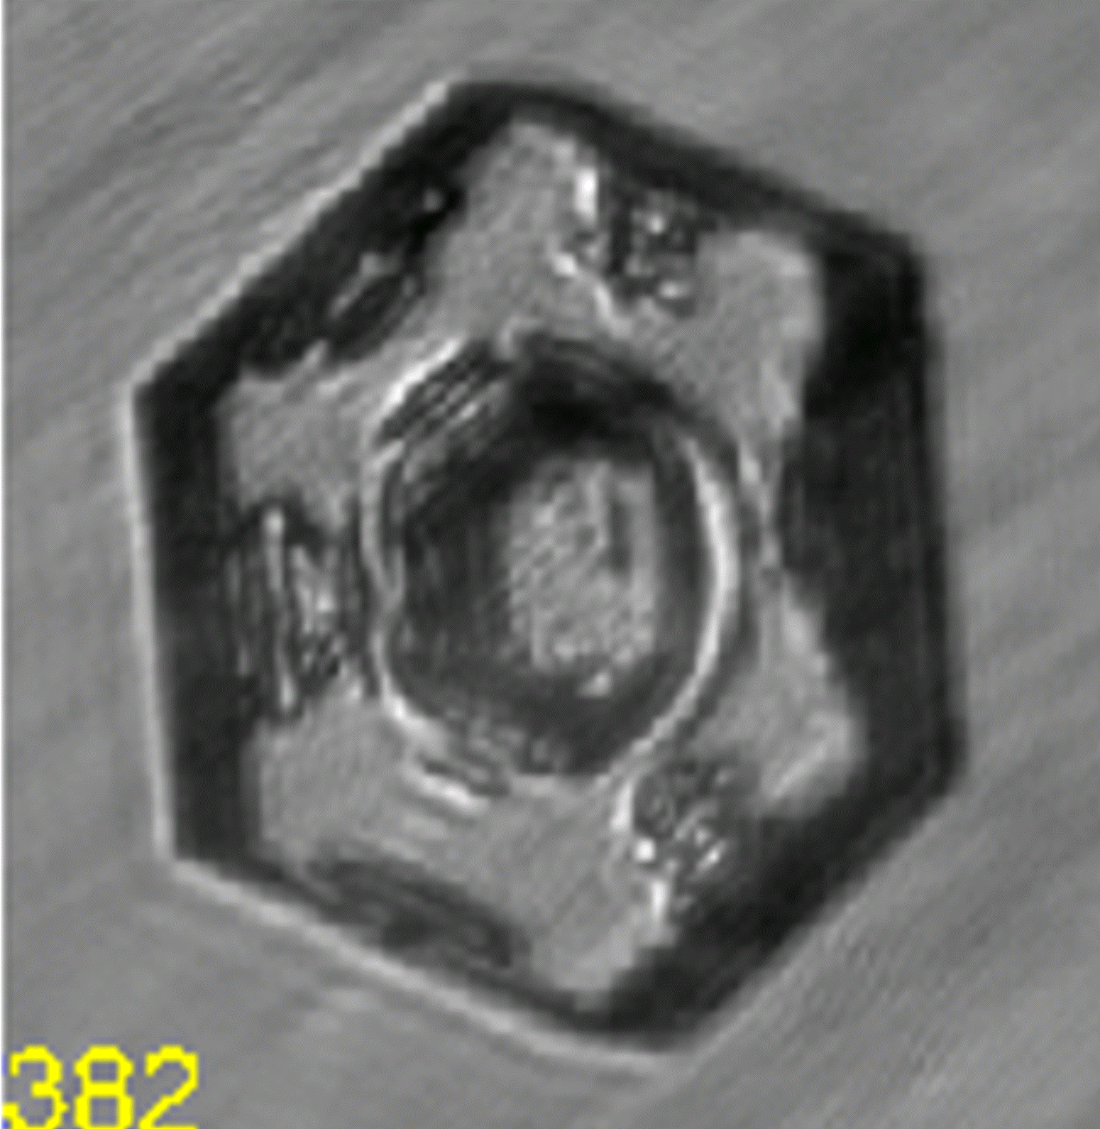
Cloud Particle Imager
~100 µm
2.3 µm - 2 mm
EMERALD Egrett Flight 2 06/09/01
Cirrus Plates & Irregulars.
Hexagonal
plate
~400 µm

Slide 6
FAAM instrumented aircraft:
joint NERC - Met Office facility
Being modified to enhance range and ceiling (completion summer 2002)
Instruments include those removed from Met Office C-130 aircraft and new JIF-funded instruments. It will be a world-class platform for measuring:
Dynamic and thermodynamic structure of atmosphere
Radiative properties of atmosphere and surface
Properties of cloud and aerosol particles
Chemical composition of atmosphere
from 15 to 12 000 m above the surface

Slide 7
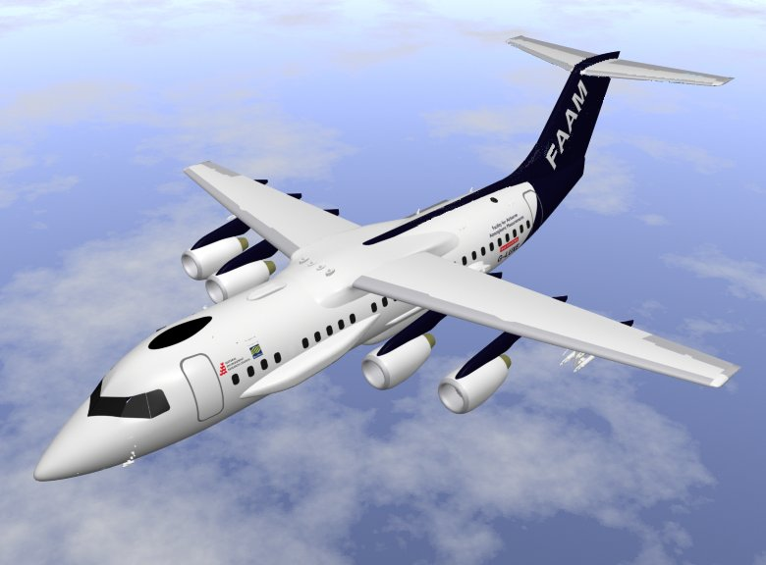

Slide 8
FAAM Aircraft
Facility of 12 staff will support the operation including scientific flight planning, operation of core instruments, installation of new instruments and provision of data
Scientific flights are expected to start in October 2002 - initial flights will be largely for instrument testing

Slide 9
The observational facilities can be used individually or together in concerted campaigns
Science problems which can now be tackled with appropriate detail include:
FAAM Aircraft
pollution transport, evolution and deposition
role of clouds in climate
formation and prediction of severe weather

