Slide 1
A Numerical Model to Investigate Urban Pollution
S. D. Wright, L. Elliott and D.B. Ingham
The School of the Environment
University of Leeds, England

Slide 2
Aims of the Research
Aims
Motivation
To develop a numerical model to calculate the ABL within the urban environment
To use real orography and land-use data-sets
To develop a model applicable to any area of the United Kingdom
For the model to be easy to use
To use the model to investigate urban pollution
From the National Environmental Research Council (NERC) thematic programme:
“Urban regeneration and the environment”
Urgent
An extension of research funded by the British Textile Technology Group (BTTG) responsible for monitoring industrial emissions in the north of England

Slide 3
Physics Included in the Model
Governing equations:
  Reynolds averaged Navier-stokes equations
  Potential temperature (stratified flow)
Turbulent properties
  Equations for TKE and rate of dissipation of TKE (k & ε)
  Used to form a non-isotropic algebraic stress model
Radiation model
  Annual and diurnal radiation model
  Force-restore method at the surface
Urban effects
  Urban drag parameterisation using real topography and land-use data
  Thermal effects included within the radiation model

Slide 4
Numerical Techniques
Solution domain
  Fully 3D and time dependent
  Resolution from all of the UK → 20x20km
  Use an embedded mesh technique to resolve a specific urban conurbation
Solution technique
  A finite volume discretisation of the governing equations including a QUICK advection scheme
  A Poisson equation for pressure based on the SIMPLEC algorithm
  Uses a Tri-Diagonal Matrix Algorithm (TDMA)
  Turbulent stresses are explicitly included within the model (allows many different turbulence schemes to be implemented)

Slide 5
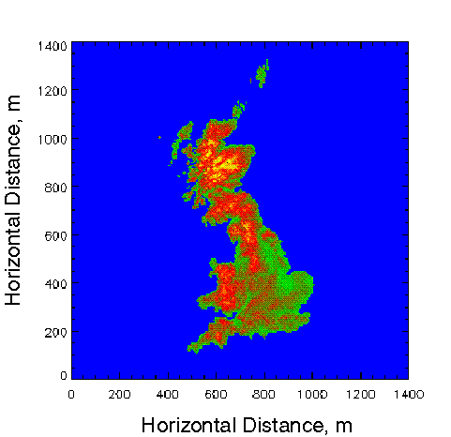
Formulation of the Lower Boundary
Topography
A data set provides heights above sea level at 500 metre resolution
These heights are interpolated onto a stretched mesh refined around the conurbation of interest
Several embedded meshes are included to gain the required resolution of the urban conurbation

Slide 6
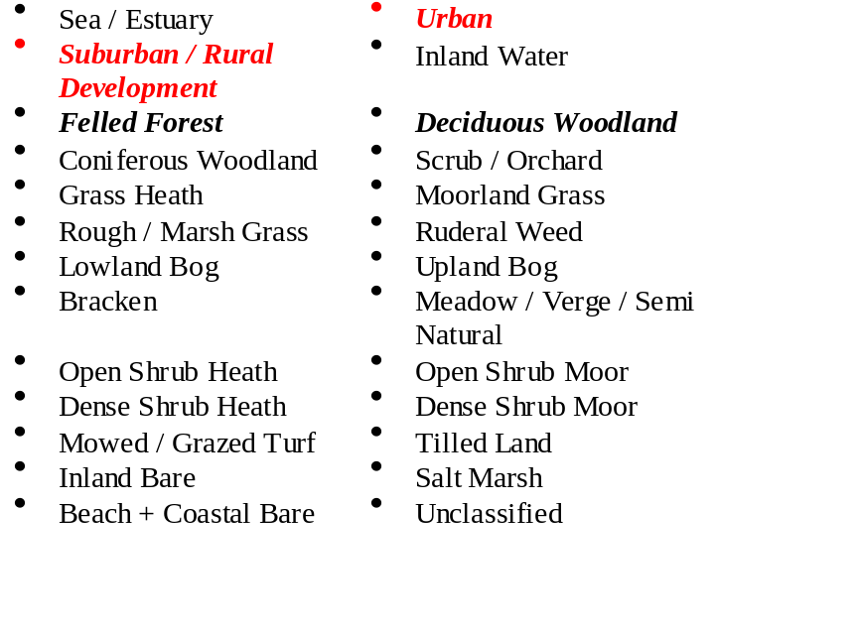
Formulation of the Lower Boundary
Land use
Categorisations
A data set is used to categorise the land use at each point in the mesh
For each of the 26 categories, the percentage of cover per 1km square is calculated
This is used to formulate boundary conditions for the model and to identify areas of urbanisation

Slide 7
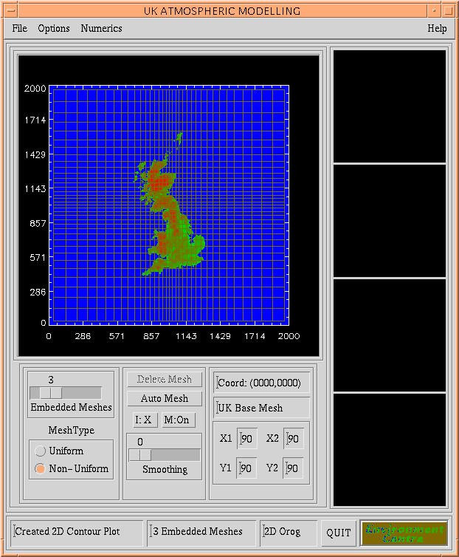
The Numerical Model
The model is fully interactive with no specialised knowledge needed.
All aspects of the model can be manipulated from the graphical user interface
The G.U.I. is used to manipulate the two data sets and the numerical model

Slide 8
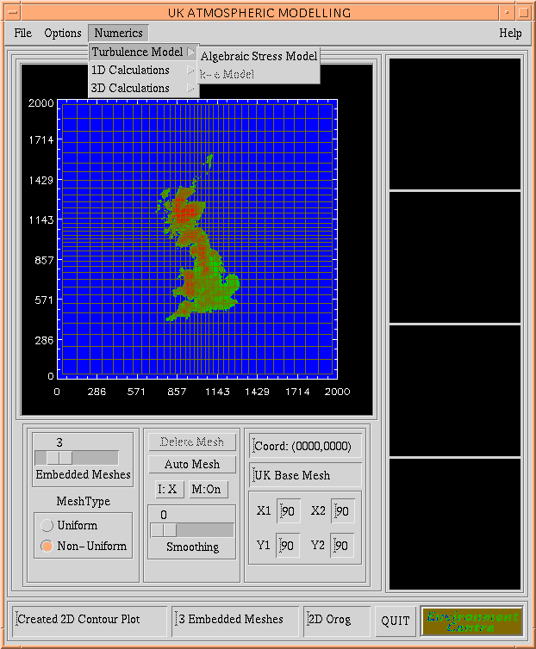
Modelling the turbulence within the Atmospheric Boundary-layer is the most difficult aspect facing the numerical modeller
In the numerical model this has been achieved by implementing two well known sophisticated turbulence models:
  The k-ε model
  The algebraic stress model
The model can be chosen from a pull-down menu

Slide 9
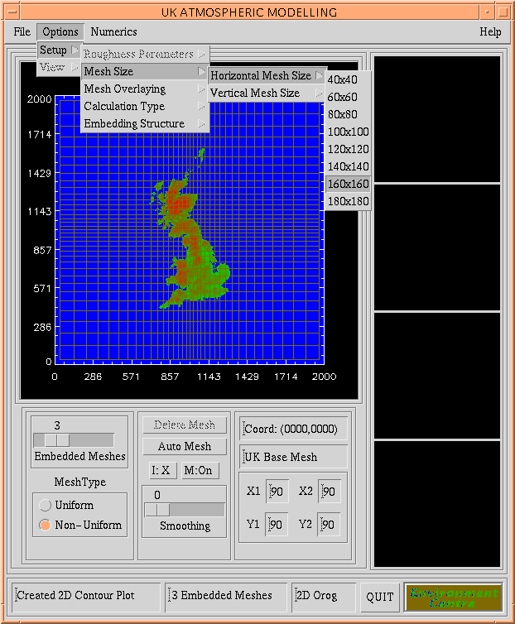
Depending on the facilities available the resolution of the simulation can be altered by increasing or decreasing the horizontal and vertical mesh sizes
In general, the greater the mesh size the better the resolution, but the slower the calculation will be
The refinement point, i.e. the area of interest can be altered by the mouse sensitive screen
The refinement point in the figure opposite can be seen to be in the centre of the display

Slide 10
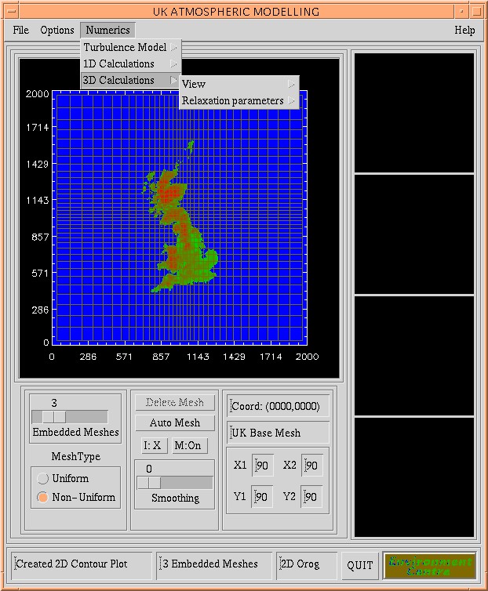
Through pull down menus the model can be tailored to model the air flow in any region of the United Kingdom.
Here, the properties of the 3D calculation are being altered. Relaxation parameters adjust the efficiency of the calculation with correct choices leading to drastic improvements in the solution time

Slide 11
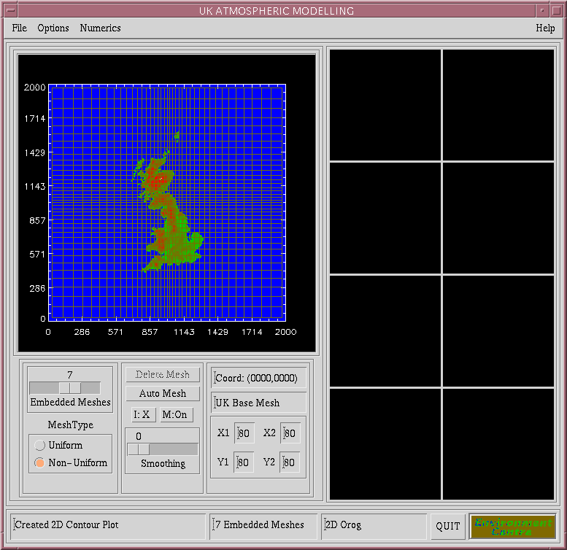
The number of embedded meshes can also be adjusted
The more embedded meshed then the better the resolution of the solution but the slower the simulation
The number of embedded meshes can be adjusted using the slider control on the main interface

Slide 12
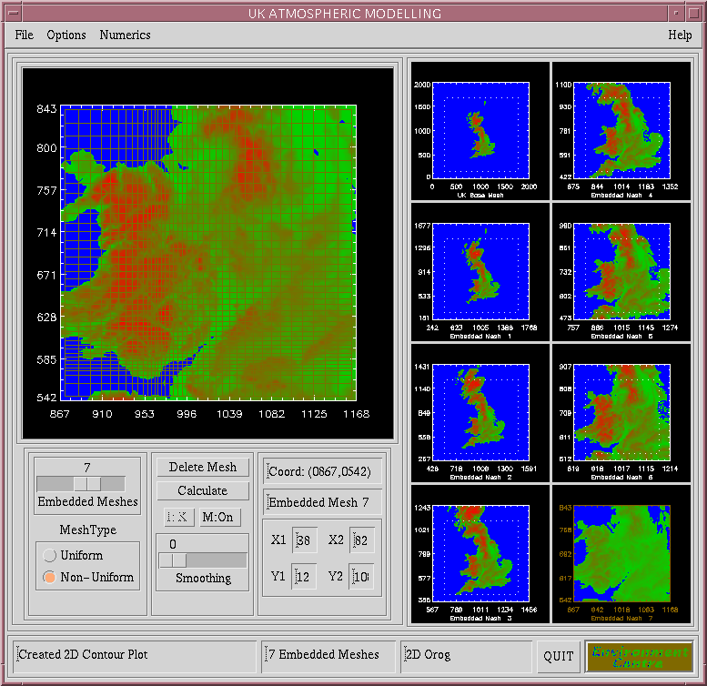
Once the number of embedded meshes has been chosen then each embedded mesh needs to be defined
Each mesh can be defined individually by using the mouse sensitive screen
Alternatively on Auto-mesh function exists that defines the meshes given the final refinement point

Slide 13
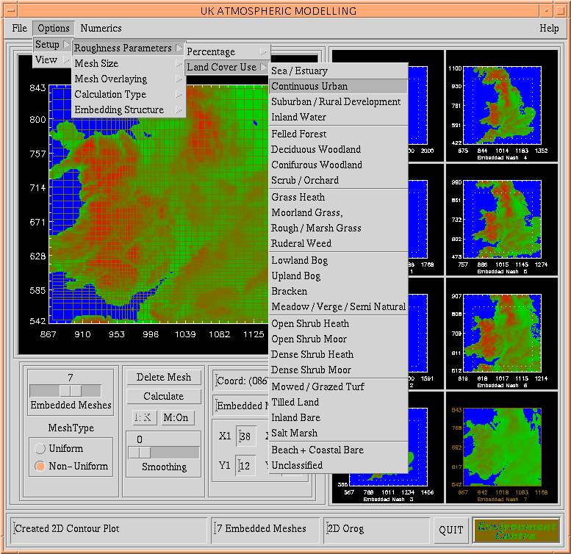
Once the solution domain has been defined the land-use properties in the region of interest can be examined
Each of the 26 land-use categories can be individually examined to make sure the solution domain represents the area of interest

Slide 14
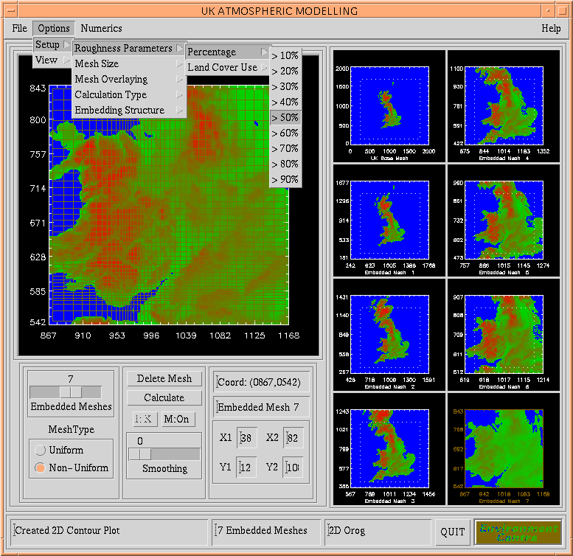
The percentage per unit area of and chosen land-use can be examined
For example in the figure opposite all urban conurbations at a resolution of more than 50% per unit area will be displayed
The embedded meshes can be refined, if necessary, at any time

Slide 15
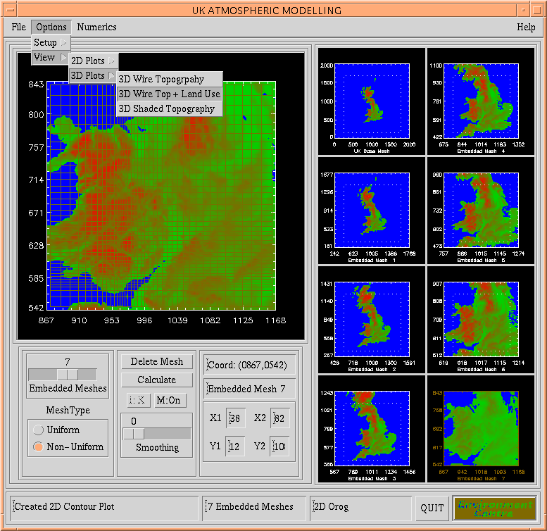
It is possible to display the data (land-use and relief height) in a variety of different formats
2D and 3D plotting functions are available that show just the relief height or superimpose the land-use onto the relief height maps

Slide 16
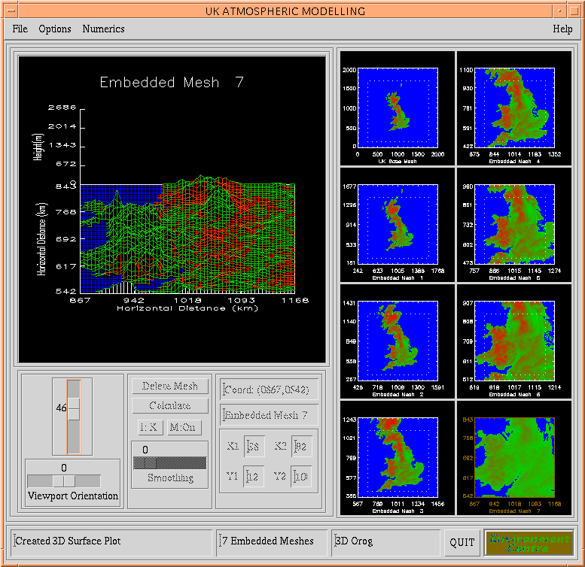
Here the urban land-use at 50% resolution is shown for the seventh embedded mesh of the solution domain
This figure shows the resolution that is possible by using the two data-sets
In this figure, the conurbations of Leeds Manchester, Liverpool and Birmingham, as well as others, are visible

Slide 17
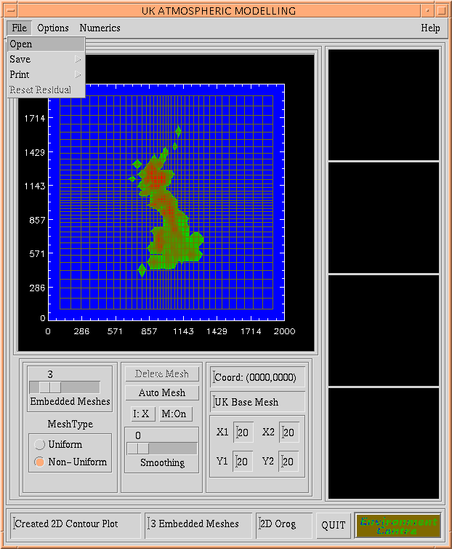
It is possible to save and restore simulations at any point
It is also possible to print any or all of the displays with the G.U.I. at any time

Slide 18
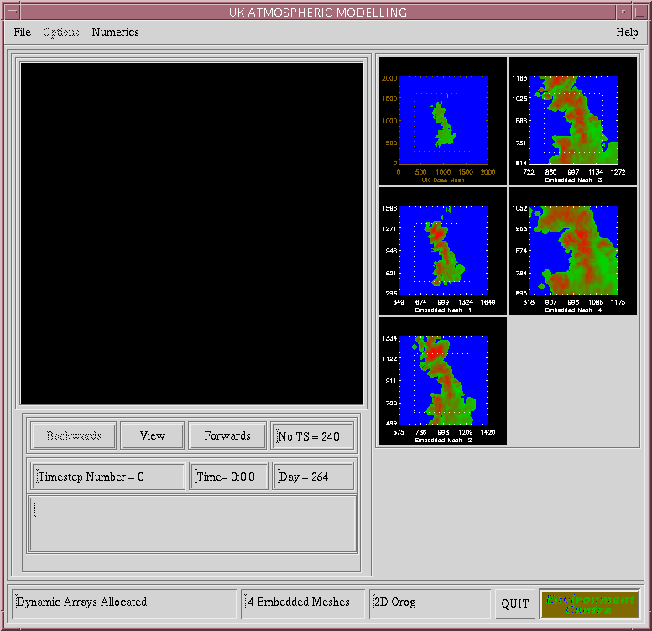
Here a simulation has been restored with 4 embedded meshes, with 240 time-steps of 5 minutes
It is possible to move forwards and backwards through the simulation, viewing any results already obtained

Slide 19
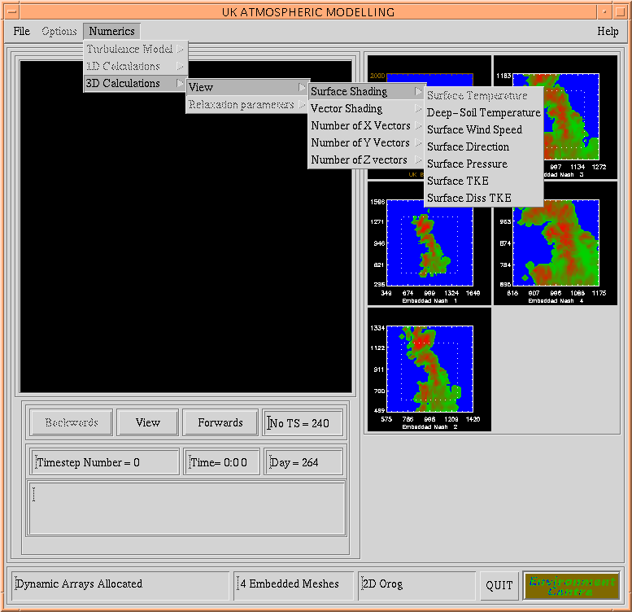
Menus are available to adjust the format of the results to be examined
3D plots are used to view the simulations, similar to the one shown earlier, with flow vectors and surface contouring implemented
The vectors and surface contours can be shaded according to one of many flow properties (shown in the figure)

Slide 20
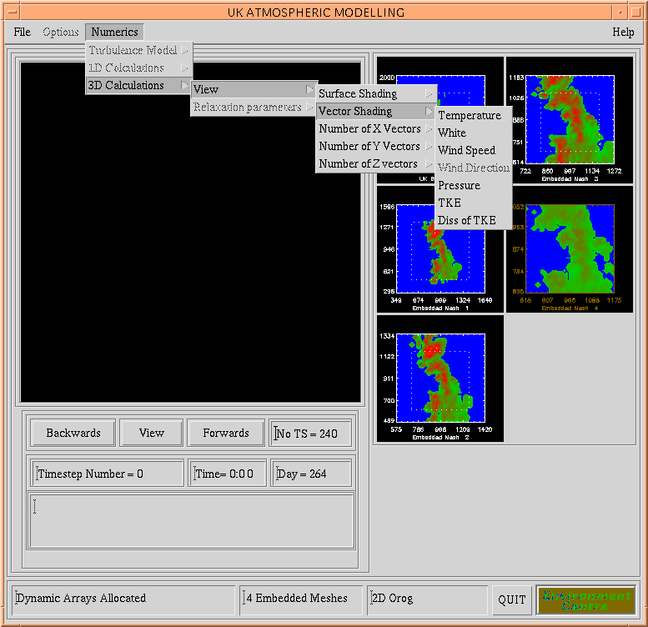
Vectors can be restricted to a 2D slice through the simulation domain, for clarity
Full 3D vector plots are also available with the number of vectors in the horizontal and vertical directions adjustable

Slide 21
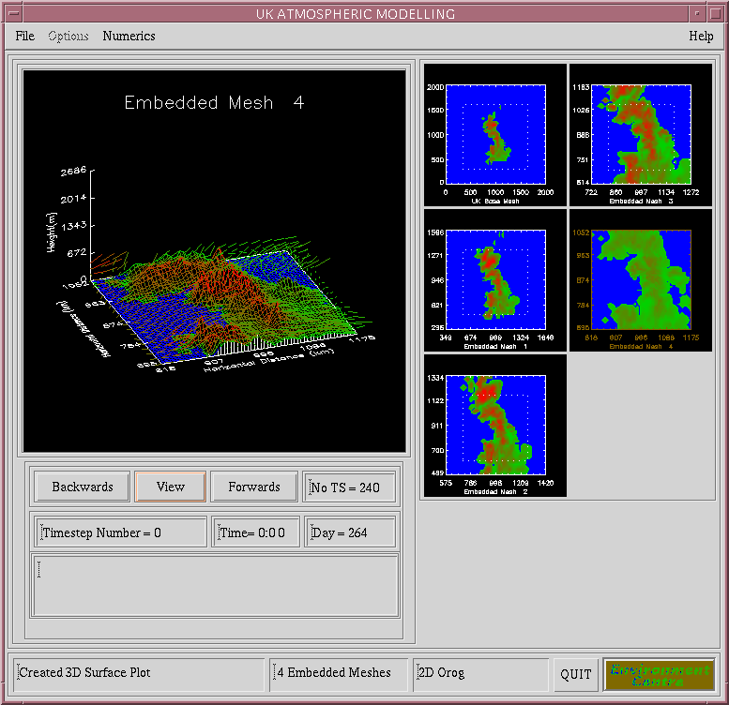
The figure opposite shows a typical flow plot
The surface shading, showing contours of surface pressure, indicates that there is high surface pressure in the region of the Pennines and North Wales
The flow pattern is shown in the form of a restricted vector plot

Slide 22
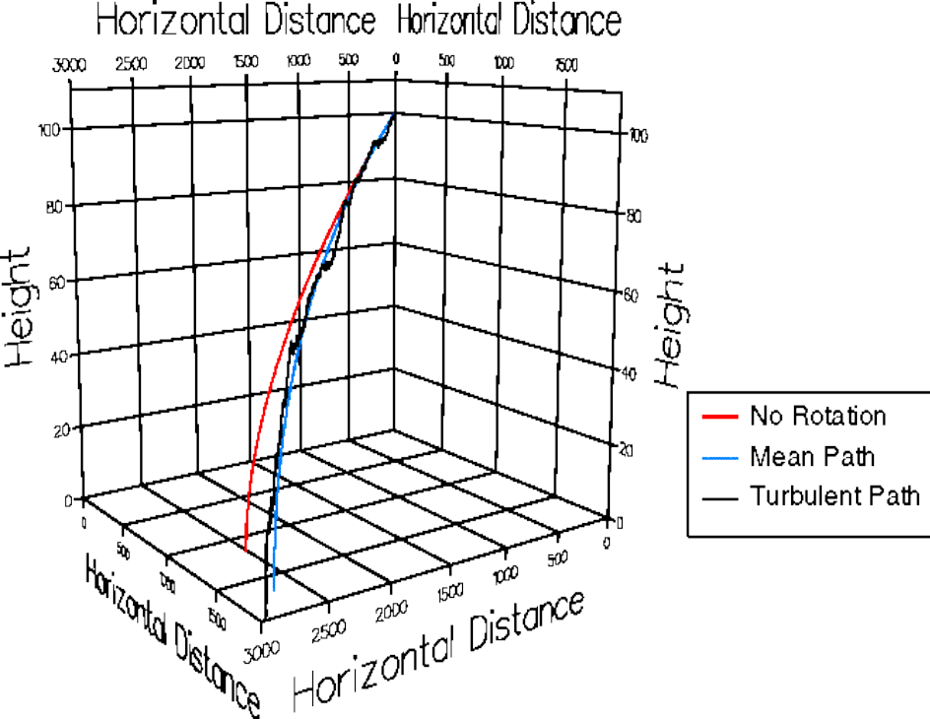
The figure opposite shows the particle trajectory of a 50μm particle from a 100 metre high chimney
The effect of the rotation of the Earth is clearly shown and influences the trajectory of the pollutant
A dispersion pattern can be formed by releasing many such particles

Slide 23
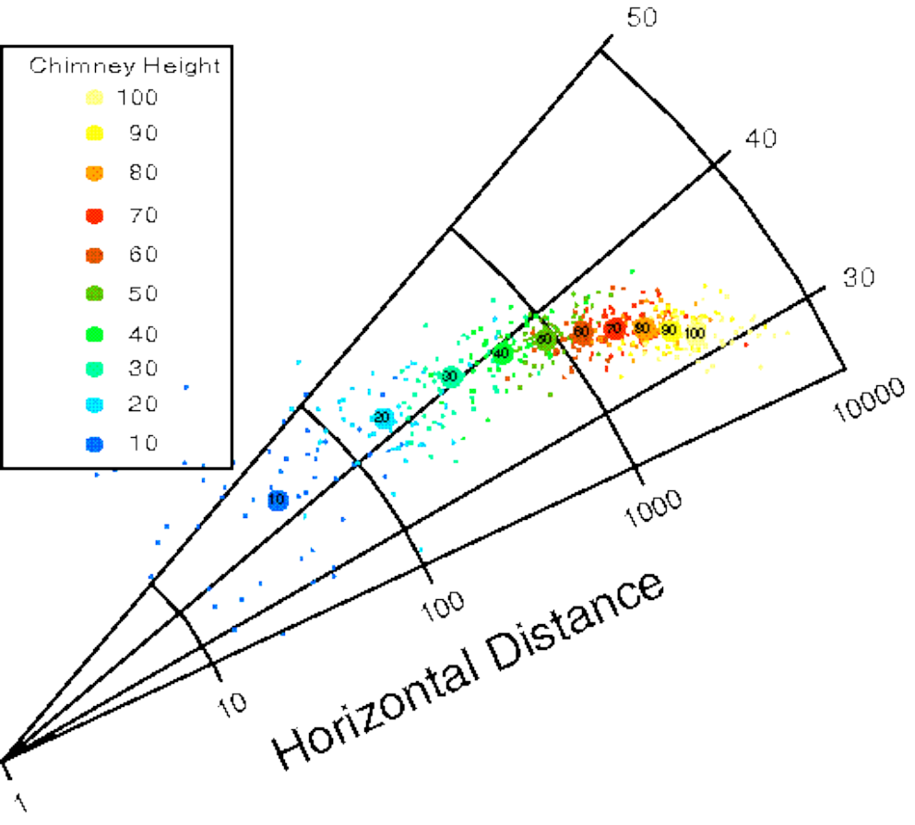
A typical dispersion pattern for the release of 50 μm particles is shown opposite
The higher the chimney height the further the particles travel, as expected
However, the chimney height also dictates the direction of travel through the geostrophic balance

Slide 24
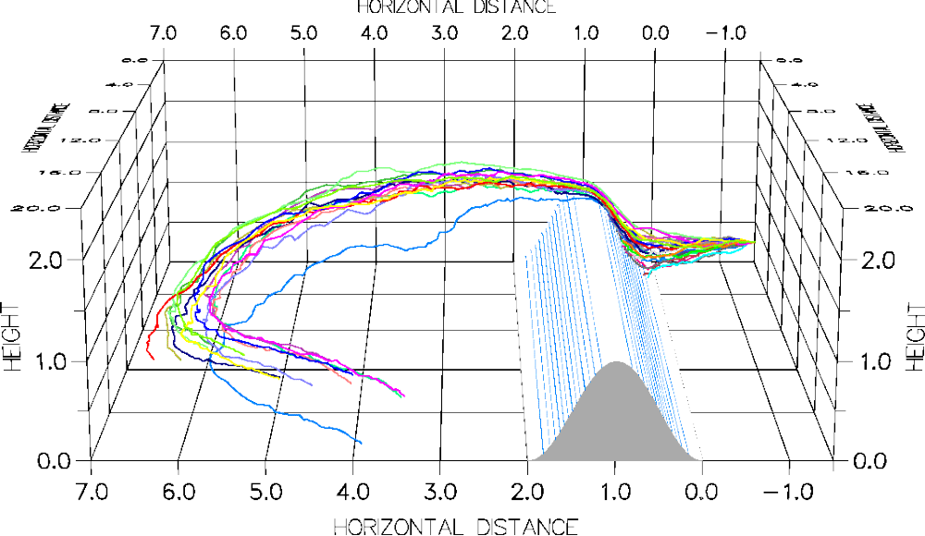
The figure above shows the turbulent trajectories in the region of an idealised ridge such as the Pennines
The mean air flow is from the right of the figure
The particles are advected by the mean flow until they hit the turbulent wake behind the ridge. In this region strong transverse rotating air flow along the ridge transport the particles along it

Slide 25
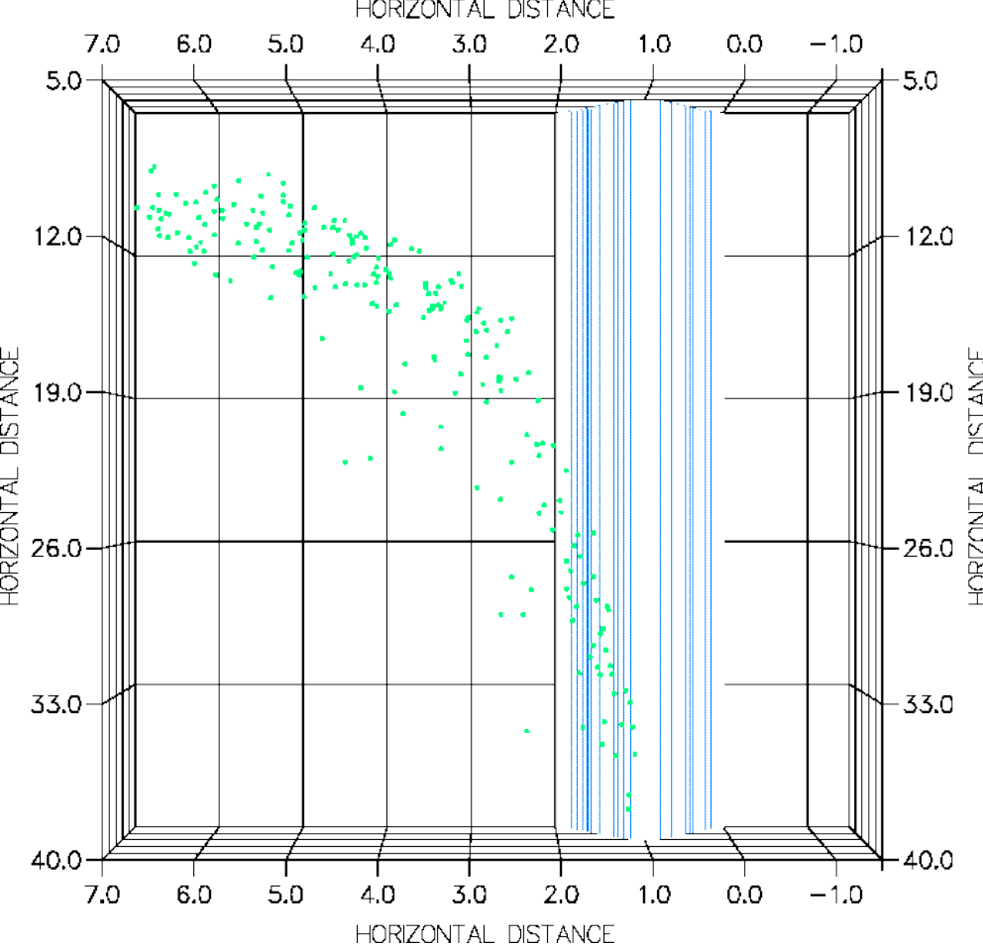
The dispersion pattern for the particles is shown in the figure opposite
Many of the particles are deposited in the general direction of the mean wind flow, i.e. the travel from the right to the left of the figure
However, a significant number are transported along the ridge and even deposited on it near the bottom of the figure

Slide 26
Acknowledgements
We would like to thank:
National Environmental Research Council (NERC)
British Textile Technology Group (BTTG)
for the financial support given

