Slide 1
CMIP7 Citation Service
Usage Guide for Reviewers
Daniel Westwood (daniel.westwood@stfc.ac.uk) Last Updated 17th September 2026

Slide 2
Contents
Requesting Reviewer Access
Editing Citation Records (UI)
Clashing Information (UI)
Minting DOIs (UI)
Editing Citation Records (API)
Minting DOIs (API)

Slide 3
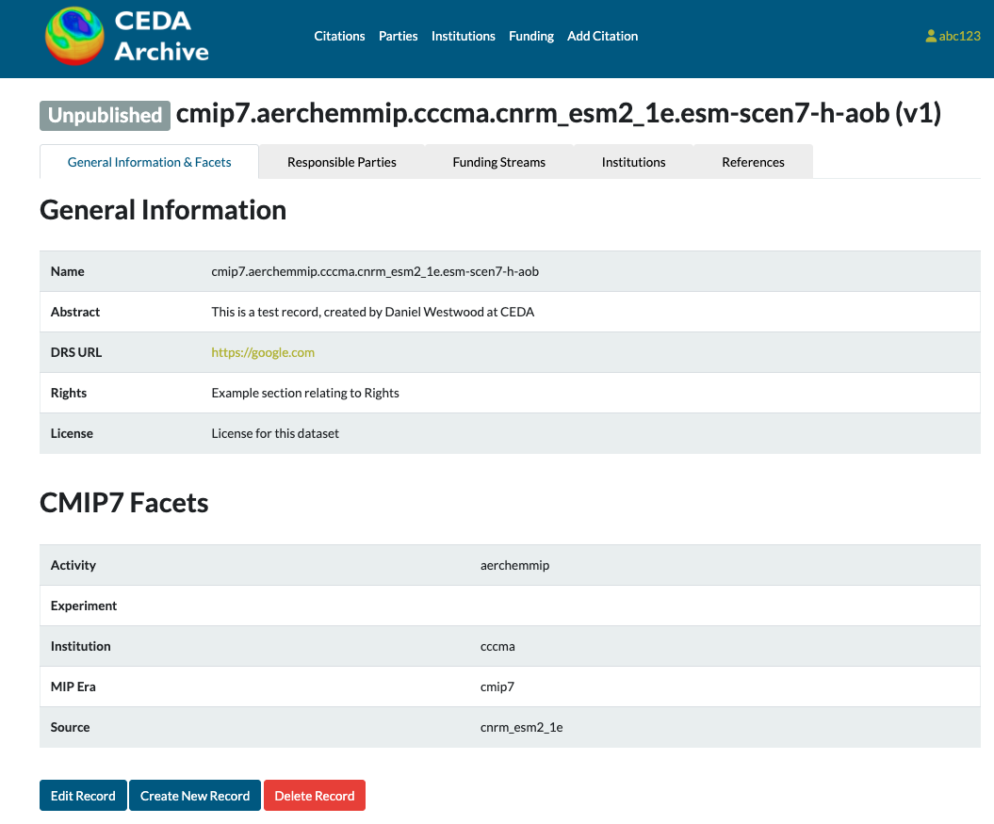
Requesting Reviewer Access
Prompt to sign in and request access through one of:
Navigate to any citation record that already exists and locate the ‘Edit record’ button at the bottom of the General Information Tab
Click ‘Add Citation’ along the top bar.
Click on the Reviewer sign in button.
You will be prompted to log in via your github account. This is purely to collect usernames and authenticate for editing purposes.

Slide 4
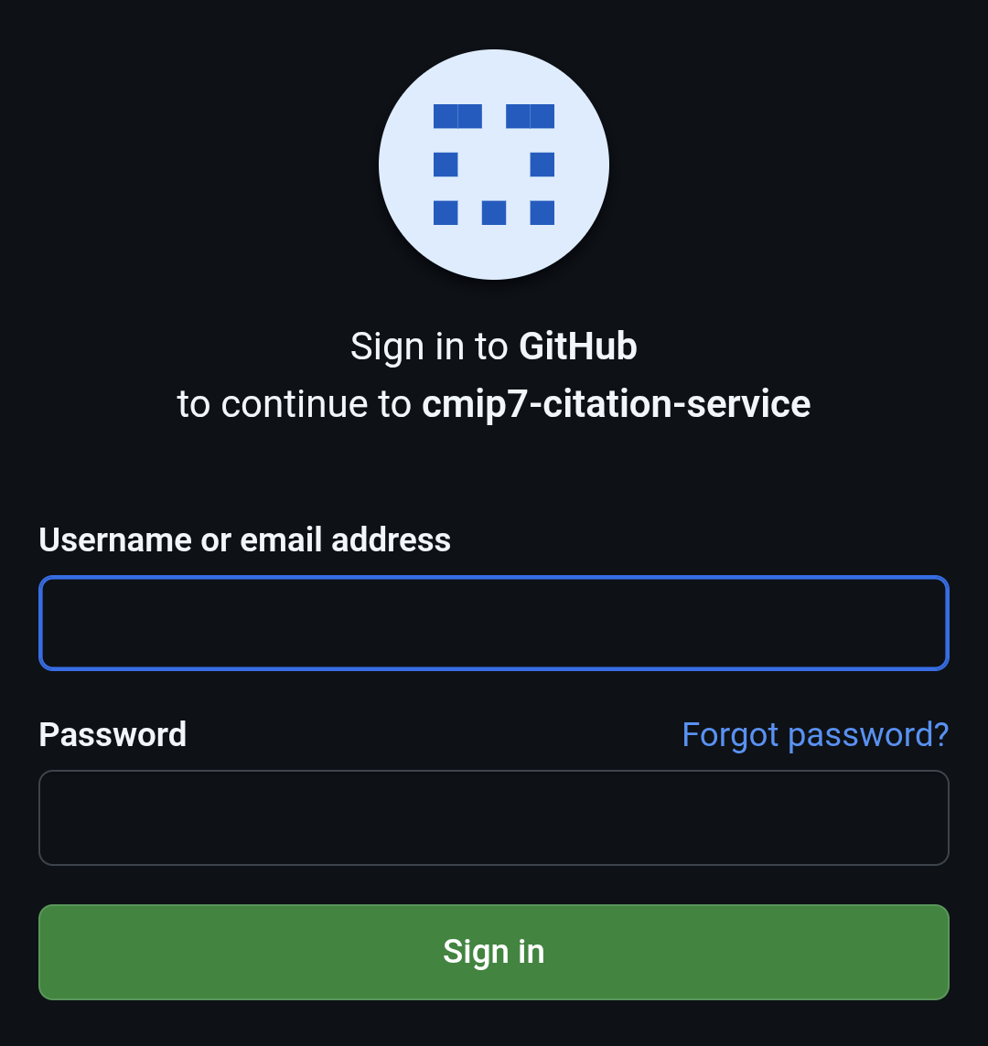
Requesting Reviewer Access
Prompt to sign in and request access through one of:
Navigate to any citation record that already exists and locate the ‘Edit record’ button at the bottom of the General Information Tab
Click ‘Add Citation’ along the top bar.
Click on the Reviewer sign in button.
You will be prompted to log in via your github account. This is purely to collect usernames and authenticate for editing purposes.

Slide 5
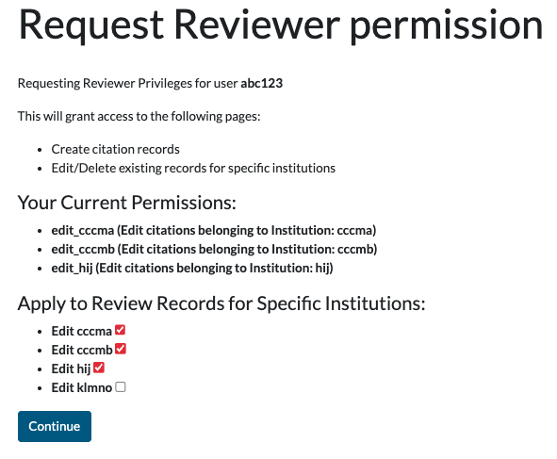
Requesting Reviewer Access
You will then be prompted to request reviewer access.
If this does not happen automatically, navigate directly to cmip7-citations.ceda.ac.uk/reviewer-request/
Tick the box(es) for the specific institutions you need access to review, and click continue to submit the request.
If an institution you require is not present in this list it may not have any existing records – you will need to press continue with access requested for any existing institutions, and then create new records that correspond to institutions not listed. These will automatically be given as permissions to your user.

Slide 6
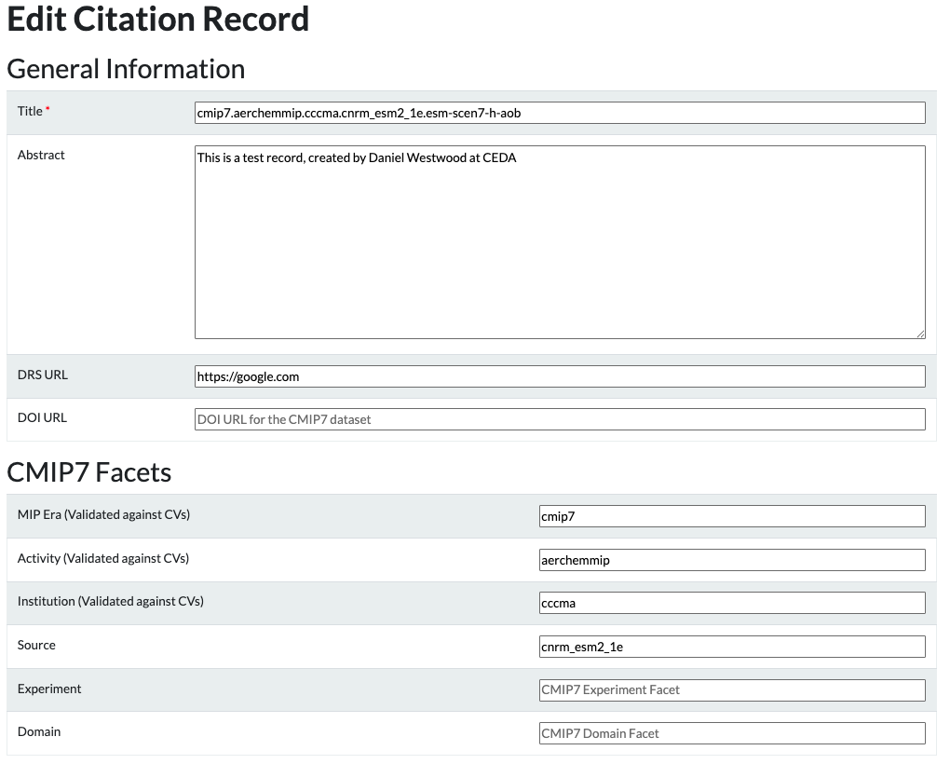
Editing Citation Records (UI)
Once reviewer access is granted, you will be able to click ‘Edit record’ on a citation record to bring up this view.
General information is auto-generated from EMD/CV info and should only be edited in limited cases.

Slide 7
Editing Citation Records (UI)
The DRS URL should NOT be manually added unless it does not conform to the template using Metagrid and the CMIP7/CORDEX facets.
The DOI URL should be entered if it already exists, otherwise a DOI may be minted using this service.

Slide 8
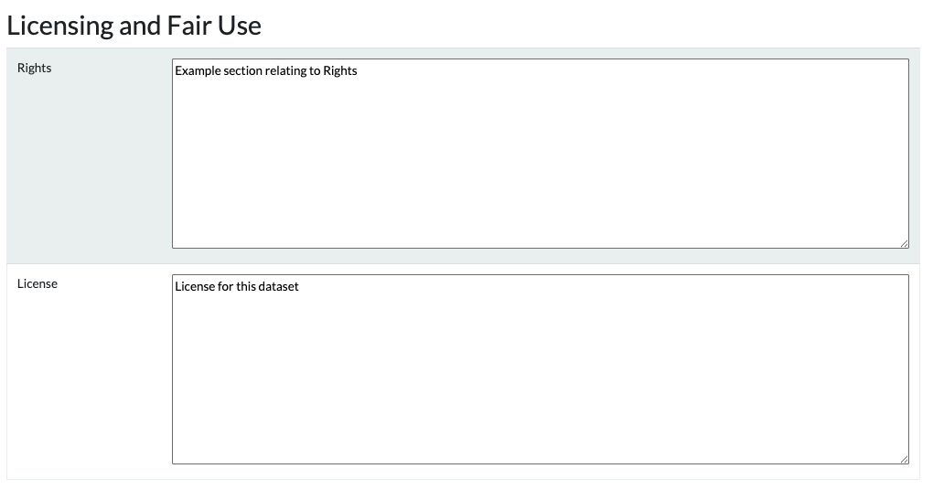
Editing Citation Records (UI)
Licensing/Rights information should only be adjusted for datasets where the auto-generated content is flawed or inaccurate.

Slide 9
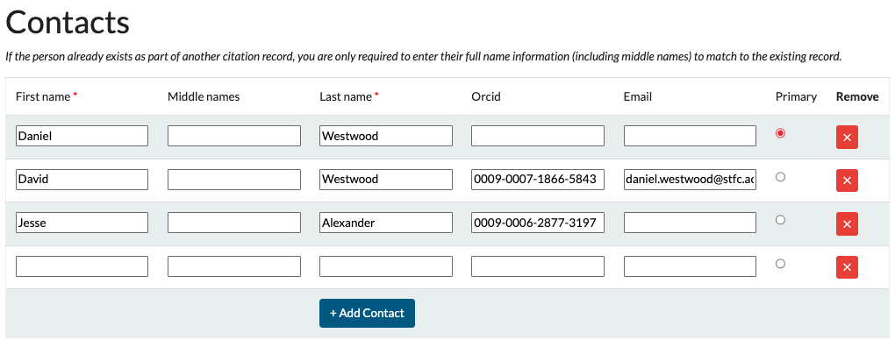
Editing Citation Records (UI)
Any number of contacts may be added. If they are present in other records their information will be connected inside the service.
One author must be selected as ‘Primary’, all other authors will be listed as Contacts

Slide 10
Editing Citation Records (UI)
Note: Contacts rows are now rearrangeable in the UI by drag-&-drop! (17/08/2026)
Any number of contacts may be added. If they are present in other records their information will be connected inside the service.
One author must be selected as ‘Primary’, all other authors will be listed as Contacts

Slide 11
Editing Citation Records (UI) – Clashing Information
If a Party already exists in the citation service with different information, this raises a clash error.
If the new information overrides some old information (i.e an email update/change) then you can ignore the warning and just resubmit the form and this error will be bypassed.
If the clash could indicate two different people with the same name (but different emails/orcids) you will need to check the Parties information that currently exists and determine the best response.

Slide 12
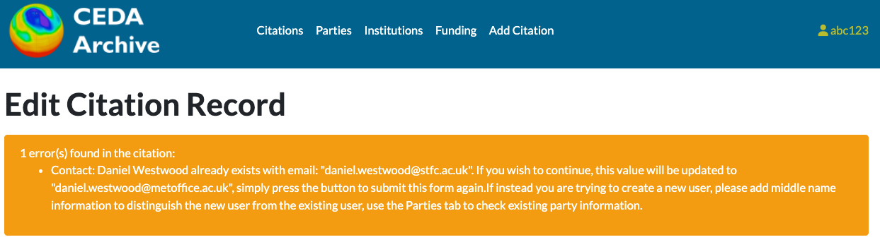
Editing Citation Records (UI) – Clashing Information

Slide 13
Editing Citation Records (UI) – Clashing Information
Existing user: Daniel Westwood (daniel.westwood@stfc.ac.uk)
Information Update
Daniel Westwood email should not be @stfc.ac.uk. Information should be updated to the correct email, so this warning can be ignored.
Different person
Daniel Westwood (STFC) and Daniel Westwood (Met Office) are two different people. You will need to add middle name information to the new Party to distinguish from the existing Party. If this cannot be completed, contact the CEDA Helpdesk for assistance resolving the issue.

Slide 14
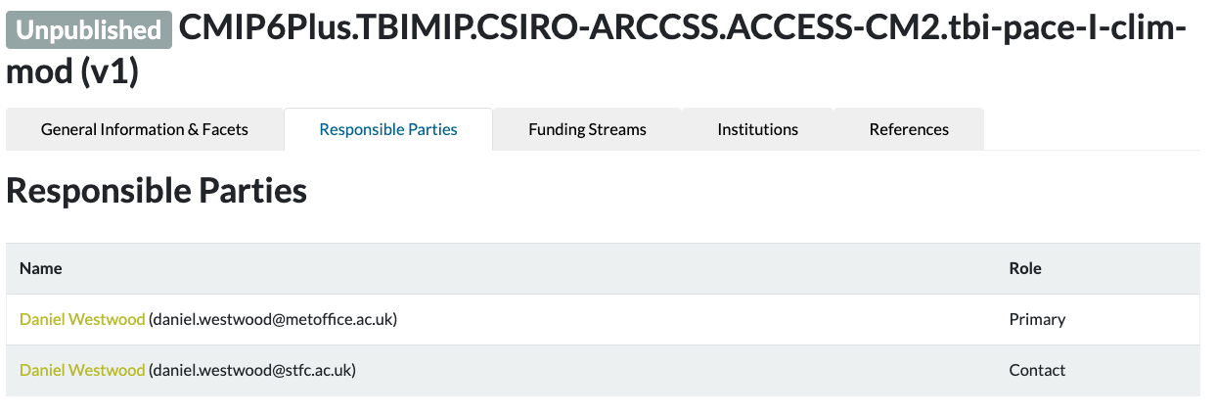
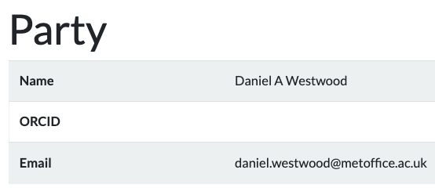
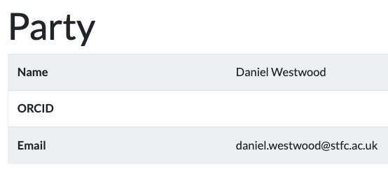
Editing Citation Records (UI) – Clashing Information
Different people with the same name MUST be differentiated using middle names, even though they’re only displayed on the Party landing pages.

Slide 15
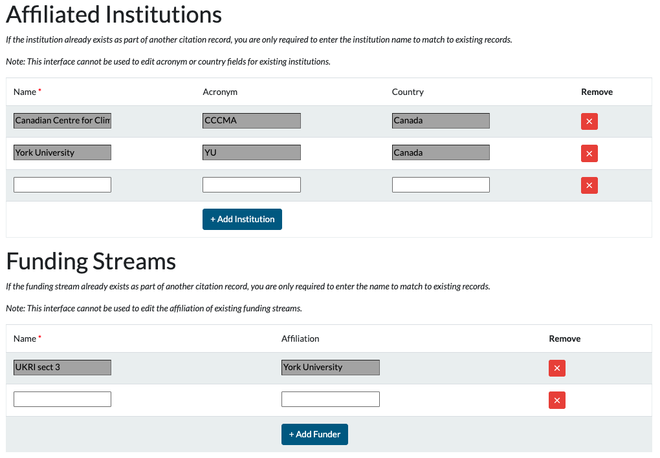
Editing Citation Records (UI)
Any number of additional affiliated institutions/funder information may be added here.
Note this interface cannot be used to edit institution or funding stream level information if they already exist, although affiliations can still be ‘removed’ by clicking the red X

Slide 16
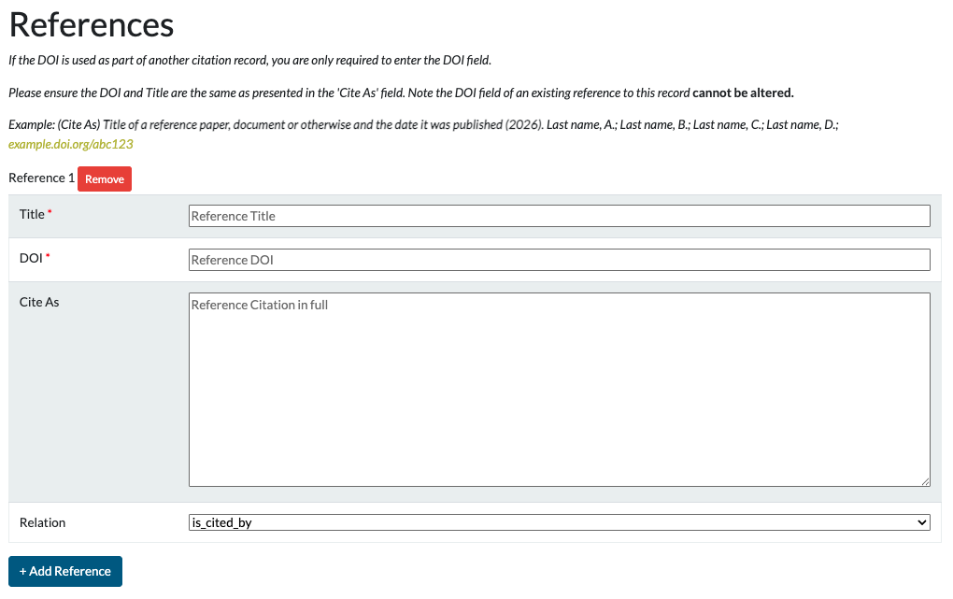
Editing Citation Records (UI)
References may be added using this interface as well. Ensure both the Title and DOI match exactly with the content in the `Cite As` field, otherwise the linking may not render correctly in the UI.
Possible Reference relations are listed in the dropdown.

Slide 17
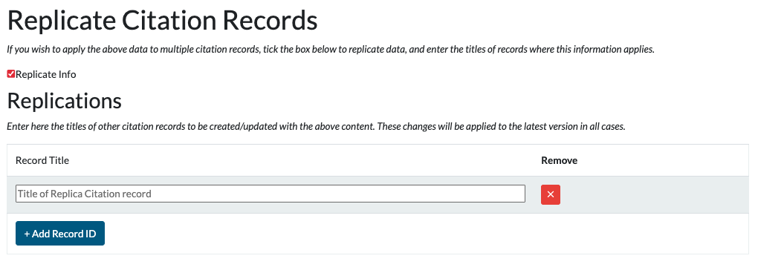
Editing Citation Records (UI)
To replicate all recorded information to other citation records, simply tick the box to `Replicate Info` and provide the Titles of other records to be replicated. This will also allow multiple DOIs to be minted for multiple records simultaneously.

Slide 18
Editing Citation Records (UI)
Note: Replication can now only be used to update existing records because the mandatory search facets are not replicated (01/09/2026)
To replicate all recorded information to other citation records, simply tick the box to `Replicate Info` and provide the Titles of other records to be replicated. This will also allow multiple DOIs to be minted for multiple records simultaneously.

Slide 19
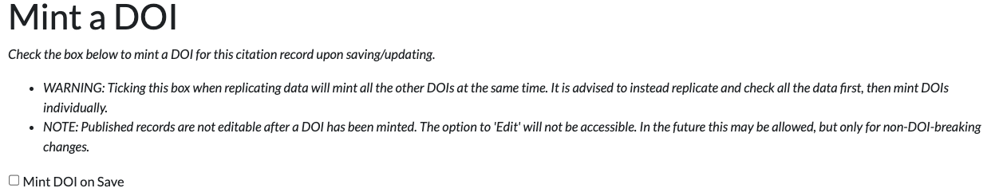
Minting DOIs (UI)
If all information in the citation record is now accurate and ready for a DOI to be minted. Check the `Publish on Save` tickbox before pressing `Update version`.
This will trigger the minting process. If successful, the citation record will present with `Published` next to the title, and a `Cite As` link will appear in the general information.

Slide 20
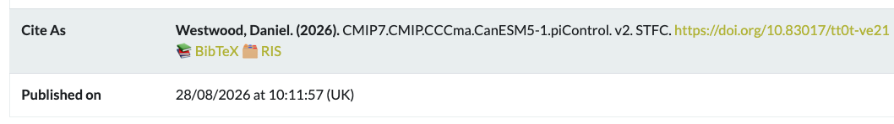
Minting DOIs (UI)
Example of a Record where the DOI has been successfully minted.
Click the BibTeX or RIS buttons to get a download of the referencing information in the respective formats. Report any issues to the CEDA Helpdesk

Slide 21
Editing Citation Records (API)
The Citation Service API allows the creation of all affiliated records (parties, institutions etc.) directly from the citation, so there’s no need to input information separately.
See the example Citation record template in this repository for details on what to include.
The mandatory fields are:
  title OR CMIP7/CORDEX facets
  Primary author information (full name)

Slide 22
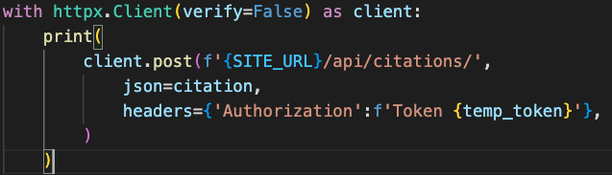
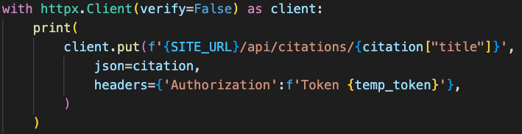
Editing Citation Records (API)
You must request an API project token to use the API services to upload content to the citation service. Contact the CEDA Helpdesk to arrange this.
The python code snippet below is an example of how to upload content to the citation service to create/update records:
Create Records
Update Records

Slide 23
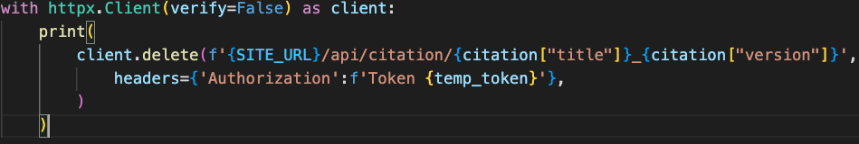
Editing Citation Records (API)
Note: Ensure that you know if the record exists or not when creating a record. If a record with a matching title already exists, creation will increment the version number and add a new version.
If you accidentally add a new version, please delete the specific version required, by specifying the ID as below:

Slide 24
Minting DOIs (API)
To mint a DOI on creating/updating a record via the API, simply add the field `publish_on_save: True` to your JSON content to be uploaded. Review the response.content object to verify if DOI minting was successful – specifically check for any `warnings` in the response JSON.
If a problem occurs please contact support@ceda.ac.uk

