Slide 1
Images for JASMIN workshop exercises and tutorial
Contents:
ex09
tut02

Slide 2
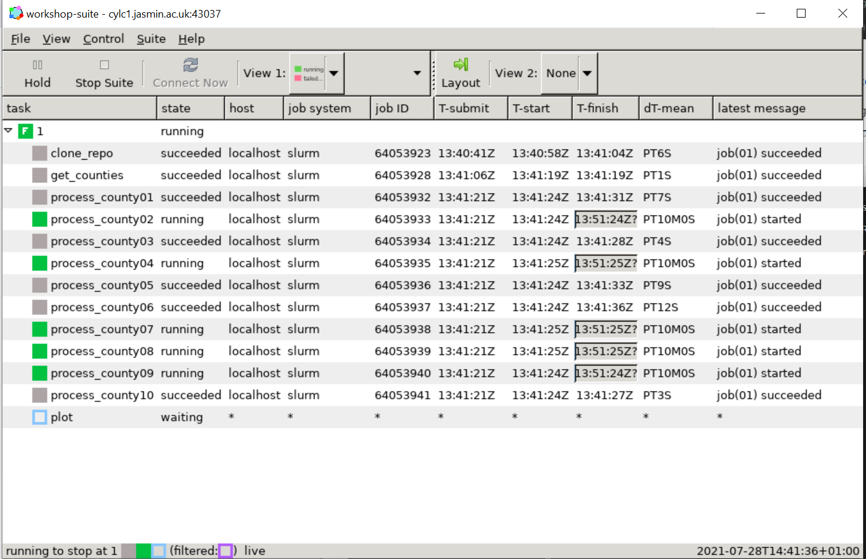
The Cylc GUI shows information about each of the tasks
Simple colour-coding gives instant information: grey=succeeded; green=in progress; red=failed

Slide 3
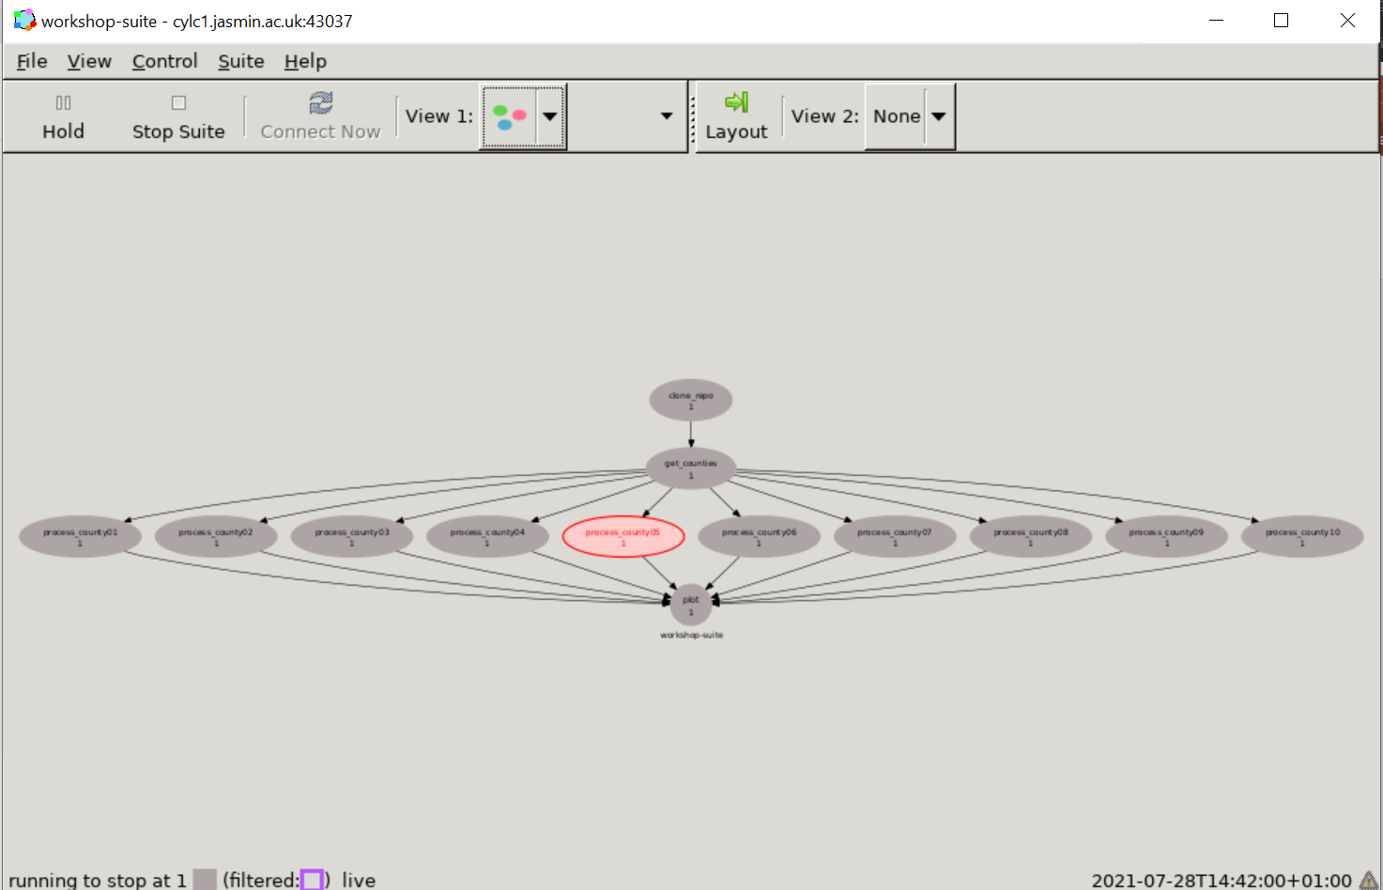
The graph view shows the entire workflow as a graph, including the dependencies between different tasks. If any task fails then none of the subsequent tasks will run.

Slide 4
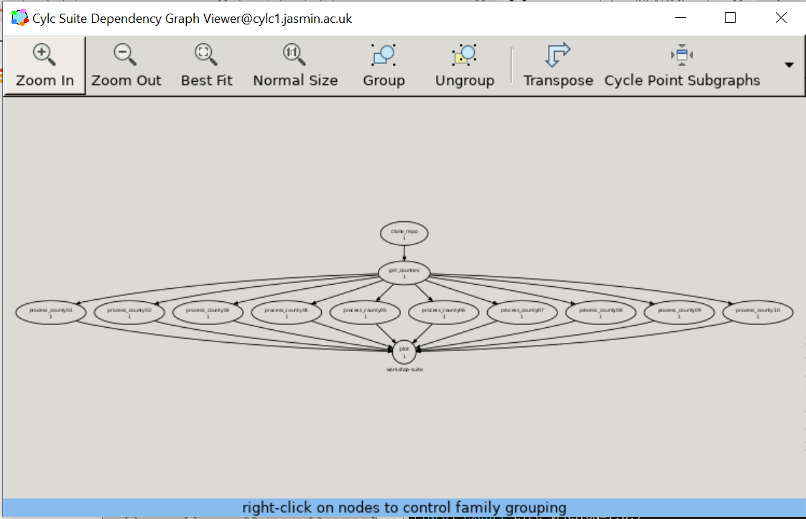

Slide 5
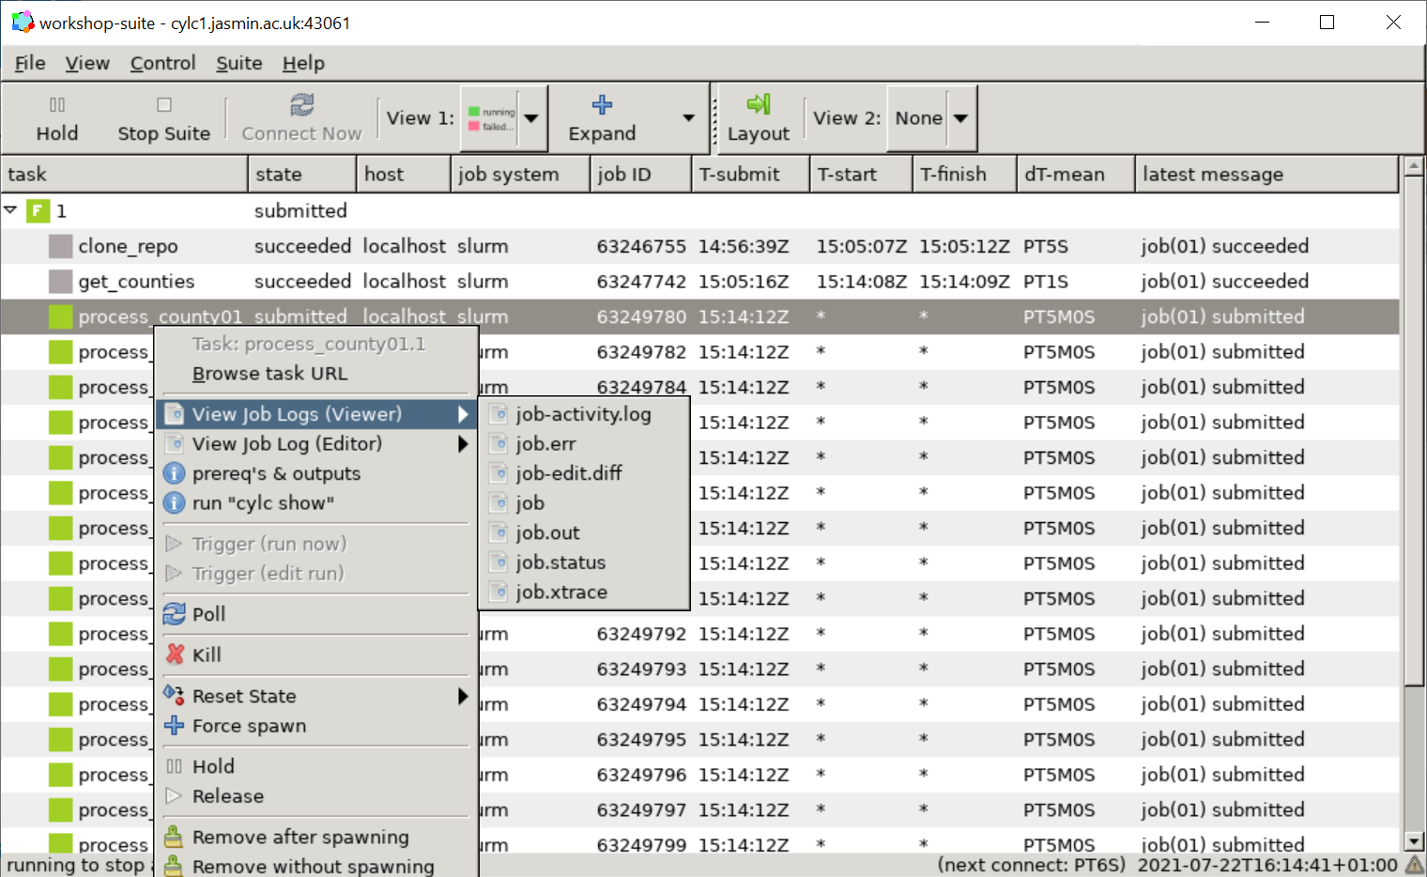

Slide 6
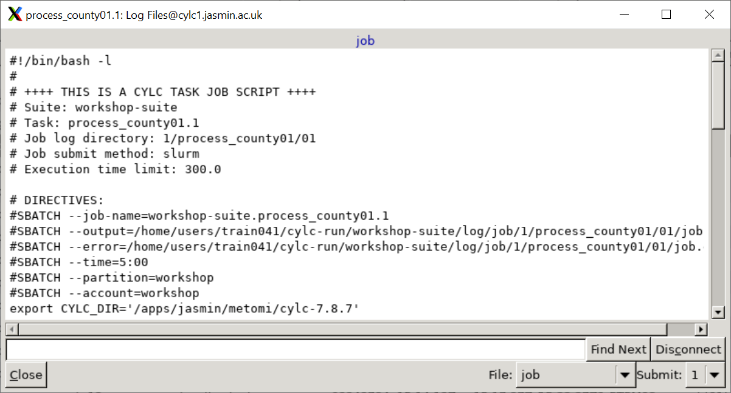

Slide 7
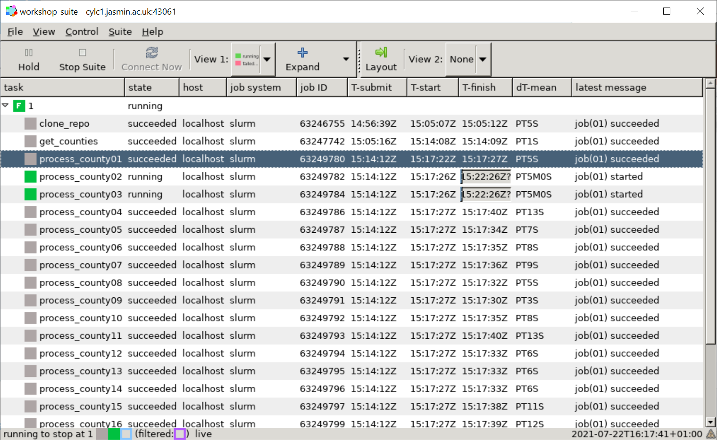

Slide 8
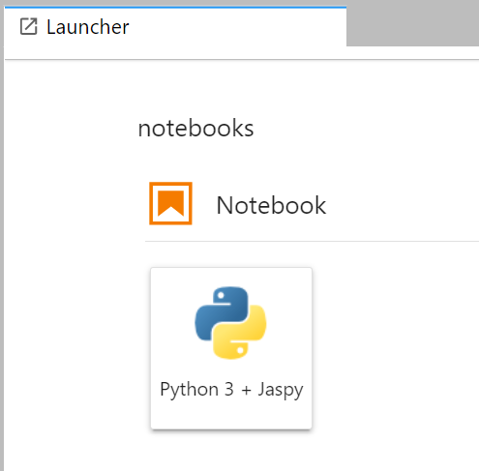
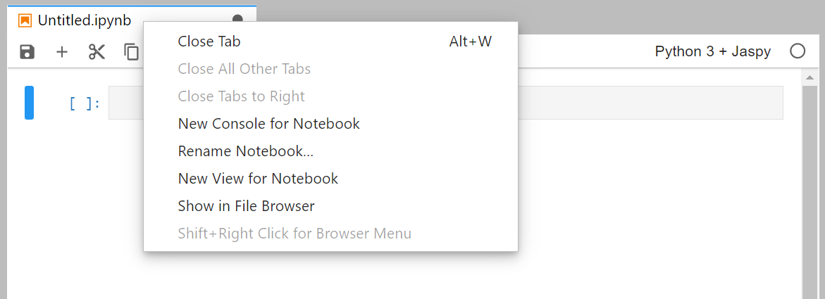

Slide 9
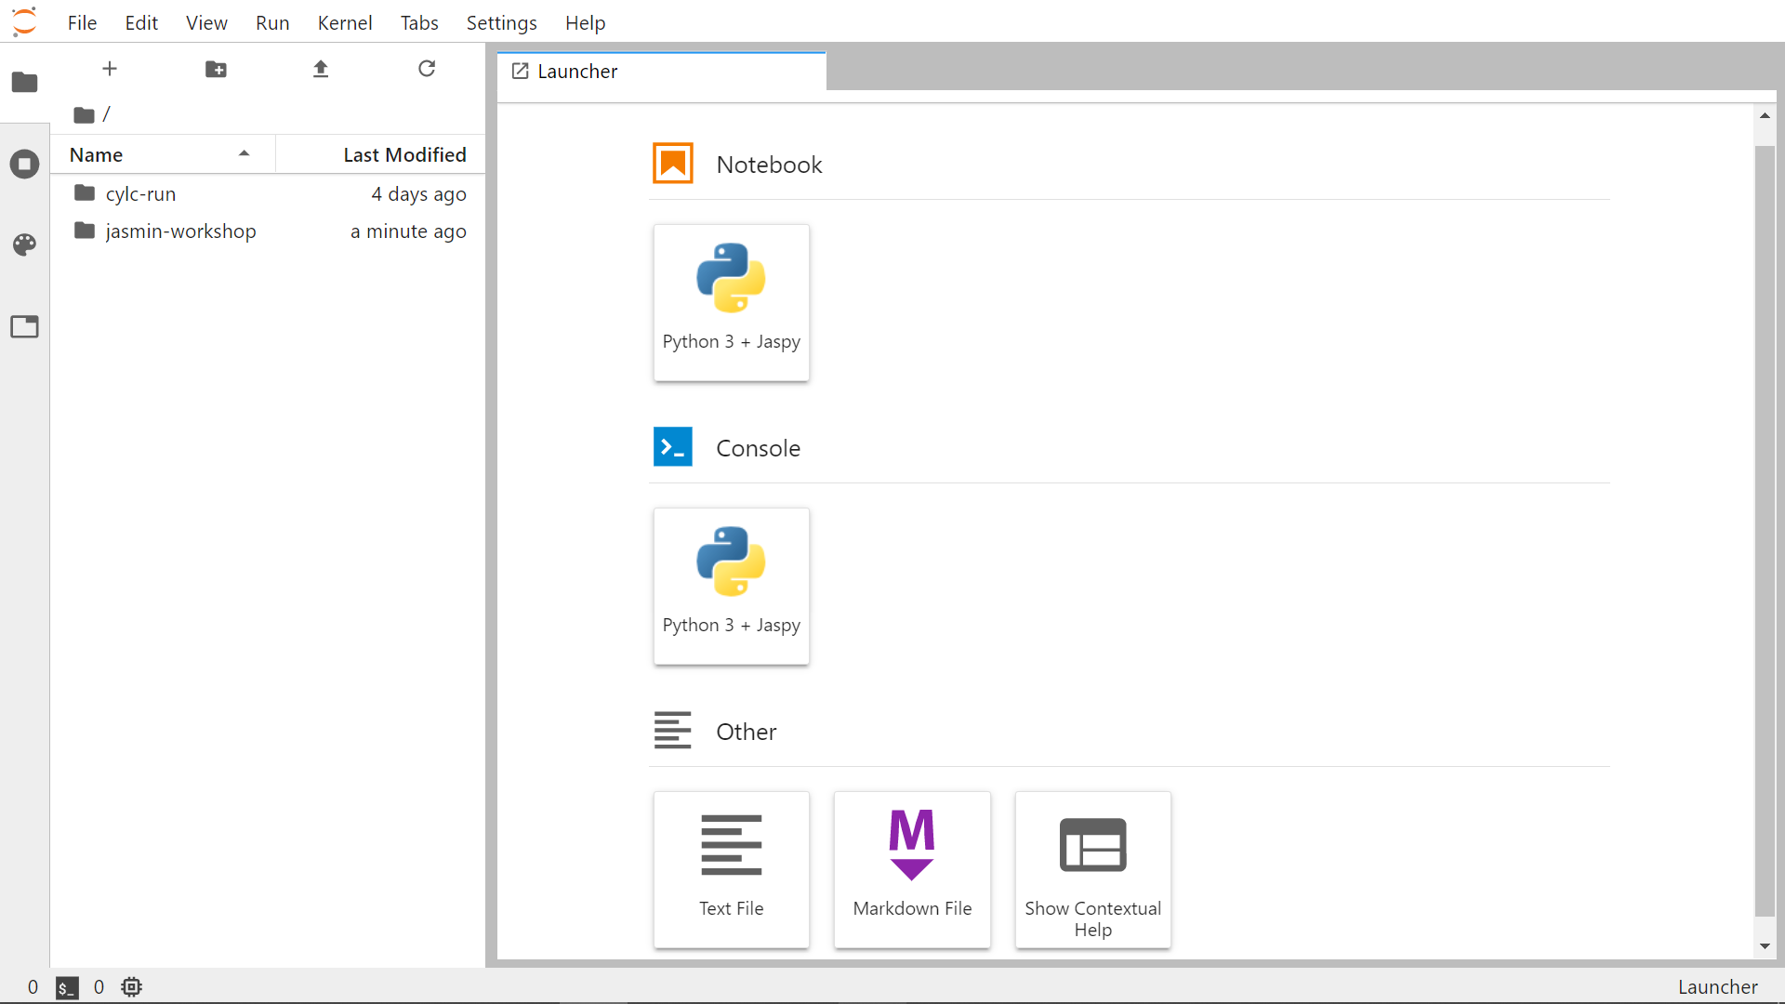

Slide 10
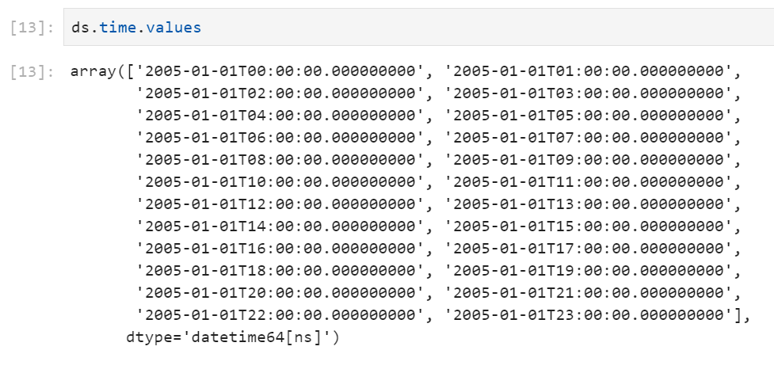
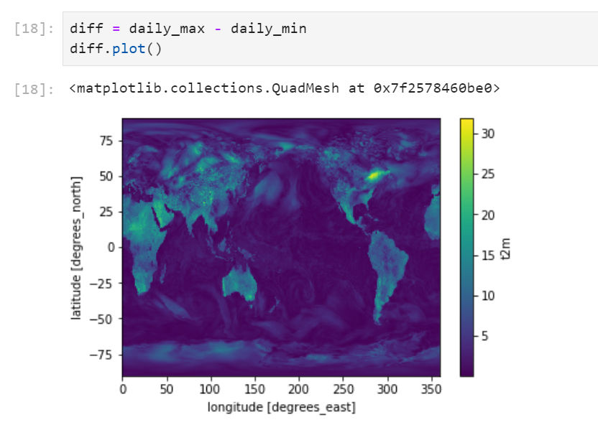

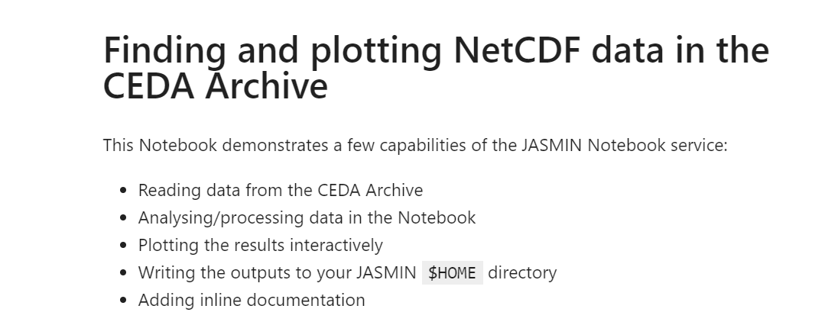

Slide 11


Slide 12
