Slide 1
Images for JASMIN workshop exercises and tutorial
Contents:
ex09
tut02

Slide 2
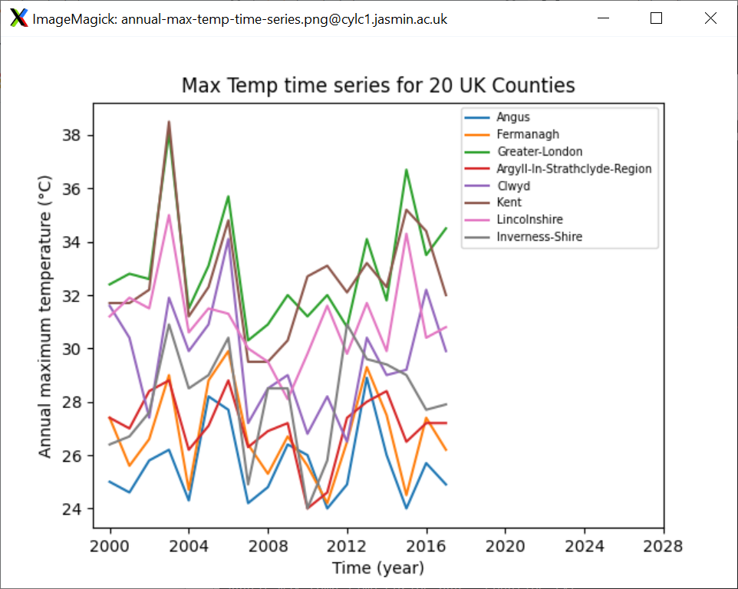

Slide 3
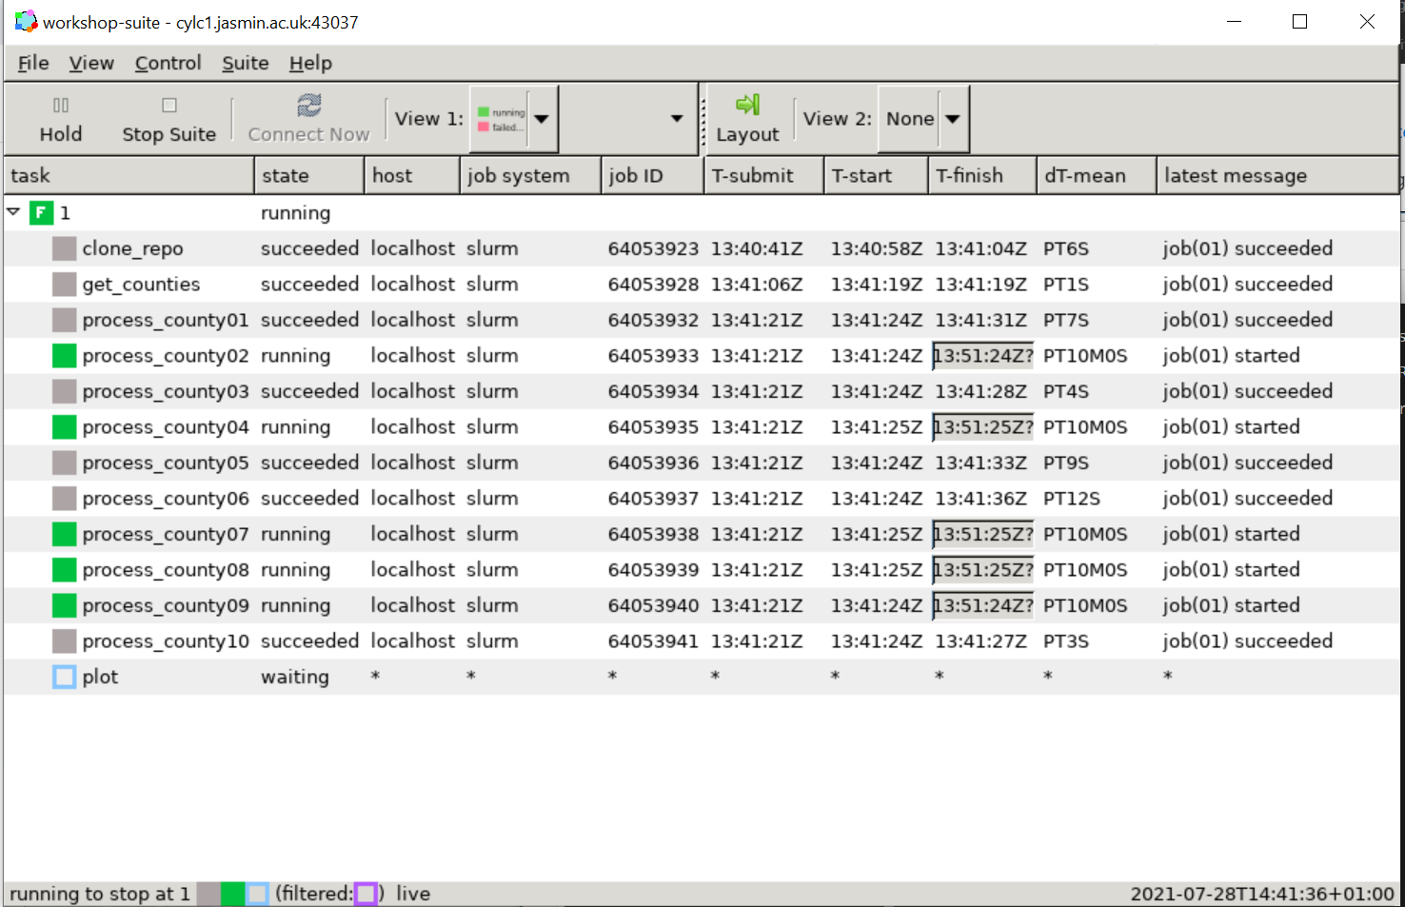
The Cylc GUI shows information about each of the tasks
Simple colour-coding gives instant information: grey=succeeded; green=in progress; red=failed

Slide 4
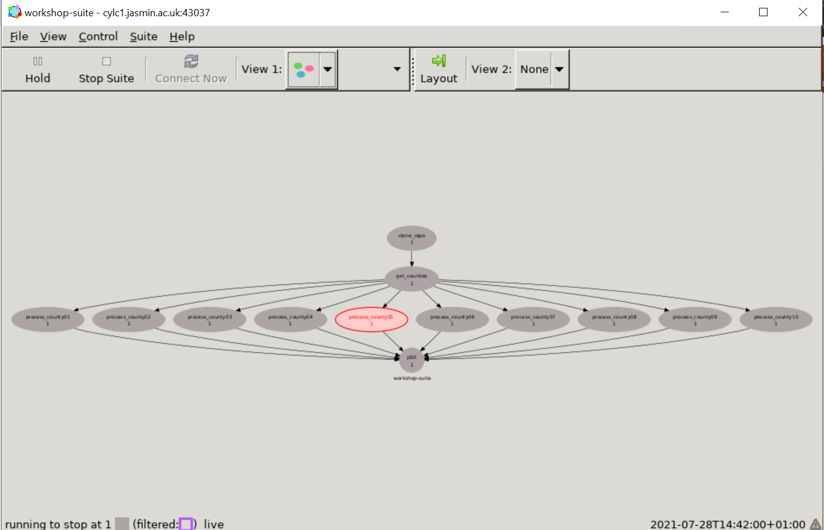
The graph view shows the entire workflow as a graph, including the dependencies between different tasks. If any task fails then none of the subsequent tasks will run.

Slide 5
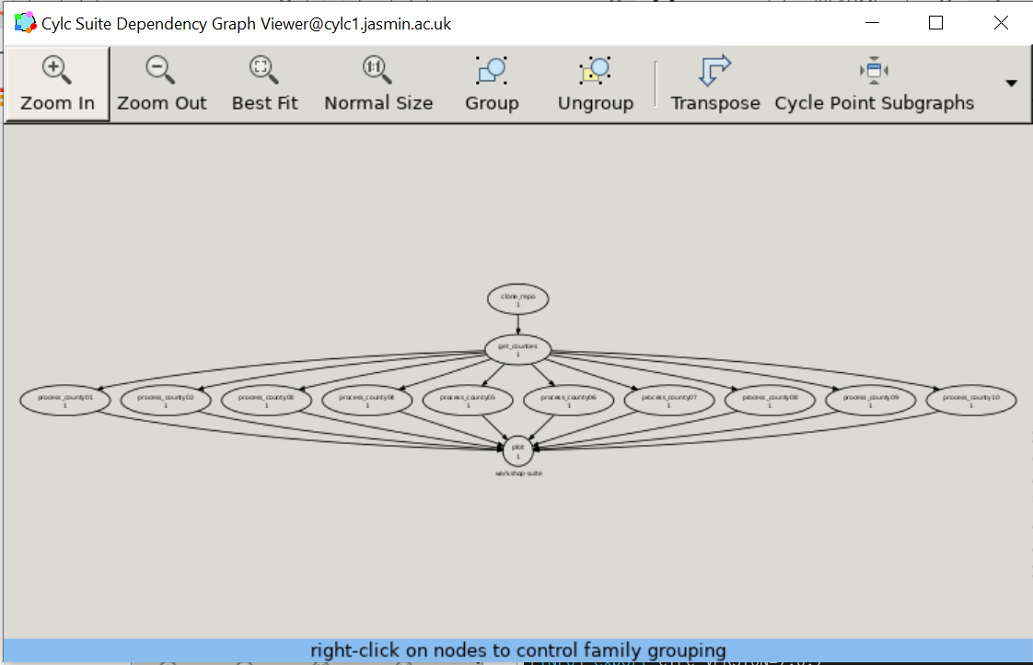

Slide 6
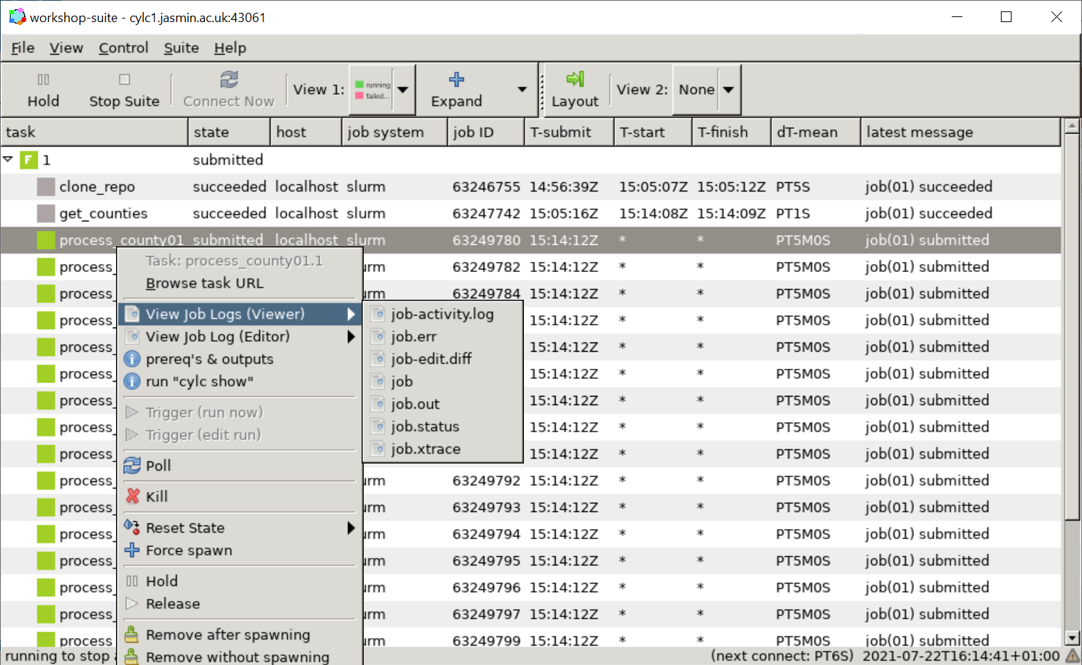

Slide 7
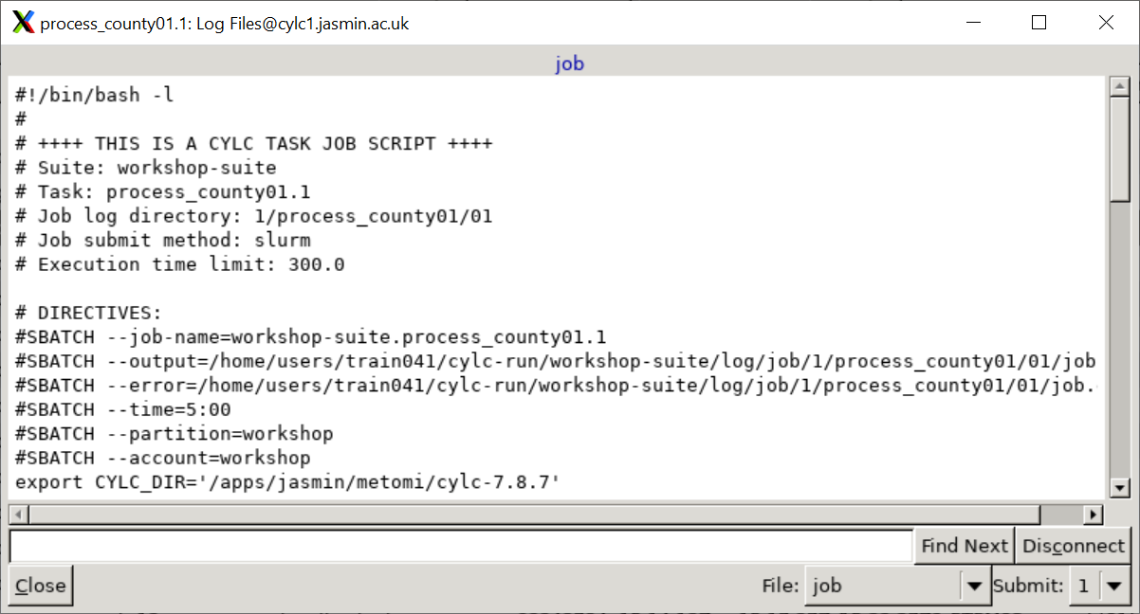

Slide 8
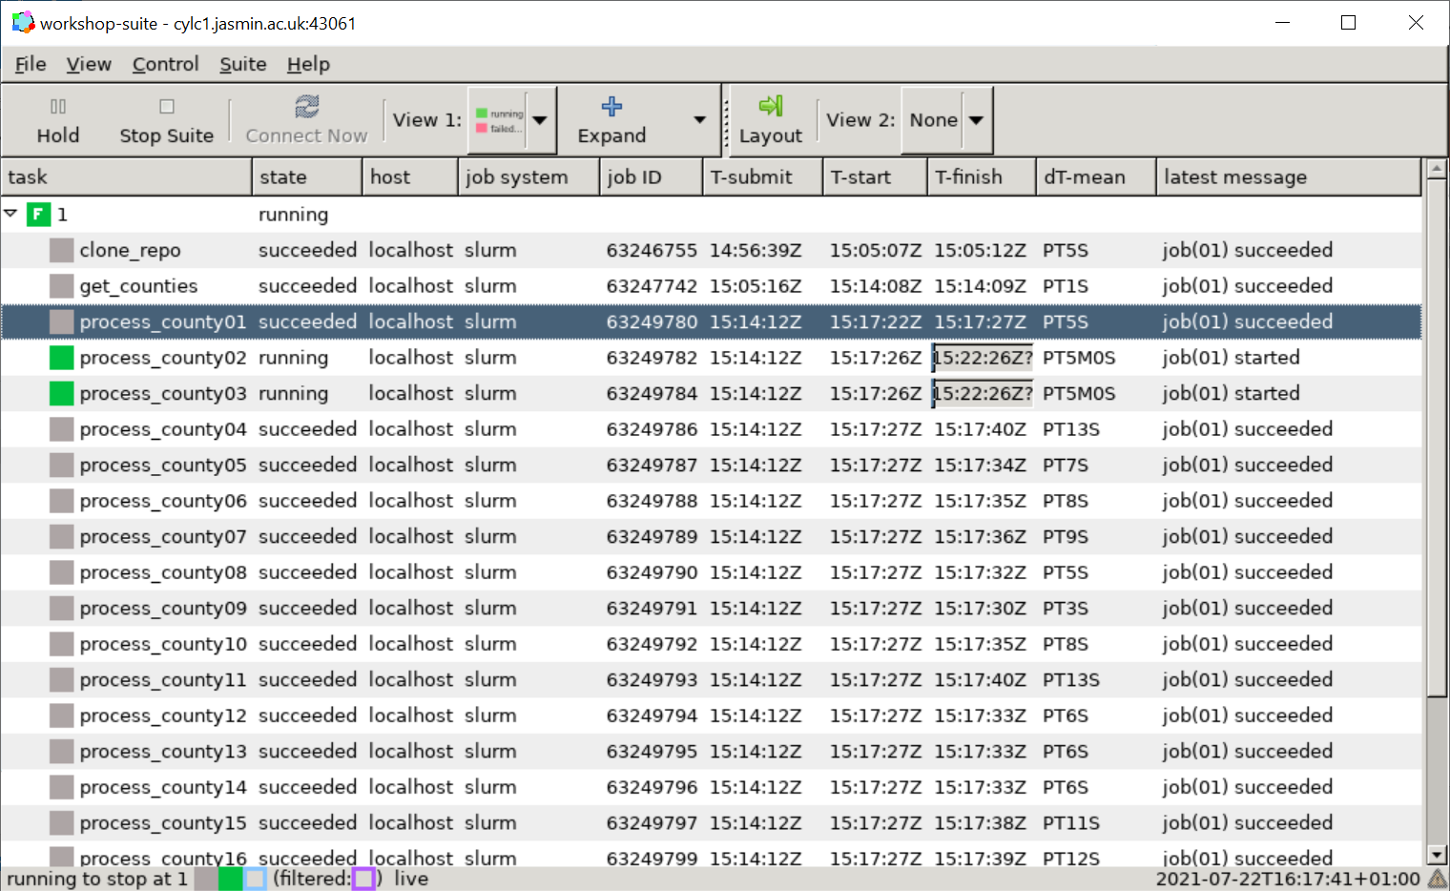

Slide 9
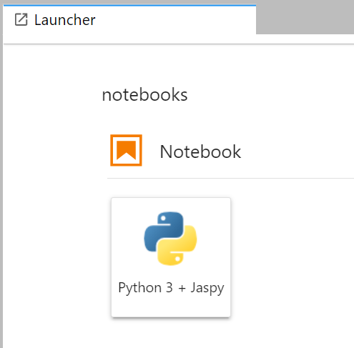
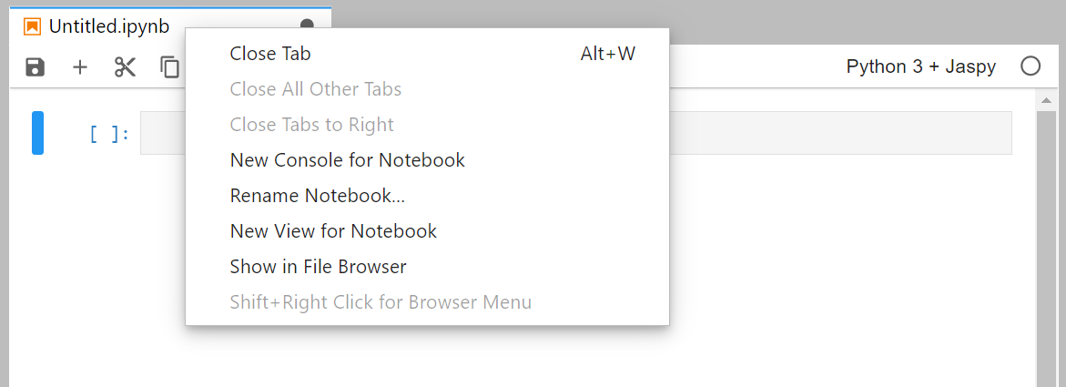

Slide 10
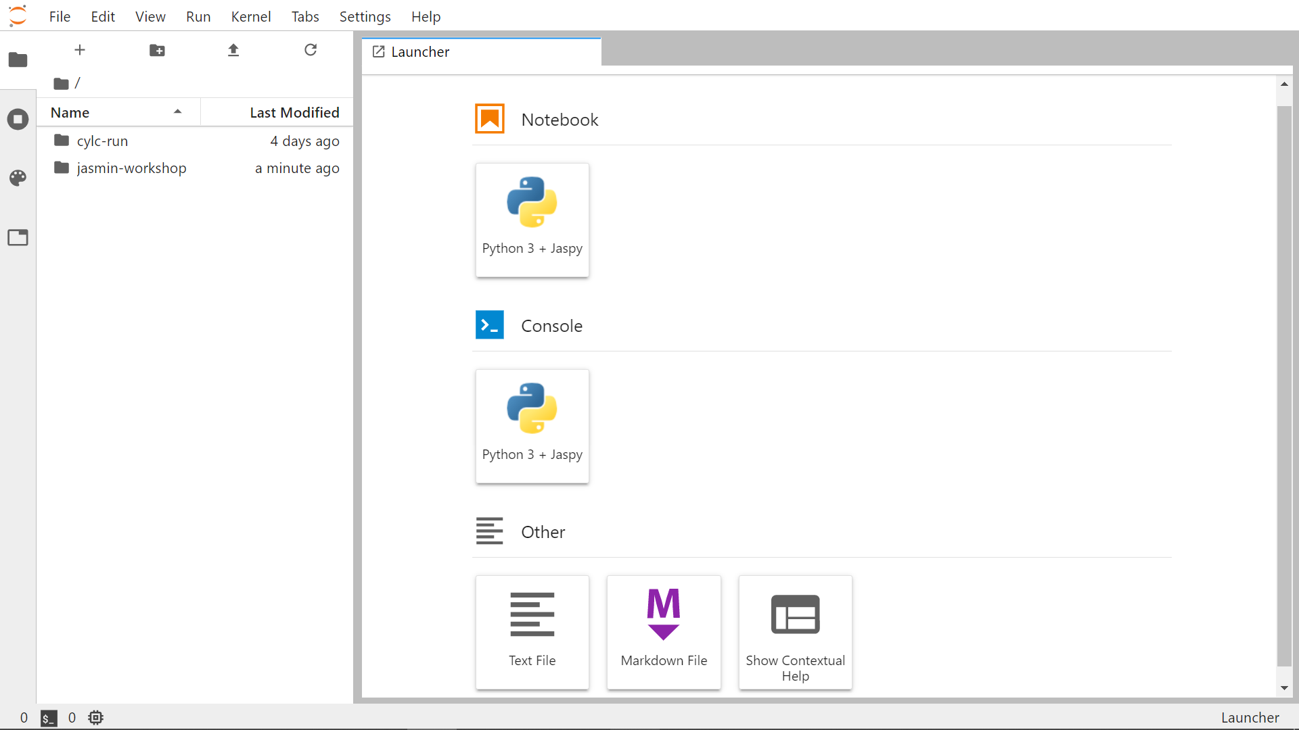

Slide 11
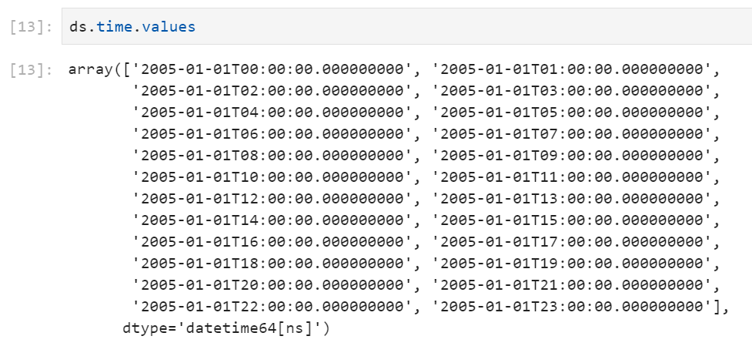
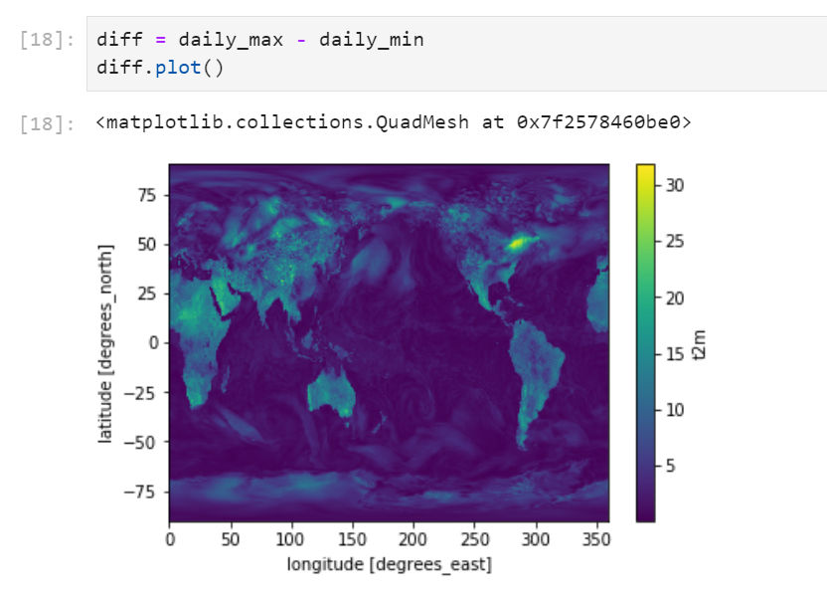

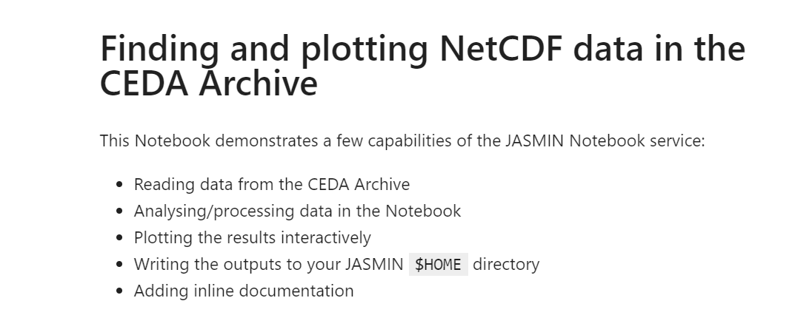

Slide 12


Slide 13
