Slide 1

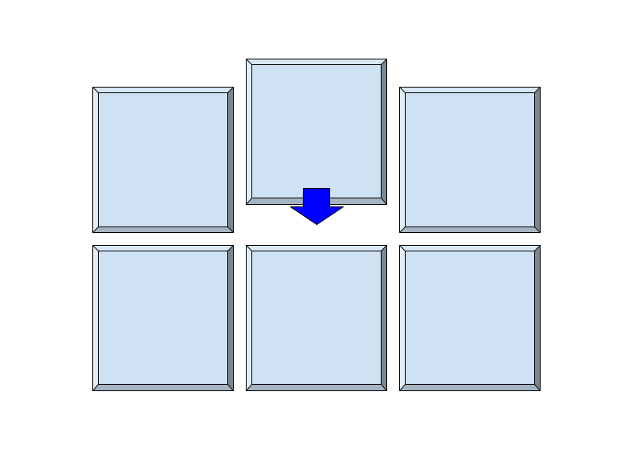






The Kerchunk Pipeline
Atlas Boardroom Workshop (23rd November)
Updated 7th March (Kerchunk Demo)
Daniel Westwood
Initialise
Scan
Compute
Validate
Catalog

Slide 2
Key Features of the Pipeline
Serial (Single) or Group dataset processing
Handles differing methods (JSON/Parquet) and advises best format (including Zarr)
Verification of Kerchunk reference files.
Key Terms
Dataset: Collection of NetCDFs that go into a single Cloud Object (Kerchunk or Zarr) Each of these is assigned a Project Code (proj_code)

Slide 3
Kerchunk Creation Pipeline
1. Initialise
Assemble config files for each dataset/project in a group – makes all config and log files for each Dataset
2. Scan
Assess selection of the files to be converted:
- Attempt conversion for a few files and get some required parameters
- Attempt concatenation of a few refs.
- Test all parts of the pipeline for initial errors
3. Compute
Convert every file to a Kerchunk reference.
Concatenate all Kerchunk references using determined parameters.
4. Validate
Perform test suites, ensure store/json has no differences to source files.
5. Catalogue
Add reference to catalogue (intake/STAC)

Slide 4
Summary of Pipeline Tools
Monitor and assess pipeline status and errors
Update existing files, replace/add/remove data
Main script for pushing to SLURM
group_run.py
assess.py
update.py
*coming soon*
User Tools
Run single dataset outside of group or single element of a group
single_run.py
init.py
Pipeline
Custom Pipeline Errors
scan.py
errors.py
compute
logs.py
Pipeline logging
validate.py
allocator.py
*coming soon*
Arrange for optimized job allocations

Slide 5
Generated Directory Tree in Pipeline
Workdir
groups
in_progress
complete
directory
group N
kerchunk-1a.json
pathlists
group N
file
Proj_code N
group N.txt
datasets.csv
Proj_code_lists
allfiles.txt
base-cfg.json
detail-cfg.json
kerchunk-1a.json
Status_log.csv
phase_logs

Slide 6

Input Files to the Pipeline
Path List: Set of patterns describing locations of NetCDF files (1 line per dataset)
CSV File: 1 record per dataset, additional parameters recorded
CMIP6
Pre-Scan: Use external tools (checksit) to determine parameters
CCI
Configure: Set up project dir + config file for each dataset

Slide 7
Live Pipeline Demo

Slide 8
Kerchunk/STAC Singularity
Single point of access for all data represented by Kerchunk (and NetCDF)
Large scale kerchunk data store accessible in the CEDA Archive - but using the catalog general users would not need to touch kerchunk files directly, just use catalog and python library tools – configuration is abstracted.
CEDA catalog tool (tool name pending…) points to all NetCDF and Kerchunk data, with sufficient abstraction so the tool auto configures for each Kerchunk dataset based on:
Storage Type - JSON or Parquet Lazy Loading
Authentication – User generates own token/certificate using central tool.
Parallelisation – Tool utilizes JASMIN Dask Gateway to parallelise computation for large processes.

Slide 9
Questions?
Initialise
Scan
Compute
Validate
Catalog
Stages of the Kerchunk Pipeline

