Slide 1
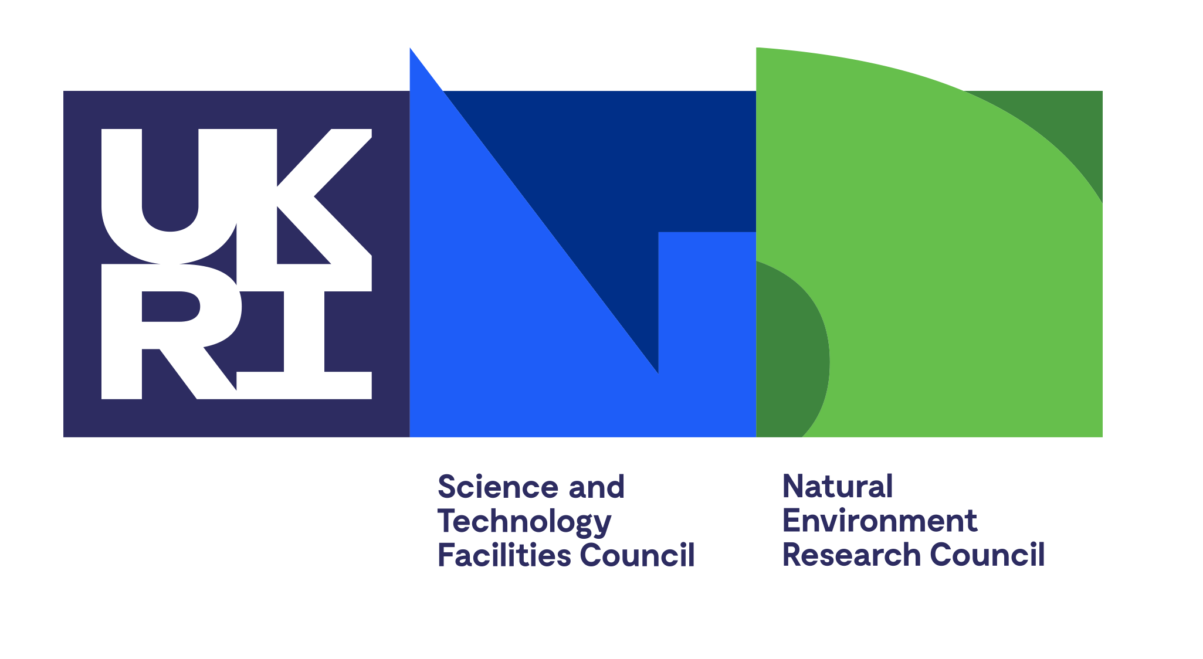
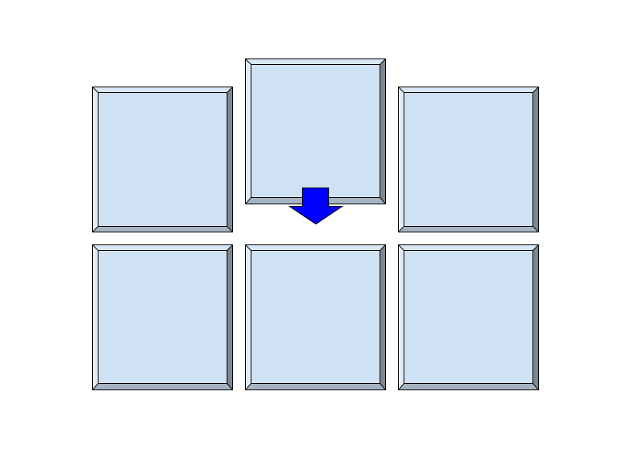
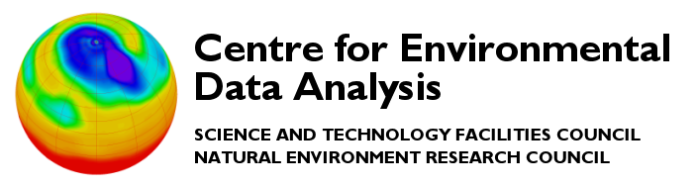





Introduction to Kerchunk
CEDA Monthly Meeting (12th October)
Daniel Westwood

Slide 2

The CEDA Archive
Archive hosts over 30 Petabytes of atmospheric and Earth observation data.
Data typically accessed via JASMIN user interfaces (SSH with Linux environment, JASMIN notebook service etc.)
Typical analysis workflow – data accessed and analysed on JASMIN, no download required.
Credit: STFC/Stephen Kill

Slide 3
Archival Format Limitations
NetCDF/HDF files optimised for high performance architecture (Parallel R/W, multiple accesses etc.)
Metadata is embedded between data chunks.
For a typical HDF file, chunk structure is unknown so you have to open the whole file to get the data you need, even if it’s just a small subset.
HDF5 File
Metadata
Binary Encoded Data
Metadata
Binary Encoded Data
Metadata
Binary Encoded Data
Metadata
Binary Encoded Data
Credit: STFC/Stephen Kill

Slide 4
Archival Format Limitations
Typical example: Compute time-series average for atmospheric variable over 30+ years (monthly data so 360 files to open)
Using python tools with NetCDF libraries, access is required to all 360 files at once, may require significant memory allocation.
Cloud applications would need access to data via JASMIN services – requirement for data usage which may become a barrier.
Some institutions may choose to download data to host system (days or weeks) which we would like to avoid.
Ideally need a different (better) method for cloud access.
NetCDF File ( E.g. 3GB)
…
30+ Yrs
Credit: STFC/Stephen Kill

Slide 5
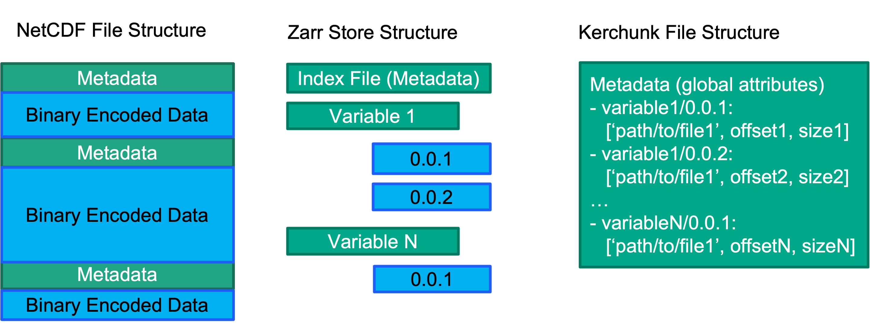
Cloud Optimised Formats (Zarr Example)
Kerchunk Data Representation
Break up datasets into smaller chunks of pure data with no embedded metadata.
Metadata stored in an index file (not repeated in multiple NetCDF files).
Single Zarr store represents the entire dataset – data rechunked during conversion.
Issues with Zarr for Archival data: Zarr storage is 10-20% extra on top of NetCDF storage space. Conversion is computationally intensive.
Kerchunk files store references to each existing chunk in NetCDF files (rechunking not included)
NetCDF data remains unchanged, only read once when building kerchunk files to determine chunk sizes etc.
Kerchunk allows extraction of only required data, without having to convert existing data to different forms.
Recreating/editing reference file much less intensive.
Credit: STFC/Stephen Kill

Slide 6
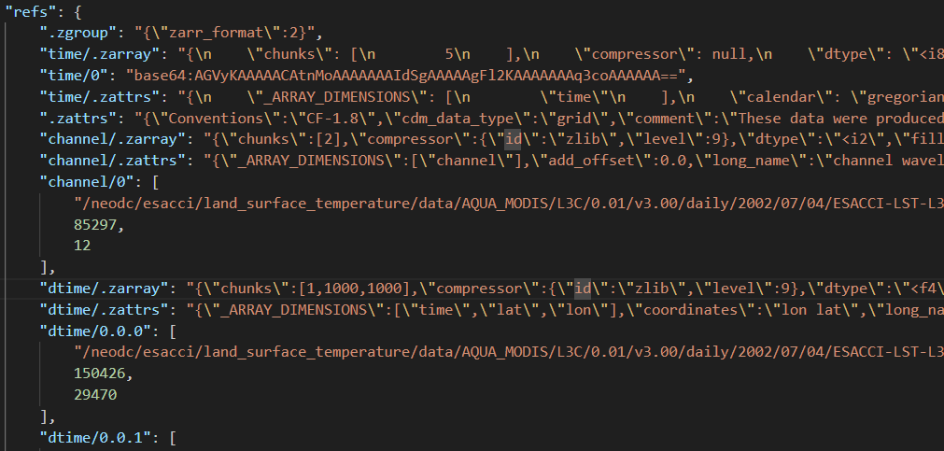
What does a Kerchunk file look like?
Default Kerchunk file format is JSON, metadata and chunk references all stored in the same file.
Mirrors Zarr file structure (hence ‘.z’ attributes) but stores data location (byte-ranges) rather than actual data.
Provides a mapper for getting chunk data from NetCDF files without the need for download/access of whole files.
Note: Lat/Lon not required, Kerchunk is dimension-agnostic but requires a stacking dimension (usually time)
Original file (NetCDF or other)
Size (bytes)
Offset/start within file (bytes)

Slide 7
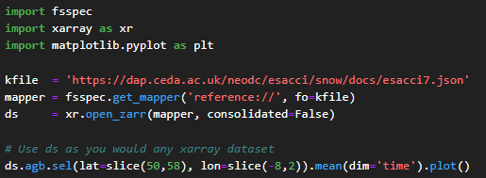
How to use a Kerchunk File (Python)
Kerchunk uses python fsspec ‘virtual filesystem’ library.
Open kerchunk reference file as a mapper, then open xarray ‘virtual dataset’ with open_zarr method using fsspec mapper to kerchunk data.
Extra parameters required for authentication with some kerchunk/netcdf data.

Slide 8
Kerchunk Aggregation Layer – The Big Picture
Kerchunk files used to serve NetCDF data, becomes more performant with greater NetCDF chunking and spatial selections from user.
Lazy Loading NetCDF data built into Kerchunk workflow (xarray/dask)
Potential for Lazy Loading Kerchunk data (references) for large datasets with many chunks.
Catalog provides easy access to kerchunk files using a simple search tool (abstracts configuration for kerchunk access).
Application Layer
Catalog Layer (Intake/STAC)
Kerchunk Reference Layer (Many Kerchunk Files)
NetCDF Dataset (Many GB or TB)

Slide 9
Questions?

