Slide 1

Data Science Clinic
PROJECT NAME HERE
STUDENT NAMES HERE

Slide 2
Project Statement
Name of the Organization
[External Mentor Bio (1 bullets) – what is their title?]
[Internal Mentor Bio (1 bullets) – who is your mentor at Chicago]
[Student team Members and background]
[Brief Description of Project] (2-3 bullets)
This description is very, very broad.
It should be at the level of a layman (think of explaining what you are doing to your parents)
The Project statement will probably be LARGER than the specific piece you are working on.
The Problem statement should make it absolutely clear WHY this problem is important to your organization (does it make money? Does it save money? Why does the external organization care about this?)

Slide 3
Problem Statement
The “Problem” is a subset of the “Project” that you are actually working on.
For example – the problem might be “Increasing retention on reddit” while the “problem” that you are working on is “estimating user churn”
Bullets should be:
[Problem Statement] (2-3 Bullets)
[Relationship between the problem and project]
[Is this primarily a “Modeling Problem” / “Analytics Problem” / “Engineering Problem”] <- Depending on the answer to this, choose one of the three next slides
[Deliverable] (1 bullet)

Slide 4
Analytics Problem
Use only if this is primarily an Analytics Problem (Data exploration, visualization, some modeling, but most of the effort is not modeling)
[Describe your data] (3-4 bullets)
Volume?
Type?
Other information: what information it contains, etc.
[Describing your main task] (2-3 bullets)
Visualization?
Exploration?
Merging data?
Basic Modelling? If so, what is the objective of the Modelling exercise

Slide 5
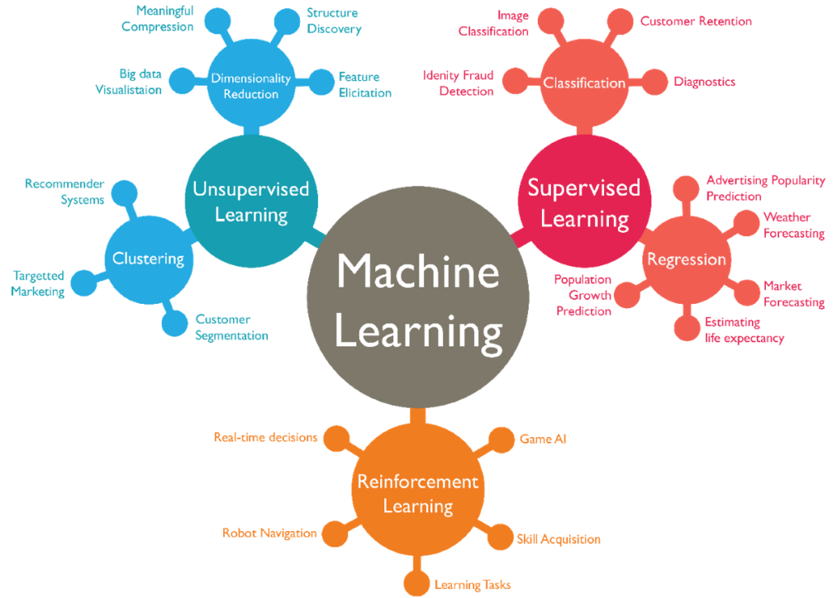
Data Science Problem
Use only if this is primarily a Data Science Problem (there an easily defined objective function that you are trying to optimize for)
Describe the problem using the following characteristics:
Supervised vs. Unsupervised?
Number of observations
[SUPERVISED] What is your objective function (accuracy? Precision? Recall?)
[UNSUPERVISED] How are you evaluating your model / defining an objective function?
What algorithms have you used?
For those algorithms, what did you achieve with your objective function?

Slide 6
Engineering Problem
Use only if this is primarily an Engineering Problem
[1-2 bullets] Describe the problem
If possible, provide a systems diagram showing how the technology fits together.
What tools and technologies are you using?
Why are you using them? What do they “do” for you?
E.g. if you are using django… what is it and why do you use it?

Slide 7
Problems you have encountered
What are the most difficult problems that you have encountered so far?

Slide 8
Final slide
Is there anything fun you want to show (optional).
If you have a neat visualization, model result you want to highlight or demo of your app, this is a great place to put it!

