Slide 1
RNA-Seq data processing pipeline
Yizhou Wang
1/31/2019

Slide 2
Mapping_QC_Auto_v3 for RNA-seq data processing
Perl based script
Run on HPC
6 samples (20M reads/sample) take ~2h
Get email notification when jobs finished
Ready-to-deliver results
Command Line:
Mapping_QC_Auto_v3.pl -t <sequencing_type> -o <Species> -p <project_ID> -n <nodes number> -qc -gb
-t : single end or paired end
-o : Human/Mouse/other species
-p : project ID for these set of samples
-n : which nodes the jobs will run on
-qc: perform QC (if not, only do alignment)
-gb: perform genebody test to check 5’ or 3’ mapping bias

Slide 3
Integrated tools
Aligner: STAR
Quantification: RSEM
Quality Control
Raw reads: FastQC
Mapping: RSeQC
Files organization/format
customized perl/R/bash scripts

Slide 4
Input:
FASTQ files only
Output:
final_results:
Final QC report (deliver)
TPM/Count/FPKM expression matrix (deliver)
fastq: original FASTQ files (deliver)
bam: sorted bam and bam index files
others: other intermediate files
RseQC_results: QC report for each sample and intermediate files from RSeQC
genes_isoforms_results: quantification results for each sample generated by RSEM
log && node_log : log files from running nodes and tools

Slide 5
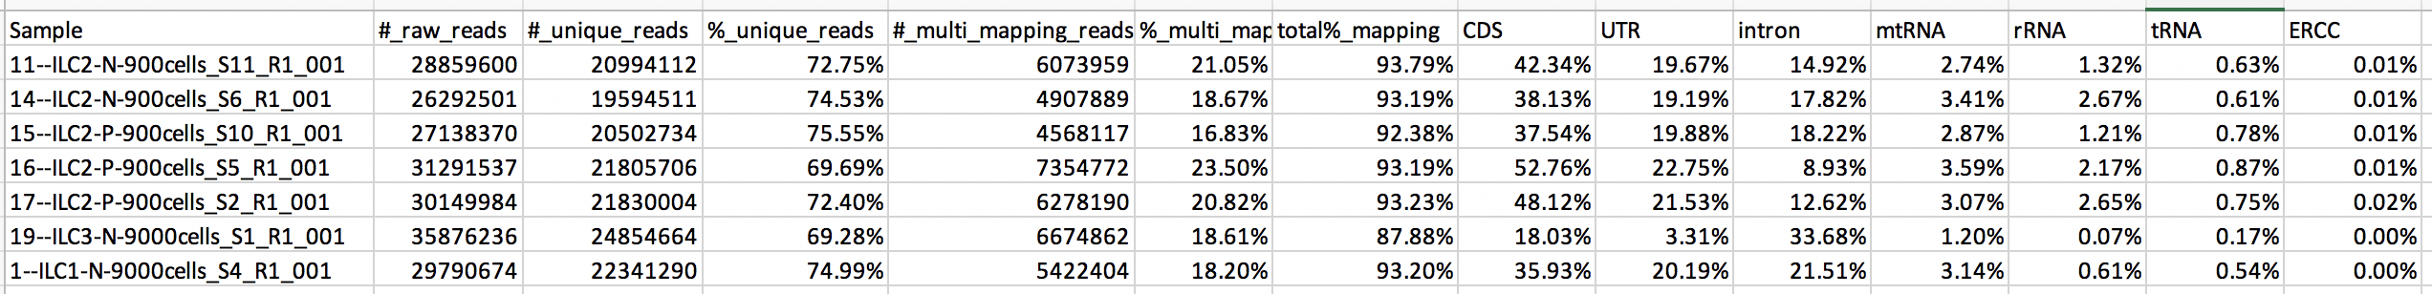
Example for QC report
MultiQC HTML report:
http://10.220.239.17/demo.html
Excel table

Slide 6
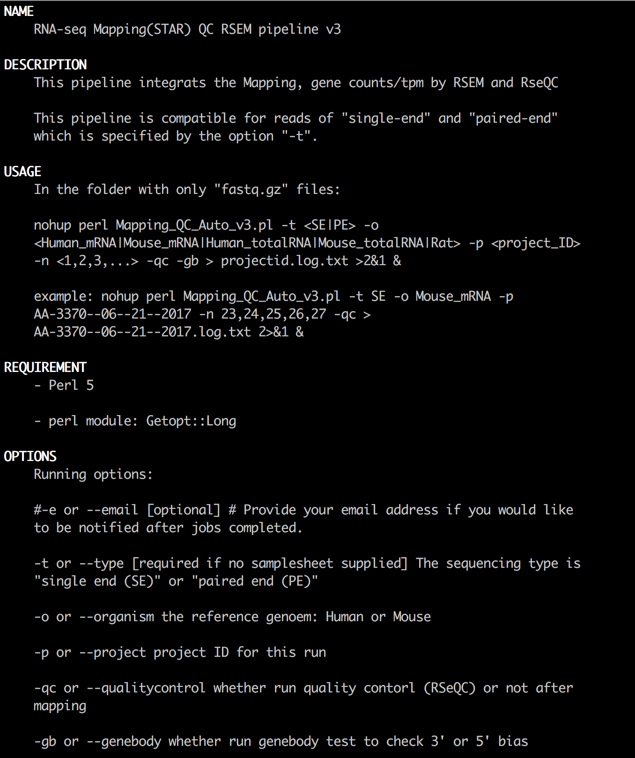
Support
Detailed help manual:
Mapping_QC_Auto.pl -h

Slide 7
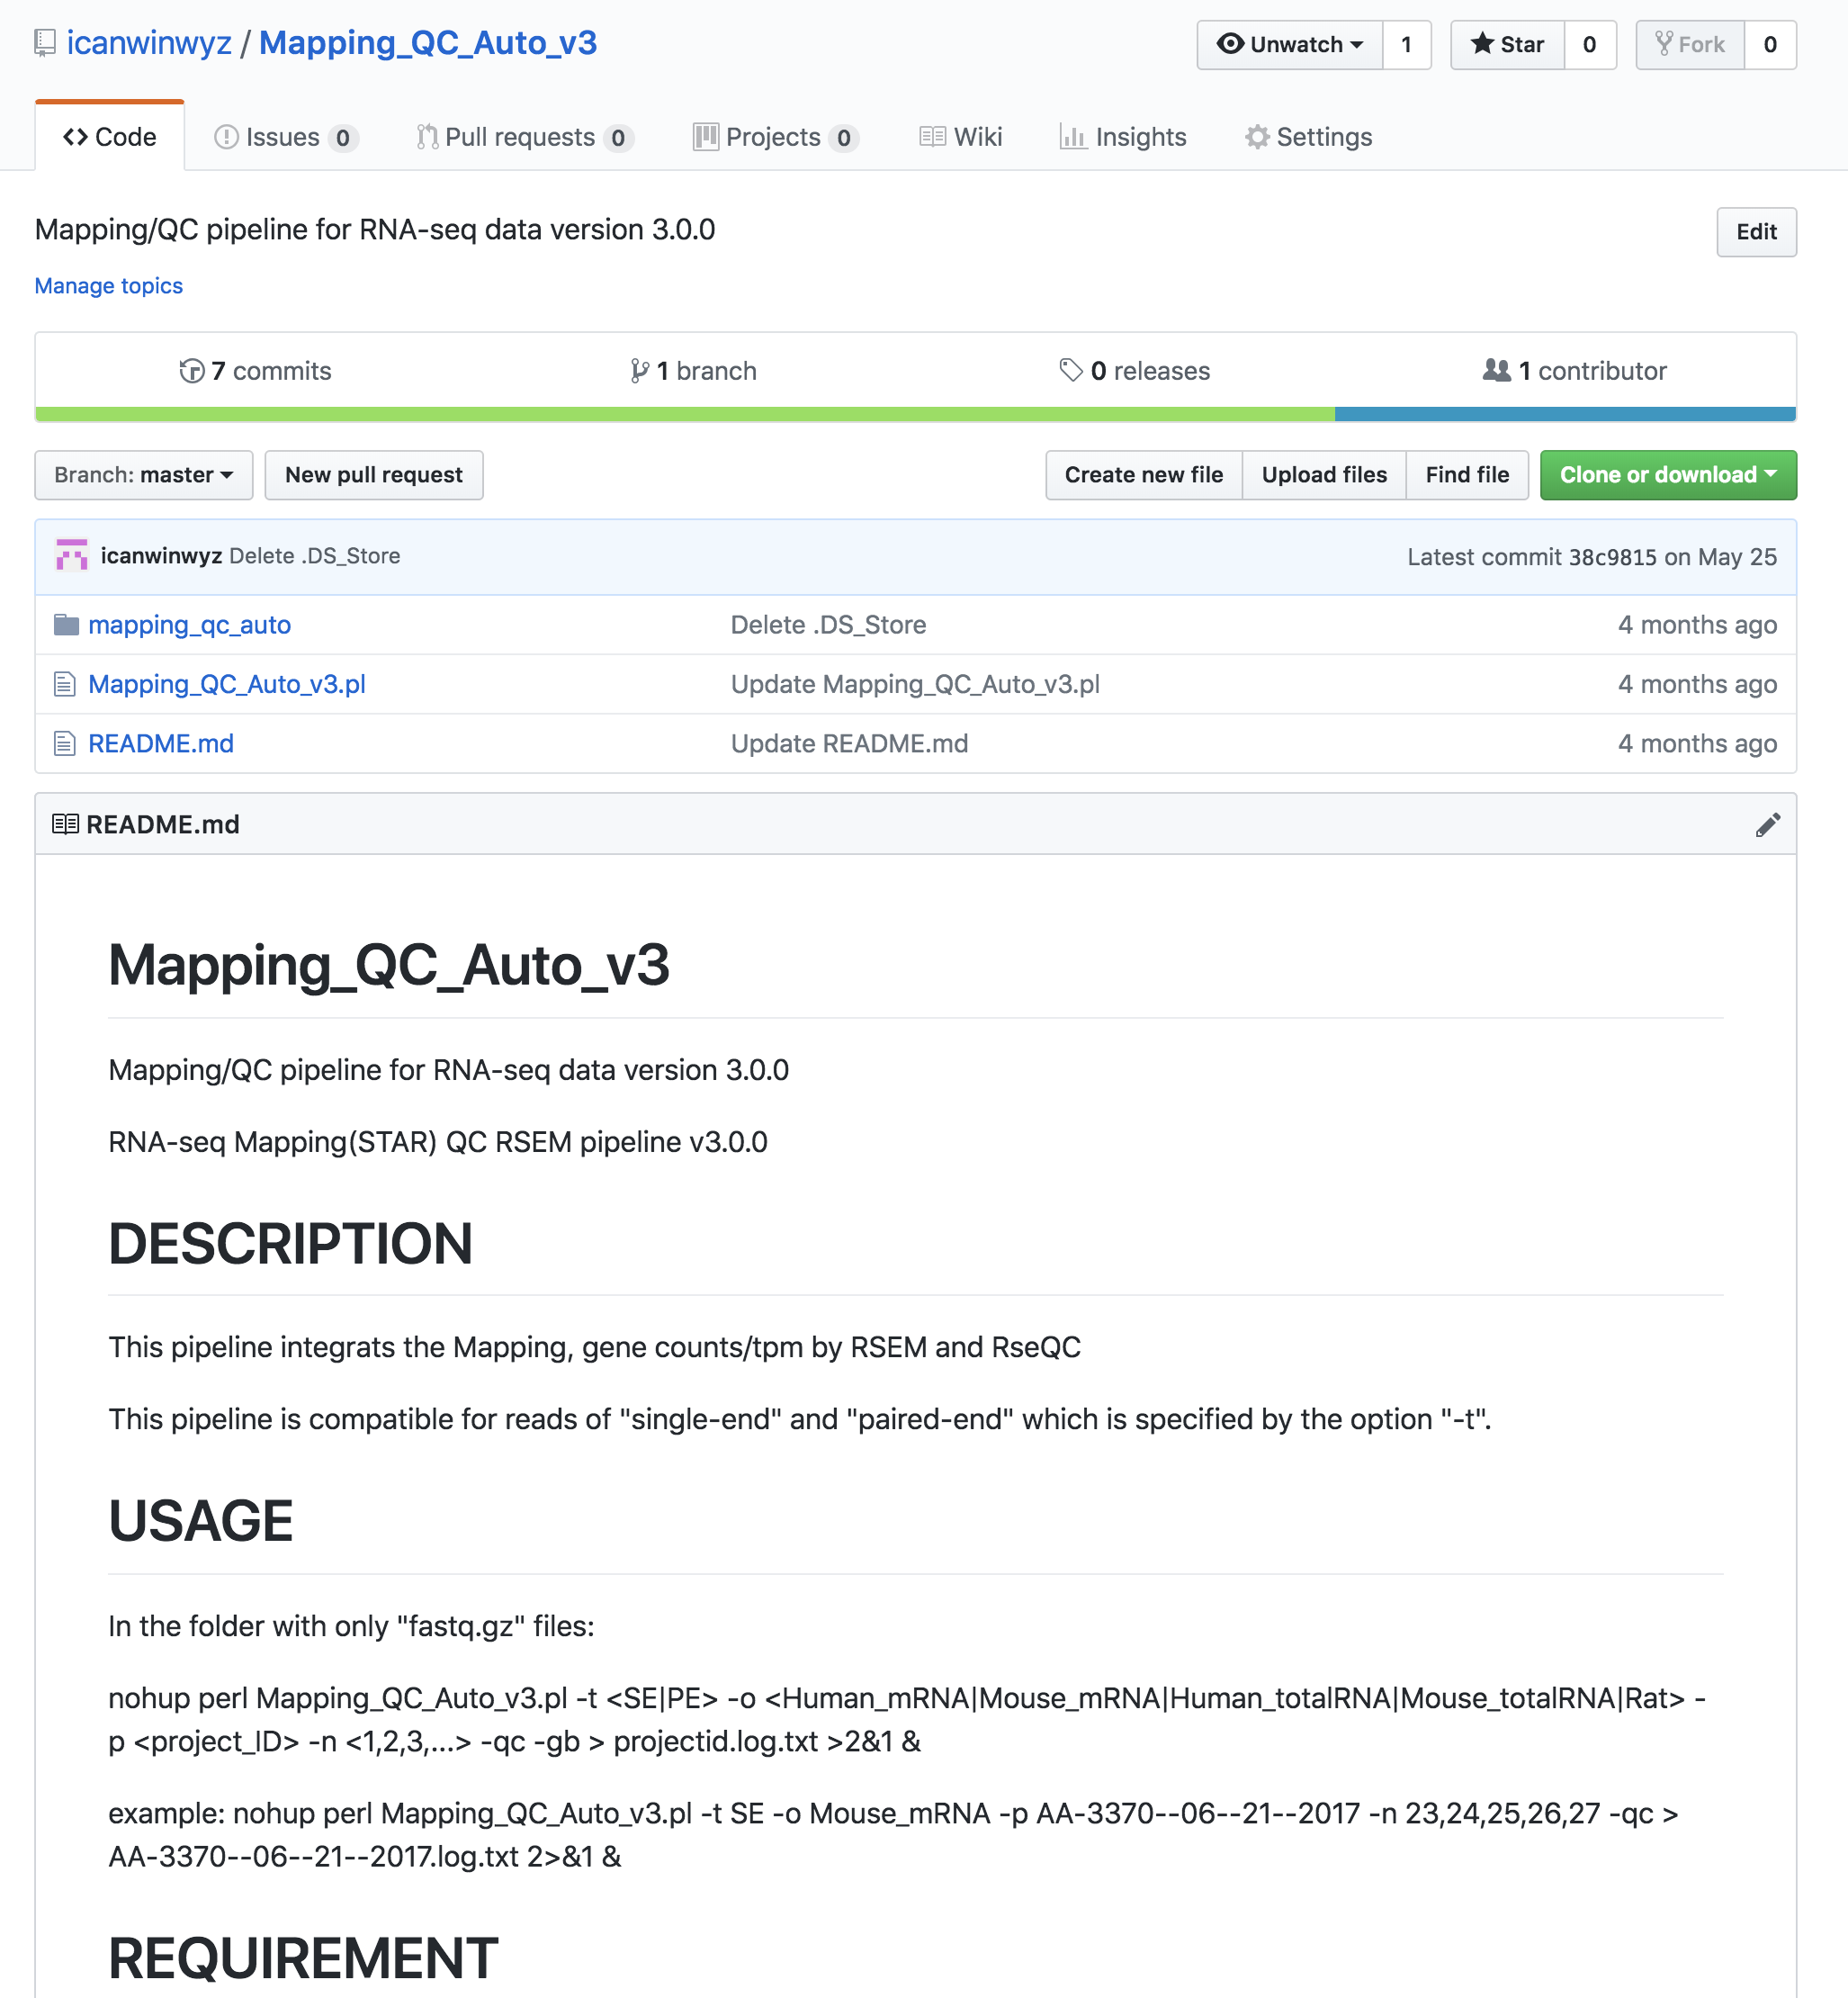
Support
Deposited on GitHub (https://github.com/icanwinwyz/Mapping_QC_Auto_v3)

Slide 8

Deployed on Titan Server Portal for wet lab
For small sample sets (< 10sampes), wet lab can do Mapping/QC by clicking button.
Jobs run on local server instead of HPC

Slide 9
Future Plan
Integrate fastqscreen to check contamination from bacteria or fungi
Integrate into NextFlow (Won is working on it)
Write detailed QC metrics explanation on MultiQC report (Done)
Other ideas?

