Slide 1
CEDARVILLE UNIVERSITY
Welcome to the
App Portal
CU
A practical orientation for creating, customizing, and publishing your first app
New-user orientation
Notes:
Welcome participants. This session is designed for people new to the portal. By the end, they should be able to select a starting point, understand what happens after creation, and know where Codex fits.
[Sources]
Internal source: Cedarville App Portal User Guide and Quick Start (reviewed 2026-08-03).
[/Sources]

Slide 2
CEDARVILLE APP PORTAL
02
The portal turns an app idea into a managed starting point
You bring the need. The portal brings Cedarville-approved defaults, a shared code home, and a path to a live app.
Your idea
A starter app
A managed path
A clear problem, audience, and outcome
A template with the right foundations
GitHub, Azure, and support-ready setup
Notes:
Emphasize that the portal is not a generic app generator. It gives users a dependable, Cedarville-managed starting point so they can focus on the department need.
[Sources]
Internal source: Cedarville App Portal User Guide and Quick Start (reviewed 2026-08-03).
[/Sources]

Slide 3
CEDARVILLE APP PORTAL
03
Codex is your collaborative partner for the work that follows
Codex can help you turn your requirements into app changes—while you remain responsible for the decisions and review.
Codex
Describe the app’s goal, users, and rules in plain language.
Clarify
Build
Explain
Improve
Ask Codex to make and explain changes in the managed repository.
Review the result, test the important task, then publish the version you trust.
Notes:
Introduce Codex plainly: it is a collaborative coding agent. New users do not need to be programmers, but should be ready to explain their process, review outputs, and test the app’s key task. Avoid presenting Codex as an automatic approval or publishing authority.
[Sources]
Internal source: Cedarville App Portal User Guide. Product framing for Codex is presenter guidance.
[/Sources]

Slide 4
CEDARVILLE APP PORTAL
04
Start with the portal’s guided lifecycle
1
2
3
4
Create or add
Customize
Prepare
Publish & manage
Choose a template, import code, or connect a local project.
Work with Codex and other developers in the managed GitHub repository.
Let the portal set up and check the GitHub–Azure connection.
Make the approved version live, then maintain access and settings.
Notes:
Walk slowly through the lifecycle. The key idea is that the portal brings together the work that otherwise gets scattered: starting code, a source of truth, publishing setup, and day-to-day management.
[Sources]
Internal source: Cedarville App Portal User Guide and Quick Start (reviewed 2026-08-03).
[/Sources]

Slide 5
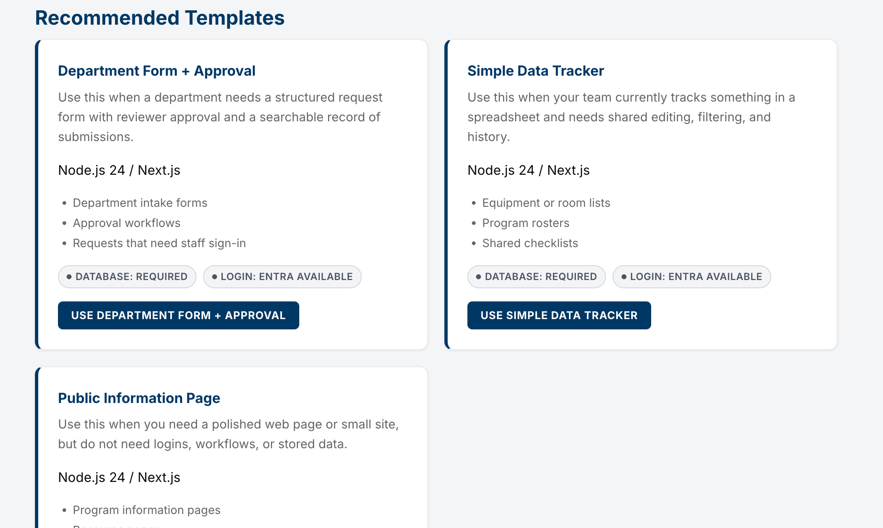
CEDARVILLE APP PORTAL
05
The Create App screen gives you some starting choices
What to notice
Recommended Templates use plain-language scenarios.
Developer Starters are available when a technical direction is already known.
Each choice signals database and Cedarville login availability.
Notes:
Use the screenshot as a live orientation. Point out the Recommended Templates first, then the Developer Starters. Avoid reading every card; help people see that each option explains the kind of work it is best for.
[Sources]
Internal source: local Cedarville App Portal Create New App screen captured 2026-08-06 in test-auth mode; Cedarville App Portal User Guide.
[/Sources]

Slide 6
CEDARVILLE APP PORTAL
06
Choose the closest business problem—not the most technical label
Department Form + Approval
A structured request, review, and searchable record
Simple Data Tracker
Shared editing, filtering, and history for a team
Public Information Page
A polished information site without logins or stored data
Custom Web App / API
A technical starting point when an architecture is already known
Notes:
Encourage users to describe the business problem first. A form and approval path, a team tracker, or an information page are usually easier starting points than picking a runtime. When in doubt, choose the template whose examples are closest to the project.
[Sources]
Internal source: Cedarville App Portal User Guide and Quick Start (reviewed 2026-08-03).
[/Sources]

Slide 7
CEDARVILLE APP PORTAL
07
Choose data and login options based on what the app needs
Use a database when…
Use Cedarville login when…
The app must save entries, records, or history.
Only authorized Cedarville users should enter.
People need to search, filter, or update shared information.
The app needs identity-aware access or staff-facing workflows.
Choose these features because the app needs them—not because they sound useful.
Notes:
These are meaningful choices. A database and login can add capability, but they also add infrastructure and configuration. Tie the decision to the app’s actual behavior and audience.
[Sources]
Internal source: Cedarville App Portal User Guide and Quick Start (reviewed 2026-08-03).
[/Sources]

Slide 8
CEDARVILLE APP PORTAL
08
When to choose Create Only or Create & Publish
Create Only
Create & Publish
Choose this when the starter needs more customization or review before it is ready to deploy.
Choose this when the starter is ready for an initial Azure deployment and you want the portal to prepare the publishing path.
In either case, keep the managed GitHub repository as the source of truth.
Notes:
Explain this in terms of readiness, not capability. Create Only is useful when a team needs time to work with Codex or a developer before a first deployment. Create & Publish follows the initial Azure path when the starter is appropriate for it.
[Sources]
Internal source: Cedarville App Portal User Guide and Quick Start (reviewed 2026-08-03).
[/Sources]

Slide 9
CEDARVILLE APP PORTAL
09
GitHub is the shared source of truth for ongoing work
The ZIP is a useful snapshot. The managed repository is where the version you review and publish lives.
Portal
Codex / developer
GitHub
Azure
Creates or connects the managed repository
Changes, explains, tests, and pushes the code
Keeps the version history and approved source
Runs the version that is published
Notes:
This slide corrects a common misunderstanding: after setup, users should not treat the downloaded ZIP as the ongoing working copy. The managed GitHub repository is the supported shared location for Codex, reviewers, collaborators, and Azure publishing.
[Sources]
Internal source: Cedarville App Portal User Guide and Quick Start (reviewed 2026-08-03).
[/Sources]

Slide 10
CEDARVILLE APP PORTAL
10
Publishing makes the reviewed GitHub version available in Azure
1
2
3
4
Confirm
Publish
Test
Return
The repository is ready, required settings are present, and the intended code is pushed.
Start the publishing action from the app details page.
Open the published app and try its most important task.
Use My Apps to see status and manage the app over time.
Notes:
Set the right expectation: a successful deployment means Azure started the app. It does not prove every form, permission, integration, or data rule works. The user must still test the most important task.
[Sources]
Internal source: Cedarville App Portal User Guide and Quick Start (reviewed 2026-08-03).
[/Sources]

Slide 11
CEDARVILLE APP PORTAL
11
My Apps is where ownership, collaboration, and maintenance continue
Share
Maintain
Protect
Invite Cedarville coworkers as portal collaborators. GitHub access is requested separately.
Check status, manage environment variables, and repair setup when needed.
Keep secrets out of code, screenshots, chat, email, and support tickets.
For help: share the app name, support reference, approximate time, and exact message—never secret values.
Notes:
This is the stewardship slide. Clarify the difference between portal collaboration and GitHub access. Reinforce safe support practices and the quick rule: never send passwords, secrets, private keys, or environment variable contents.
[Sources]
Internal source: Cedarville App Portal User Guide and Quick Start (reviewed 2026-08-03).
[/Sources]

Slide 12
Your next move
1
Name the problem and intended users.
2
Choose the closest Recommended Template.
3
Create the app, then use Codex to customize it.
4
Review, publish, and test the app’s key task.
Questions?
Notes:
Close by inviting questions about the participants’ first app ideas. If time remains, ask participants to name their audience and the primary task their app should support. This creates a productive bridge to choosing a template.
[Sources]
Internal source: Cedarville App Portal User Guide and Quick Start (reviewed 2026-08-03).
[/Sources]

