Slide 1

Chapter 4: Beam-Centric Mobility and Handover (Multi-Beam Networks)
陳裕賢 特聘教授
國立臺北大學資訊工程系

Slide 2
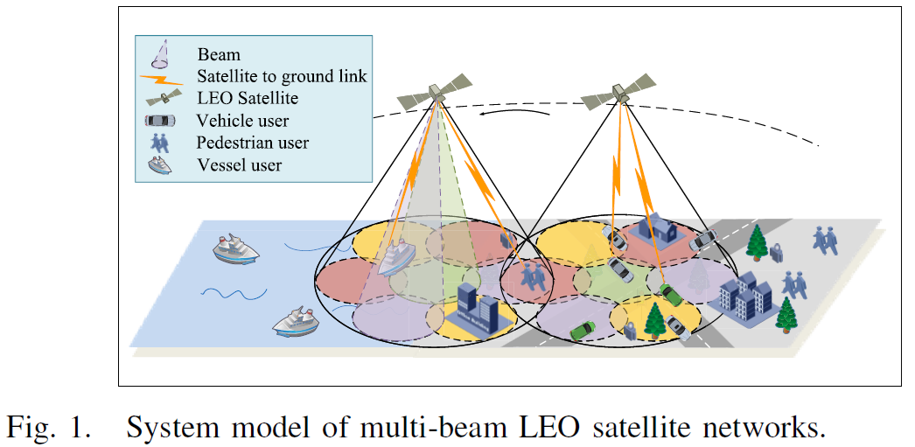
Multi-Beam Coverage
Each satellite radiates several beams at once, users of different kinds share the same ground coverage:
Y. Sun et al., “Handover for Multi-Beam LEO Satellite Networks: A Multi-Objective Reinforcement Learning Method,” IEEE Communications Letters, Dec. 2024.

Slide 3
Chain Overview
A single causal chain runs from beam geometry to a learned handover policy:
Beam geometry
position in beam
Signal quality
SINR
Service rate
throughput
Three objectives
combined reward
Learned policy
MODQN
Continuous satellite motion changes which beam best serves a user, making the next beam a recurring decision.
Signal strength alone ignores current beam load and switching cost, and is therefore a poor criterion on its own.
The handover decision is evaluated against three simultaneous objectives, learned by a neural network.
System power inside the reward box is treated as a given quantity until its own dedicated derivation.

Slide 4
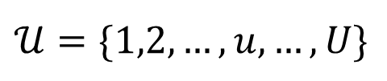
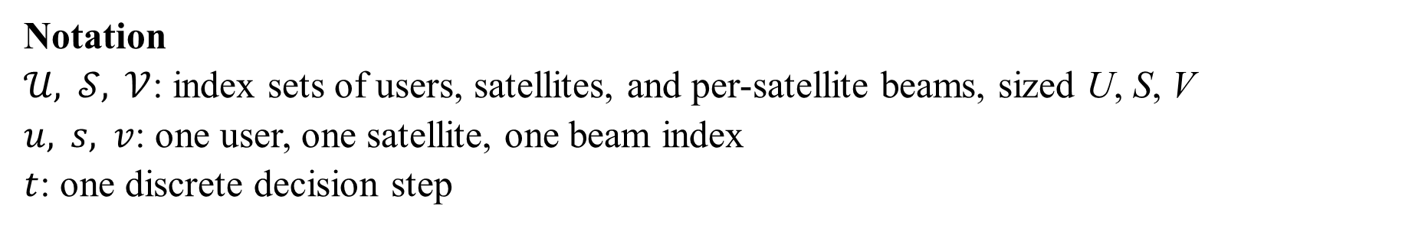
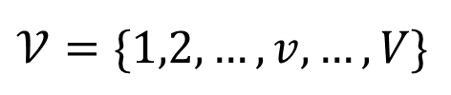
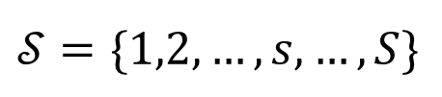
System Indices
Time is discretized into steps, at every step the network assigns each user one service beam:
$$𝒰=\{1,2,…,u,…,U\}$$
$$𝒮=\{1,2,…,s,…,S\}$$
$$𝒱=\{1,2,…,v,…,V\}$$
A physical beam is always the pair $(s,v)$, the beam index is reused on every satellite.
Notation
$𝒰, 𝒮, 𝒱$: index sets of users, satellites, and per-satellite beams, sized U, S, V
$u, s, v$: one user, one satellite, one beam index
$t$: one discrete decision step

Slide 5
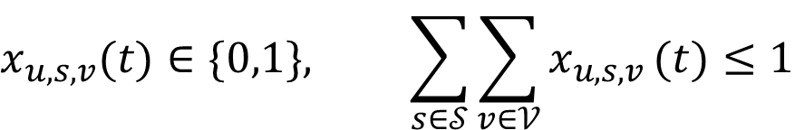
Realized Connection
The realized connection records what the network actually delivered at each step, one binary value per candidate link:
$$x_{u,s,v}(t)∈\{0,1\}, \sum_{s∈𝒮}^{​}{\sum_{v∈𝒱}^{​}{x_{u,s,v}}}(t)≤1$$
$x=1$: the network connects user $u$ to beam $(s,v)$ at step $t$.
Sum at most 1: a user connects to at most one beam in each step.
$x=0$: the user is not served at that step.
Notation
$x_{u,s,v}(t)$: indicator that user u is served by beam (s, v) at step t
Y. Sun et al., “Handover for Multi-Beam LEO Satellite Networks: A Multi-Objective Reinforcement Learning Method,” IEEE Communications Letters, Dec. 2024.

Slide 6
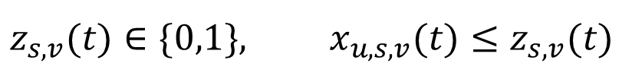
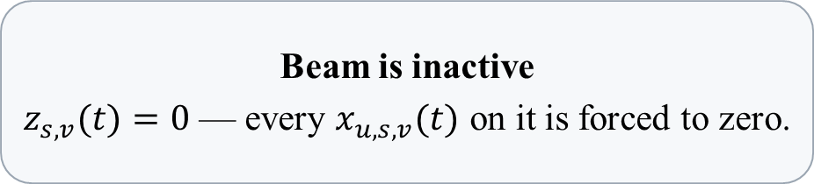
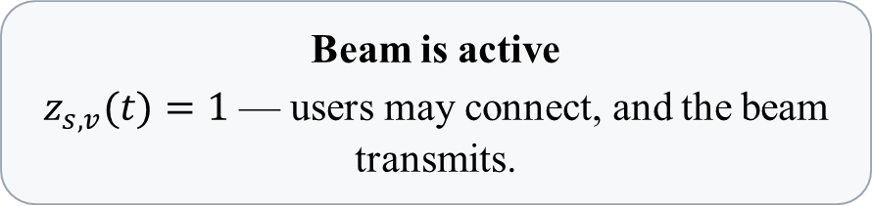
Beam Activation
A user can connect only to an active beam:
$$z_{s,v}(t)∈\{0,1\}, x_{u,s,v}(t)≤z_{s,v}(t)$$
Beam is active
$z_{s,v}(t)=1$ — users may connect, and the beam transmits.
Beam is inactive
$z_{s,v}(t)=0$ — every $x_{u,s,v}(t)$ on it is forced to zero.
The inequality goes only one way: a user cannot connect to an inactive beam. The next slide defines the load and derived activation.
Notation
$z_{s,v}(t)$: indicator that beam (s, v) is active at step t

Slide 7
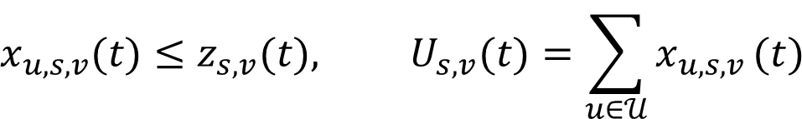
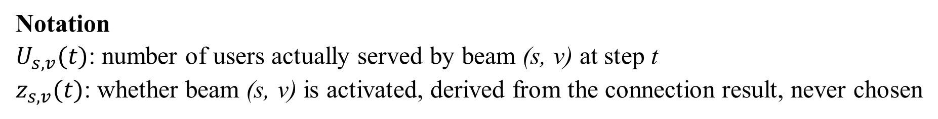
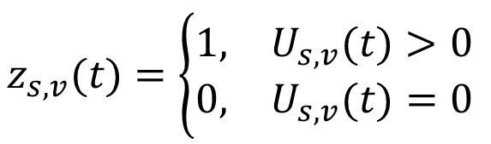
Beam Activation and Load
A realized connection is legal only on an active beam, the beam's realized load determines whether it is active:
$$x_{u,s,v}(t)≤z_{s,v}(t), U_{s,v}(t)=\sum_{u∈𝒰}^{​}{x_{u,s,v}}(t)$$
$$z_{s,v}(t)=\left\{\begin{matrix}1, & U_{s,v}(t)>0 \\ 0, & U_{s,v}(t)=0\end{matrix}\right.$$
An empty beam draws no power and creates no interference.
Notation
$U_{s,v}(t)$: number of users actually served by beam (s, v) at step t
$z_{s,v}(t)$: whether beam (s, v) is activated, derived from the connection result, never chosen

Slide 8
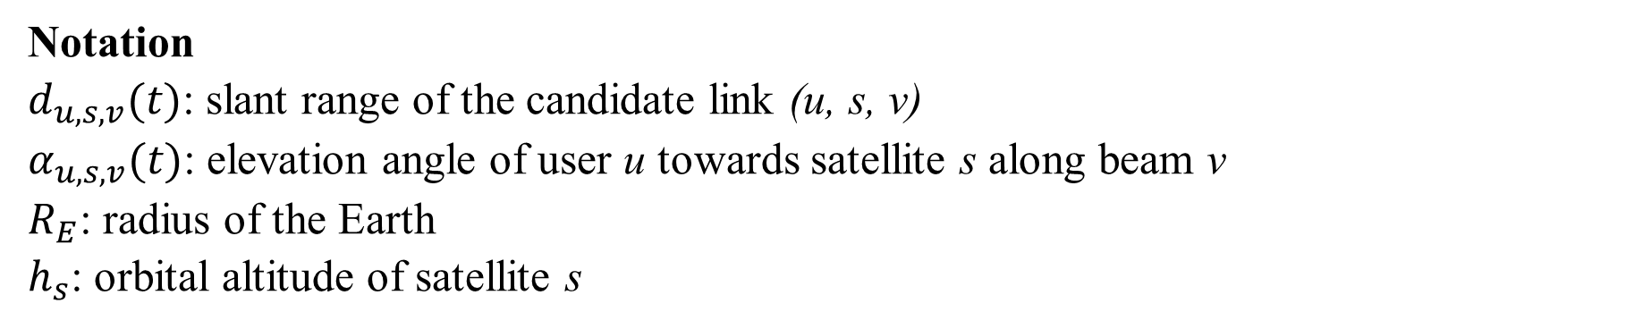
Slant Range
Curved-Earth geometry fixes how far the signal travels from satellite to user:
$$d_{u,s,v}(t)=\sqrt{R_{E}^{2}{\text{sin}}^{2}α_{u,s,v}(t)+h_{s}^{2}+2R_{E}h_{s}}−R_{E}\text{sin}α_{u,s,v}(t)$$
High elevation: satellite nearly overhead, short path, little atmosphere. Low elevation: long slanted path through more of it.
Beam index $v$ is carried only for consistency, beams on one satellite share the same slant range.
Notation
$d_{u,s,v}(t)$: slant range of the candidate link (u, s, v)
$α_{u,s,v}(t)$: elevation angle of user u towards satellite s along beam v
$R_{E}$: radius of the Earth
$h_{s}$: orbital altitude of satellite s
3GPP et al., “Study on New Radio (NR) to Support Non-Terrestrial Networks (NTN),” 3GPP Technical Report TR 38.811, V15.4.0, 2020.

Slide 9
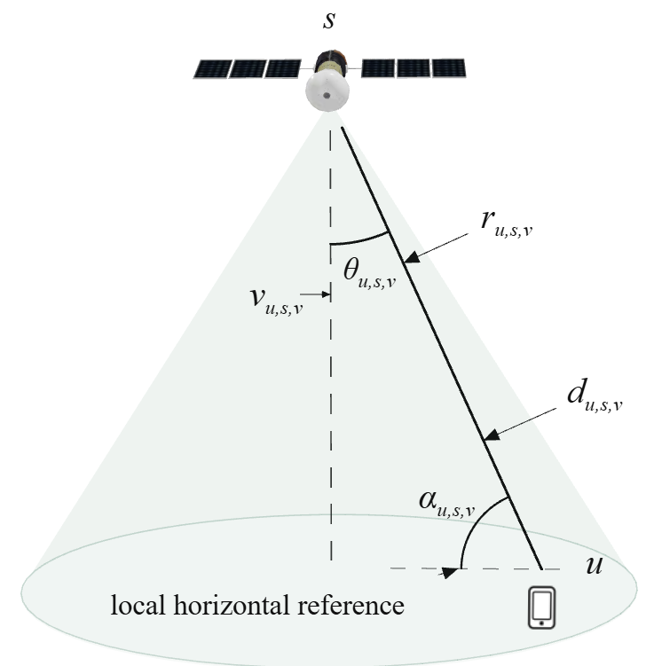
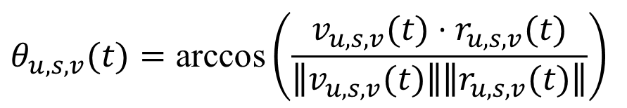
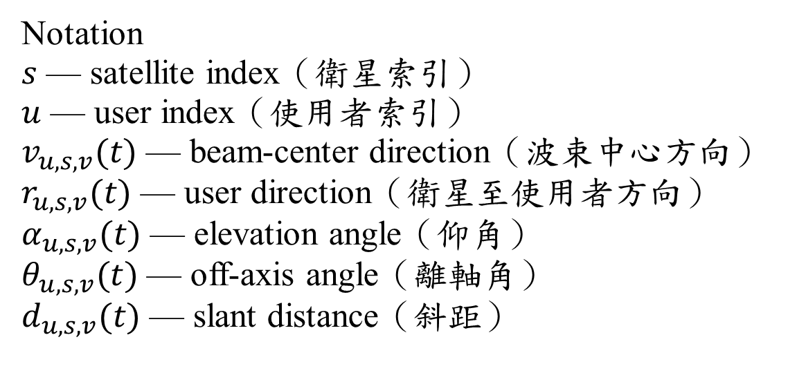
Off-Axis Angle
Off-axis angle compares the user direction with beam center, elevation uses the local horizontal.
$$θ_{u,s,v}(t)=\text{arccos}​\left(\frac{v_{u,s,v}(t)⋅r_{u,s,v}(t)}{∥v_{u,s,v}(t)∥∥r_{u,s,v}(t)∥}\right)$$
Notation
$s$ — satellite index（衛星索引）
$u$ — user index（使用者索引）
$v_{u,s,v}(t)$ — beam-center direction（波束中心方向）
$r_{u,s,v}(t)$ — user direction（衛星至使用者方向）
$α_{u,s,v}(t)$ — elevation angle（仰角）
$θ_{u,s,v}(t)$ — off-axis angle（離軸角）
$d_{u,s,v}(t)$ — slant distance（斜距）

Slide 10
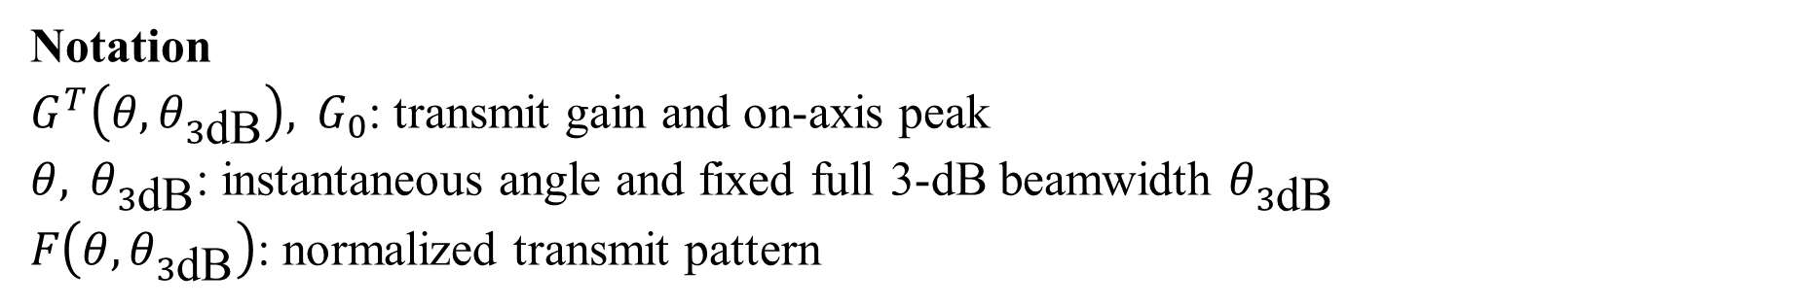
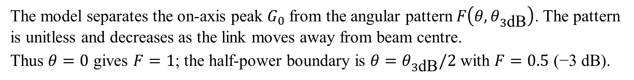
Angle-Dependent Transmit Gain
$θ$ is the user's instantaneous off-axis angle; $θ_{3\text{dB}}$ is the fixed full beamwidth from the antenna specification. The model uses $θ_{3\text{dB}}/2$ as the centre-to-edge half-angle.
$$G^{T}​\left(θ,θ_{3\text{dB}}\right)=G_{0}F​\left(θ,θ_{3\text{dB}}\right), G^{T}​\left(0,θ_{3\text{dB}}\right)=G_{0}$$
The model separates the on-axis peak $G_{0}$ from the angular pattern $F​\left(θ,θ_{3\text{dB}}\right)$. The pattern is unitless and decreases as the link moves away from beam centre.
Thus $θ=0$ gives $F=1$; the half-power boundary is $θ=θ_{3\text{dB}}/2$ with $F=0.5$ (−3 dB).
Notation
$G^{T}​\left(θ,θ_{3\text{dB}}\right), G_{0}$: transmit gain and on-axis peak
$θ, θ_{3\text{dB}}$: instantaneous angle and fixed full 3-dB beamwidth $θ_{3\text{dB}}$
$F​\left(θ,θ_{3\text{dB}}\right)$: normalized transmit pattern
S.-H. Chen et al., “Energy-Efficient Joint Handover and Beam Switching Scheme for Multi-LEO Networks,” IEEE Vehicular Technology Conference (VTC2024-Spring), Singapore, 2024.

Slide 11
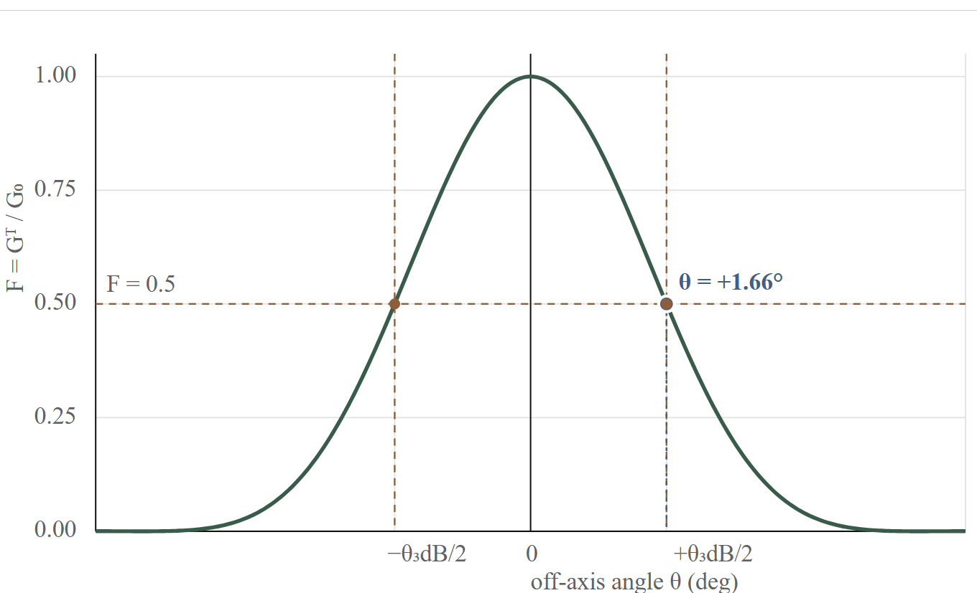
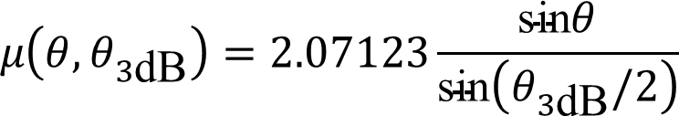
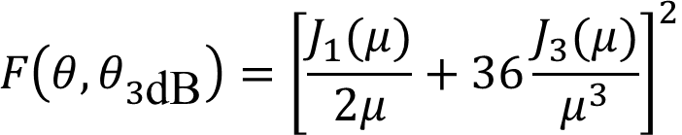
How F and $θ_{3\text{dB}}$ Shape the Beam
The curve is the normalized power pattern F: the centre is 1, and the fixed $θ_{3\text{dB}}$ width marks where the pattern reaches 0.5 (−3 dB).
$$F​\left(θ,θ_{3\text{dB}}\right)={\left[\frac{J_{1}(μ)}{2μ}+36\frac{J_{3}(μ)}{μ^{3}}\right]}^{2}$$
$$μ​\left(θ,θ_{3\text{dB}}\right)=2.07123\frac{\text{sin}θ}{\text{sin}​\left(θ_{3\text{dB}}/2\right)}$$
S.-H. Chen et al., “Energy-Efficient Joint Handover and Beam Switching Scheme for Multi-LEO Networks,” IEEE Vehicular Technology Conference (VTC2024-Spring), Singapore, 2024.

Slide 12

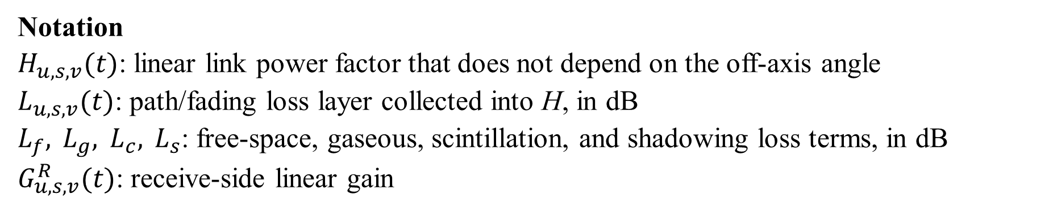
Non-Angle Channel Factor
Every link property independent of the off-axis angle is collected into one linear power factor $H_{u,s,v}(t)$, the wanted link then carries exactly two gain factors:
$$H_{u,s,v}(t) G^{T}​\left(θ_{u,s,v},θ_{3\text{dB}}\right)$$
$$H_{u,s,v}(t)={10}^{−\frac{L_{u,s,v}(t)}{10}}G_{u,s,v}^{R}(t), L_{u,s,v}(t)=L_{f}+L_{g}+L_{c}+L_{s}$$
Notation
$H_{u,s,v}(t)$: linear link power factor that does not depend on the off-axis angle
$L_{u,s,v}(t)$: path/fading loss layer collected into H, in dB
$L_{f}, L_{g}, L_{c}, L_{s}$: free-space, gaseous, scintillation, and shadowing loss terms, in dB
$G_{u,s,v}^{R}(t)$: receive-side linear gain
S.-H. Chen et al., “Energy-Efficient Joint Handover and Beam Switching Scheme for Multi-LEO Networks,” IEEE Vehicular Technology Conference (VTC2024-Spring), Singapore, 2024.

Slide 13
Link Transmit Power
$p_{u,s,v}​\left(t,θ_{u,s,v},θ_{3\text{dB}}\right)$ denotes the radio-frequency power the satellite radiates on a link, the last ingredient of signal quality.
It is the RF power of one served link, not the satellite's total electrical power.
It enters the wanted-signal numerator of SINR;
Notation
$p_{u,s,v}​\left(t,θ_{u,s,v},θ_{3\text{dB}}\right)$: radio-frequency power radiated on link (u, s, v) at step t

Slide 14
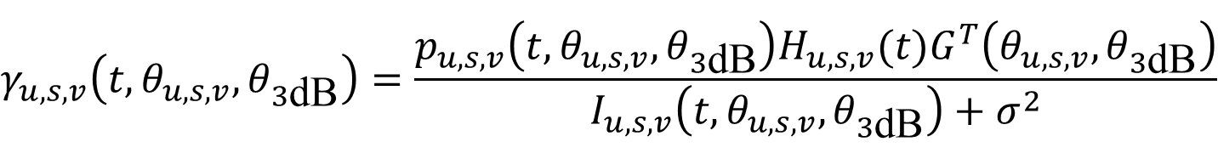
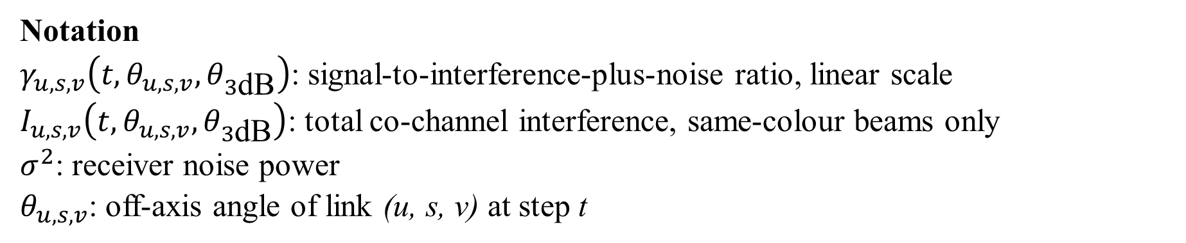
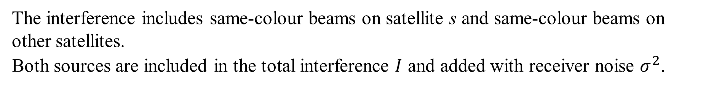
Link SINR
Signal quality is wanted power divided by everything competing with it:
$$γ_{u,s,v}​\left(t,θ_{u,s,v},θ_{3\text{dB}}\right)=\frac{p_{u,s,v}​\left(t,θ_{u,s,v},θ_{3\text{dB}}\right)H_{u,s,v}(t)G^{T}​\left(θ_{u,s,v},θ_{3\text{dB}}\right)}{I_{u,s,v}​\left(t,θ_{u,s,v},θ_{3\text{dB}}\right)+σ^{2}}$$
The interference includes same-colour beams on satellite s and same-colour beams on other satellites.
Both sources are included in the total interference $I$ and added with receiver noise $σ^{2}$.
Notation
$γ_{u,s,v}​\left(t,θ_{u,s,v},θ_{3\text{dB}}\right)$: signal-to-interference-plus-noise ratio, linear scale
$I_{u,s,v}​\left(t,θ_{u,s,v},θ_{3\text{dB}}\right)$: total co-channel interference, same-colour beams only
$σ^{2}$: receiver noise power
$θ_{u,s,v}$: off-axis angle of link (u, s, v) at step t
S.-H. Chen et al., “Energy-Efficient Joint Handover and Beam Switching Scheme for Multi-LEO Networks,” IEEE Vehicular Technology Conference (VTC2024-Spring), Singapore, 2024.

Slide 15
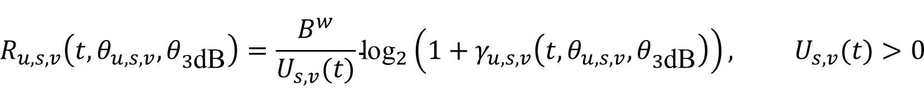
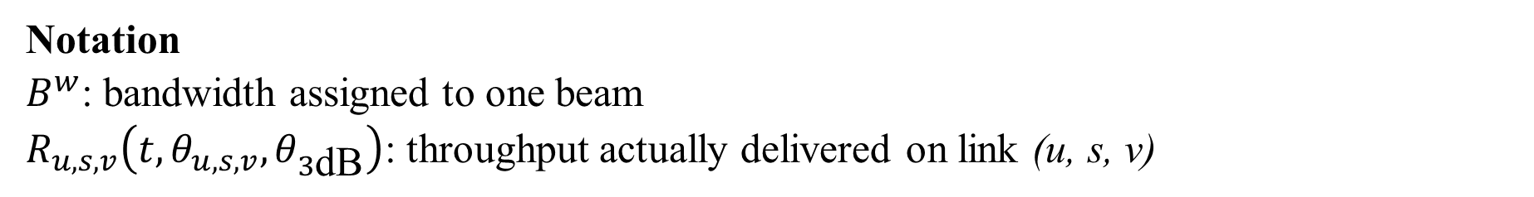
Link Throughput
Users on one beam share its bandwidth by taking turns, the rate a user receives is a fraction of the beam's capacity:
$$R_{u,s,v}​\left(t,θ_{u,s,v},θ_{3\text{dB}}\right)=\frac{B^{w}}{U_{s,v}(t)}{\text{log}}_{2}​\left(1+γ_{u,s,v}​\left(t,θ_{u,s,v},θ_{3\text{dB}}\right)\right), U_{s,v}(t)>0$$
Sharing the beam
$B^{w}/U_{s,v}(t)$ is the share each served user gets.
Turning quality into bits
is the Shannon capacity per hertz, at this signal quality.
Notation
$B^{w}$: bandwidth assigned to one beam
$R_{u,s,v}​\left(t,θ_{u,s,v},θ_{3\text{dB}}\right)$: throughput actually delivered on link (u, s, v)
Y. Sun et al., “Handover for Multi-Beam LEO Satellite Networks: A Multi-Objective Reinforcement Learning Method,” IEEE Communications Letters, Dec. 2024.

Slide 16
Limits of a Single Objective
Optimizing any single objective in isolation produces a distinct failure:
Signal strength alone
collapses per-user rate on the busiest beam
Fewer handovers alone
leaves users on a beam moving out of range
Even load alone
spreads users onto beams that serve them badly
A joint criterion is needed: delivered service, switching cost, and traffic balance evaluated together.
P1, P2, P3: the three baseline objectives; P1 includes an angle-aware energy-efficiency contribution.

Slide 17
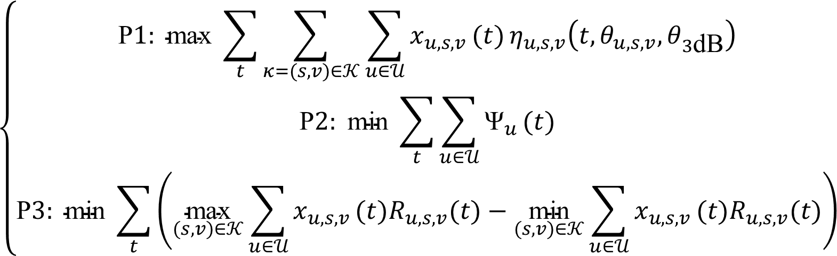
Joint Optimization Problem: P1–P3
Across the whole run, the network optimizes the three original objectives together. The brace keeps the public MODQN objective contract visible, with P1 written here at first-order expansion:
$$\left\{\begin{matrix}\text{P}1: \text{max} \sum_{t}^{​}{\sum_{κ=(s,v)∈𝒦}^{​}{\sum_{u∈𝒰}^{​}{x_{u,s,v}}}}(t) η_{u,s,v}​\left(t,θ_{u,s,v},θ_{3\text{dB}}\right) \\ \text{P}2: \text{min} \sum_{t}^{​}{\sum_{u∈𝒰}^{​}{{\text{Ψ}}_{u}}}(t) \\ \text{P}3: \text{min} \sum_{t}^{​}{\left(\underset{(s,v)∈𝒦}{\text{max}}\sum_{u∈𝒰}^{​}{x_{u,s,v}}(t)R_{u,s,v}(t)−\underset{(s,v)∈𝒦}{\text{min}}\sum_{u∈𝒰}^{​}{x_{u,s,v}}(t)R_{u,s,v}(t)\right)}\end{matrix}\right.$$
P1 maximizes delivered data per unit energy, P2 minimizes switching cost, and P3 minimizes squared beam occupancy.
Y. Sun et al., “Handover for Multi-Beam LEO Satellite Networks: A Multi-Objective Reinforcement Learning Method,” IEEE Communications Letters, Dec. 2024.

Slide 18
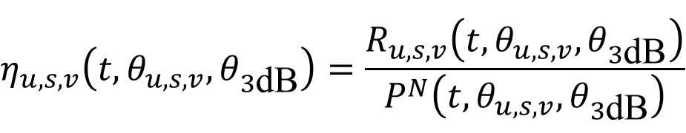
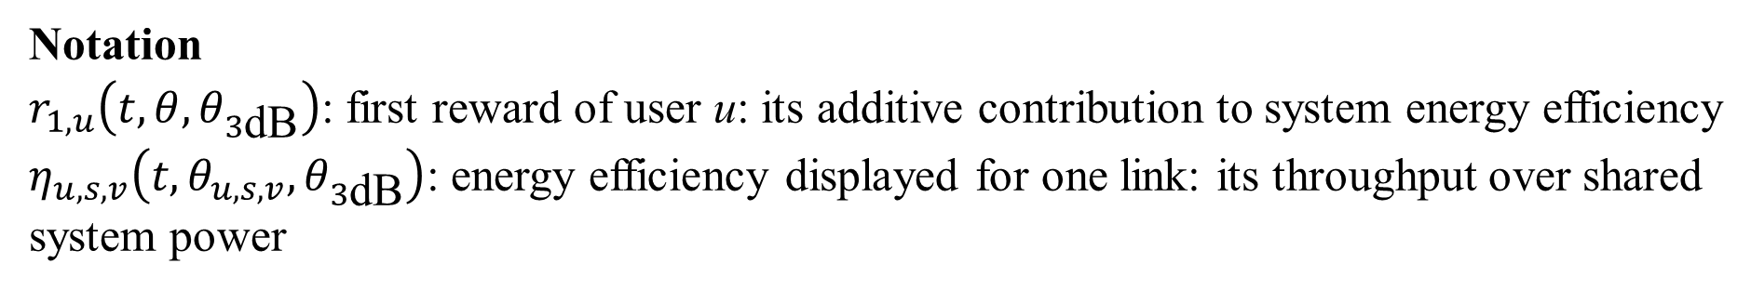
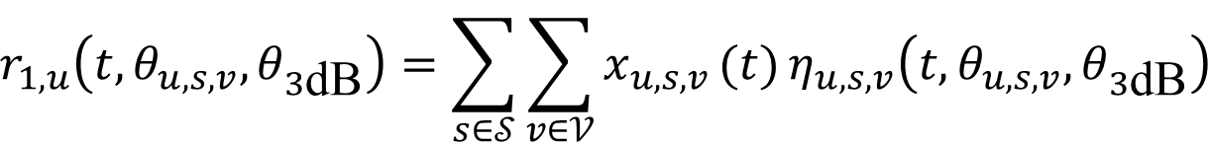
P1: Expand the Angle-Aware First Reward
The P1 inner sum first evaluates link energy efficiency, then selects the serving link:
$$η_{u,s,v}​\left(t,θ_{u,s,v},θ_{3\text{dB}}\right)=\frac{R_{u,s,v}​\left(t,θ_{u,s,v},θ_{3\text{dB}}\right)}{P^{N}​\left(t,θ_{u,s,v},θ_{3\text{dB}}\right)}$$
$$r_{1,u}​\left(t,θ_{u,s,v},θ_{3\text{dB}}\right)=\sum_{s∈𝒮}^{​}{\sum_{v∈𝒱}^{​}{x_{u,s,v}}}(t) η_{u,s,v}​\left(t,θ_{u,s,v},θ_{3\text{dB}}\right)$$
Notation
$r_{1,u}​\left(t,θ,θ_{3\text{dB}}\right)$: first reward of user u: its additive contribution to system energy efficiency
$η_{u,s,v}​\left(t,θ_{u,s,v},θ_{3\text{dB}}\right)$: energy efficiency displayed for one link: its throughput over shared system power

Slide 19
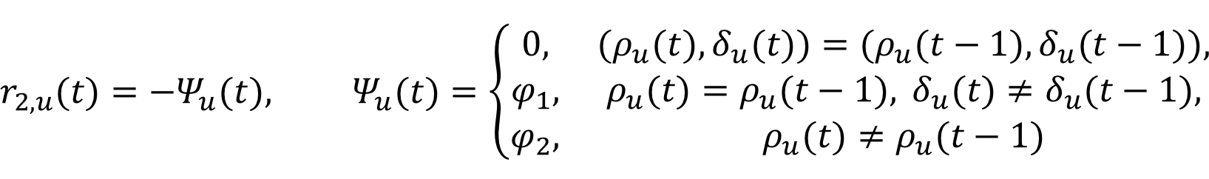
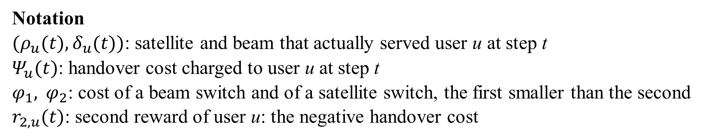
P2: Handover Cost
The beam actually serving a user is written $(ρ_{u}(t),δ_{u}(t))$, a switch is charged according to how far the user moved:
$$r_{2,u}(t)=−Ψ_{u}(t), Ψ_{u}(t)=\left\{\begin{matrix}0, & (ρ_{u}(t),δ_{u}(t))=(ρ_{u}(t−1),δ_{u}(t−1)), \\ φ_{1}, & ρ_{u}(t)=ρ_{u}(t−1), δ_{u}(t)≠δ_{u}(t−1), \\ φ_{2}, & ρ_{u}(t)≠ρ_{u}(t−1)\end{matrix}\right.$$
Notation
$(ρ_{u}(t),δ_{u}(t))$: satellite and beam that actually served user u at step t
$Ψ_{u}(t)$: handover cost charged to user u at step t
$φ_{1}, φ_{2}$: cost of a beam switch and of a satellite switch, the first smaller than the second
$r_{2,u}(t)$: second reward of user u: the negative handover cost
Y. Sun et al., “Handover for Multi-Beam LEO Satellite Networks: A Multi-Objective Reinforcement Learning Method,” IEEE Communications Letters, Dec. 2024.

Slide 20
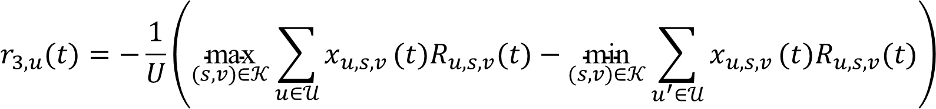
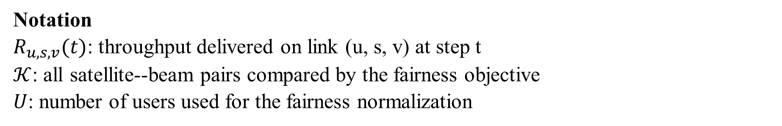
P3: Beam Throughput Fairness
At each step, add the throughput delivered by users on each beam, then compare the largest beam total with the smallest:
$$r_{3,u}(t)=−\frac{1}{U}\left(\underset{(s,v)∈𝒦}{\text{max}}\sum_{u∈𝒰}^{​}{x_{u,s,v}}(t)R_{u,s,v}(t)−\underset{(s,v)∈𝒦}{\text{min}}\sum_{u^{′}∈𝒰}^{​}{x_{u,s,v}}(t)R_{u,s,v}(t)\right)$$
The same normalized fairness penalty is returned to each user agent; a larger beam-throughput gap produces a smaller third reward.
Notation
$R_{u,s,v}(t)$: throughput delivered on link (u, s, v) at step t
$𝒦$: all satellite--beam pairs compared by the fairness objective
$U$: number of users used for the fairness normalization
Y. Sun et al., “Handover for Multi-Beam LEO Satellite Networks: A Multi-Objective Reinforcement Learning Method,” IEEE Communications Letters, Dec. 2024.
20

Slide 21
The Reward Vector
The environment returns three separate numbers per decision, not one score:
$${\vec{R}}_{u}​\left(t,θ_{u,s,v},θ_{3\text{dB}}\right)=\left[r_{1,u}​\left(t,θ_{u,s,v},θ_{3\text{dB}}\right), r_{2,u}(t), r_{3,u}(t)\right]$$
Energy efficiency
bit per joule
Handover cost
cost units
Load balance
baseline objective
MODQN keeps the three rewards separate during learning. Each objective has its own Q-value, and the preference weights are applied only when the action is selected.
Y. Sun et al., “Handover for Multi-Beam LEO Satellite Networks: A Multi-Objective Reinforcement Learning Method,” IEEE Communications Letters, Dec. 2024.

Slide 22
Markov Decision Process Formulation
The environment returns three objective values rather than one scalar score, so the problem is formulated as a multi-objective Markov decision process:
State: what the user knows before choosing.
Action: the action selected from the baseline action space.
Reward: the three numbers the environment returns.
Transition: how satellites, beams, and loads evolve to the next step.
Discount factor: how much a future reward counts relative to an immediate one.
Each objective keeps its own value estimate; the weighted action choice is the point where the three objectives are compared.

Slide 23
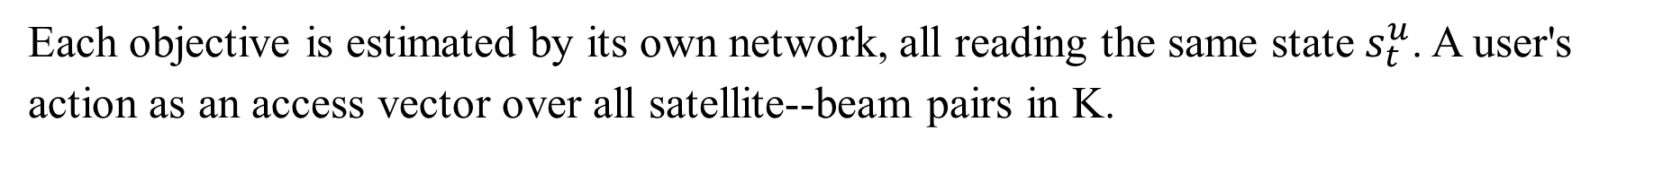
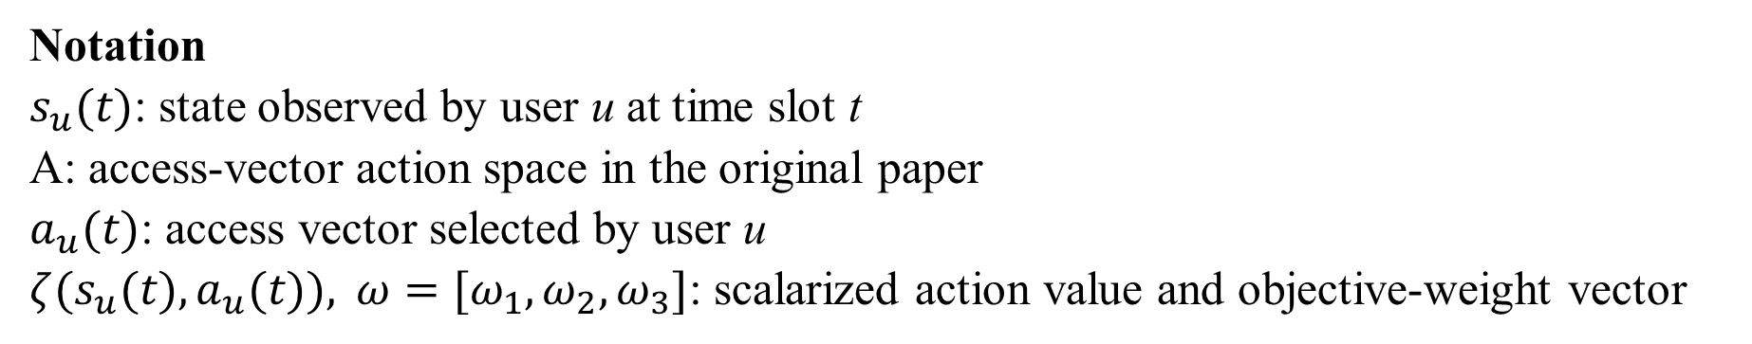
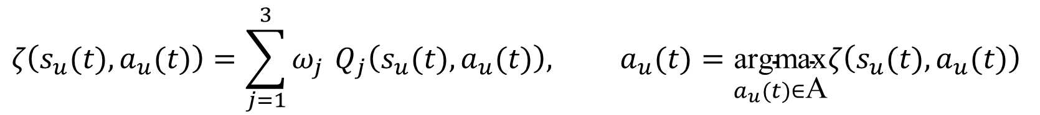
MODQN: Three Networks, One Action
Each objective is estimated by its own network, all reading the same state $s_{t}^{u}$. A user's action as an access vector over all satellite--beam pairs in $\text{K}$.
$$ζ​\left(s_{u}(t),a_{u}(t)\right)=\sum_{j=1}^{3}{ω_{j}} Q_{j}​\left(s_{u}(t),a_{u}(t)\right), a_{u}(t)=\underset{a_{u}(t)∈\text{A}}{\text{argmax}}ζ​\left(s_{u}(t),a_{u}(t)\right)$$
Each objective keeps its own value estimate, the weights combine them at decision time.
Notation
$s_{u}(t)$: state observed by user u at time slot t
$\text{A}$: access-vector action space in the original paper
$a_{u}(t)$: access vector selected by user u
$ζ(s_{u}(t),a_{u}(t)), ω=[ω_{1},ω_{2},ω_{3}]$: scalarized action value and objective-weight vector
Y. Sun et al., “Handover for Multi-Beam LEO Satellite Networks: A Multi-Objective Reinforcement Learning Method,” IEEE Communications Letters, Dec. 2024.
24

Slide 24
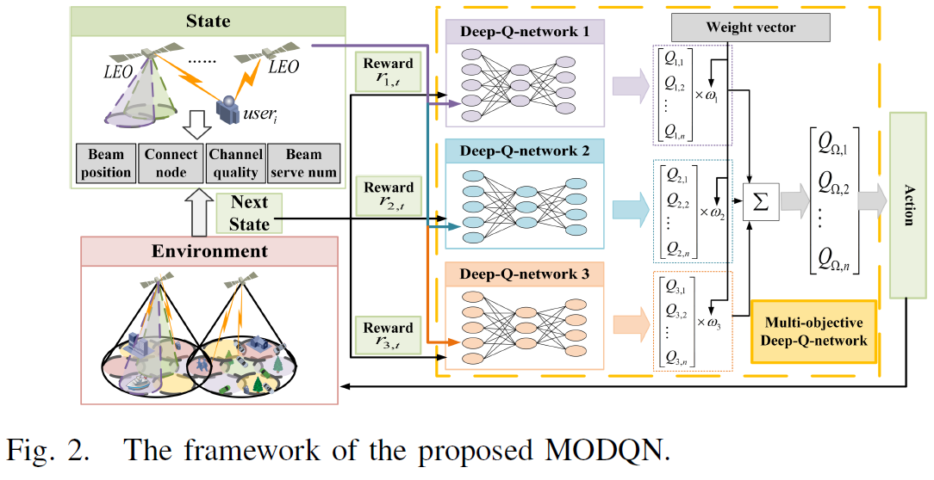
MODQN Architecture
State and environment feed three Q-networks into one weighted action:
The three networks share one state, meeting only at the weighted action choice.
Y. Sun et al., “Handover for Multi-Beam LEO Satellite Networks: A Multi-Objective Reinforcement Learning Method,” IEEE Communications Letters, Dec. 2024.

Slide 25
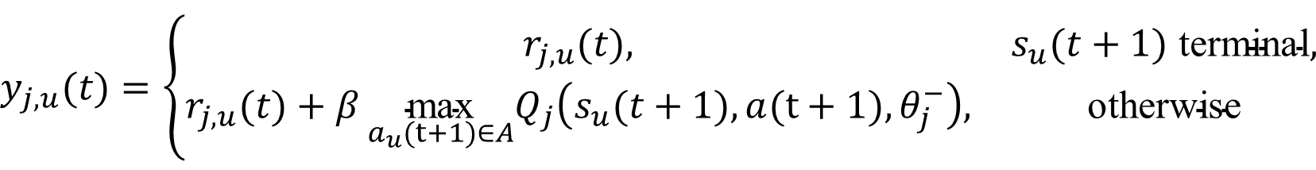
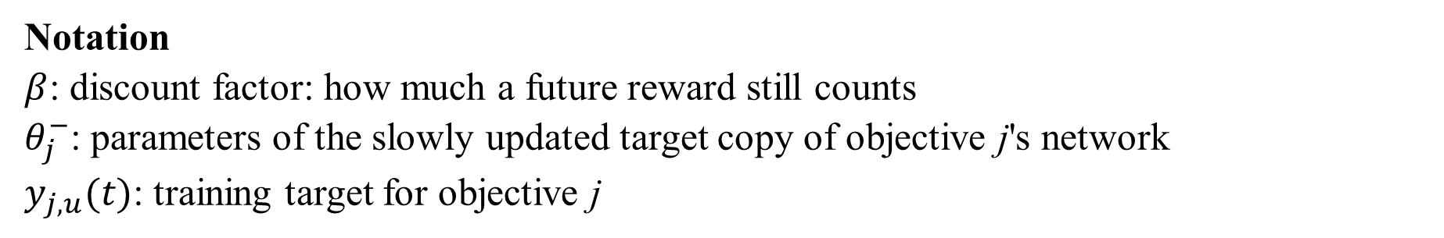
Temporal-Difference Target
Each network trains toward a target built from the reward just received plus the expected future value:
$$y_{j,u}(t)=\left\{\begin{matrix}r_{j,u}(t), & s_{u}(t+1) \text{terminal}, \\ r_{j,u}(t)+β \underset{a_{u}(t+1)∈A}{\text{max}}Q_{j}​\left(s_{u}(t+1),a(t+1),θ_{j}^{−}\right), & \text{otherwise}\end{matrix}\right.$$
Each objective maximises over its own target network, the three heads never share one next action.
Notation
$β$: discount factor: how much a future reward still counts
$θ_{j}^{−}$: parameters of the slowly updated target copy of objective j's network
$y_{j,u}(t)$: training target for objective j
Y. Sun et al., “Handover for Multi-Beam LEO Satellite Networks: A Multi-Objective Reinforcement Learning Method,” IEEE Communications Letters, Dec. 2024.

Slide 26
Training Procedure
Every training step follows the same cycle:
Build the state
current user state
Select an action
weighted values
Environment responds
next state and rewards
Store the transition
replay buffer
Sample a mini-batch
from the buffer
Build the targets
reward plus discounted value
Update the networks
one per objective
Refresh the target copies
every fixed period
The training data is produced by the agent's own choices, the experience distribution shifts as the policy improves. The buffer breaks the correlation between consecutive steps and lets one experience be reused many times.
Y. Sun et al., “Handover for Multi-Beam LEO Satellite Networks: A Multi-Objective Reinforcement Learning Method,” IEEE Communications Letters, Dec. 2024.

Slide 27
Chain Summary
One chain, from beam geometry to the learned policy:
Off-axis angle
geometry
Transmit gain
antenna
Signal quality
SINR
Service rate
throughput
Three rewards
learned policy
Environment evaluates
Each satellite–beam action is judged by energy efficiency, handover cost, and beam-throughput fairness.
MODQN learns
It keeps one Q-function per objective and combines their values only when selecting a single action.

