Slide 1

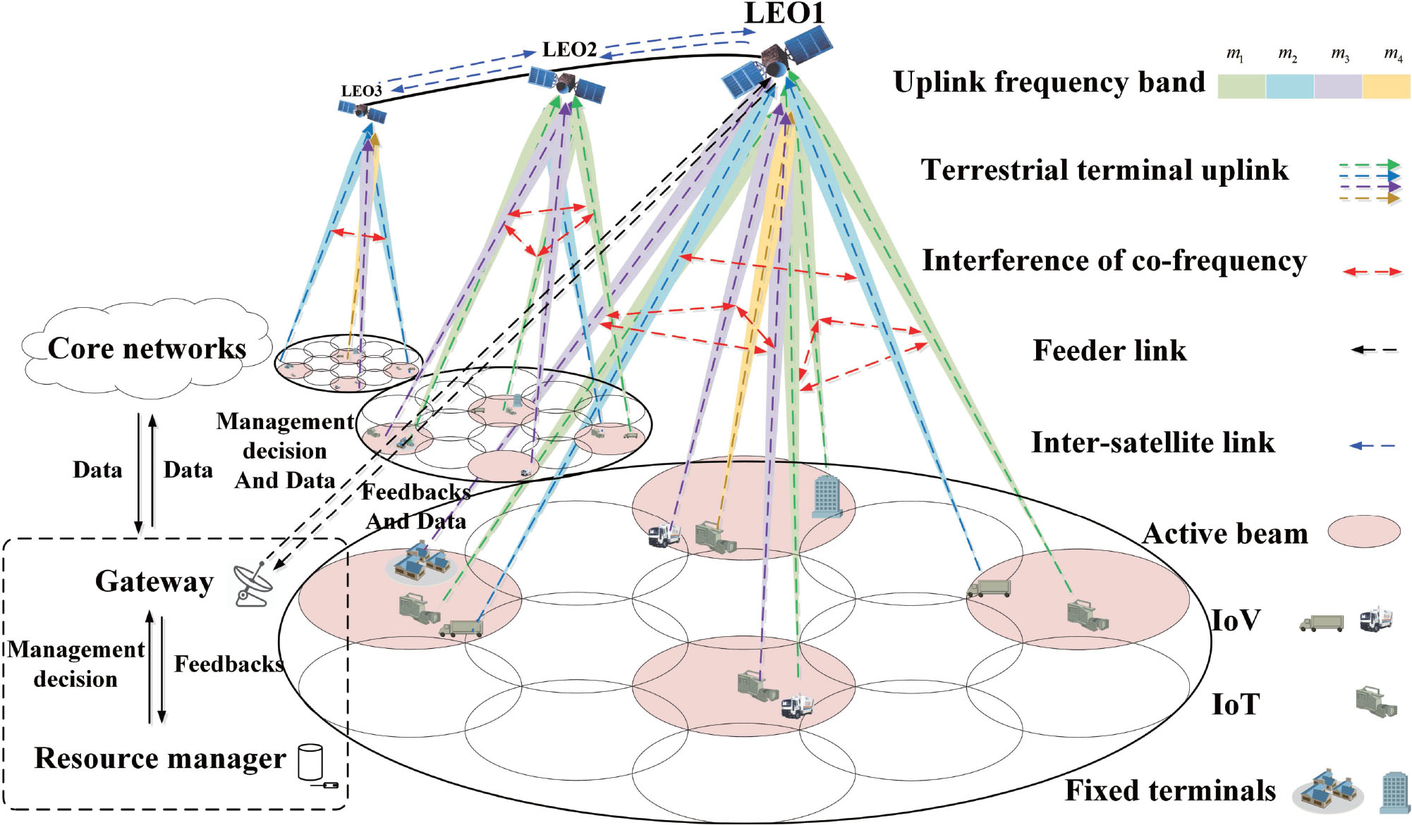
Chapter 5: Energy-Efficient and Power-Aware Handover Mechanisms
陳裕賢 特聘教授
國立臺北大學資訊工程系

Slide 2
From Off-Axis Angle to Two Branches
The off-axis angle changes the transmit gain. That change feeds the link-rate numerator and the system-power denominator:
Off-axis angle
geometry
Transmit gain
pattern
Transmit power
segment rule
Rate branch — numerator
signal quality, then throughput
Power branch — denominator
supply power, then system power
Energy efficiency
S.-H. Chen et al., “Energy-Efficient Joint Handover and Beam Switching Scheme for Multi-LEO Networks,” IEEE Vehicular Technology Conference (VTC2024-Spring), Singapore, 2024.
2

Slide 3
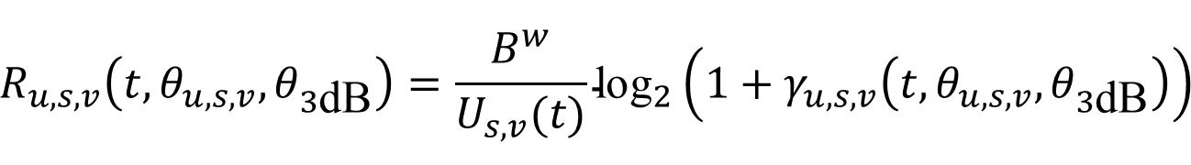
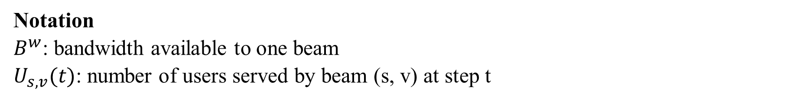
Power in the Delivered Rate
SINR becomes delivered rate through the same rate expression:
$$R_{u,s,v}​\left(t,θ_{u,s,v},θ_{3\text{dB}}\right)=\frac{B^{w}}{U_{s,v}(t)}{\text{log}}_{2}​\left(1+γ_{u,s,v}​\left(t,θ_{u,s,v},θ_{3\text{dB}}\right)\right)$$
The angle-aware extension changes the power term, the rate branch still divides one beam's bandwidth among its served users.
Notation
$B^{w}$: bandwidth available to one beam
$U_{s,v}(t)$: number of users served by beam (s, v) at step t
Y. Sun et al., “Handover for Multi-Beam LEO Satellite Networks: A Multi-Objective Reinforcement Learning Method,” IEEE Communications Letters, Dec. 2024.
3

Slide 4
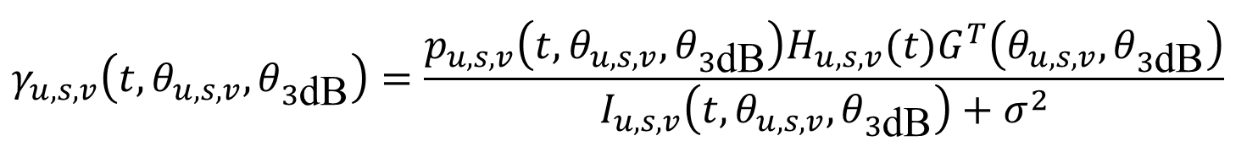
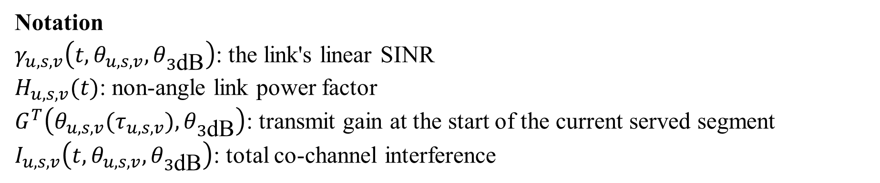
Power in the Link SINR
The rate above is controlled by SINR. Its numerator contains the angle-aware link power:
$$γ_{u,s,v}​\left(t,θ_{u,s,v},θ_{3\text{dB}}\right)=\frac{p_{u,s,v}​\left(t,θ_{u,s,v},θ_{3\text{dB}}\right)H_{u,s,v}(t)G^{T}​\left(θ_{u,s,v},θ_{3\text{dB}}\right)}{I_{u,s,v}​\left(t,θ_{u,s,v},θ_{3\text{dB}}\right)+σ^{2}}$$
The off-axis angle changes $G^{T}​\left(θ_{u,s,v},θ_{3\text{dB}}\right)$ and link power, both affect the desired-signal term in SINR.
Notation
$γ_{u,s,v}​\left(t,θ_{u,s,v},θ_{3\text{dB}}\right)$: the link's linear SINR
$H_{u,s,v}(t)$: non-angle link power factor
$G^{T}​\left(θ_{u,s,v}(τ_{u,s,v}),θ_{3\text{dB}}\right)$: transmit gain at the start of the current served segment
$I_{u,s,v}​\left(t,θ_{u,s,v},θ_{3\text{dB}}\right)$: total co-channel interference
S.-H. Chen et al., “Energy-Efficient Joint Handover and Beam Switching Scheme for Multi-LEO Networks,” IEEE Vehicular Technology Conference (VTC2024-Spring), Singapore, 2024.
4

Slide 5
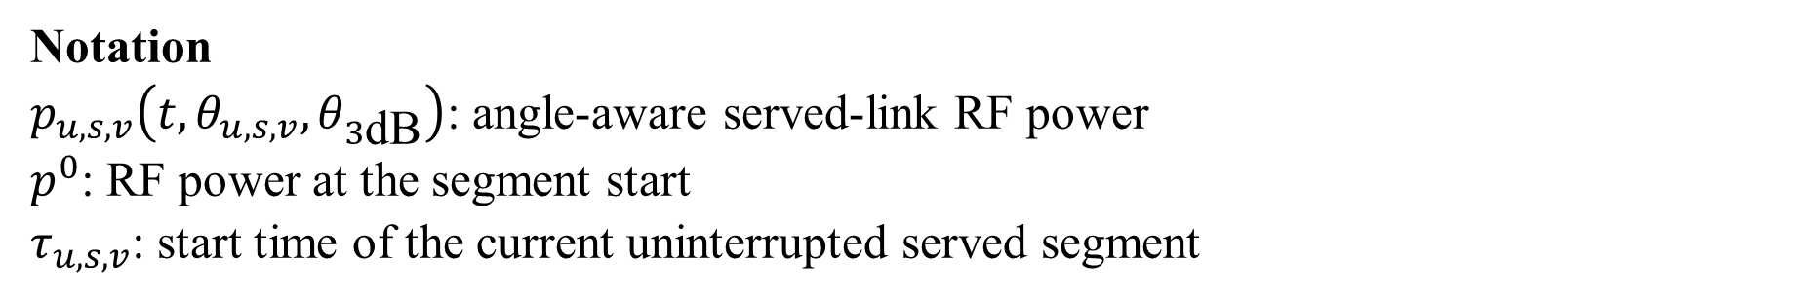
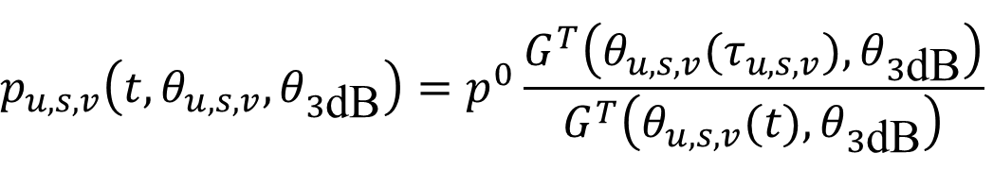
Angle-Aware Link Power
For an uninterrupted served segment, RF power is referenced to its starting value:
$$p_{u,s,v}​\left(t,θ_{u,s,v},θ_{3\text{dB}}\right)=p^{0}\frac{G^{T}​\left(θ_{u,s,v}(τ_{u,s,v}),θ_{3\text{dB}}\right)}{G^{T}​\left(θ_{u,s,v}(t),θ_{3\text{dB}}\right)}$$
When transmit gain falls, the model increases RF power to compensate. This raises the power cost, while SINR may still change.
Notation
$p_{u,s,v}​\left(t,θ_{u,s,v},θ_{3\text{dB}}\right)$: angle-aware served-link RF power
$p^{0}$: RF power at the segment start
$τ_{u,s,v}$: start time of the current uninterrupted served segment
5

Slide 6
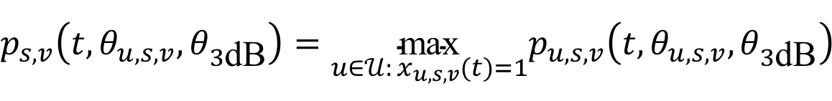
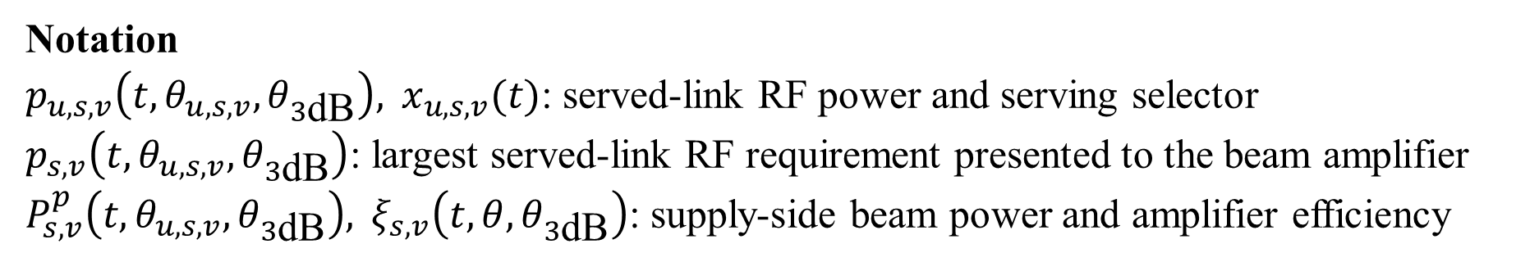
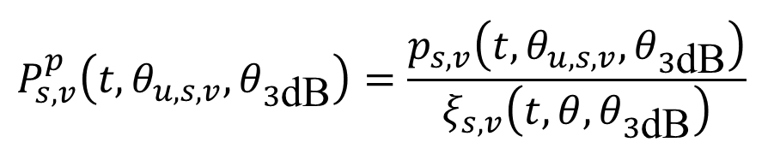
From Served Links to Beam Supply Power
One beam has one RF output, so its beam power is set by the largest served-link requirement at the current step:
$$p_{s,v}​\left(t,θ_{u,s,v},θ_{3\text{dB}}\right)=\underset{u∈𝒰: x_{u,s,v}(t)=1}{\text{max}}p_{u,s,v}​\left(t,θ_{u,s,v},θ_{3\text{dB}}\right)$$
Amplifier efficiency converts that RF output to supply power:
$$P_{s,v}^{p}​\left(t,θ_{u,s,v},θ_{3\text{dB}}\right)=\frac{p_{s,v}​\left(t,θ_{u,s,v},θ_{3\text{dB}}\right)}{ξ_{s,v}​\left(t,θ,θ_{3\text{dB}}\right)}$$
Notation
$p_{u,s,v}​\left(t,θ_{u,s,v},θ_{3\text{dB}}\right), x_{u,s,v}(t)$: served-link RF power and serving selector
$p_{s,v}​\left(t,θ_{u,s,v},θ_{3\text{dB}}\right)$: largest served-link RF requirement presented to the beam amplifier
$P_{s,v}^{p}​\left(t,θ_{u,s,v},θ_{3\text{dB}}\right), ξ_{s,v}​\left(t,θ,θ_{3\text{dB}}\right)$: supply-side beam power and amplifier efficiency
S.-H. Chen et al., “Energy-Efficient Joint Handover and Beam Switching Scheme for Multi-LEO Networks,” IEEE Vehicular Technology Conference (VTC2024-Spring), Singapore, 2024.
6

Slide 7
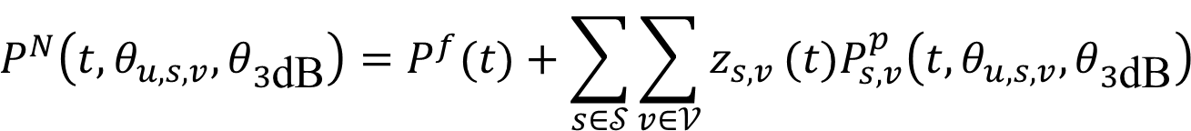
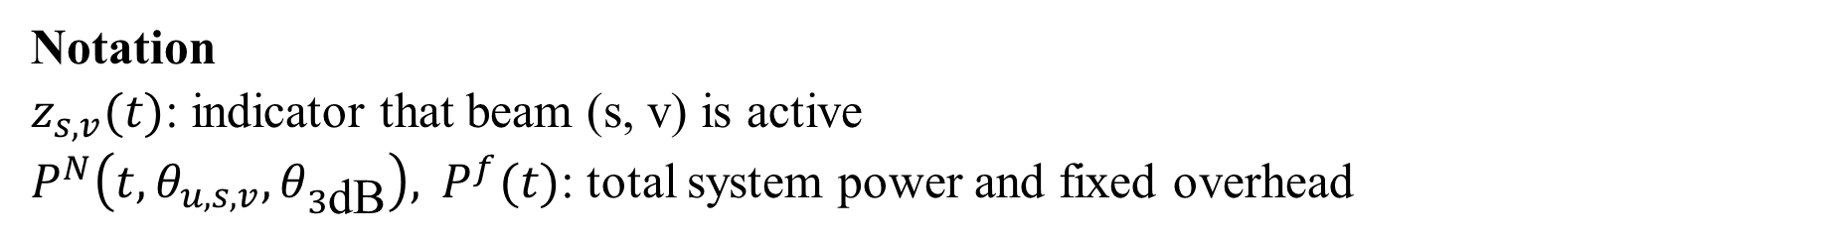
From Beam Supply Power to System Power
The denominator continues from $P_{s,v}^{p}$ to $P^{N}$.
Sum active beam supply powers and fixed overhead:
$$P^{N}​\left(t,θ_{u,s,v},θ_{3\text{dB}}\right)=P^{f}(t)+\sum_{s∈𝒮}^{​}{\sum_{v∈𝒱}^{​}{z_{s,v}}}(t)P_{s,v}^{p}​\left(t,θ_{u,s,v},θ_{3\text{dB}}\right)$$
This common system power is the denominator of the energy-efficiency reward.
Notation
$z_{s,v}(t)$: indicator that beam (s, v) is active
$P^{N}​\left(t,θ_{u,s,v},θ_{3\text{dB}}\right), P^{f}(t)$: total system power and fixed overhead
7

Slide 8
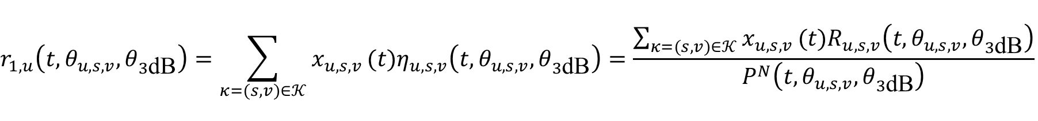
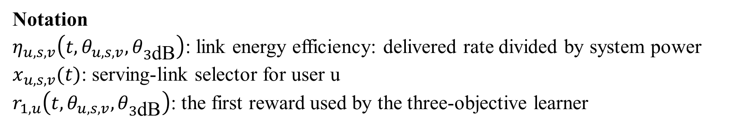
The First Reward from Selected Links
For each user, candidate satellite--beam pairs are collected in 𝒦=𝒮×𝒱; the serving-link selector keeps the link-level energy efficiency:
$$r_{1,u}​\left(t,θ_{u,s,v},θ_{3\text{dB}}\right)=\sum_{κ=(s,v)∈𝒦}^{​}{x_{u,s,v}}(t)η_{u,s,v}​\left(t,θ_{u,s,v},θ_{3\text{dB}}\right)=\frac{\sum_{κ=(s,v)∈𝒦}^{​}{x_{u,s,v}}(t)R_{u,s,v}​\left(t,θ_{u,s,v},θ_{3\text{dB}}\right)}{P^{N}​\left(t,θ_{u,s,v},θ_{3\text{dB}}\right)}$$
The second form uses $η=R/P^{N}$. The denominator $P^{N}​\left(t,θ_{u,s,v},θ_{3\text{dB}}\right)$ is common to all candidate links at the current step, so it can be factored outside the selector sum.
Notation
$η_{u,s,v}​\left(t,θ_{u,s,v},θ_{3\text{dB}}\right)$: link energy efficiency: delivered rate divided by system power
$x_{u,s,v}(t)$: serving-link selector for user u
$r_{1,u}​\left(t,θ_{u,s,v},θ_{3\text{dB}}\right)$: the first reward used by the three-objective learner
Y. Sun et al., “Handover for Multi-Beam LEO Satellite Networks: A Multi-Objective Reinforcement Learning Method,” IEEE Communications Letters, Dec. 2024.
8

Slide 9
Angle-Aware Energy Efficiency
The complete chain:
Angle
geometry
Gain
antenna
Link Power
segment rule
Rate and system power
Energy efficiency
first reward
An increasing off-axis angle can reduce link quality and increase the cost of serving the link, so must balance both.
The most energy-efficient choice is not necessarily the one with the highest SINR, its delivered rate must justify the resulting system power.
9

Slide 10
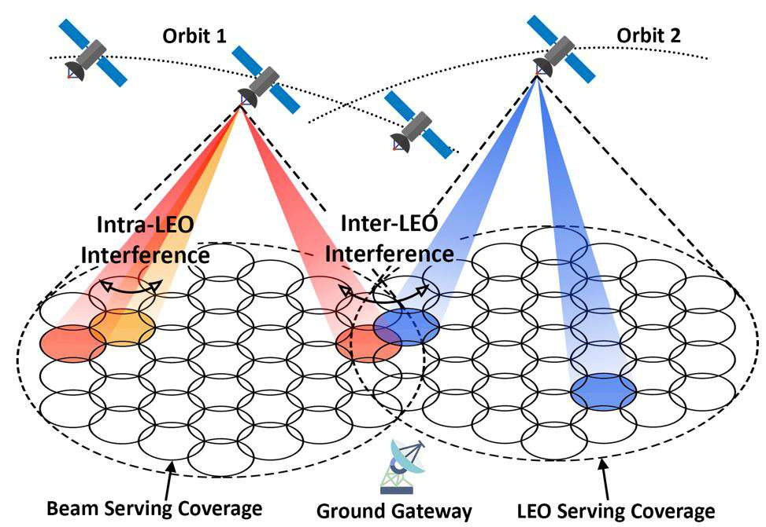
Why Beam Choice Is Hard in Multi-LEO Networks
HOBS begins with a moving multi-satellite system in which one user can be affected by several beams at the same time.
Intra-LEO interference
beams from one satellite reuse spectrum and compete at the user.
Inter-LEO interference
beams from different satellites can overlap in the same area.
Mobility and handover
the best satellite-beam pair changes as the constellation moves.
S.-H. Chen et al., “Energy-Efficient Joint Handover and Beam Switching Scheme for Multi-LEO Networks,” IEEE Vehicular Technology Conference (VTC2024-Spring), Singapore, 2024.
10

Slide 11
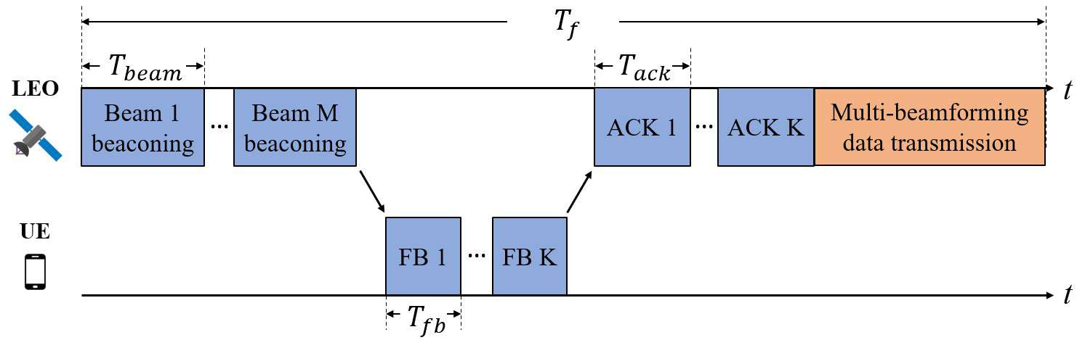
Why Exhaustive Search Consumes the Frame
Beam training comes before data transmission in each frame.
Training phase
Beam 1…M beacons; the UE returns feedback and receives ACKs.
Data phase
Multi-beam data uses only the remaining part of the frame.
HOBS scans fewer candidates, leaving more time for data.
S.-H. Chen et al., “Energy-Efficient Joint Handover and Beam Switching Scheme for Multi-LEO Networks,” IEEE Vehicular Technology Conference (VTC2024-Spring), Singapore, 2024.
11

Slide 12
HOBS Narrows the Candidate Search
The main idea is to use recent successful SINR observations to avoid sweeping every beam again.
Observe history
recent successful beam and SINR
Estimate motion
how the preferred beam has shifted
Build candidates
a smaller nearby search region
Search and decide
beam switch or satellite handover
Reliable history keeps the search local and reduces training time.
Missing or unsuccessful history expands the candidate region.
The decision uses beam indexes and SINR feedback rather than full instantaneous channel-state information.
Scope of HOBS
HOBS changes which beams are searched, it does not replace the SINR definition.
S.-H. Chen et al., “Energy-Efficient Joint Handover and Beam Switching Scheme for Multi-LEO Networks,” IEEE Vehicular Technology Conference (VTC2024-Spring), Singapore, 2024.
12

Slide 13
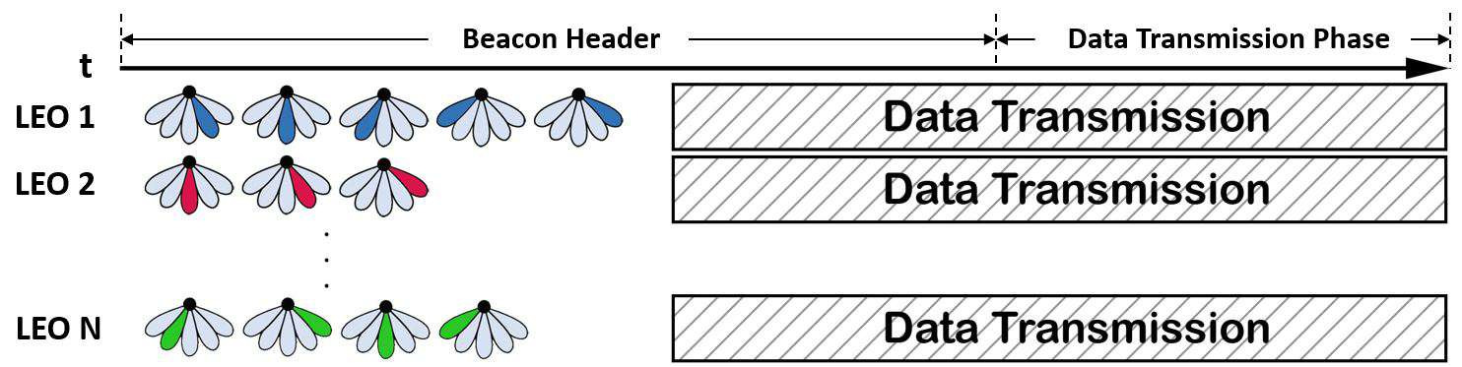
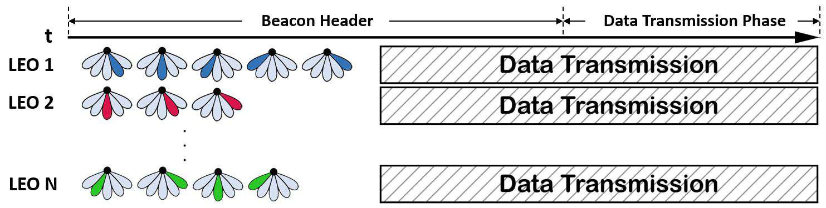
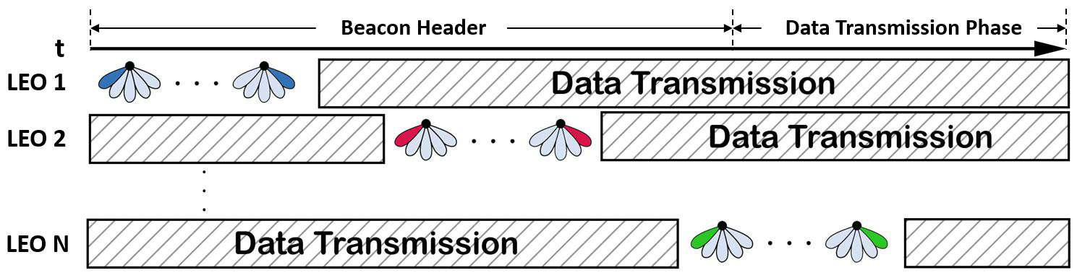
Three Beam-Sweeping Schedules
SCBS
Satellites sweep in sequence: little simultaneous training interference, but the longest overall delay.
SSBS
Satellites sweep together: shorter training, with stronger inter-satellite interference.
ABS
Asynchronous sweeps spread training over time while other satellites keep transmitting.
S.-H. Chen et al., “Energy-Efficient Joint Handover and Beam Switching Scheme for Multi-LEO Networks,” IEEE Vehicular Technology Conference (VTC2024-Spring), Singapore, 2024.
13

Slide 14
What the HOBS Evaluation Shows
Under different frame sizes, HOBS is compared with exhaustive beam search (EBS):
Fewer candidates
historical SINR lowers beam-training latency
SINR retained
HOBS approaches EBS without scanning every beam
EE trade-off
per-beam power updates use EE/SINR; stale history at large frames hurts
Mechanism: fewer candidates → shorter training phase → more time for data.
lower training delay, SINR close to EBS, and highest EE with adaptive beam-power updates; a large frame size makes history and power updates stale.
S.-H. Chen et al., “Energy-Efficient Joint Handover and Beam Switching Scheme for Multi-LEO Networks,” IEEE Vehicular Technology Conference (VTC2024-Spring), Singapore, 2024.
14

