Slide 1
Outline
Learning Objectives
TLE Data Processing Pipeline
What is TLE Data?
Professional Tools & Libraries
TLE Parsing Process
SGP4 Orbital Propagation
Coordinate System Transformations
Visibility Calculations
Output Data Structure
Data Flow to Subsequent Stages
Performance & Scalability Metrics
Real-world Applications

Slide 2
Learning Objectives
TLE Data Structure: How orbital parameters are encoded in NORAD TLE format
Professional Tools: Industry-standard libraries and algorithms for orbital mechanics
SGP4 Algorithm: Core orbital propagation methodology and physical effects
Coordinate Transformations: Multi-frame coordinate system conversions
Visibility Analysis: Observer-relative position calculations
Data Pipeline: How F1 output feeds into subsequent processing stages
Performance Optimization: Scalability considerations for large satellite constellations
Research Applications: Real-world use cases in LEO satellite communications

Slide 3
TLE Data Processing Pipeline
Understanding Satellite Tracking: From Raw Data to Real Applications
Course Outline:
What is TLE Data?
Processing Architecture
Professional Tools Used
Step-by-Step Processing Flow
Output Data Structure
Real-World Applications
Learning Goals:
✅ Understand satellite tracking fundamentals
✅ Learn industry-standard tools and methods
✅ See complete data transformation pipeline
✅ Apply to LEO satellite handover research

Slide 4
Phase‑1 Targets & Time Window
Scale targets: <2 min load; <100 m accuracy; <2 GB memory; ≥90% success
Observer: NTPU (24.9441667°N, 121.3713889°E, 50 m)
Time grid (code): 30‑s steps; default 200 min → 400 points
Deck example: 6 h window → 720 points (configurable)
Batching by 100 satellites; async gather per batch
Param | Value (Code) | Notes
time_range_minutes | 200 | Default; configurable
time_resolution_seconds | 30 | Fixed step
batch_size | 100 | Compute batches
observer | NTPU Topos | lat/lon/alt from code
targets | <2m; <100m; <2GB; ≥90% | Phase‑1 goals

Slide 5
What is TLE Data?
Two-Line Element Sets: Satellite Orbital Information
TLE Format Example:
STARLINK-1008 ← Satellite Name
1 44714U 19074B 25217.61307579 .00001585 00000+0 12526-3 0 9993 ← Line 1
2 44714 53.0552 76.6258 0001186 97.2887 262.8236 15.06399803316185 ← Line 2
Why Important:
- ✅ Global standard for satellite tracking
- ✅ Updated daily by NORAD/Space Force
- ✅ Enables precise position prediction
Line | Contains | Examples
Name | Satellite identifier | STARLINK-1008
Line 1 | Catalog number, epoch time | 44714, 25217.613...
Line 2 | Orbital parameters | Inclination: 53.0552°

Slide 6
Pipeline Architecture
Raw TLE Files (8,735 satellites)
Processing Scale:
Input: ~8,735 satellites from Starlink + OneWeb + others
Time Range: 6 hours (360 minutes)
Resolution: 30-second intervals = 720 time points
Total Calculations:
8,735 × 720 = ~6.3 million position calculations
TLE Data Loading
Orbital Parameter Extraction
SGP4 Calculations
Coordinate Transformations
Visibility Analysis
Time-Series Position Data
Output to Next Stage

Slide 7
Professional Tools & Libraries
Tool | Purpose | Key Capabilities
SGP4 | Orbital propagation | Standard algorithm for satellite tracking
Skyfield | Astronomical calculations | High-precision orbital mechanics
NumPy | Mathematical operations | Vector/matrix calculations
Python asyncio | Parallel processing | Handle 8,735 satellites efficiently
SGP4 Algorithm Features:
- ✅ Atmospheric drag effects
- ✅ Earth's gravity field variations (J2 perturbations)
- ✅ Solar/lunar gravitational influences
- ✅ Sub-meter accuracy for LEO satellites
Why These Tools:
- ✅ NASA/NORAD approved algorithms
- ✅ Used by satellite operators worldwide
- ✅ Proven accuracy and reliability

Slide 8
Local TLE Sources (Auto‑Discover)
Base: netstack/tle_data/{starlink|oneweb}/tle/
Pattern: starlink_*.tle; oneweb_*.tle
Pick latest by mtime per constellation
Fallback: synthetic dataset if none found
Validator: enhanced checks for robustness
Constellation | Path Pattern
Starlink | .../starlink/tle/starlink_*.tle
OneWeb | .../oneweb/tle/oneweb_*.tle

Slide 9
TLE Parsing Process
Extracting Orbital Parameters from TLE Data
Line 2 Parameter Extraction:
Calculated Parameters:
Orbital Period: 24×60 ÷ Mean Motion = 96 minutes
Altitude: Derived from mean motion using gravitational formulas
Ground Track: Combination of orbital motion + Earth rotation
Parameter | Position | Value Example | Meaning
Inclination | Chars 8-16 | 53.0552° | Orbital tilt relative to equator
RAAN | Chars 17-25 | 76.6258° | Right Ascension of Ascending Node
Eccentricity | Chars 26-33 | 0.0001186 | Orbit shape (0=circle, 1=parabola)
Argument of Perigee | Chars 34-42 | 97.2887° | Orientation of orbit
Mean Anomaly | Chars 43-51 | 262.8236° | Satellite position in orbit
Mean Motion | Chars 52-63 | 15.06399803 | Revolutions per day

Slide 10
TLE Field Extraction Map
Line 1: sat no., epoch year/day → datetime (UTC)
Line 2: inclination, RAAN, e, ω, M, n (rev/day)
Derived: a from n; period (min); apogee/perigee altitudes
Consistency: validator checks; sample_limits optional
Constellation tag from source path (starlink/oneweb)
Field | Slice | Meaning
satellite_number | L1[2:7] | NORAD ID
epoch (yy, ddd.ddd) | L1[18:20], L1[20:32] | Year/day → datetime
inclination_deg | L2[8:16] | Orbit tilt
raan_deg | L2[17:25] | Ascending node
eccentricity | L2[26:33] | 0.xxxxxxx
arg_perigee_deg | L2[34:42] | ω
mean_anomaly_deg | L2[43:51] | M
mean_motion | L2[52:63] | n (rev/day)

Slide 11
SGP4 Orbital Propagation
Core Physics Engine for Satellite Position Prediction
SGP4 Algorithm Steps:
1. Initialize orbital elements from TLE
2. Apply perturbations (drag, gravity variations)
3. Propagate to target time
4. Output position and velocity vectors
Physical Effects Modeled:
Output Data:
Position: (X, Y, Z) in Earth-centered coordinates
Velocity: (VX, VY, VZ) velocity vectors
Time: Precise timestamp for each calculation
Effect | Impact | Example
Atmospheric Drag | Orbital decay | Satellite slows down, altitude decreases
J2 Perturbation | Precession | Orbit plane slowly rotates
Solar Pressure | Minor drift | Small push from sunlight
Lunar/Solar Gravity | Long-term changes | Gradual orbital modifications

Slide 12
Skyfield vs. Enhanced SGP4
Primary: Skyfield EarthSatellite.at(t); subpoint(); altaz()
Fallback: enhanced SGP4 (Kepler + J2; numeric E solver)
Observer‑relative: elevation/azimuth/distance, range‑rate
Velocity: numeric diff at Δt=1 s or 0.1 s
Accuracy estimate capped at 200 m
Path | Inputs | Outputs
Skyfield | TLE L1/L2, ts, Topos | lat/lon/alt; el/az/dist; v (km/s)
Enhanced SGP4 | SGP4 params, dt | ECEF pos/vel; geo; el/az/dist

Slide 13
Coordinate System Transformations
Transformation Chain
Converting Between Reference Frames
Coordinate Systems Explained:
NTPU Observer Location:
Latitude: 24.9441667°N
Longitude: 121.3713889°E
Altitude: 50 meters
TLE Parameters
System | Description | Use Case
ECI | Fixed to stars, doesn't rotate | Orbital calculations
ECEF | Rotates with Earth | GPS positioning
Geographic | Lat/Lon/Alt on Earth surface | Mapping applications
Observer | Relative to ground station | Antenna pointing
SGP4 Calculation
ECI (Earth-Centered Inertial)
ECEF (Earth-Centered Earth-Fixed)
Geographic
(Latitude/Longitude/Altitude)
Observer-Relative
(Elevation/Azimuth/Distance)

Slide 14
Observer‑Relative & Frames
Frames: ECI → ECEF → geographic; GST for Earth rotation
Observer ECEF from lat/lon/alt + GST
Relative vector → unit vector; elevation/azimuth from components
Range‑rate = v·r̂; positive receding
All timestamps normalized to UTC
Quantity | Symbol | Unit
Elevation | el | deg
Azimuth | az | deg
Distance | |r| | km
Range‑rate | ṙ | km/s
Velocity | |v| | km/s

Slide 15
Visibility Calculations
Determining When Satellites Are Observable
Key Calculations:
Visibility Thresholds:
Visibility Analysis:
Input: Observer position + satellite position
Output: Boolean visibility + geometric parameters
Purpose: Filter 8,735 satellites → ~554 viable candidates
Measurement | Formula Basis | Purpose
Elevation Angle | arctan(altitude/distance) | Height above horizon
Azimuth Angle | arctan2(east, north) | Compass direction
Range Distance | √(Δx² + Δy² + Δz²) | Distance to satellite
Constellation | Elevation Threshold | Reasoning
Starlink | ≥ 5° | Lower altitude, more frequent passes
OneWeb | ≥ 10° | Higher altitude, stronger signals
Others | ≥ 10° | Conservative default

Slide 16
Visibility & Filtering
Input: observer Topos + satellite at(t)
Compute: el/az/dist; visibility if el ≥ threshold
Typical threshold: 10–15° (configurable)
Candidate reduction before later stages
Output: boolean + geometric details
Threshold | Effect
el ≥ 10° | Broader set; more handover options
el ≥ 15° | Better link budget; fewer candidates

Slide 17
Output Data Structure
Data Structure Per Satellite:
json
{
"satellite_id": "starlink_44714",
"constellation": "starlink",
"positions": [
{
"timestamp": "2025-08-15T12:00:00Z",
"latitude": 24.95,
"longitude": 121.37,
"altitude_km": 550.0,
"elevation_deg": 15.2,
"azimuth_deg": 45.8,
"distance_km": 850.5,
"velocity_km_s": 7.8,
"is_visible": true
}
// ... 720 time points (30-second intervals)
]
}
Time-Series Orbital Position Database
Output Statistics:
Satellites Processed: ~8,735
Time Points: 720 (6 hours × 2 per minute)
Total Data Points: ~6.3 million positions
File Format: JSON for F2 stage consumption
Memory Usage: ~500MB structured data

Slide 18
SatellitePosition Schema
Time‑series per satellite stored in memory
Fields include geographic + observer‑relative
Velocity magnitude from numeric diff
JSON export for downstream use (optional)
Load/calculation stats exported on request
Field | Type/Unit
timestamp | datetime (UTC)
latitude_deg, longitude_deg | deg
altitude_km | km
elevation_deg, azimuth_deg | deg
distance_km | km
velocity_km_s | km/s

Slide 19
Data Flow to Subsequent Stages
F1 Output Feeds Complete Processing Pipeline
Key Design Principle:
✅ TLE processed ONCE - F1 only stage that touches raw TLE data
✅ Memory passing - No file I/O between stages
✅ Data refinement - Each stage adds value to previous output
F1 → F2 Interface:
Data type: Structured orbital positions
No TLE re-parsing required
Efficient memory transfer
Benefits:
Performance: SGP4 calculations done once
Consistency: All stages use same orbital data
Scalability: 8,735 satellites processed efficiently
Processing Chain:
Stage | Input | Processing | Output
F1 | TLE files | SGP4 + visibility | Position time-series
F2 | F1 positions | Satellite filtering | ~554 candidates
F3 | F2 candidates | Signal analysis | A4/A5/D2 events
A1 | F3 events | Dynamic planning | Final satellite pools

Slide 20
Performance & Scalability Metrics
Processing Statistics and Optimization Results
Performance Benchmarks:
Scalability Analysis:
Optimization Techniques:
- ✅ Async processing for I/O operations
- ✅ Batch calculations for similar satellites
- ✅ Memory streaming to avoid storage bottlenecks
- ✅ Error handling with graceful degradation
Metric | Value | Optimization
TLE Loading | ~30 seconds | Parallel constellation loading
SGP4 Calculations | ~2 minutes | Async batch processing
Coordinate Transform | ~15 seconds | Vectorized operations
Total F1 Runtime | ~3 minutes | End-to-end processing
Constellation | Satellites | Processing Time | Memory Usage
Starlink | ~5,000 | 105 seconds | 300MB
OneWeb | ~800 | 18 seconds | 50MB
Others | ~2,935 | 62 seconds | 150MB
Total | 8,735 | 185 seconds | 500MB

Slide 21
Batching & Phase‑1 Targets
Local TLE discovery by newest file per constellation
Parallel load via asyncio; cache validity checks
Compute in batches of 100; gather with exceptions
Statistics exported to JSON (timestamped)
Sample limits supported during development
Metric | Target
Load time | < 120 s
Accuracy | < 100 m
Memory | < 2 GB
Success rate | ≥ 90%
Time points | 200 min @30 s → 400 points

Slide 22
Real-world Applications
LEO Satellite Handover Research Use Cases
Research Applications:
Academic Research:
PhD Thesis: LEO satellite handover optimization
Publications: Real orbital data vs. simulated models
Validation: 45-day historical TLE dataset
Reproducibility: Standardized processing pipeline
Application | Data Usage | Research Value
Handover Timing | Satellite visibility windows | Optimize switching decisions
Signal Prediction | Distance/elevation data | Calculate link quality
Coverage Analysis | Multi-satellite positions | Ensure continuous service
Constellation Comparison | Starlink vs OneWeb tracking | Performance benchmarking

Slide 23
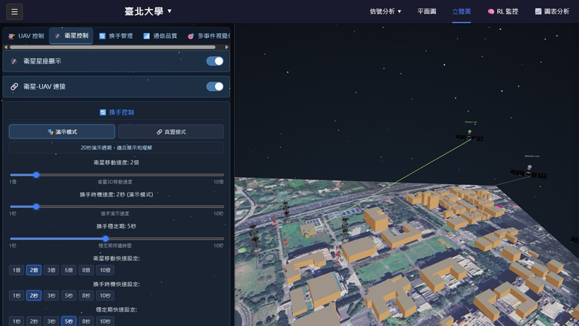
Handover Simulator

