Slide 1
Xtext and Xtend Properties Mapping
Cheng Deng
2023/04/05

Slide 2
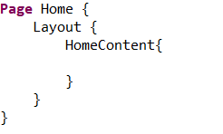
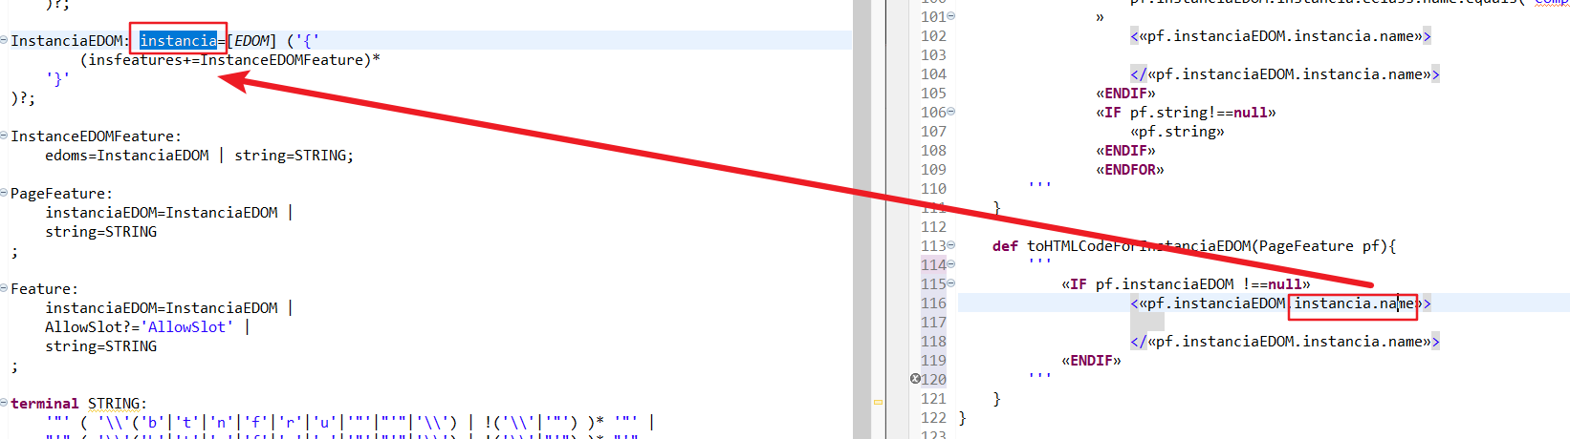
Name from model and instance into the transformation of the code
(Model) Metamodel
(Instance)Model of MM
(Model) Transformation
Instance of the code

Slide 3
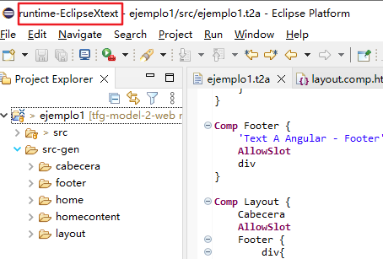
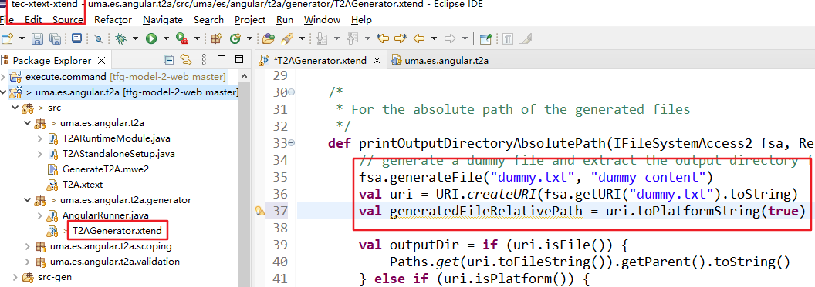
src-gen relative path
2
1
3

Slide 4
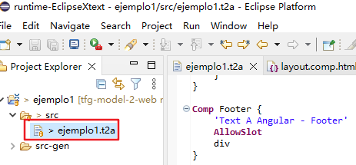
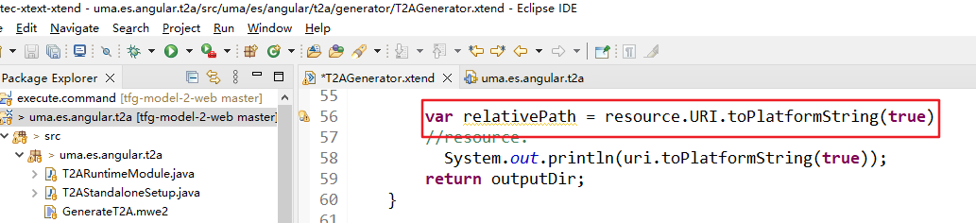
src relative path
2
1
3

Slide 5
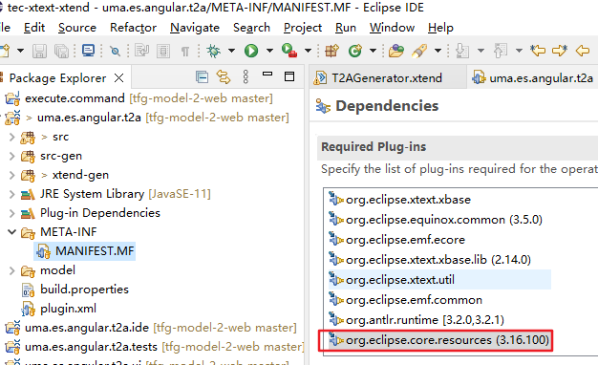
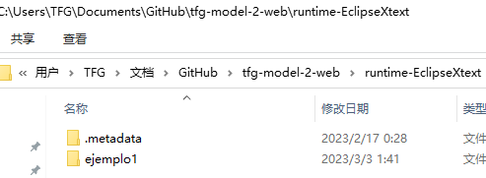
Output workspace absolute path
1 add the plugin to the xtext project
3 result
2 usage in the xtend file

Slide 6
Put all generated code in an empty Angular project
Must be a entry file for the Angular project.
App module, app.html, app.ts and etc.
Declare all the components in one module.
First find the absolute path of the generated files.
Copy them and put them in an angular project’s directory src.
Run the Angular Project.
We want to make a directory of the project here

Slide 7
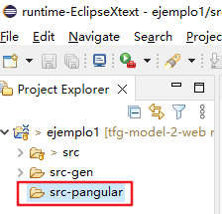
Where we save our project angular?
We want to make a directory of the project here

Slide 8
Where we save our project angular?
When put the generated files in the angular project we need to think the how
1. The angular project is generated only once
2. When the instance is changed the angular project only updates the corresponding generated files.
Remove the old files.
Put new generated files in
3. The angular project hot-runs;

Slide 9
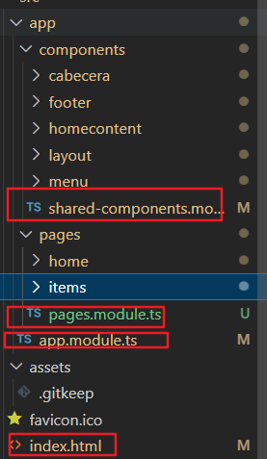
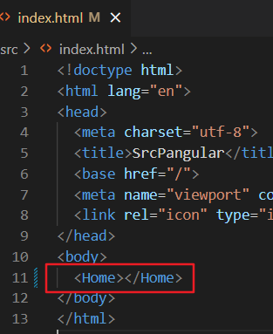
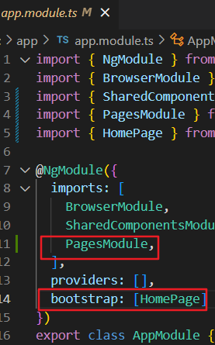
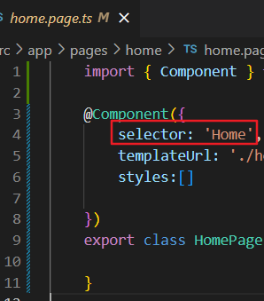
Los elementos obligatorios para ejecución de Angular. – La entrada de la APP

Slide 10
Angular Router – para las transiciones entre pages

Slide 11
Clases
Ref:
Xtend - Classes and Members (eclipse.org)

