Slide 1
Xtext - Grammar
Tutorial
Cheng Deng

Slide 2
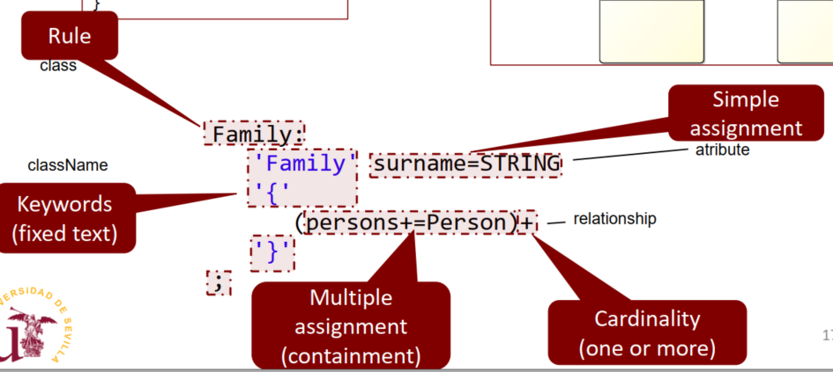
Basic Grammar in Xtext
RuleName:
‘Keyword’ name=Type // simple assignment for attributes
‘Keyword’ truefalse?=‘truefalse’ // simple assignment for boolean
‘Keyword’ relationName+=Type // multiple assignment for containtment
‘Keyword’ relationName+=[Type] // M.A for association
‘Keyword’ relationName+=[]
‘Keyword’ (relationName+=[Type])cardi;
Cardinality(cardi) can be
+ one or more
* zero or more
? optional
;

Slide 3
Assignment Operator
Simple assignment for equal
=
Simple assgnment for boolean
?=
Optional
?
Multiple
*
Multiple one or more
+=

Slide 4
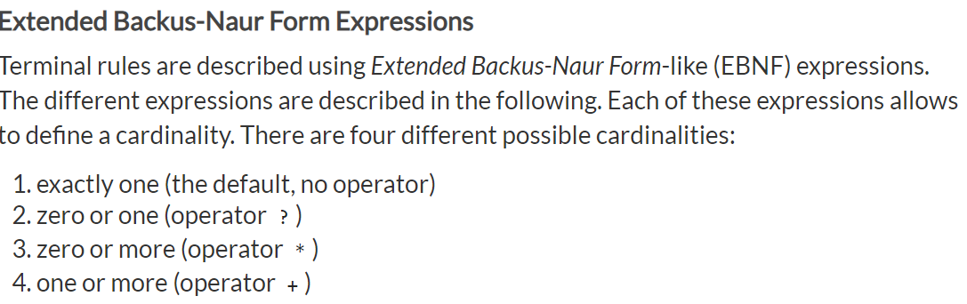
Four Different possible cardinalities
Reference: https://www.eclipse.org/Xtext/documentation/301_grammarlanguage.html

Slide 5
Different cardinalities
different cardinalities
? = optional
= any number
+ = at least once

Slide 6
Regular Expression
terminal ID: '^'?('a'..'z'|'A'..'Z'|'_') ('a'..'z'|'A'..'Z'|'_'|'0'..'9')*;
Check Regex
https://regex101.com/r/ODlZz4/1

Slide 7
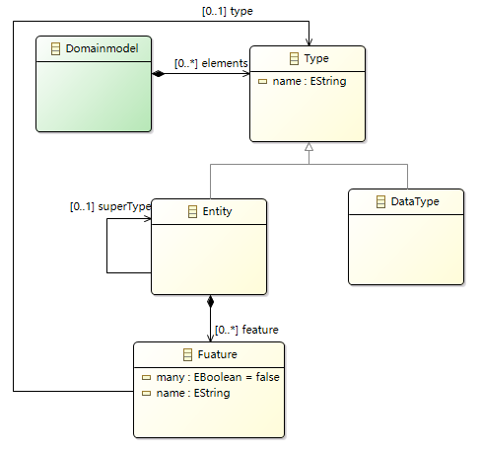

Asociation - Cardinality 1
Fuature has a type

Slide 8
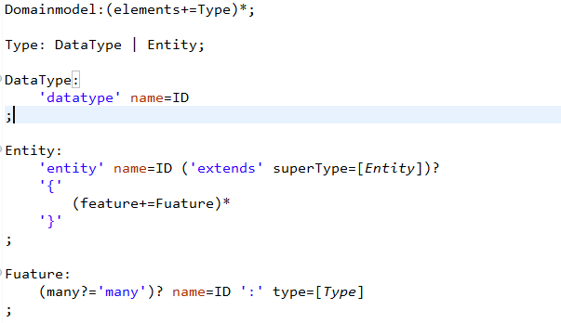
In XText

Slide 9
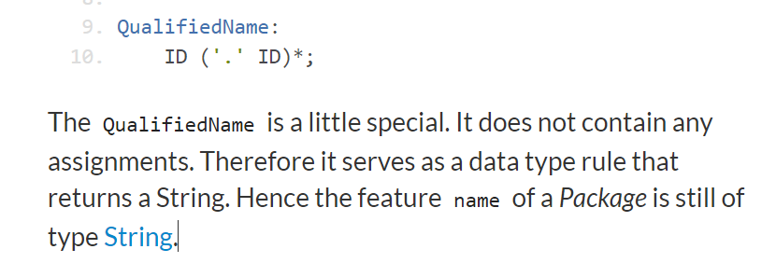
DataTypeRule qualified name – （有资质的）被赋能的 名称 -

Slide 10
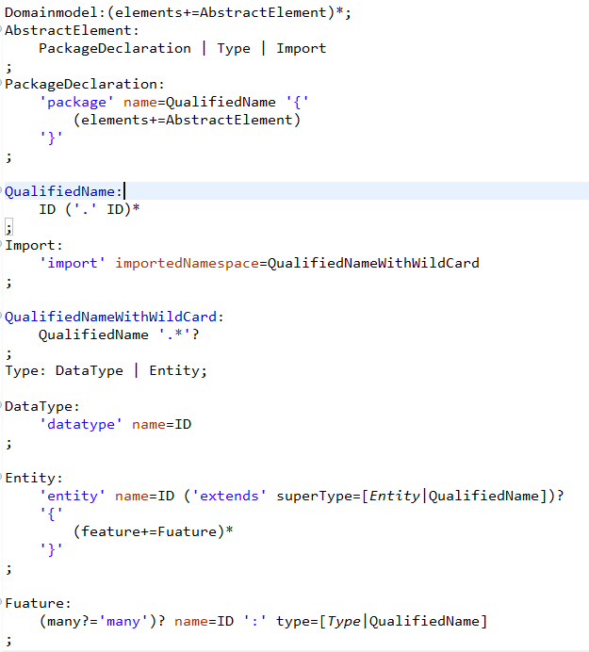
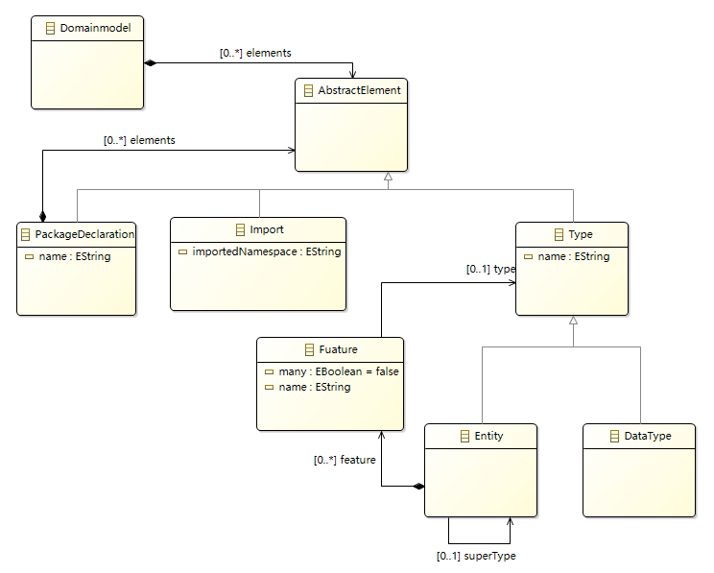
MM with Package, Import

Slide 11
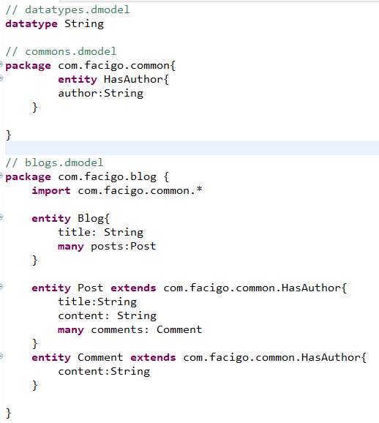
Instance regarding MM

Slide 12
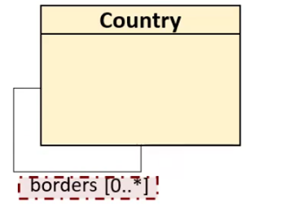
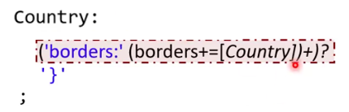
Cardinality 0..* - asociation
Cardinality 1..*
In Xtext
Optional
So. The cardinality is 0..*
If the + with ? appears it is not necessary to define instances for this relation

Slide 13
Cross Reference []
In Xtext
The bracket [cross reference]
Means the instance must exist

Slide 14
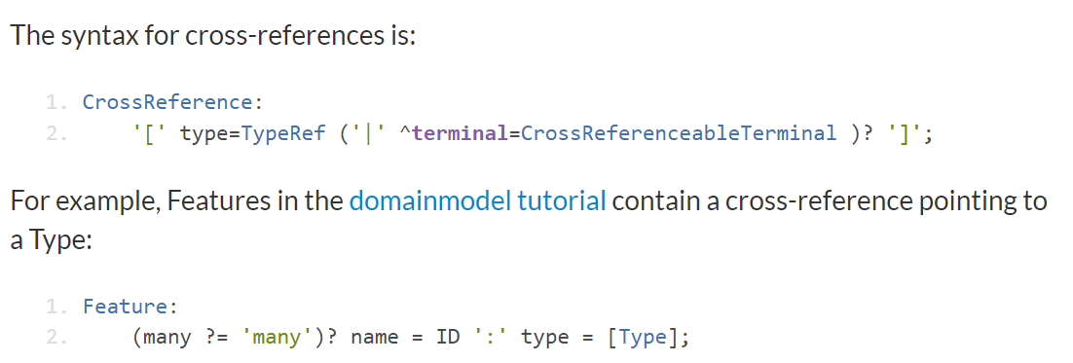
Syntax for Cross-references

Slide 15
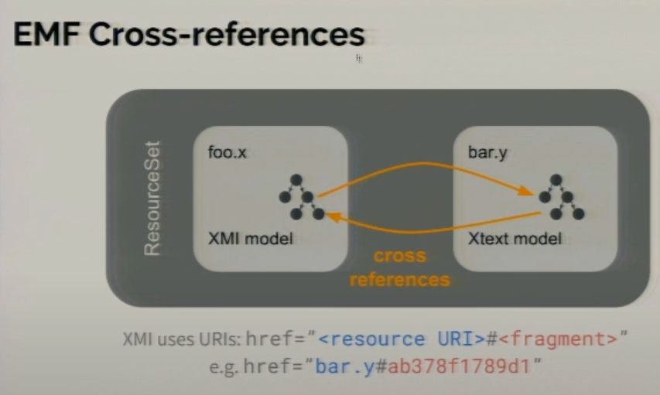
Integrating Xtext and Sirius: Strategies and Pitfalls - YouTube

Slide 16
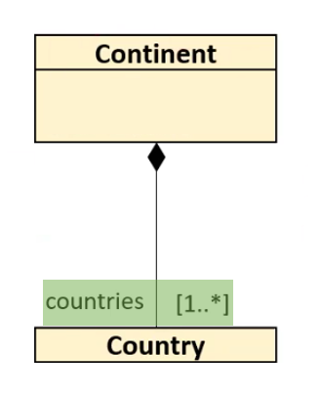
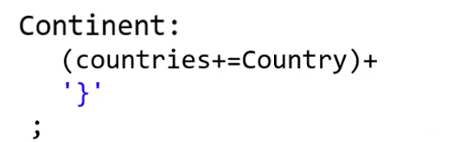
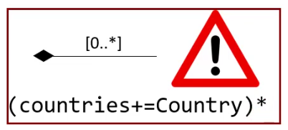
Cardinality 1..* - Containment
Multivalue
Assignment
In Xtext
Cardinality 1..*

Slide 17
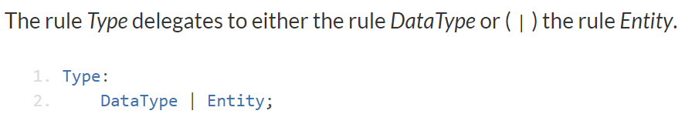
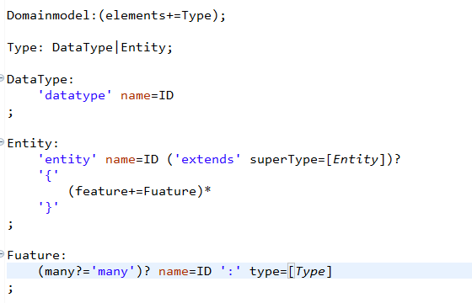
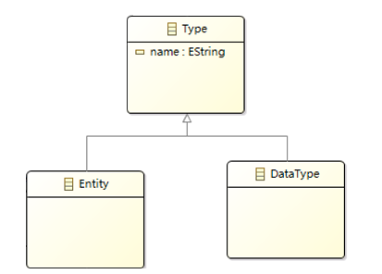
Type in Xtext – Herencia in Java

Slide 18

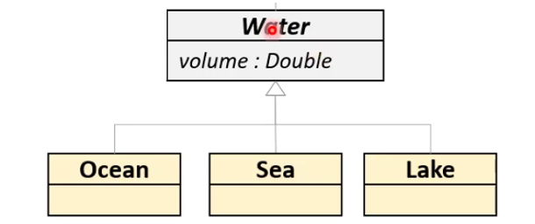
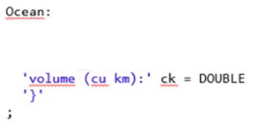
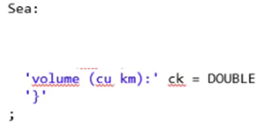
Type in Xtext – Herencia in Java
In Xtext

Slide 19
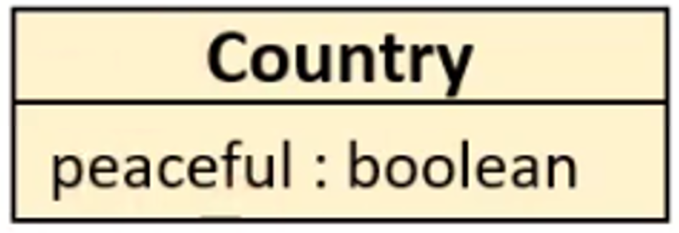
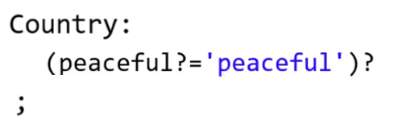
Attributes - boolean
In Xtext
Boolean Assginment

Slide 20
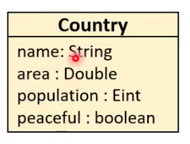
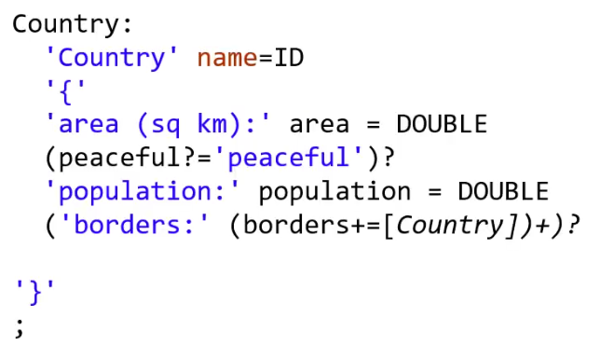
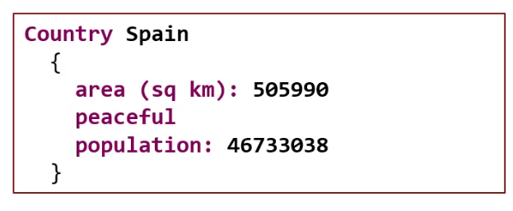
Attributes
In Xtext
Rule
Typically, one of the attributes serves as ID
Class Diagram
Instance In Xtext
Keywords
If this appears then is true

Slide 21
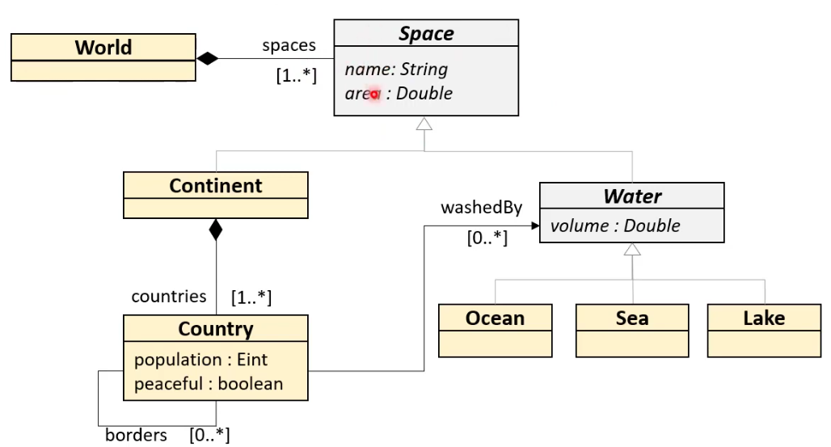
Full Example – Class Diagram - MM(Metamodel)

Slide 22
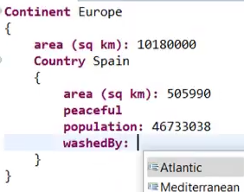
We want our instances like this

Slide 23
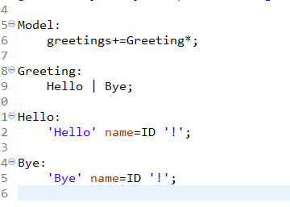
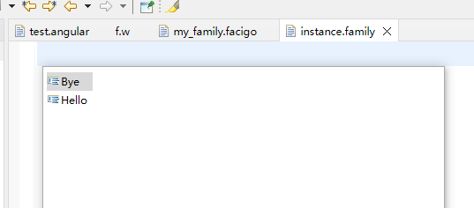
One thing
If the model hasn’t keyword then this model no needs to be instanciated.
There are only two possible models

Slide 24
Full Example – World MetaModel in Xtext
Ocean:
'Ocean:' name=ID
'{'
'area:' area=DOUBLE
'volume:' volume=DOUBLE
'}';
Sea:
'Sea:' name=ID
'{'
'area:' area=DOUBLE
'volume:' volume=DOUBLE
'}';
Lake:
'Lake:' name=ID
'{'
'area:' area=DOUBLE
'volume:' volume=DOUBLE
'}';
World:
// Relations
(spaces+=Space)+ // 1..*
;
Country:
'Country' name=ID
'{'
// attributes
'population:' population=DOUBLE
peaceful?='peaceful' // boolean
// relation - containment
('borders:' borders+=Country)+ // 1..*
// relation - asociation 0..*
('washedBy:' (washedBy+=[Water])+)?
'}';
Space:
Continent | Water;
Continent:
// attributes
'Continent:' name=ID
'{'
'area:' area=DOUBLE
// relations
// containment - composition relation
((countries+=Country)+)
'}'
;
Water:
Ocean | Sea | Lake
;
terminal DOUBLE:
('_'' '*)? INT ('.' INT)?
;

Slide 25
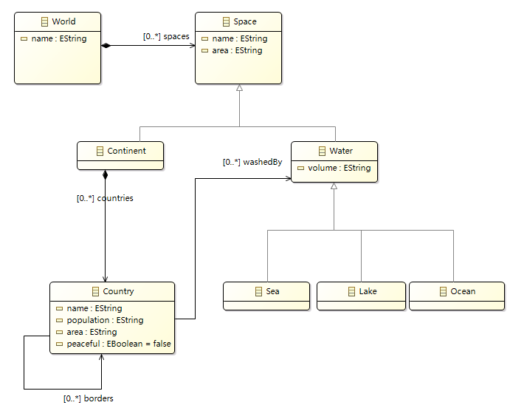
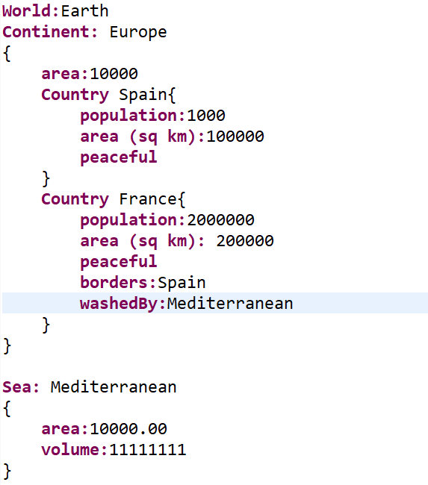
Instance made regarding the MM of World

Slide 26
References
https://www.eclipse.org/Xtext/documentation/102_domainmodelwalkthrough.html

Slide 27
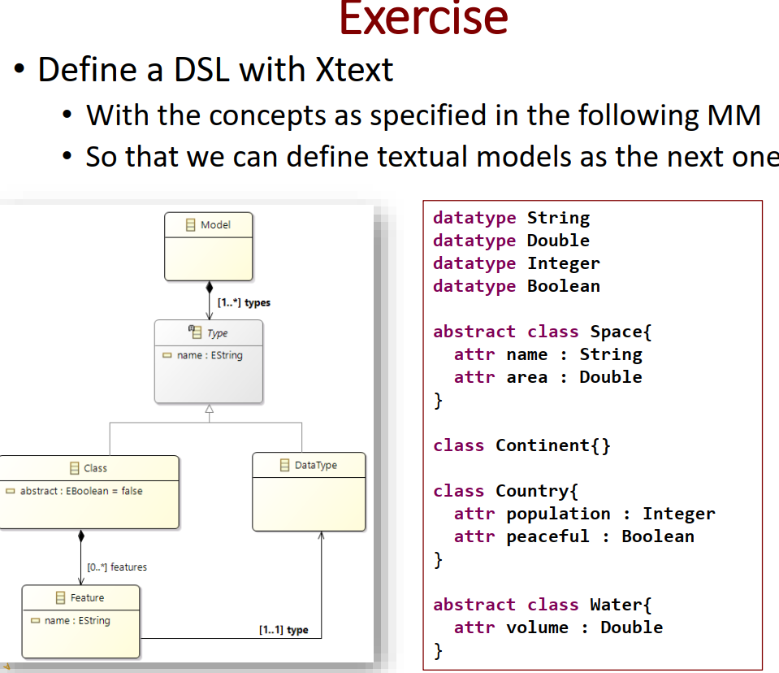

Slide 28
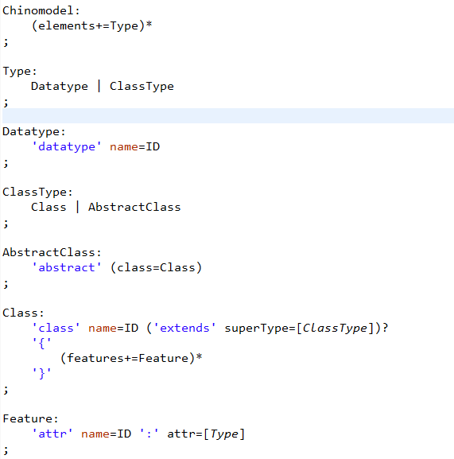
My Solution
Chinomodel:
(elements+=Type)*
;
Type:
Datatype | ClassType
;
Datatype:
'datatype' name=ID
;
ClassType:
Class | AbstractClass
;
AbstractClass:
'abstract' (class=Class)
;
Class:
'class' name=ID ('extends' superType=[ClassType])?
'{'
(features+=Feature)*
'}'
;
Feature:
'attr' name=ID ':' attr=[Type]
;

Slide 29
A instance model
datatype Integer
class Node{
attr value: Integer
}
class List extends Node{
attr next: Node
attr previous: Node
}

Slide 30
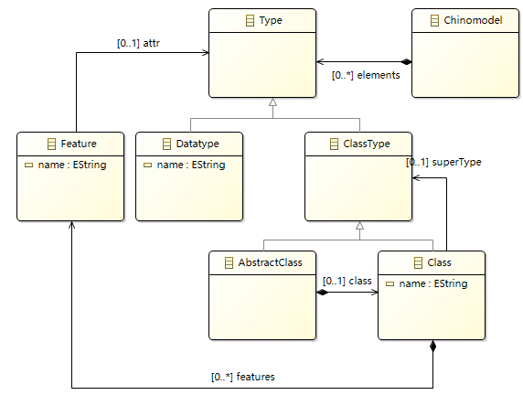
Class Diagram

Slide 31
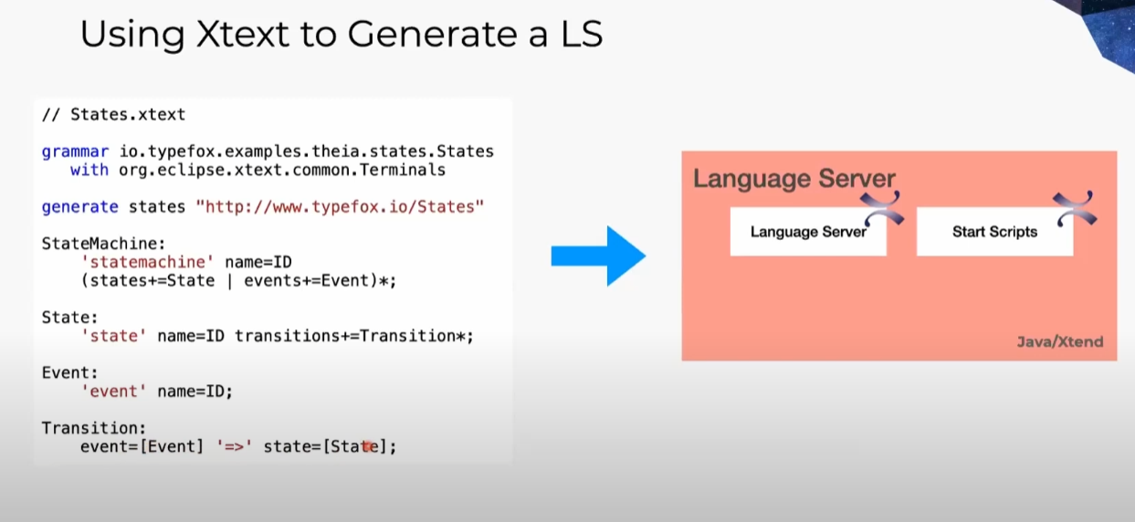
Statemachine
Beyond LSP: Getting Your Language into Theia and VS Code - YouTube

