Slide 1
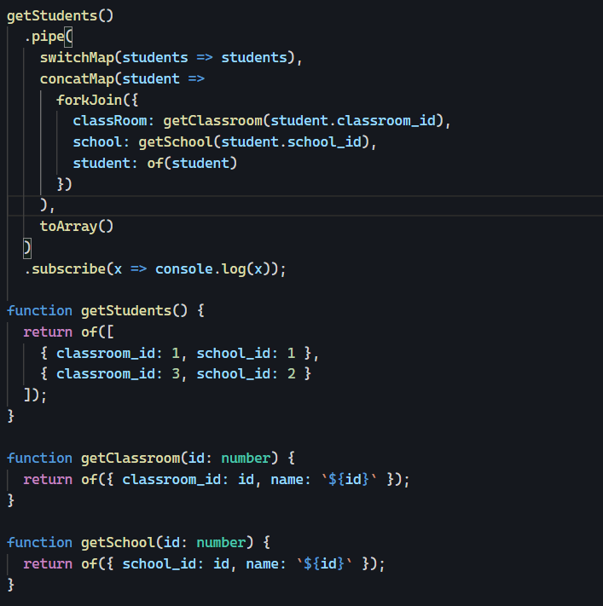
forkJoin

Slide 2
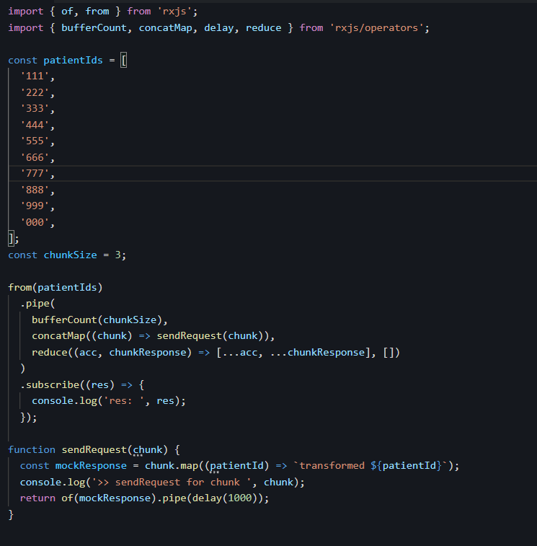
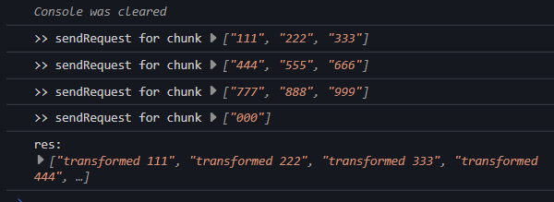
rxjs-chunk-requests
https://stackblitz.com/edit/rxjs-chunk-requests-hwyxtj?file=index.ts

Slide 3
Angular
Mi abstracción
Un framework de app en tecnología web.

Slide 4
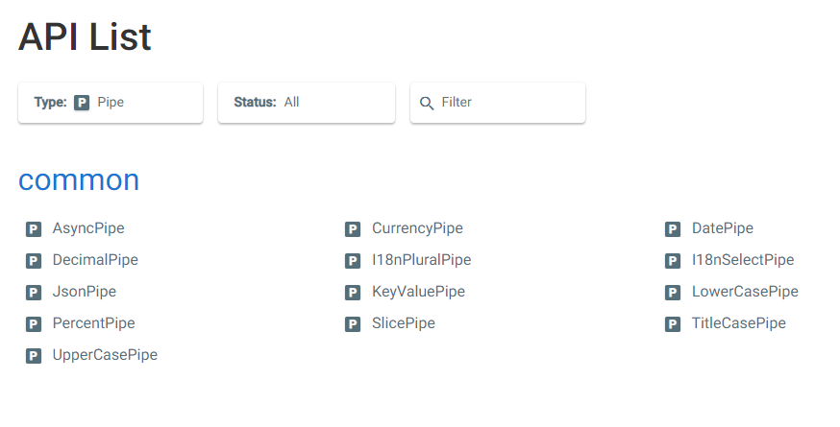
APIs-search
Angular - API List

Slide 5
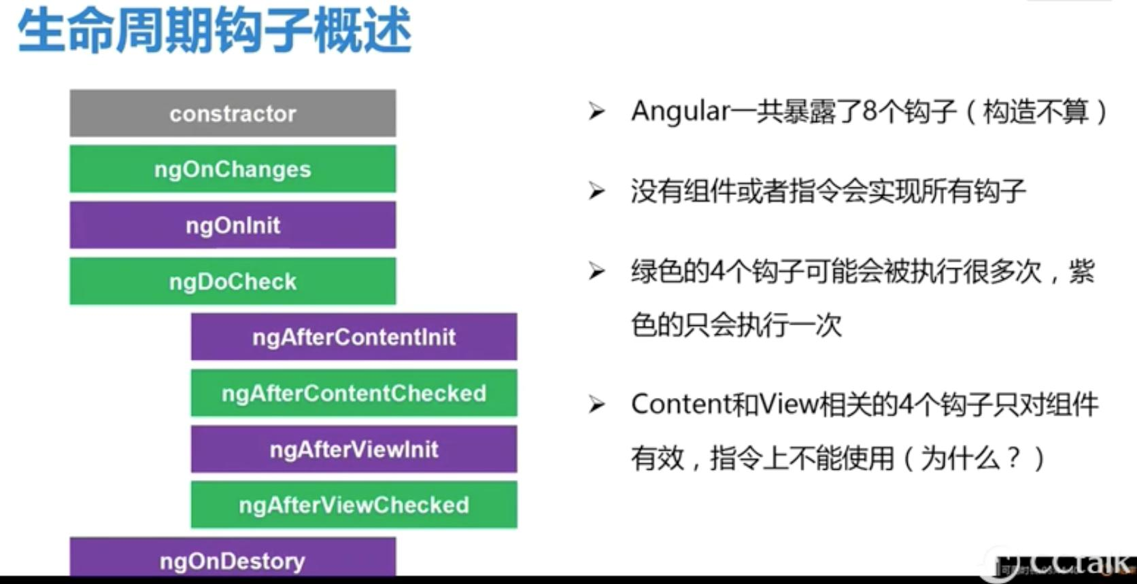
Ciclo de Vida

Slide 6
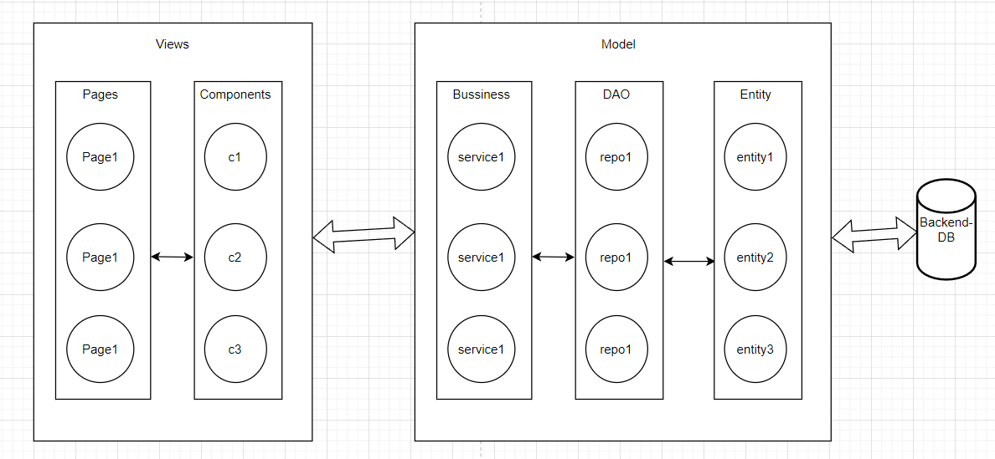
Estructura simple

Slide 7
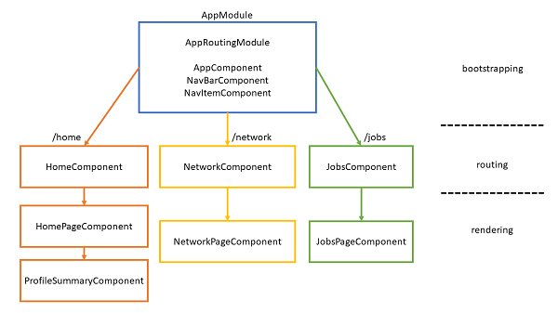
Angular - arquitecture

Slide 8
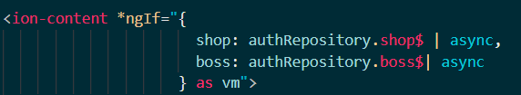
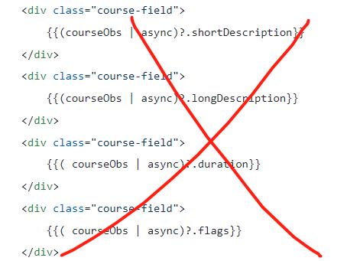
Async in template – high effectively approach
This way can prevent multiple subscriptions of observable
because we need to use the async pipe multiple times. Actually, this would cause multiple subscriptions (meaning multiple HTTP requests), which could lead to other problems and also it's not as readable.

Slide 9
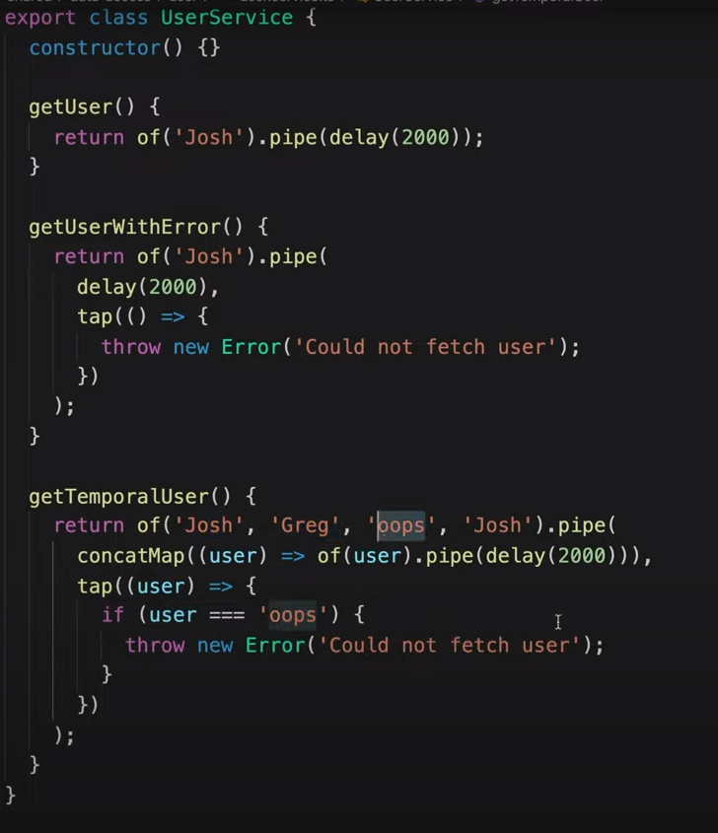
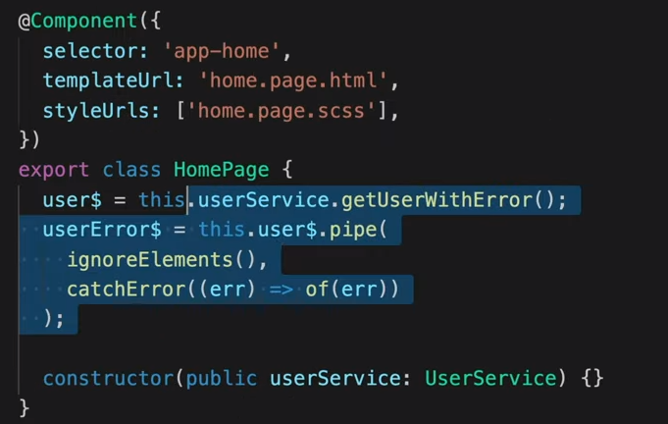
How to handle errors REACTIVELY with the async pipe - YouTube
Joshua Morony - YouTube

Slide 10
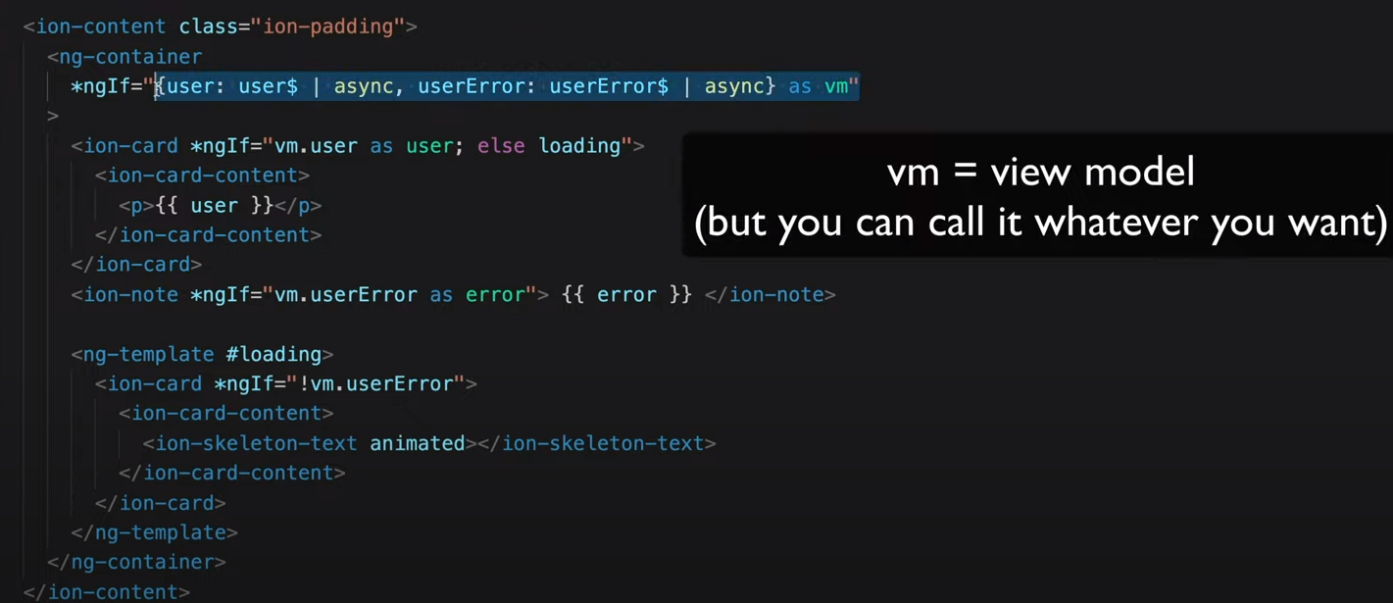
How to handle errors REACTIVELY with the async pipe - YouTube

Slide 11
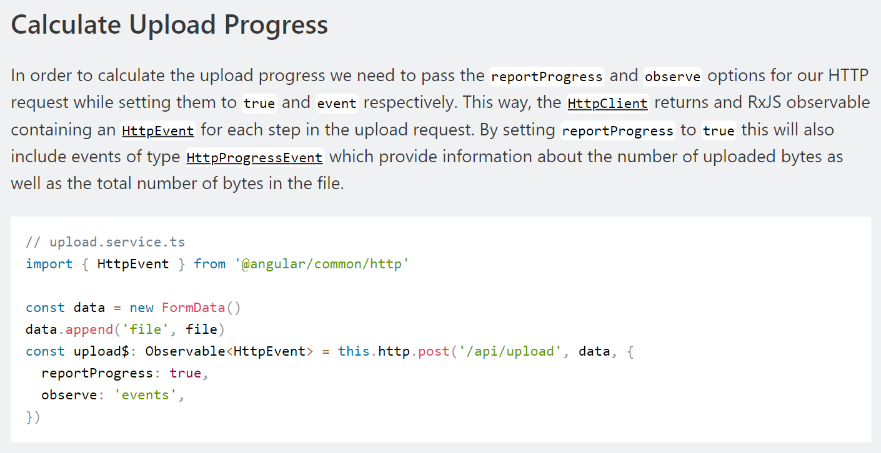
HTTP and Observable
Angular File Upload with Progress | Nils Mehlhorn (nils-mehlhorn.de)

Slide 12
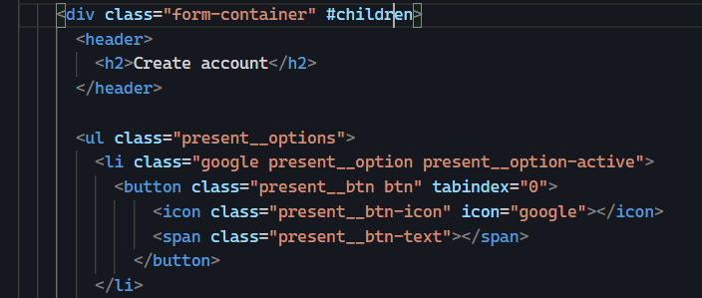
Get DOMS
@ContentChildren('children') children!: QueryList<unknown>;

Slide 13
Element references (ElementRef) in Angular templates
@ViewChild('inputDom') input: ElementRef;
// Component.ts
export class Component {
@ViewChild('inputDom') input: ElementRef;
public ngOnInit() {
const input$ = fromEvent(this.input.nativeElement, 'keyup');
input$
.pipe(
map((event: Event) => {
return event.target as HTMLInputElement;
})
)
.subscribe((target) => {
console.log(target.value);
});
}
}
//Template.html
<input ngModel #inputDom type="text" />
https://jake.stackblitz.com/edit/angular-rxjs-playground-ardmt6?file=app%2Fapp.component.ts,app%2Fapp.component.html

Slide 14
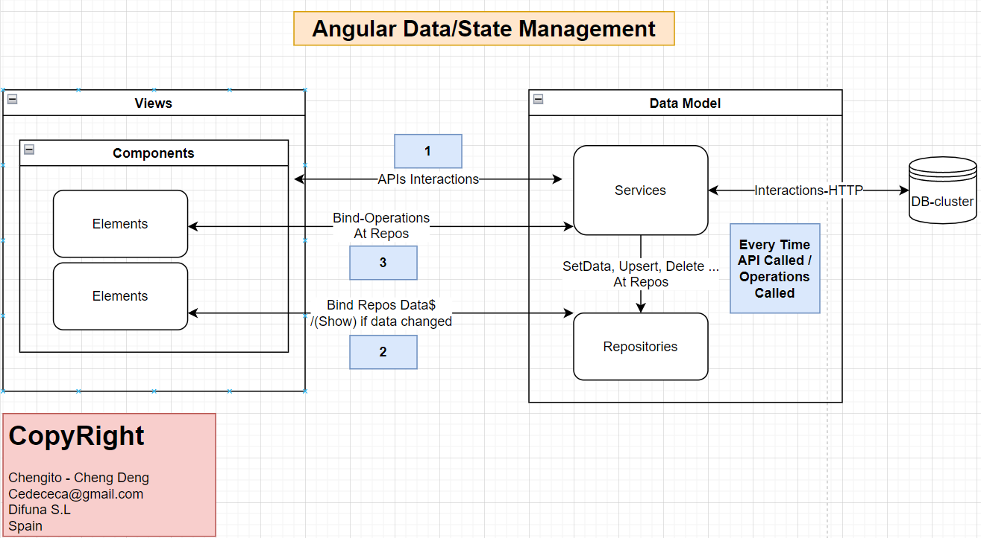
Angular Data/State Management

Slide 15
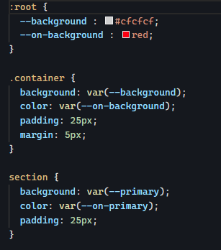
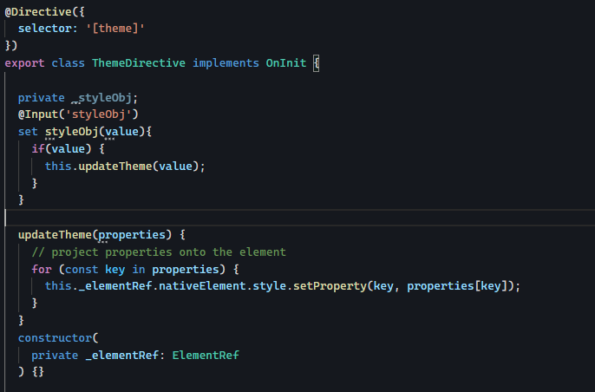
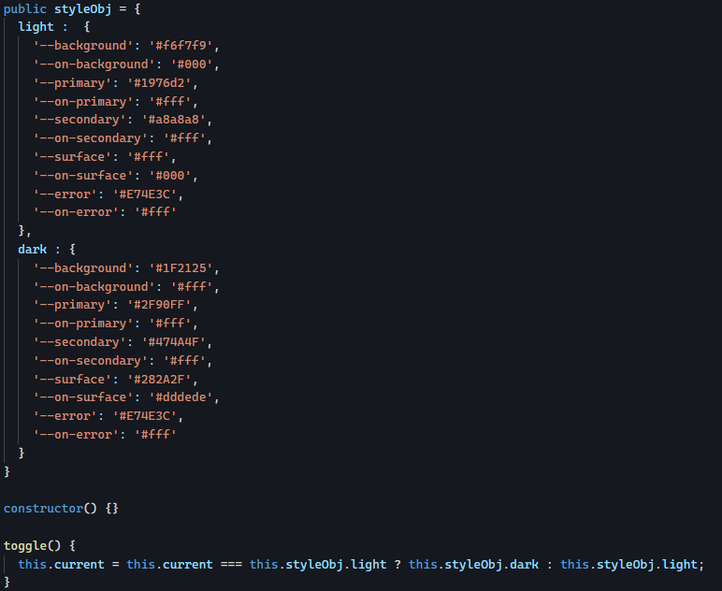
Angular – style - Directive
Angular Dynamic Style Change - StackBlitz

Slide 16
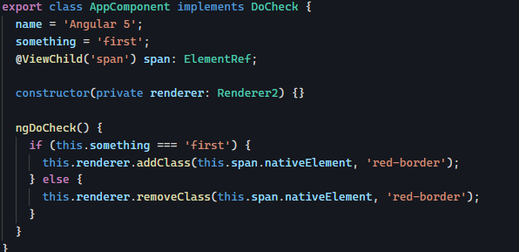
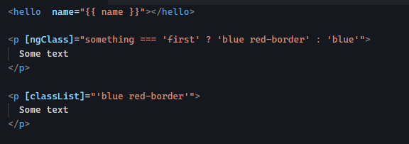
Angular – class
Angular Dynamic Class Toggle – StackBlitz
Dynamically Change Classes - StackBlitz

Slide 17
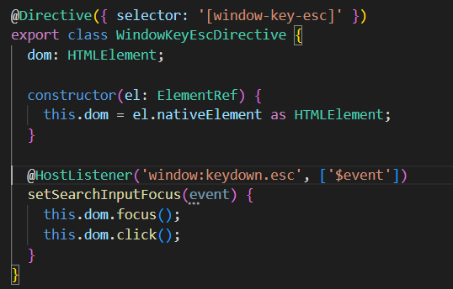
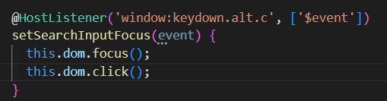
Key
JavaScript Key Code for AltLeft | Toptal®

Slide 18
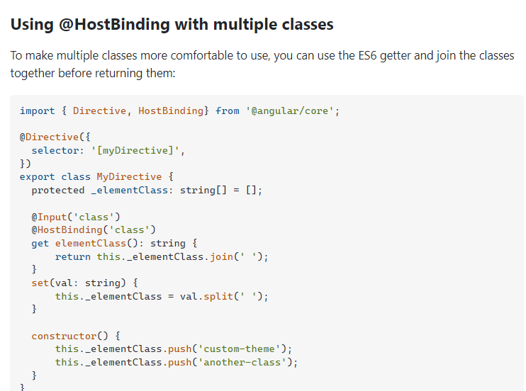
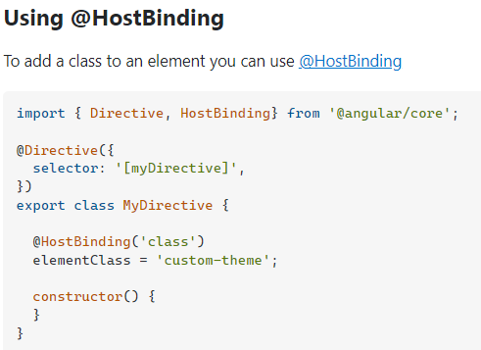
Directive 添加class

Slide 19
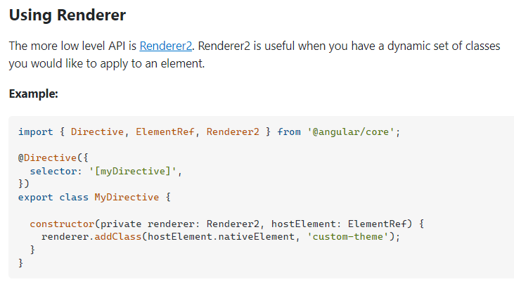
Directive 添加class

Slide 20
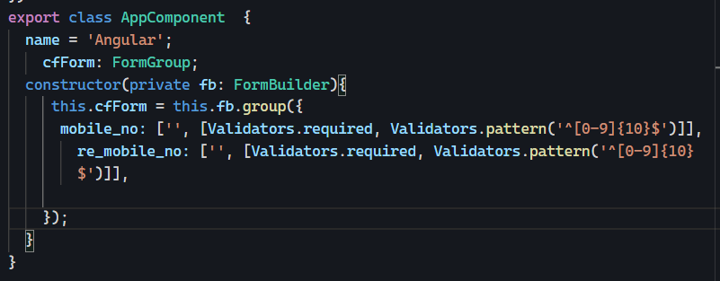
FormBuilder - Group

Slide 21
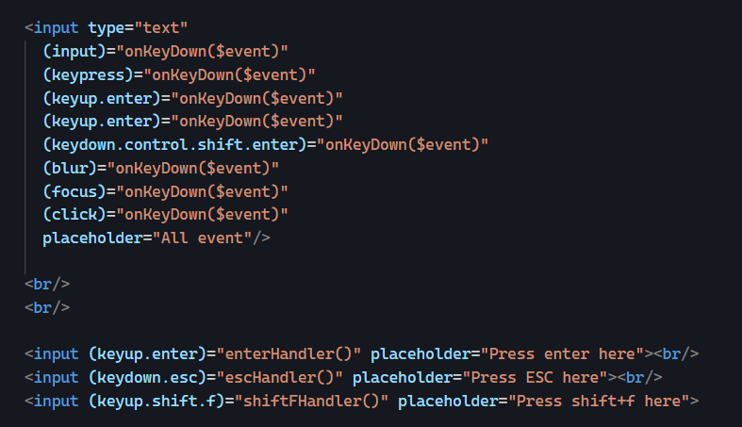
Event – en plantilla

Slide 22
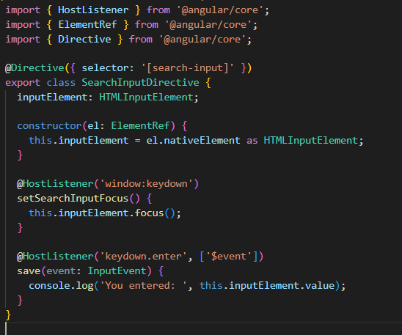
Event – En Directiva

Slide 23
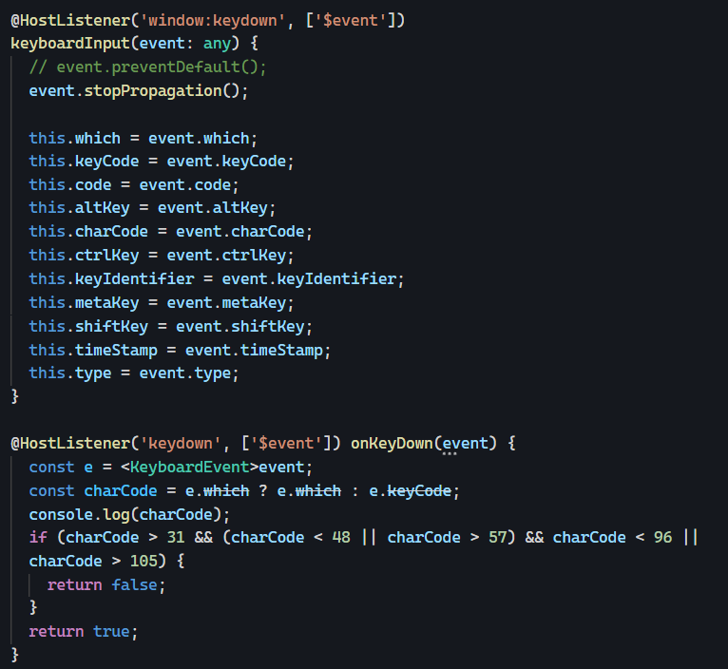
Event – En Components

Slide 24
Un gestor de estados ELF
Props 小部件-小东西-或者可以理解为属性
定义 你在软件运行期间要跟踪的 全局的数据 比如 user interface AuthProps { user: { id: string } | null; } const authStore = createStore( { name: ‘auth’ }, withProps<AuthProps>({ user: null }) // 初始化null );
获取 user export const user$ = authStore.pipe(select((state) => state.user));
更新 user authStore.update( (state) => ({ ...state, user, }) );

Slide 25
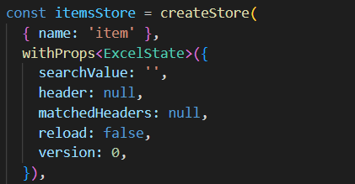
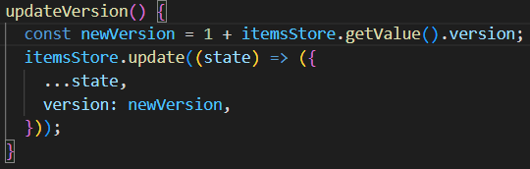

Actualizar estado que dispara update para los observadores
Preparación
Las funciones que pasan los observadores al observable version$ van a ser ejecutadas de nuevo
tras cada llamada a updateVersion()

Slide 26
ELF- Repository 存储库
定义: 数据存储库, 好处 1. 将对数据的操作很好的组织在库里. 提高重用和利于查找 2. 更改数据库时 不需要 改动 业务逻辑（business logic at service）
@Injectable({ providedIn: 'root' })
export class AuthRepository { user$ = authStore.pipe(select((state) => state.user)); updateUser(user: AuthProps['user']) { authStore.update((state) => ({ ...state, user, })); } }
CLI: create boilerplate for repository
npx @ngneat/elf-cli repo CLI | Elf | A Reactive Store with Magical Powers (ngneat.github.io)

Slide 27
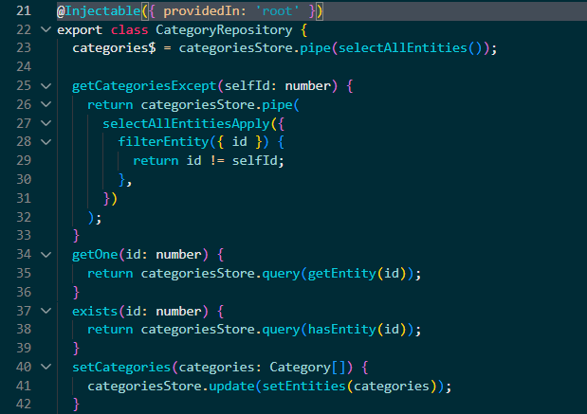

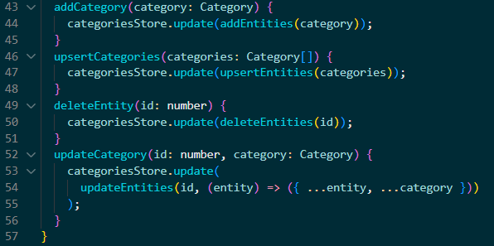
Entities

Slide 28
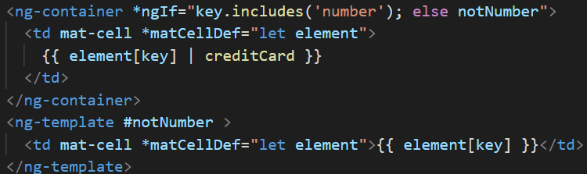
ngIf and else

Slide 29
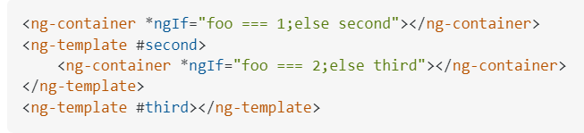
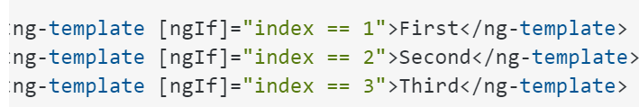
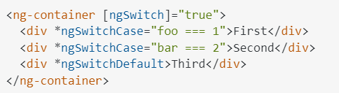
Ng if, else if, then else -alternatives

Slide 30
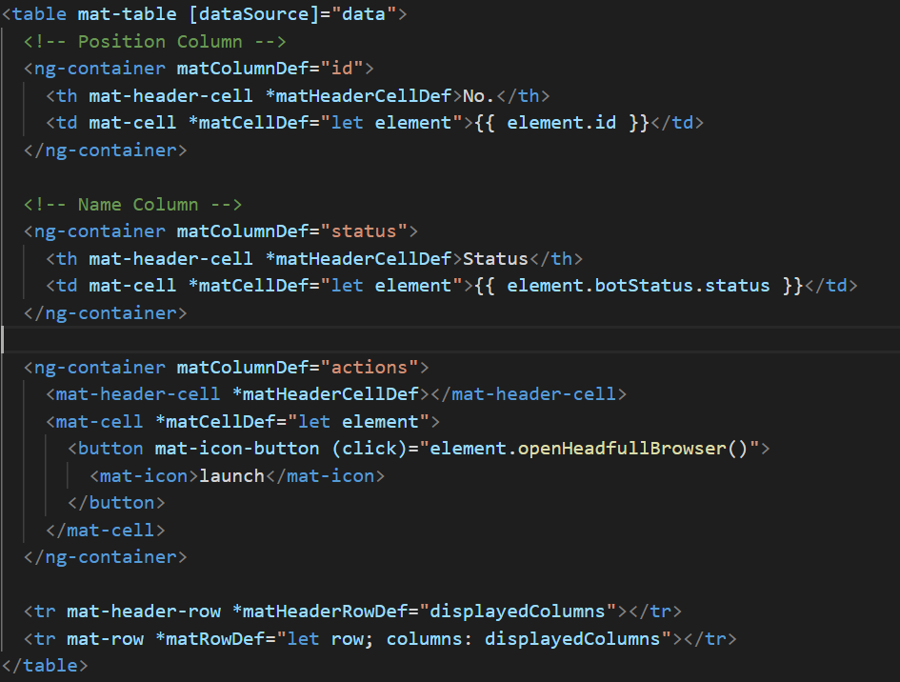
Static Table

Slide 31
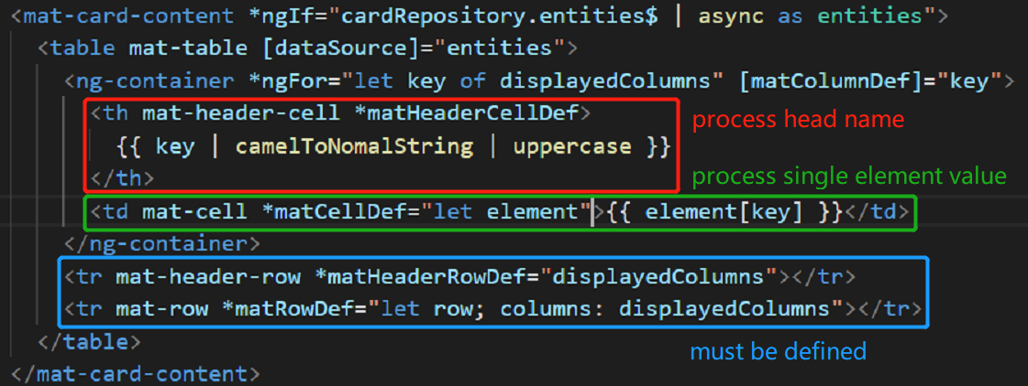
Dynamic Table

