Slide 1
CSS

Slide 2
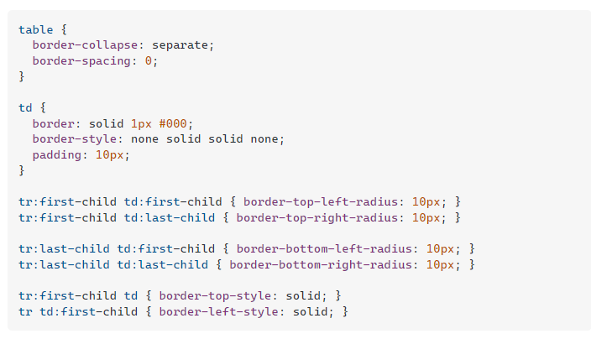
add border radius on table row

