Slide 1
Xtext and Xtend Properties Mapping
Cheng Deng
2023/04/05

Slide 2
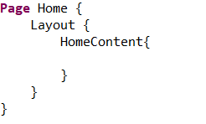
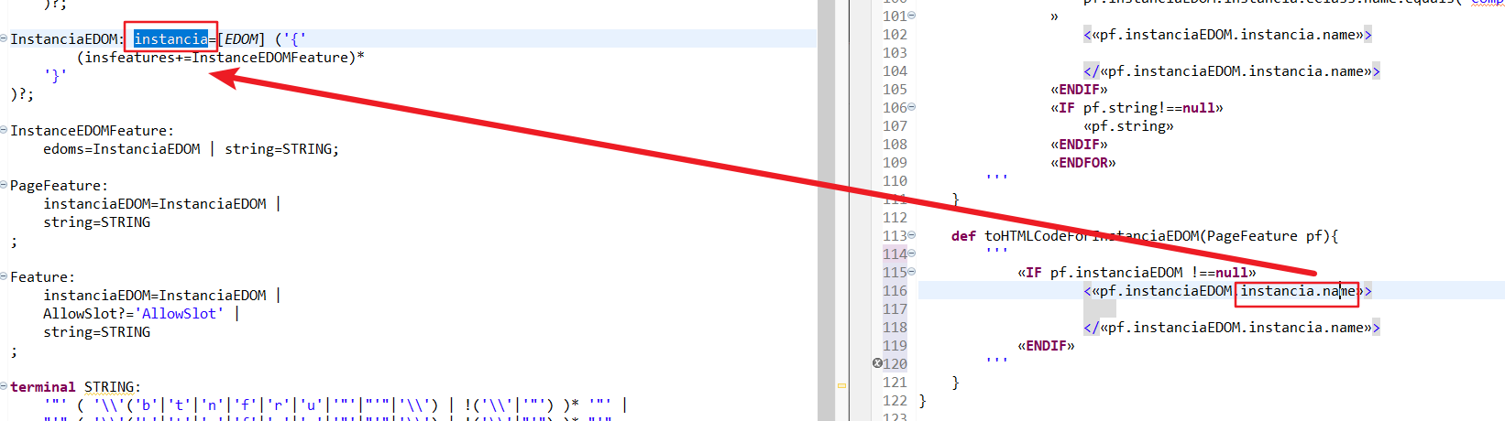
Name from model and instance into the transformation of the code
(Model) Metamodel
(Instance)Model of MM
(Model) Transformation
Instance of the code

