Slide 1
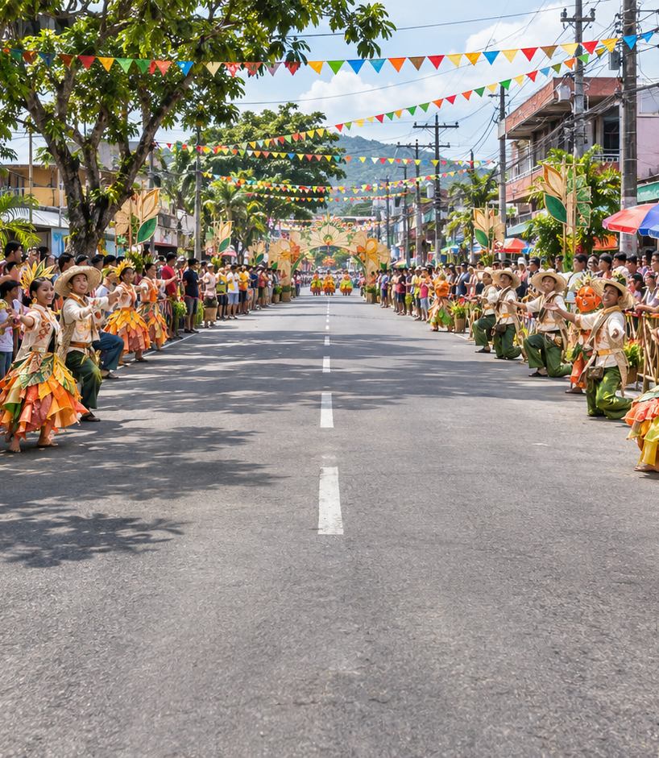

KA-PAMANA
A mobile application for interactive learning and preservation of Oriental Mindoro’s culture and heritage
Mathew Andrei F. Abao • John Christopher C. Araño
Mica V. Palpallatoc
BSIT 4-5
Notes:
Introduce the project title and the team. Explain that KaPamana is a working educational prototype focused on Oriental Mindoro. The image is festival-inspired artwork generated for the app, not documentation of a specific real event.

Slide 2
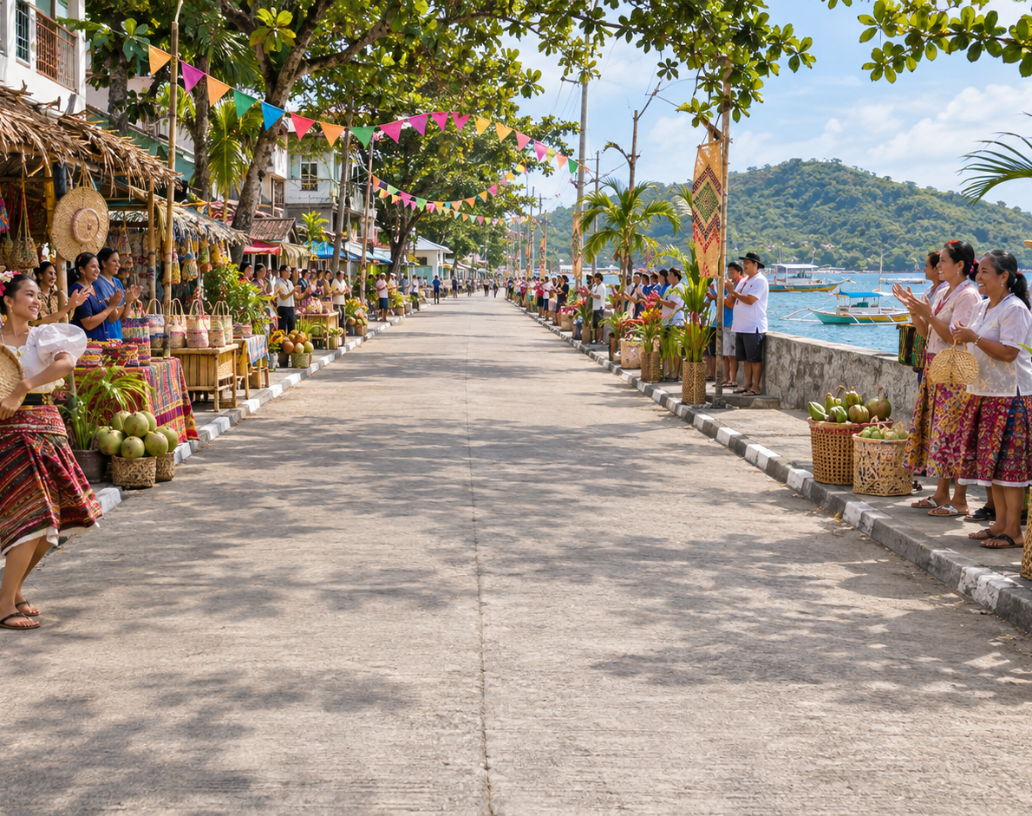
Why we developed KA-PAMANA
Oriental Mindoro has one city and 14 municipalities. Its places and living traditions deserve context that learners can revisit beyond a single lesson.
We built short mobile adventures that connect a place, a mission, a discovery, and a record of progress.
Illustrative app artwork
02
Notes:
The Philippine Statistics Authority lists Calapan City and 14 municipalities for Oriental Mindoro. UNESCO frames living heritage as practice recognized by communities. Our aim is to support awareness through repeatable mobile activities, while treating local communities as the authority on their heritage. Sources: https://psa.gov.ph/classification/psgc/citimuni/1705200000 and https://ich.unesco.org/convention

Slide 3
Research problem
01
How can learners explore places and festivals through short interactive activities?
02
How can the chosen Buddy remain the playable character across festival routes?
03
How can script practice avoid confusing spelling conversion with language translation?
04
How can progress survive a restart and reconnect to an account?
03
Notes:
These questions reflect the implemented scope of the system. The study also asks what technical checks establish current functionality, and what future evaluation is required before making educational or cultural-effectiveness claims.

Slide 4
Study objectives
01
Develop place and festival routes with clear mission goals.
02
Keep the selected Buddy as the playable runner and show festival characters as guides.
03
Record stars, discoveries, rewards, and passport progress.
04
Provide Hanunóo character lessons, spelling practice, tracing, saving, and sharing.
05
Protect account data and document what still requires user and cultural review.
04
Notes:
The general objective is to develop and document KaPamana as a mobile application for interactive learning about Oriental Mindoro culture and heritage. The specific objectives correspond to features present in the repository. The project does not claim measured learning gains.

Slide 5
Research and design basis
UNESCO
Living heritage requires respect for the communities who practice it.
NCCA and Unicode
Hanunóo lessons need cultural context and correct script encoding.
Sailer and Homner
Game elements can support learning, but outcomes depend on design.
Casual Learn study
Mobile heritage learning should be evaluated with observed use.
Full references appear at the end of this deck.
05
Notes:
UNESCO: https://ich.unesco.org/convention. NCCA: https://ncca.gov.ph/about-culture-and-arts/in-focus/ginaw-bilog-and-the-ambahan-tradition/. Unicode: https://www.unicode.org/versions/Unicode17.0.0/core-spec/chapter-17/. Sailer and Homner (2020): https://doi.org/10.1007/s10648-019-09498-w. Ruiz-Calleja et al. (2023): https://doi.org/10.1016/j.ijhcs.2022.102959. These sources inform the design and evaluation plan; they are not evidence that KaPamana already improved learning.

Slide 6
Conceptual framework
INPUT
PROCESS
OUTPUT
Place and festival records
Buddy choice
Touch and word input
Runner mission
Discovery and script rendering
Drawing capture and save
Result and passport
Learning progress
Complete story image
FEEDBACK
Build checks, unit tests, device demonstration, and planned user and cultural review guide revisions.
06
Notes:
This is the study’s input-process-output framework. Inputs include catalog content, the selected Buddy, touch input, and word entry. The app processes game rules, cultural discoveries, Hanunóo character rendering, drawing, local save, and cloud sync. Observable outputs include mission results, passport records, and an exported story image. Feedback includes completed technical checks and later evaluation.

Slide 7
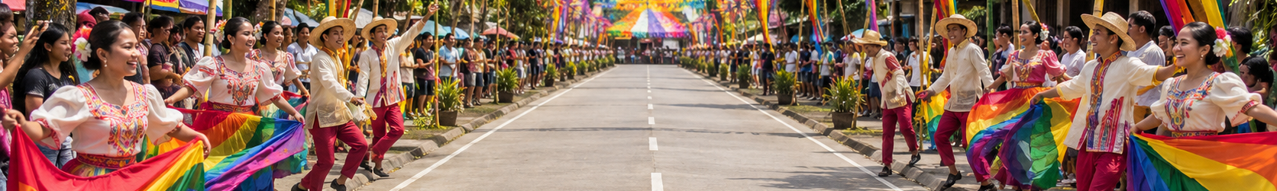
Current content scope
15
18
72
Oriental Mindoro
city and municipalities
festival-inspired
routes
festival runner
missions
The active catalog contains 64 destinations and 407 missions overall. Each festival route has four missions.
07
Notes:
The active-group filter in src/App.tsx excludes the archived International group. The resulting active catalog has 64 destinations and 407 missions. The Oriental Mindoro festival group has 18 routes and 72 missions, four per route. The 18 routes are distributed across the 15 local government units, with multiple Calapan routes. These counts describe the repository snapshot, not a complete or official register of festivals. Geographic source: https://psa.gov.ph/classification/psgc/citimuni/1705200000

Slide 8
Traveler experience
01
Sign in and choose a Buddy
02
Open a place or festival route
03
Complete a runner mission
04
Read the discovery and check the passport
05
Practice a character, then save or share a tracing image
08
Notes:
The current configured build starts with account creation or sign-in. A traveler then chooses a Buddy, browses destinations, plays a mission, views results and discoveries, and uses the learning area. Returning signed-in sessions can continue from cached resources and locally saved progress during a connection interruption.

Slide 9
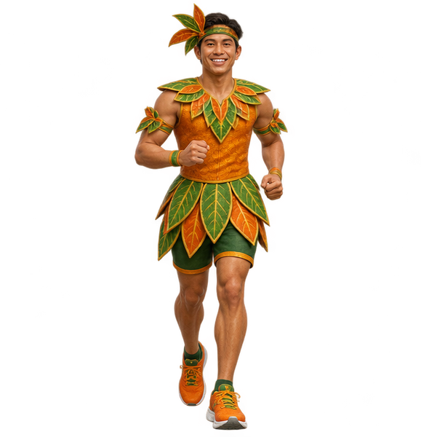
Buddy and festival guide
Chosen Buddy
Festival guide
Playable runner throughout the route
Introduces the route; does not replace the Buddy
09
Notes:
The traveler’s selected Buddy stays the active runner in festival missions. Festival-specific runner art is used as a guide character and route identity. This distinction was an explicit correction requested during development. The character art is illustrative game artwork.

Slide 10
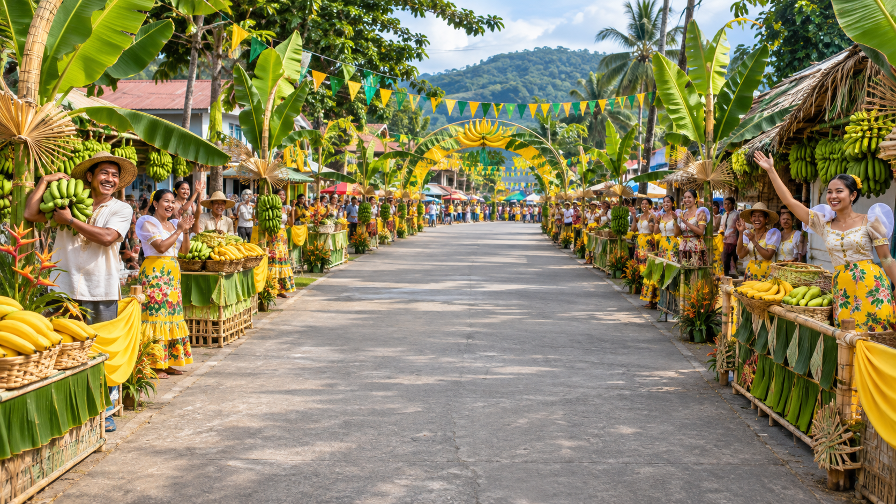
Festival runner missions
Four missions per route
Move across three lanes. Collect themed items, avoid hazards, and meet the mission goal.
Results update stars and rewards in the traveler’s save.
Festival imagery is illustrative, not event photography.
10
Notes:
The festival group contains 18 routes and 72 missions. Each route has a themed background, collectible, icon, and guide. Mission content is a game interpretation of festival themes. The generated art must not be represented as a photograph of an actual celebration.

Slide 11
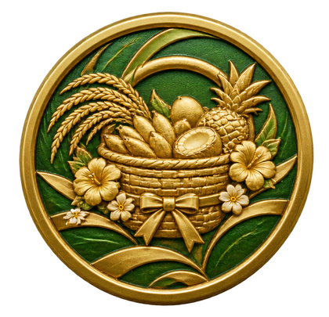
Passport and discoveries
A visible record of the journey
Mission results add stars, rewards, and best scores. Route stamps and short discoveries connect progress to a place.
The passport reflects play. Cultural understanding needs separate evaluation.
11
Notes:
The passport lets users revisit destinations, rewards, stamps, and discoveries. The point of the design is to make a learning prompt available after play. A high game score does not itself prove cultural knowledge, so the proposed evaluation includes knowledge and interpretation questions.

Slide 12
Hanunóo learning area
18
70
base characters
practice words
Character lessons, recognition checks, finger tracing, and saved drawings support repeated practice.
Word entry renders supported Latin spelling in script. It does not translate a word into the Hanunóo language.
12
Notes:
The Hanunóo module uses 18 base characters and 70 word exercises documented in the project. Unicode provides the script encoding. The converter applies mechanical spelling rules to supported Latin input; it does not translate meanings, establish pronunciation, or assess culturally accepted handwriting. Sources: docs/HANUNOO-LEARNING.md; https://www.unicode.org/versions/Unicode17.0.0/core-spec/chapter-17/; https://ncca.gov.ph/about-culture-and-arts/in-focus/ginaw-bilog-and-the-ambahan-tradition/

Slide 13
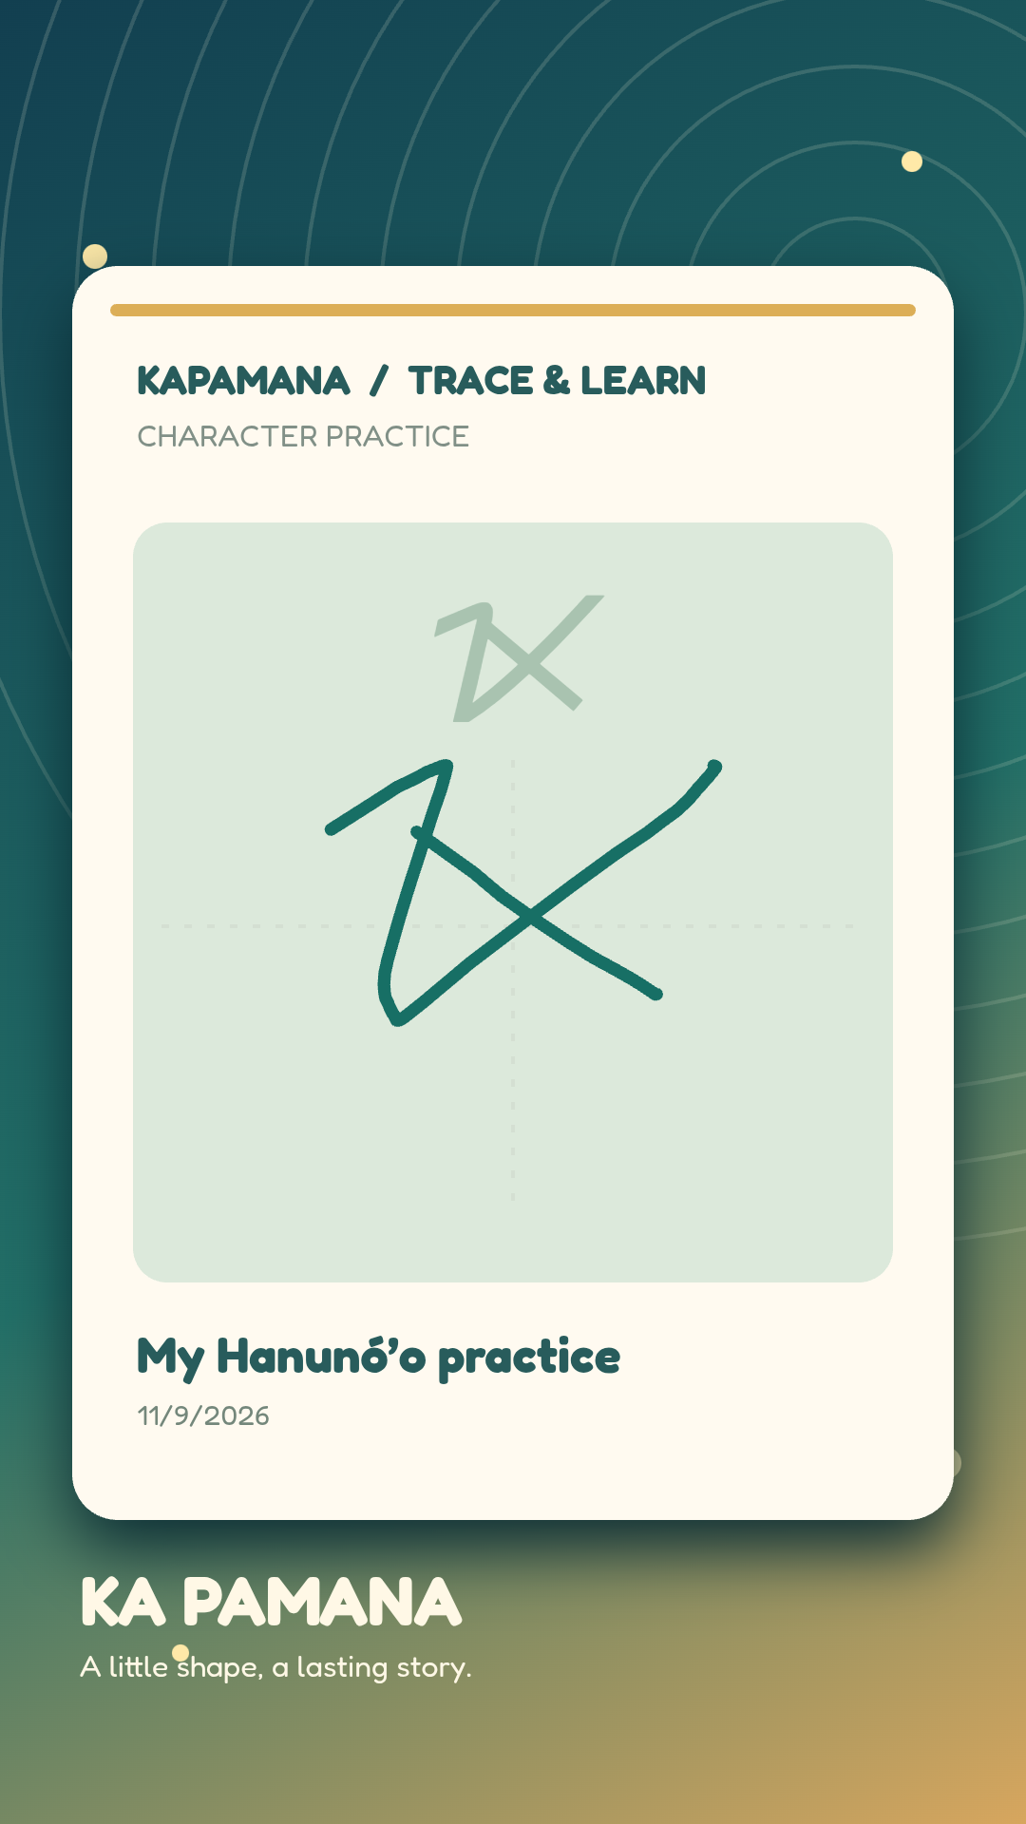
Actual saved tracing image
The app exports the complete portrait story, including the drawing, border, caption, and footer.
Users can save the PNG on the phone or hand it to Android’s share sheet.
This is the team’s actual uncropped export.
13
Notes:
This is the actual PNG supplied from the app’s tracing flow, shown in full without cropping. The implementation exports a 1080 by 1920 image. It can save through Capacitor Filesystem and invoke the Android Share API. The image itself is evidence of export, not evidence that it was posted to a social platform. Capacitor Share: https://capacitorjs.com/docs/apis/share

Slide 14
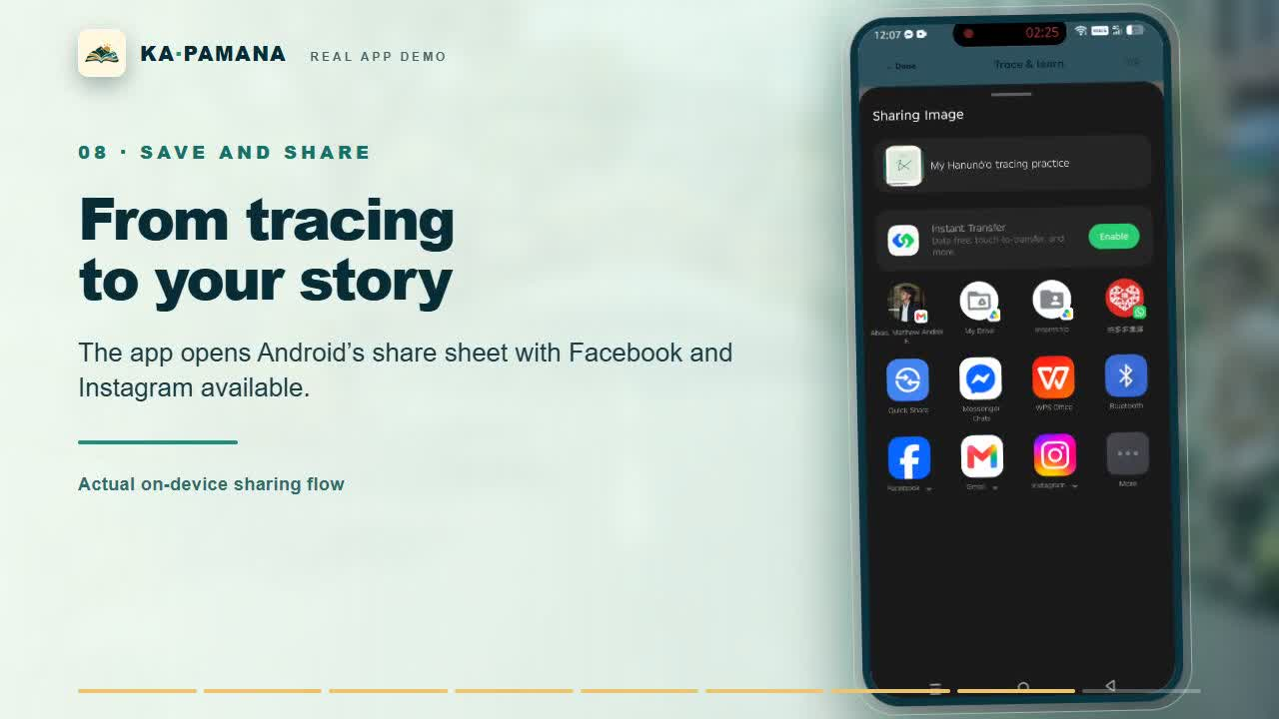
Notes:
This frame comes from the narrated demo assembled from the team’s real Android recording. The share sheet shows Facebook and Instagram among the available apps. The user still chooses the destination and completes any posting step in that app. Open the separately supplied KaPamana_Actual_App_Demo.mp4 for the full recorded sequence.

Slide 15
Progress and data design
ON THE PHONE
IN THE ACCOUNT
FOR CONTENT STAFF
Progress saves locally first, so a returning signed-in traveler can continue during an interruption.
Supabase stores an account-linked player save and can restore progress after sign-in on another device.
Editors manage published and draft content. Database roles and row policies govern access.
A new sign-in needs connectivity. Cross-device restore still requires a fresh live verification run.
15
Notes:
The Ionic React and Capacitor app uses local Capacitor Preferences and native Filesystem facilities. Supabase provides authentication, content records, and account-linked player_saves. Migration files define roles and row-level security. The documentation run verified implementation code but did not independently reverify the live deployment or cross-device restore. Supabase RLS source: https://supabase.com/docs/guides/database/postgres/row-level-security

Slide 16
Development methodology
01
Inspect existing game material and assets
02
Define a focused requirement
03
Implement code and structured content
04
Run tests and build the app
05
Inspect the browser or phone flow
06
Revise wording, visuals, or behavior
16
Notes:
This is an applied design-and-development study. The team iterated from requirements to implementation and technical checks. The completed evidence includes repository files, build output, automated tests, and an Android demonstration recording. There is no completed participant survey, controlled pretest/posttest, or formal community review in the manuscript.

Slide 17
What we verified
PASS
Production TypeScript and app build
115
unit tests passed across 14 files
OPEN
Browser tests need an account-aware setup
OPEN
Live cloud restore and cultural learning outcomes need direct evaluation
Snapshot checked 9 November 2026
17
Notes:
The production build passed TypeScript, Vite, and stylesheet checks. All 115 unit tests in 14 files passed. The attempted browser end-to-end suite timed out at the account-first gate because its scripts still expected legacy onboarding controls. That suite is not counted as passed. Live Supabase restore and formal usability, learning, and cultural outcomes were not reverified during the documentation run.

Slide 18
Evaluation still required
Usability
Cultural review
Reliability
Observe people signing in, choosing a Buddy, completing a mission, and exporting a tracing image.
Ask appropriately identified knowledge holders to examine wording, images, and script guidance.
Test offline restart, second-device restore, access rules, and draft visibility with real accounts.
These activities are proposed. No participant results are claimed in Chapters 1–3.
18
Notes:
The manuscript proposes task observation, consent and participant criteria, cultural review with knowledgeable community members, and reliability/security scenarios. The team should document the actual sample, devices, consent, results, failures, and limitations before reporting effectiveness. ISO 9241-210 and ISO/IEC 25010 inform the plan: https://www.iso.org/standard/77520.html and https://www.iso.org/standard/78176.html

Slide 19
Live demonstration
01
Open the app and select a Buddy
02
Enter one festival route
03
Play a mission and view the result
04
Open the passport and discovery
05
Type a word, trace, save, and share
Backup: play the 90-second narrated app video stored with this presentation.
19
Notes:
Use the installed APK and a dedicated account. The live sequence is Buddy, festival, mission, result, passport, then word entry and tracing export. Keep the local KaPamana_Actual_App_Demo.mp4 ready as a backup. The runbook also recommends a primary and backup connection; do not display private credentials on the projector.

Slide 20
References and questions
Philippine Statistics Authority. Province of Oriental Mindoro. PSGC.
UNESCO. (2003). Convention for the Safeguarding of the Intangible Cultural Heritage.
NCCA. Ginaw Bilog and the ambahan tradition. Unicode Standard 17.0.
Sailer & Homner. (2020). The gamification of learning: A meta-analysis.
Ruiz-Calleja et al. (2023). Casual Learn and cultural heritage learning.
ISO 9241-210:2019 and ISO/IEC 25010:2023.
Full bibliographic entries are in the Chapters 1–3 document.
20
Notes:
Thank the panel and invite questions. Full references with links appear in the Chapters 1–3 document. Project repository: https://github.com/cedimscalapan/bp. The slide sources are also cited in the notes of the relevant slides.

