Slide 1
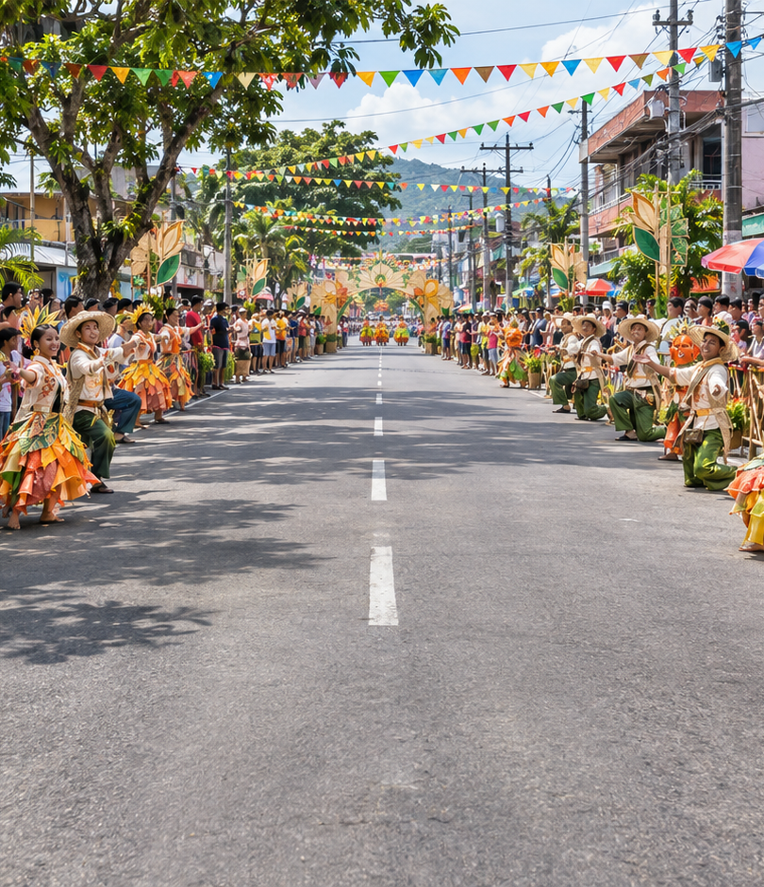
KA-PAMANA
A Mobile Application for Interactive Learning and Preservation of Oriental Mindoro’s Culture and Heritage
ABAO, MATHEW ANDREI F.
ARAÑO, JOHN CHRISTOPHER C.
PALPALLATOC, MICA V.
BSIT 4-5

Slide 2
CORE EXPERIENCE
A Buddy-led adventure
Choose a Buddy
Your selected Buddy runs the route. Festival characters appear as guides.
Play short missions
Move between three lanes, collect items, avoid hazards, and earn stars, coins, and XP.
KA-PAMANA • BSIT 4-5
02

Slide 3
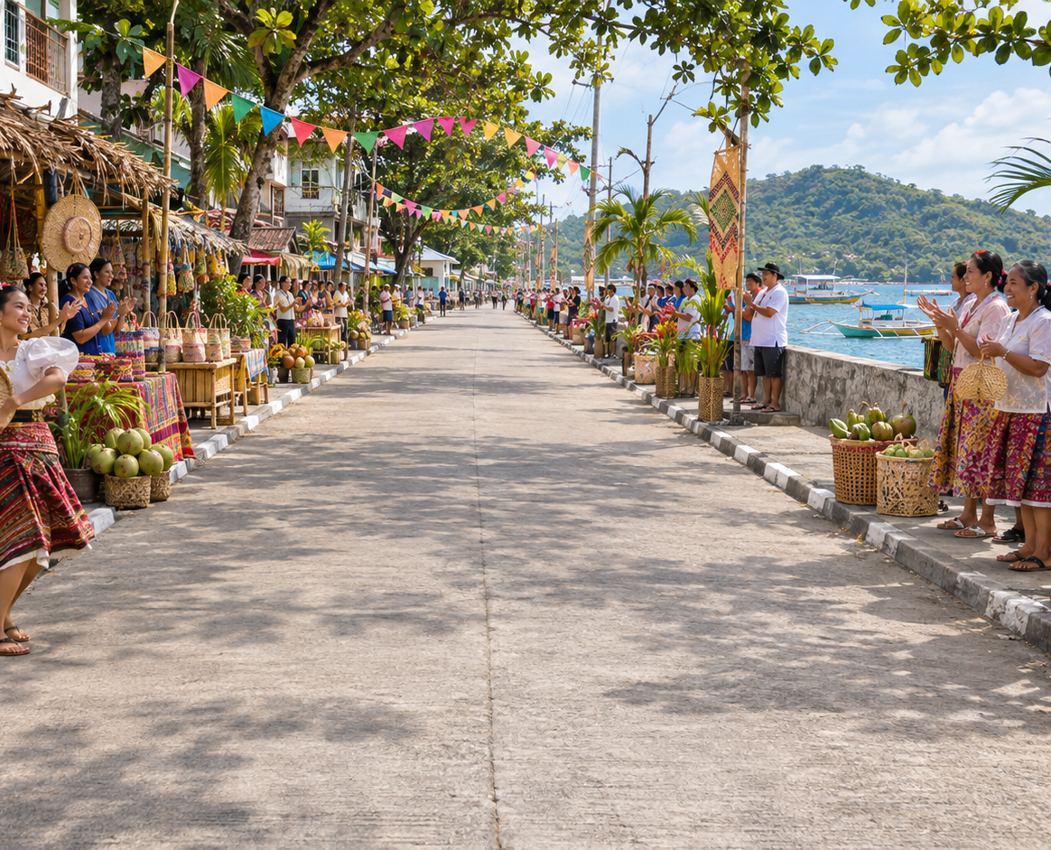
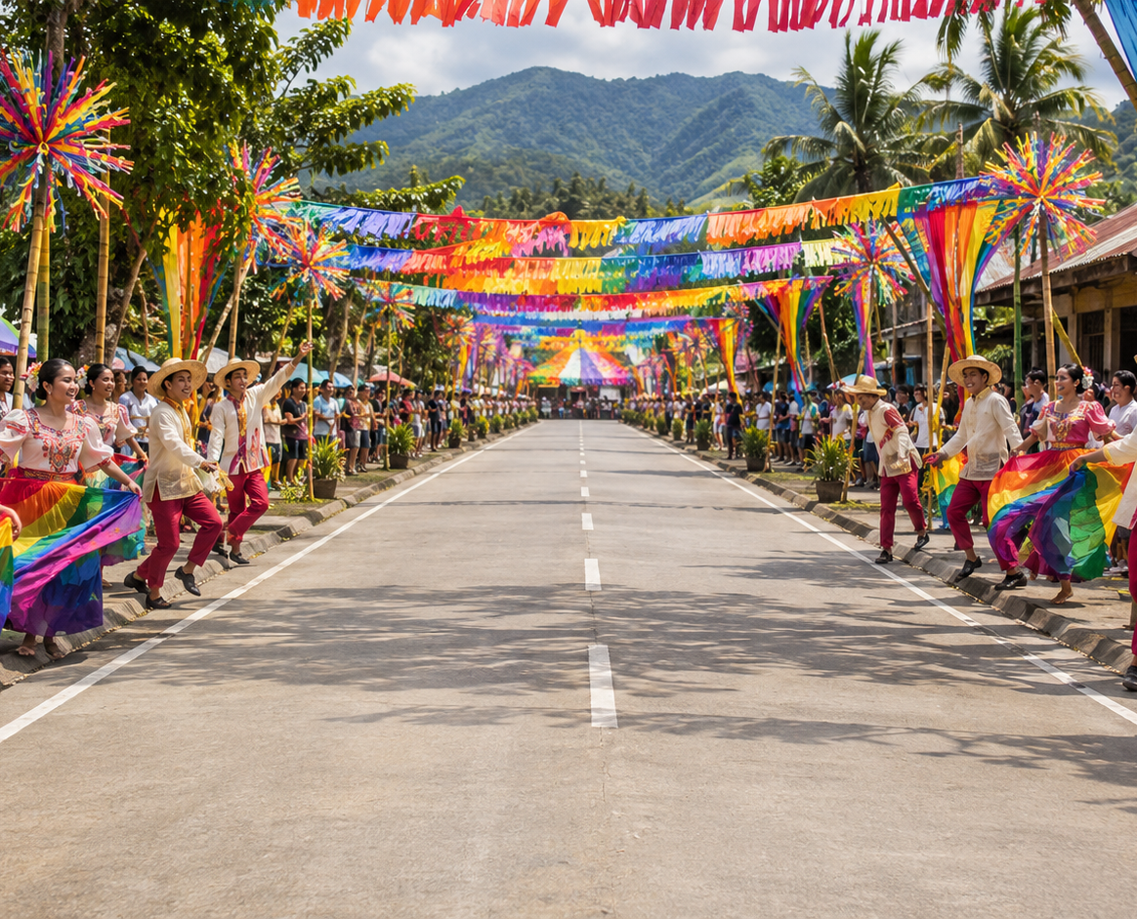
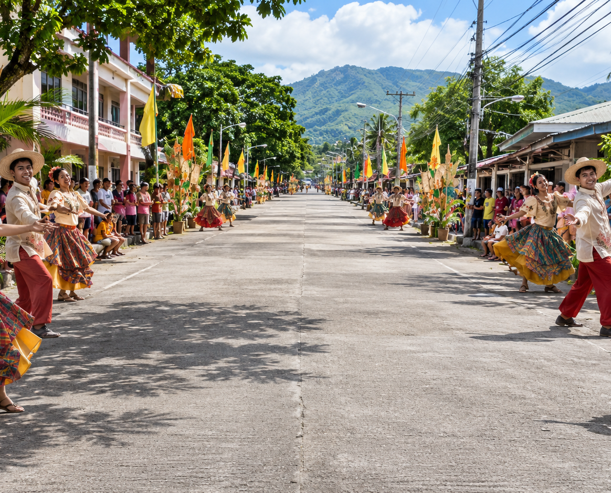
Oriental Mindoro festivals
18 festival routes • 72 runner missions
Every route has four missions, a background, collectible, passport icon, and festival guide.
Generated illustrations depict festival themes; they are not event photographs.

Slide 4
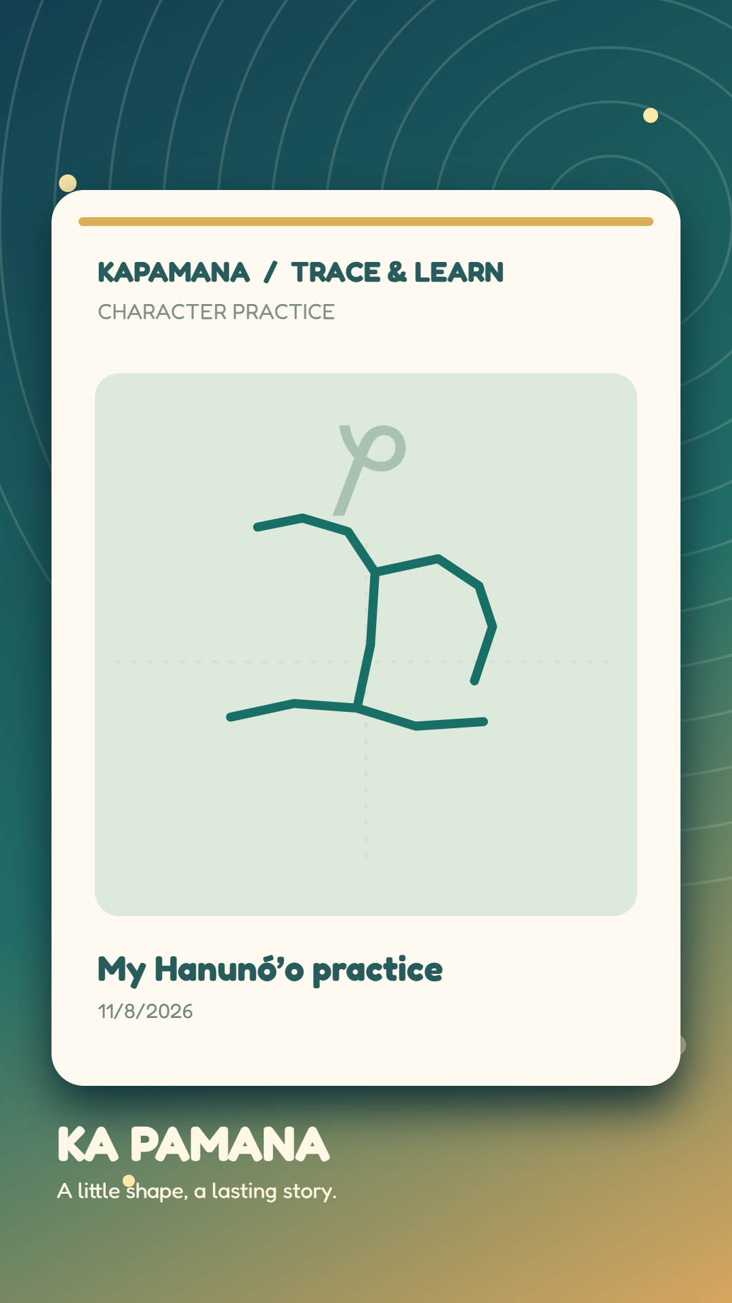
LEARNING STUDIO
Learn and trace Hanunó’o
18 base characters
Practice character forms and familiar words with touch tracing.
Write your own word
The converter renders Latin spelling in script for tracing. Save the drawing as an image or share it through your phone.
KA-PAMANA • BSIT 4-5
04

Slide 5

Progress follows the traveler
Passport and rewards
Mission results update stars, best scores, discoveries, and stamps.
Account-linked cloud save
Progress saves locally first, then syncs to Supabase when the signed-in phone has a connection.
Offline changes are retried when the app reconnects.

Slide 6
PRESENTATION FLOW
Live demonstration
01
Sign in and choose a Buddy
02
Open a festival route
03
Run a mission and view the result
04
Check the passport
05
Enter a word, trace, save, and share
Keep the MP4 and APK stored locally for the presentation.
KA-PAMANA • BSIT 4-5
06

