Slide 1
Pens and Printer Project analysis
BERTHEZENE Cédric
Notes:
Hello,
Thanks for joining this presentation.
I am Cedric and today I will talk about Pens and Printer, a company specialized in providing high-quality office products for large corporations.

Slide 2
CONTEXT AND BUSINESS OBJECTIVES
Launch a new line of office stationery (notebooks, pens and sticky notes)
Collected some data for the past 6 weeks of the performance for each sales method
Goal : identify the most efficient sales method balancing the revenue earned and the energy spent
Notes:
The company launched a new line of office stationery including notebook, pens and sticky notes.
They tested for 6 weeks different sales techniques and collected data for one goal : identity the most efficient sales method balancing the revenue earned and the energy spent.

Slide 3
METHODOLOGY AND DATA CLEANING
Cleaned 6 weeks of sales data
Fixed sales method categories
Analyzed the overall revenue, the revenue per sales method and assessed if there were any differences between each customers’ groups
Set a business metric to monitor the performance for each sales method
Notes:
To ensure my mission a success, I first of all, make sure the data was ready for analysis. So I checked for duplicates and invalid values. And by counting each values in each colums, I noticed that there were missing values in the revenue columns (excluded from my analysis) and inconsistent entries in the sales methods fields.
I therefore formatted to three distinct categories to ensure a accurate grouping later on.
Second of all, I made my analysis depending on the company needs as the instructions I received by email.

Slide 4

DATA EXPLORATORY

Slide 5
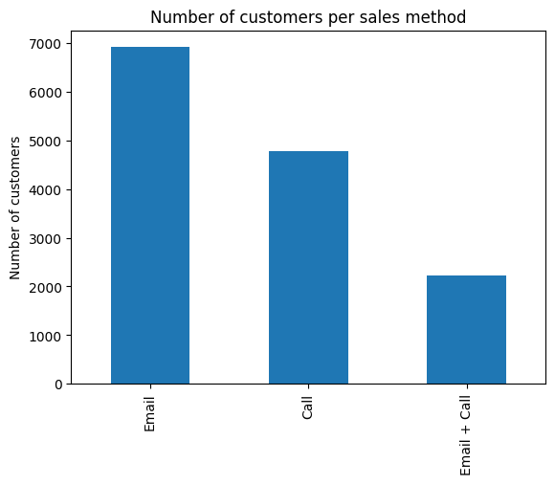
Email : the most effective channel for customers acquisition
Notes:
Over the past six weeks, email alone accounted for approximately 50% of all customer interactions. This confirms that email remains an efficient and scalable method to capture customer attention—especially in an increasingly digital world where quick communication is key.
However, does capturing attention via email alone translate into high revenue? To answer this, we now dive deeper into the revenue analysis of each sales method.

Slide 6
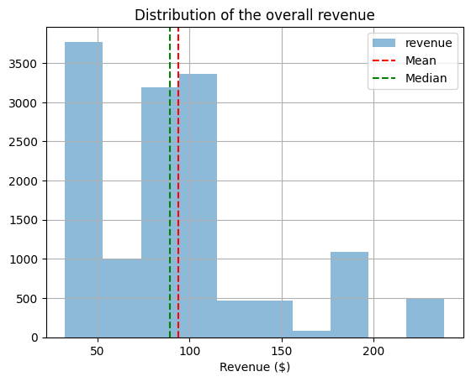
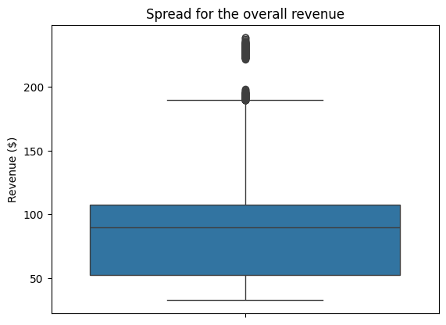
Solid revenue performance driven by high-value office stationery
Notes:
The median revenue around $100 is a solid result considering the type of products which was sold. Considering also, some products were sold for more that $200. That implies a good relationship with qualified customers ready to spend more to renew their office stationery products.

Slide 7
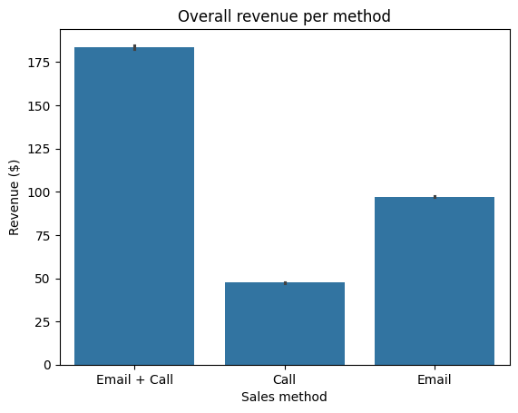
Email and call : the most effective combination tool for generating high revenues
Notes:
As per the number of customers captured, sending an email only is the best way to generate higher revenue returned. While the call, which is very time-consuming is the least effective.

Slide 8
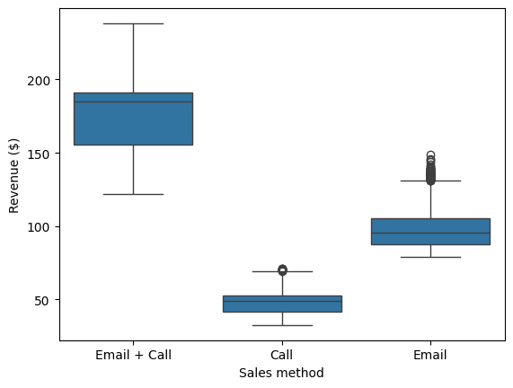
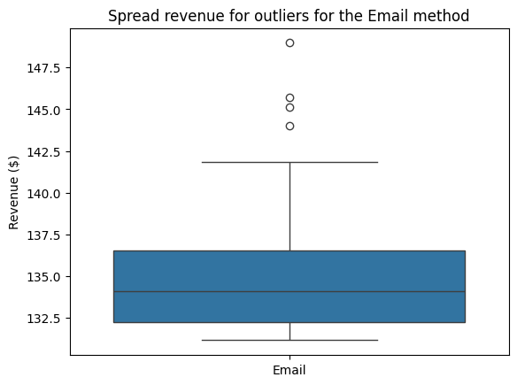
Boosting revenue : Combining emails with follow-up call for long-term gains
Notes:
Email alone proves to be an efficient method for generating significant revenue, though individual transaction amounts can vary widely—some exceeding $142.50, while others fall below $100. To secure more consistent and sustainable revenue growth over the long term, combining email outreach with a follow-up call is far more effective

Slide 9
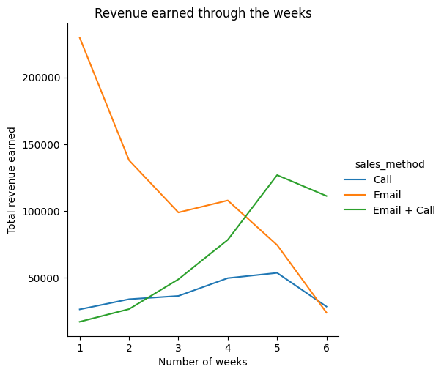
Ensuring stable revenue growth with email and follow-up calls
Notes:
The combination of email and call is the safest approach to ensure steady and long-term revenue growth across the weeks. While email alone can generate high revenue, it is also prone to significant fluctuations, making it less reliable for consistent results. In contrast, the strategy of sending an email followed by a call as a follow-up has shown to maintain a more stable and increasing revenue trend.

Slide 10
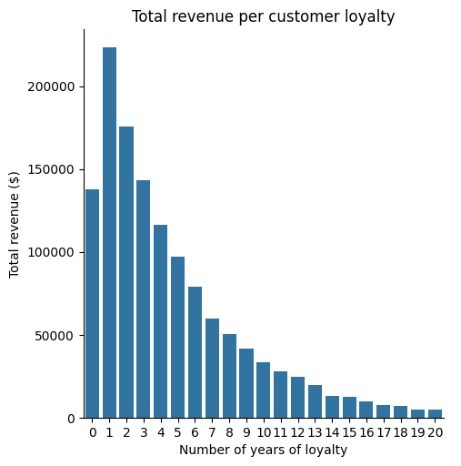
Single-year customers generated the highest revenue
Notes:
New customers and those who have been buying for around 5 years generated the highest revenues. Interestingly, the single-year customers stand out as the group with the highest spending on the new product line. Moreover, the longer a customer has been with the company, the less they tend to purchase the new products. This trend might be because long-term customers already know their preferred products or are less open to trying new offerings.

Slide 11
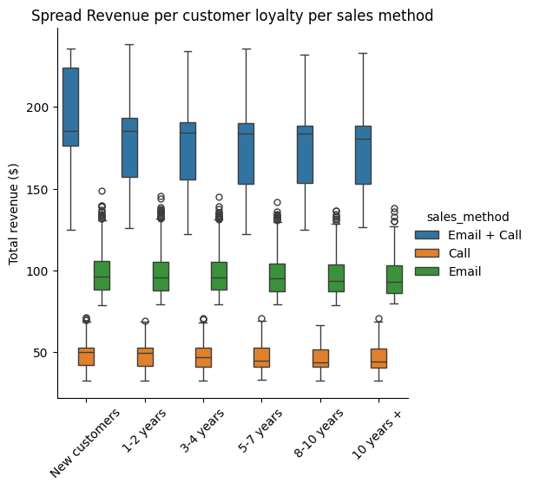
Email and follow-up calls increase the chance to get a higher revenue
Notes:
It seems that the Email + Call is the most efficient way of generating revenue remains really efficient even among the the customer loyaly. Even though, the email can generate higher revenue, because we see many outliers that would show that in some cases, the email is enough to generate a high revenue.

Slide 12

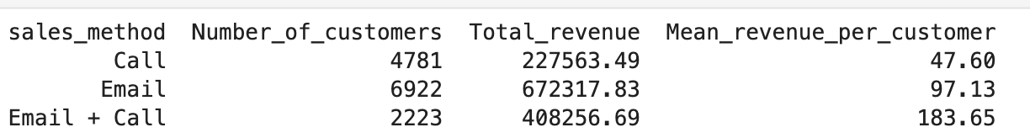
Business metric to follow
Notes:
Our analysis showed that the best sales method was the combination of Email + Call based on the revenue. In order for the company to assess and monitor closely each method performance, the revenue, the number of customers and the average revenue needs to be included as key components. Here bellow the equation :
When evaluating this metric, sending only emails is a great way to generate a high revenue and reach a wide number of customers. But, sending an email and follow-up with a call a week later has a conversion rate with a higher mean revenue per customer contacted (twice more important than only sending an email).

Slide 13
Conclusion and recommandations
Email and follow-up calls is the best sales method
The longer a customer is loyal, the less he is ready to buy new products
Use this business metric to keep assessing the sales method performance
Keep combining emails and follow-up calls for longer and sustainable growth
Focus efforts on customers withing their first 5 years

