Slide 1
Anelloviruses – The Enigma
Cedric CS Tan
3rd year, BSc Molecular Biology

Slide 2
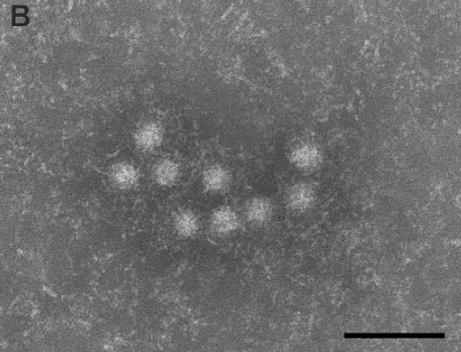
Introduction
Torque teno virus was first member discovered (Nishizawa et al., 1997)
No stable cell culture system
No animal models
~30nm, non-enveloped, icosahedral capsid
100nm
Itoh et al., 2000
Notes:
https://pubmed.ncbi.nlm.nih.gov/9405239/
https://pubmed.ncbi.nlm.nih.gov/11118351/

Slide 3
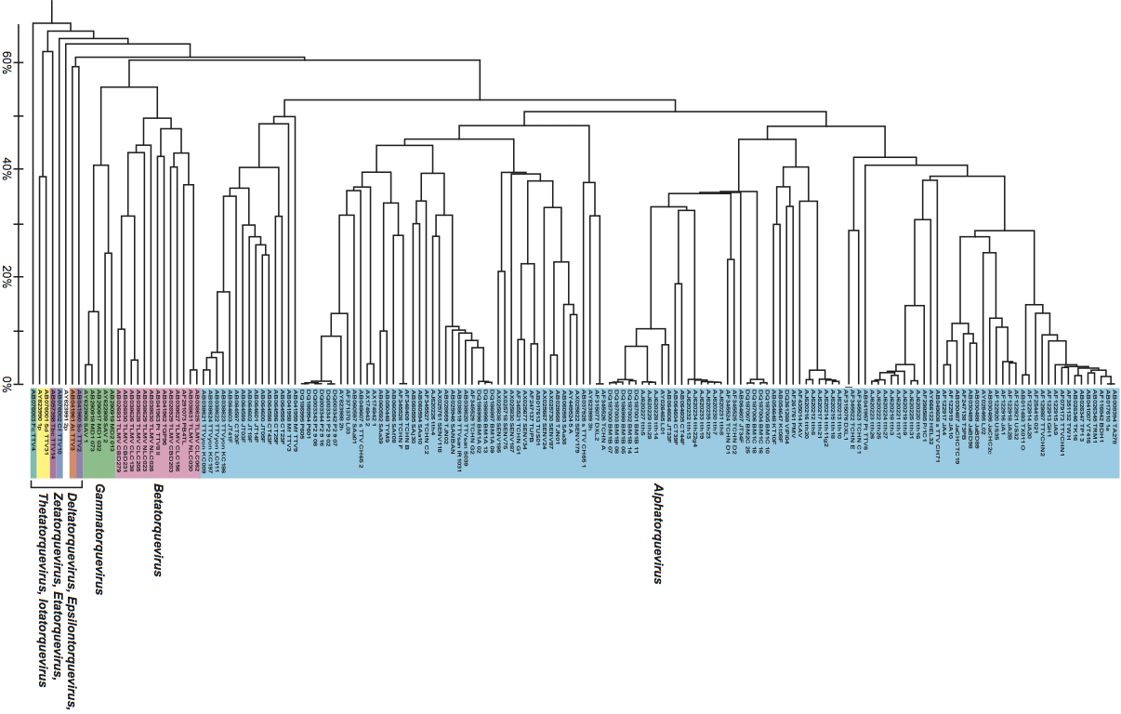

Taxonomy
UPGMA; ORF1
Notes:
https://talk.ictvonline.org/ictv-reports/ictv_9th_report/ssdna-viruses-2011/w/ssdna_viruses/140/anelloviridae-figures

Slide 4
Nomenclature
Alpha → Torque teno
Beta → Torque teno mini
Gamma → Torque teno midi
Delta → Torque teno tupaia
Epsilon → Torque teno tamarin
Zeta → Torque teno douroucouli
Eta → Torque teno felis
Theta → Torque teno canis
Iota → Torque teno sus
Kappa → Torque teno sus virus K2
Lambda → Torque teno zalophus
Mu → Torque teno equus
Nu → Torque teno seal
Notes:
https://talk.ictvonline.org/ictv-reports/ictv_9th_report/ssdna-viruses-2011/w/ssdna_viruses/140/anelloviridae-figures

Slide 5
Genome structure
(-)ssDNA
Circular (rolling-circle)
2-3.9kb (Kaczorowska et al., 2020)
Notes:
https://doi.org/10.1093/femsre/fuaa007

Slide 6
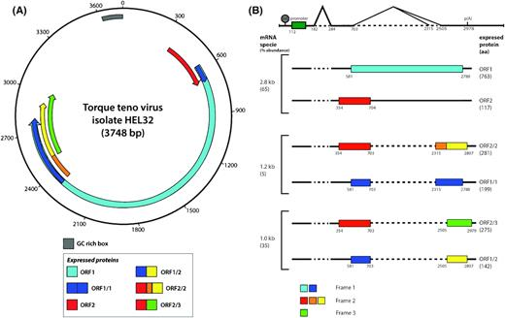
Genome structure
Alternative splicing
Kaczorowska et al., 2020
Notes:
https://doi.org/10.1093/femsre/fuaa007

Slide 7
Prevalence

Slide 8
Host Range
wood mice (Apodemus sylvaticus)
field voles (Microtus agrestis)
bank voles (Myodes glareolus)
Notes:
https://pubmed.ncbi.nlm.nih.gov/24744300/

Slide 9
Two events are fundamental to establishment of chronic viral infection (Figure 1). First, the virus must evade sterilizing immunity (the complete elimination of a virus). Second, the immune system must adjust to the continuous presence of viral antigen-driven inflammatory responses in order to limit viral replication to an acceptable level without untoward damage to permanently infected tissues.
Currently, there is no cell culture system established to propagate human AVs, and there is no animal model that could provide information on the virus–host interactions.
Notes:
https://doi.org/10.1016/j.cell.2009.06.036

