Slide 1
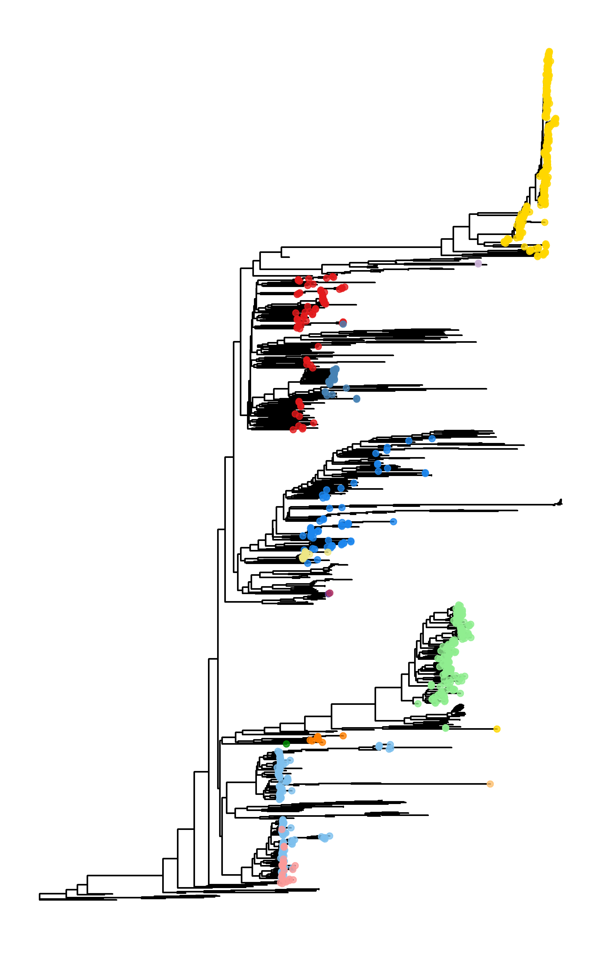
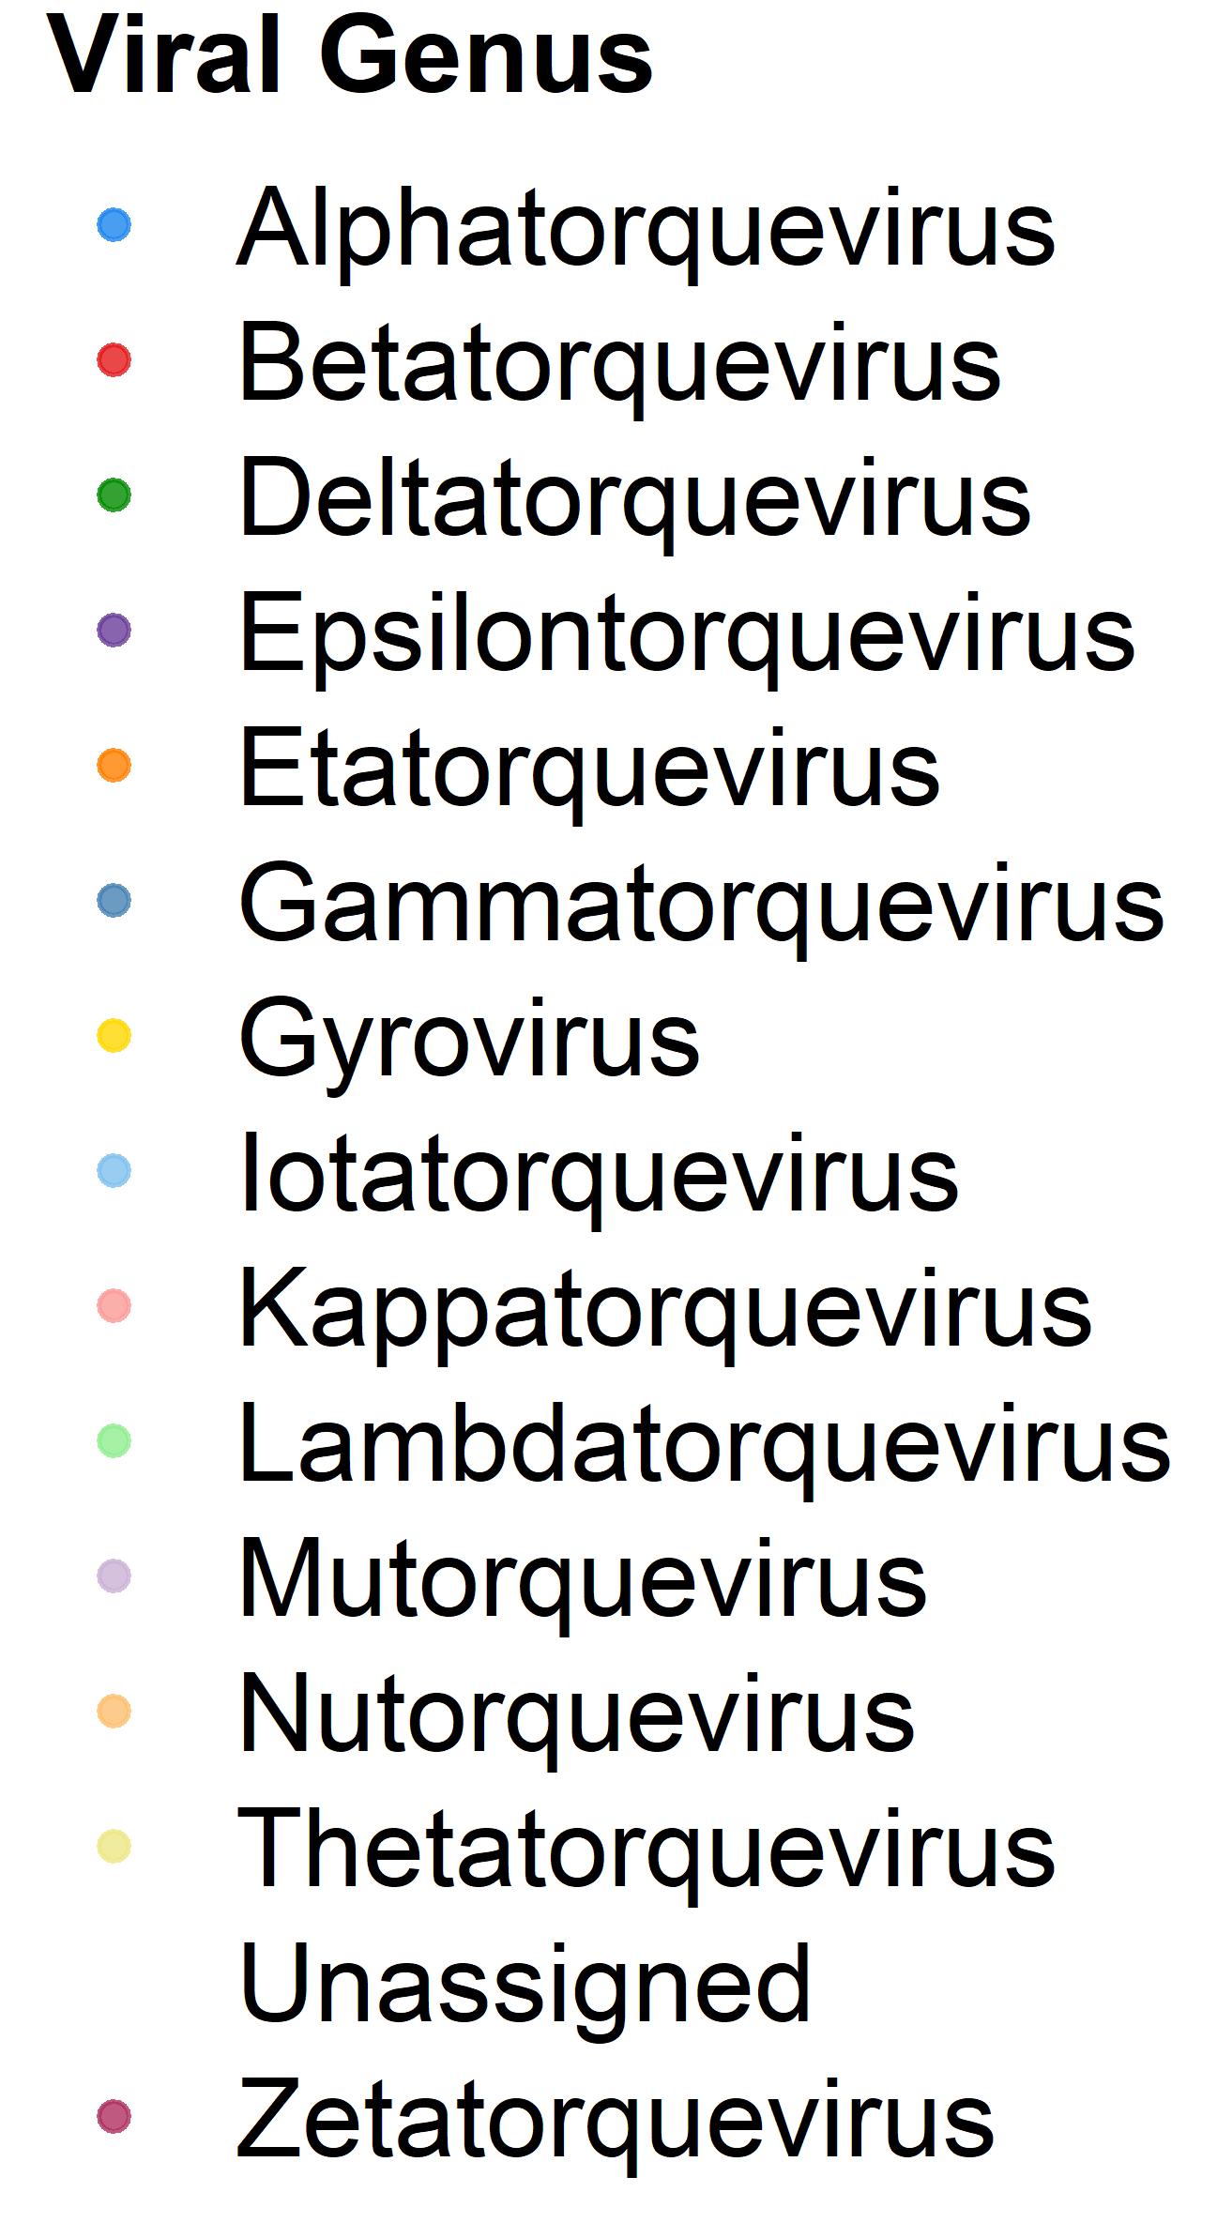

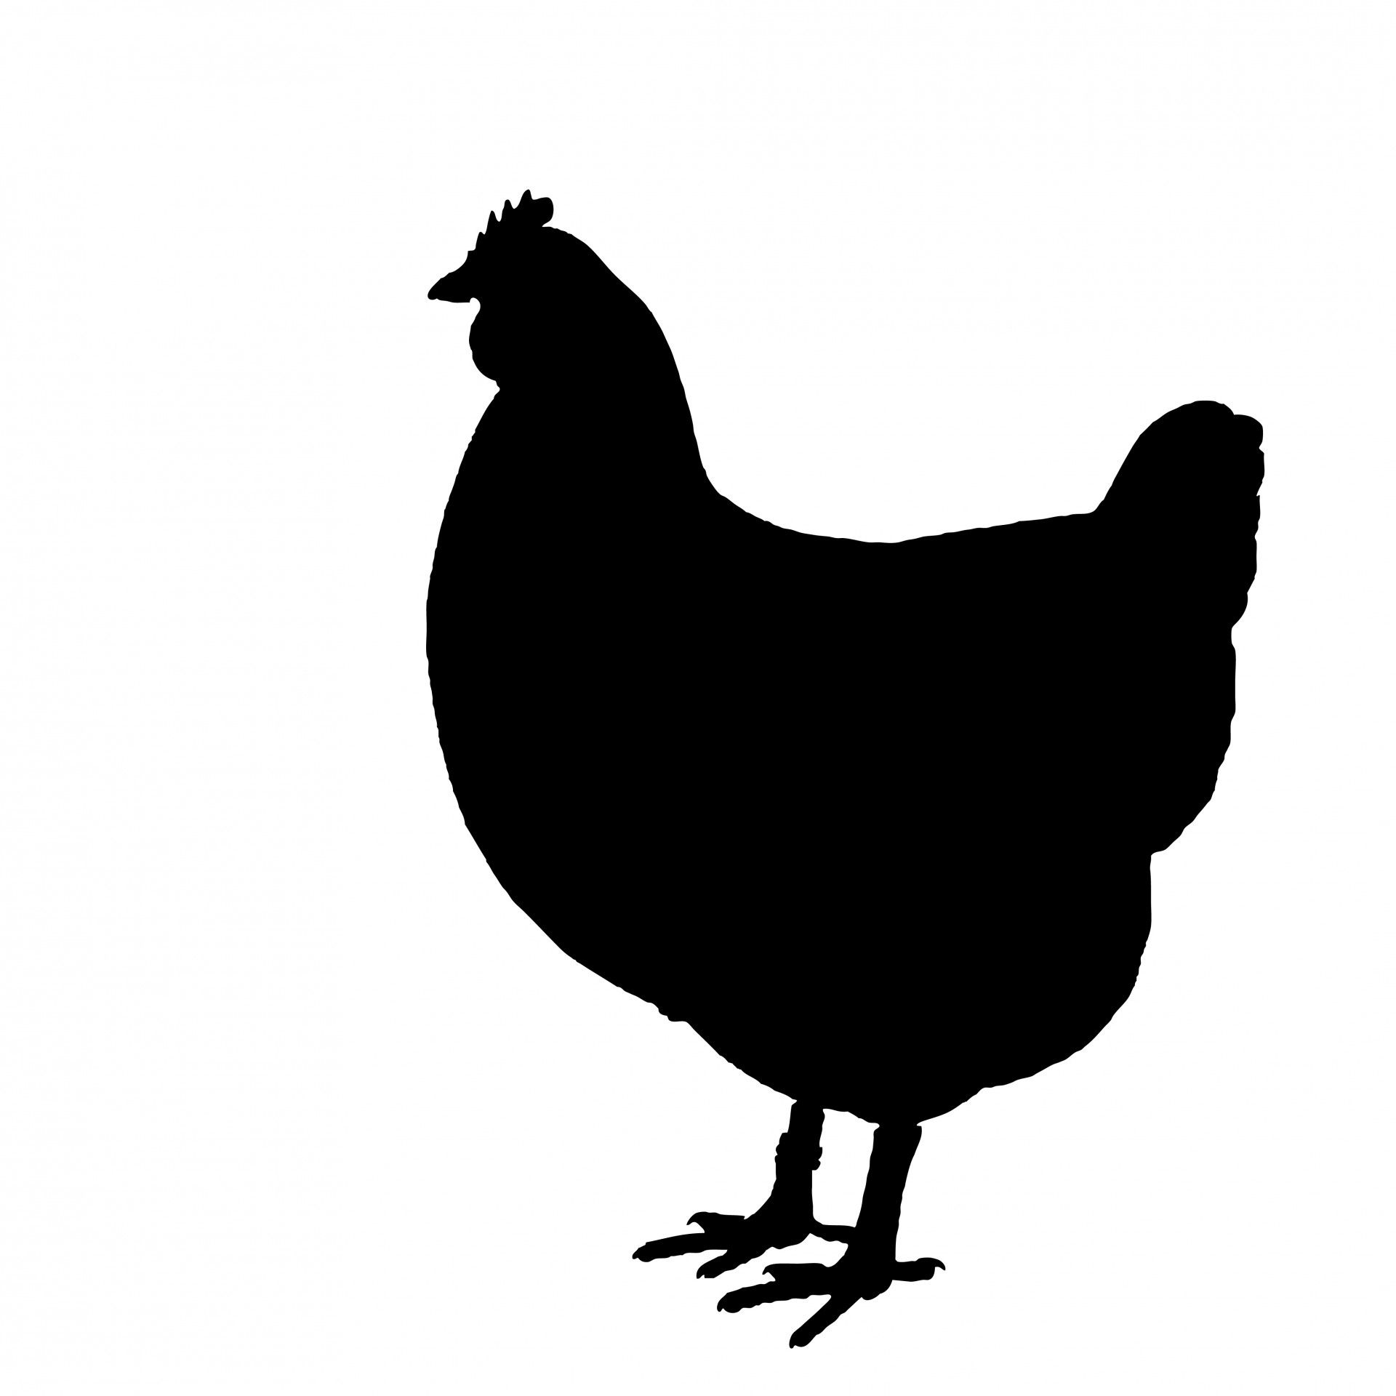


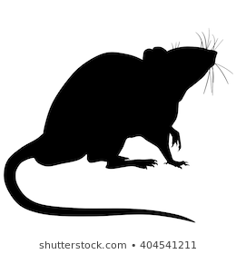
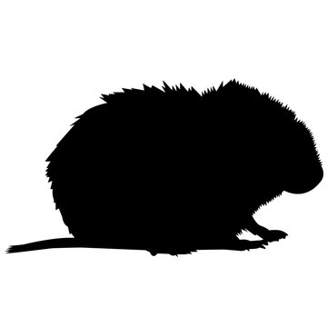

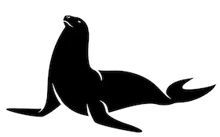

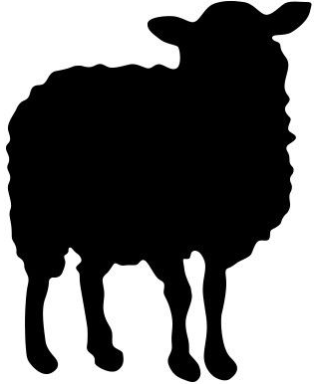


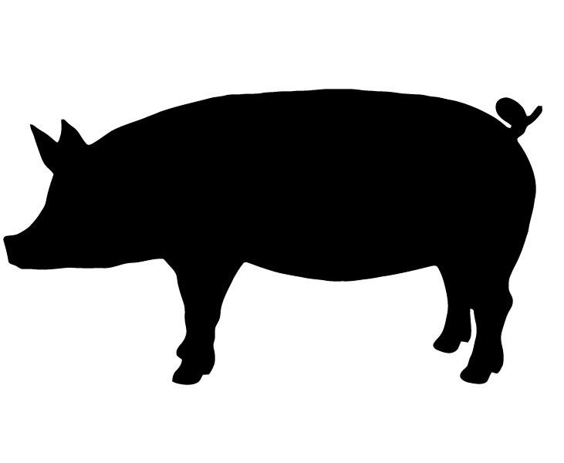
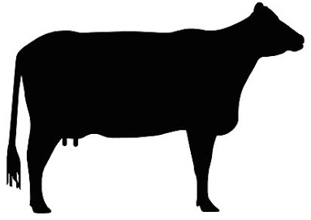


CAV
AGV
TTMV
TTMDV
TTMV
TTV
RoTTV
TTSuV
TTSuV
Transmission type
Host
Anthroponosis
Humans
Cats
Mice
Sheep
Zoonosis
Swine
Monkeys
Voles
Cow
Animal-animal
Chicken
Pinnipeds
Chinchillas
Elk
Dogs
Bats
Opossums
Horse
Tan, C. (2021)
Notes:
Proteome-wide 40% PID merged

Slide 2

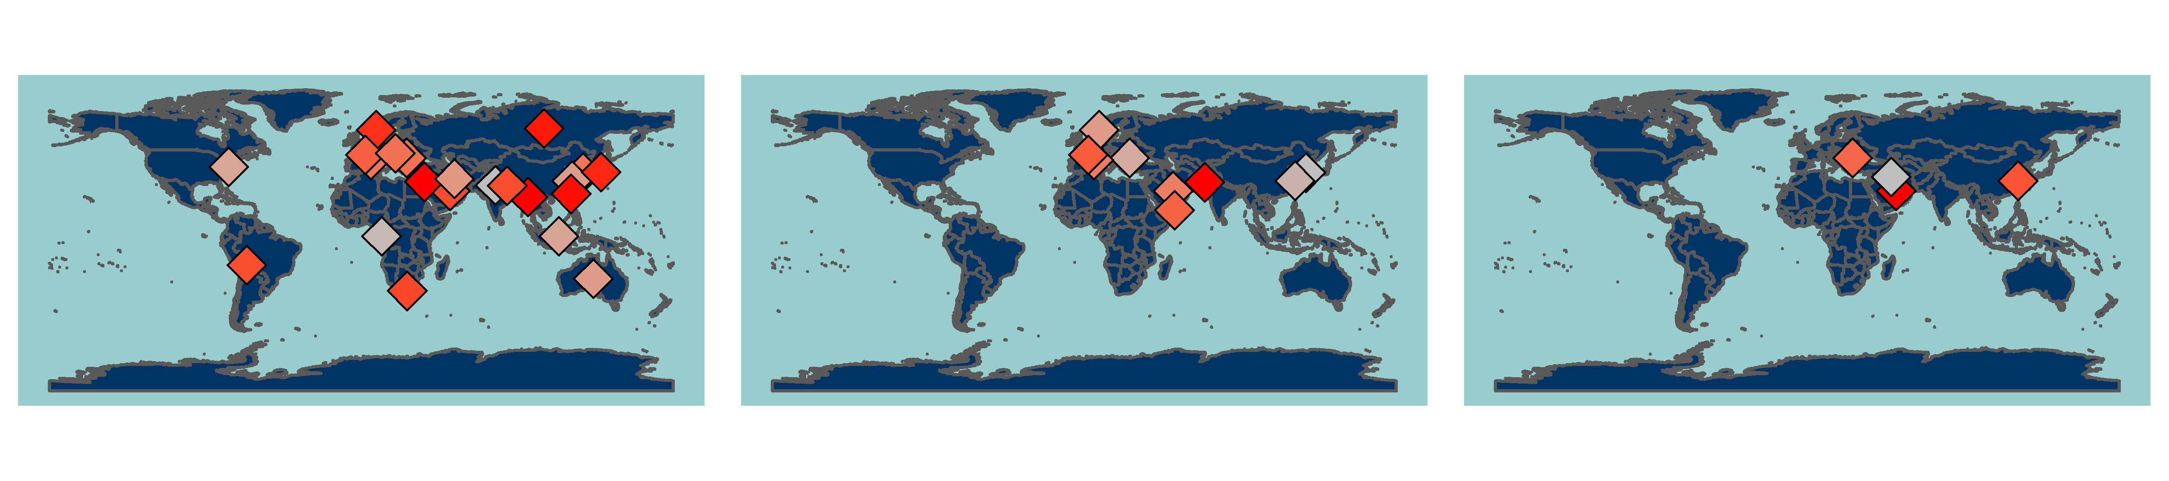
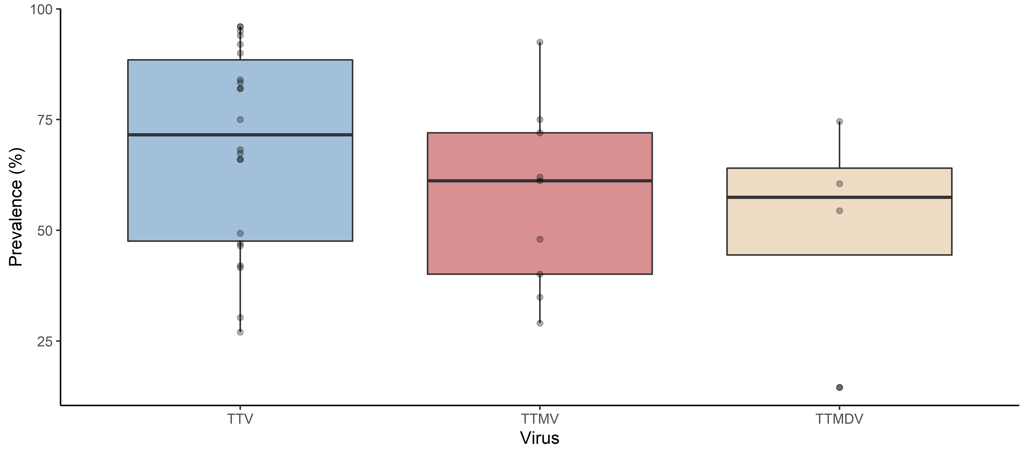
Tan, C. (2021)

Slide 3
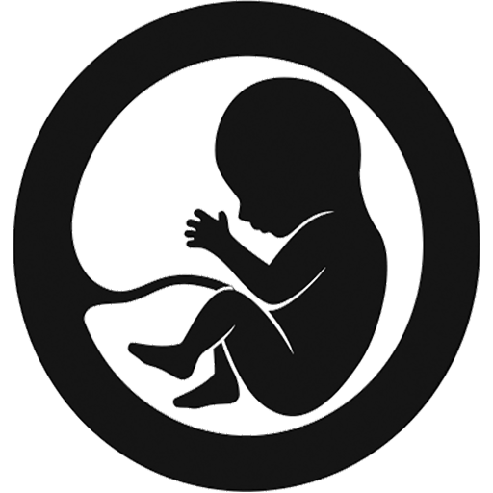

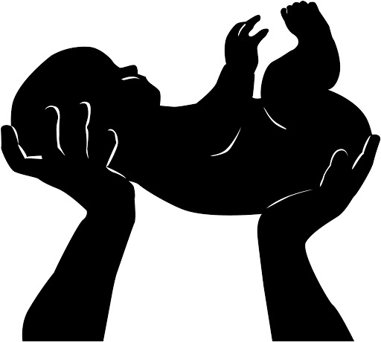





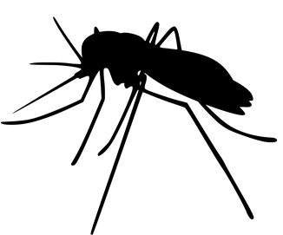


Prenatal
Cross placental barrier
Vertical
Perinatal
Maternal blood
Vaginal/cervical mucus
Postnatal
Breast milk
Horizontal
Fomites
Hospital air and surfaces
Feather dust
Laboratory reagents
Vaccines
Sexual
Semen
Vaginal/cervical mucus
Fecal-oral
Faeces
Blood
PBMC
Vector-borne
Vampire bats
Mosquitos
Waterborne
Rivers
Wastewater
Drinking water
Airborne
Saliva
Mucus
Tan, C. (2021)

Slide 4
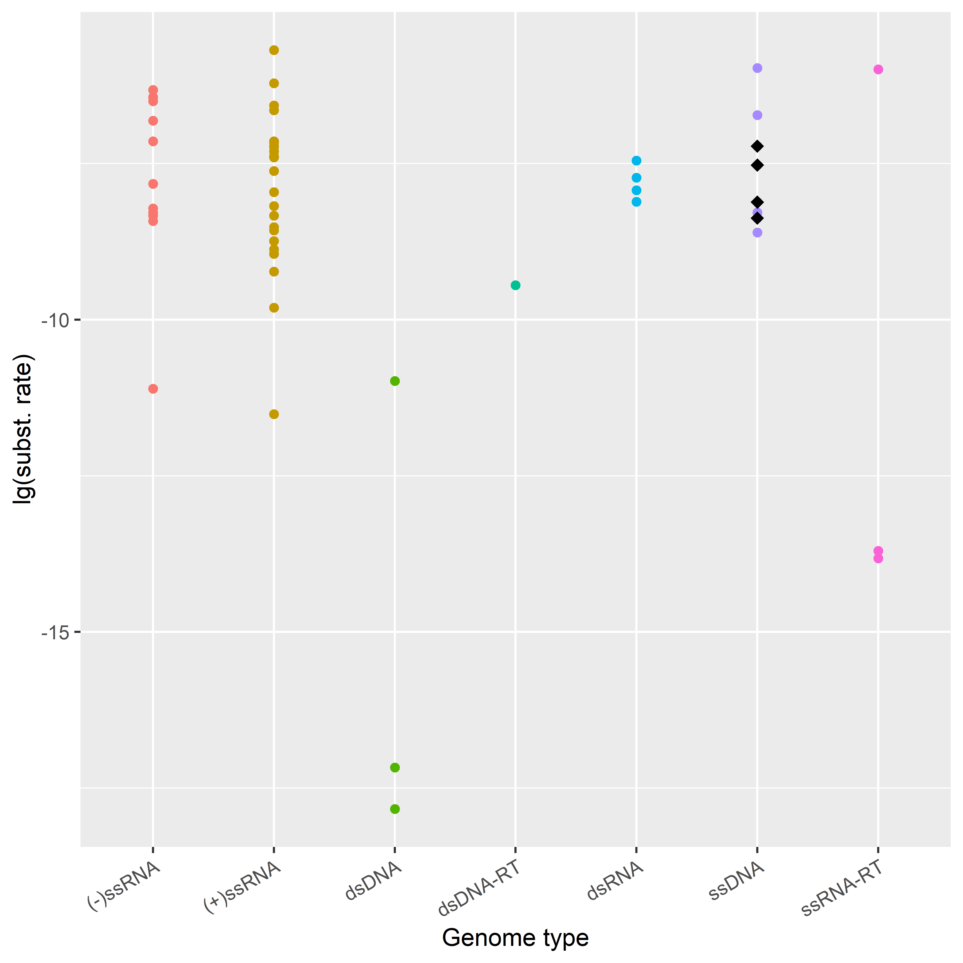
Circoviridae
Human TTV (syn)
TTSuV
Feline TTV
Human TTV
Parvoviridae
Tan, C. (2021)

Slide 5
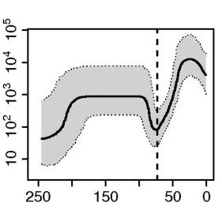
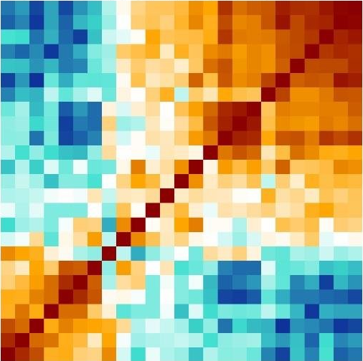
(a) Alignment-based approaches
Phylogenetic dating
2009
Full genome alignment
2008
2012
2016
Genome 1
Population dynamics
Genome 2
Population size
…
Genome N
Years before 2021
Phylogenetic reconstruction
(b) Alignment-free approaches
Unaligned sequences
Decompose into k-mers
Compute pairwise distances
Genome 1
Genome 2
…
Genome N
(c) ‘Core’ genome extraction
Genome 1
‘Core’ alignment
Genome 2
Genome 1
Genome 2
…
Genome N
Genome N
…
‘Unalignable’
Tan, C. (2021)

Slide 6
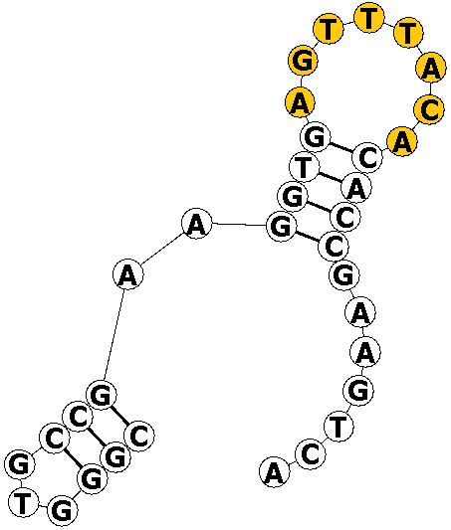
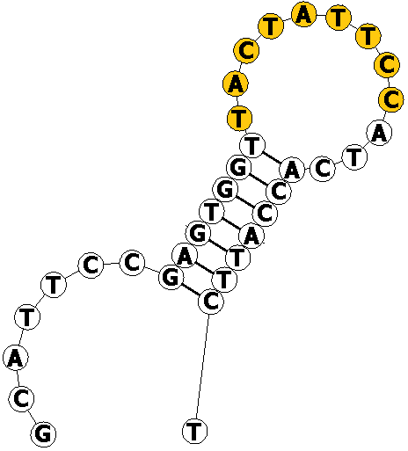
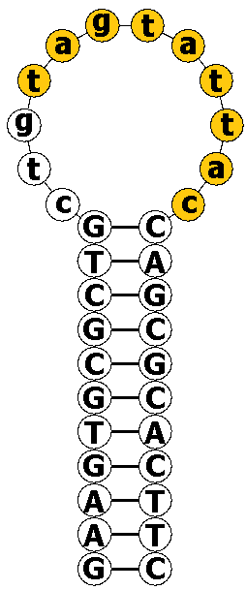
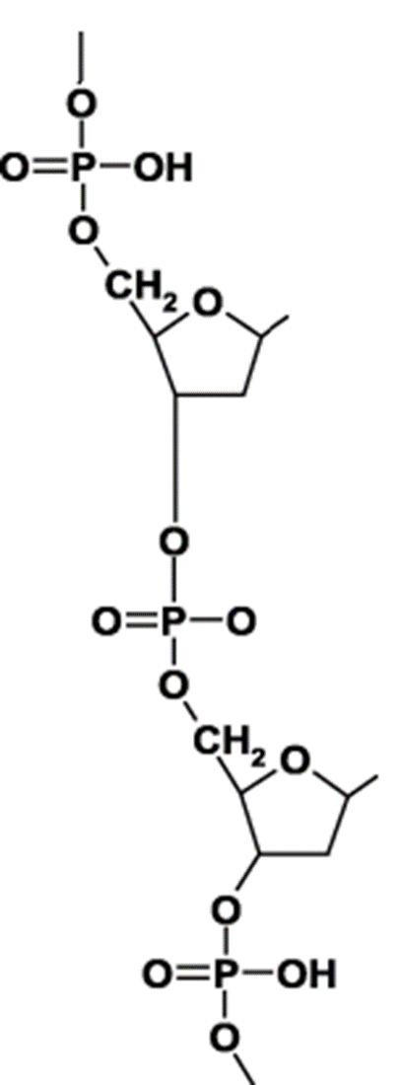
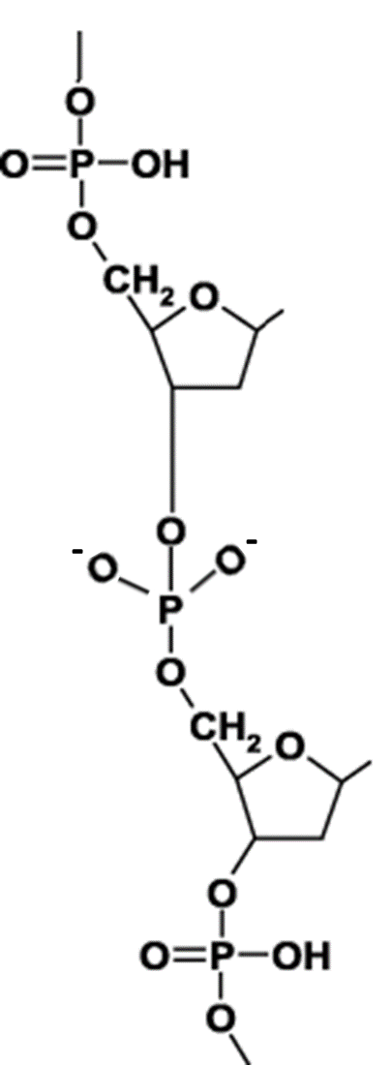
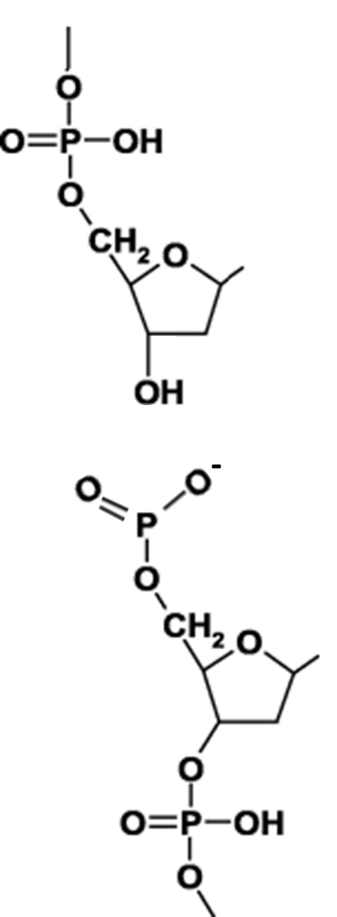
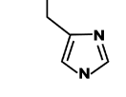



(c)
Nick
(d)
+1
CAV
+9
+8
+1
(d)
TTV
174
207
1
34
(b)
+1
PCV
Viral Family/
Replicon Type
(a)
Nick
CAV
TTV
PCV
CDFV
SCSV
BBTV
Geminivirus
φX174
pC194
Anelloviridae
+9
Circoviridae
Nanoviridae
Geminiviridae
Microviridae
Plasmid
1739
13
Catalytic site
(e)
H
H
H
base
U
base
U
base
HUH
motif
U
3’
M²⁺
M²⁺
M²⁺
5’
⁻
H
base
H
base
H
base
O
O
O⁻
Y
Y
Y
ssDNA
Tan, C. (2021)

Slide 7
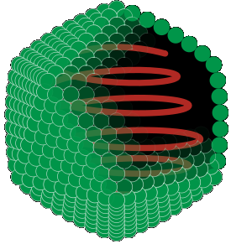
(a)
Proteoglycan
Chondroitin sulfate
1. Attachment
Core protein
Cell membrane
Encapsidated virus
Heparin sulfate
3. Uncoating
ssDNA genome
2. Endocytosis
Host cell
(b)
Human TTV
TTSuV
CAV
TTLwV
PCV
Tan, C. (2021)

Slide 8
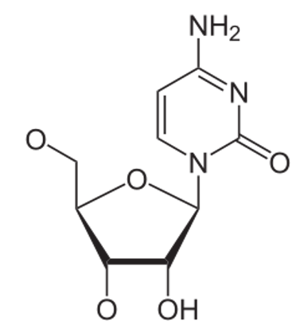
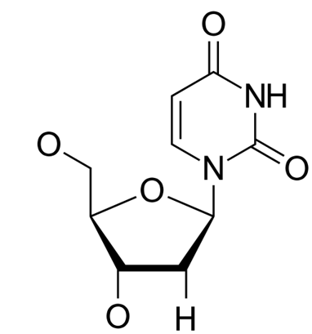
(a) Host-editing
Template
Complement
Template
Complement
A
T
G
A
A
T
A
A
Cytidine deaminase
Cytidine
Uradine
H₂O
NH₃
T
T
(b) Recombination
Mutations
Recombination breakpoint
Tan, C. (2021)
Cannot be represented by single phylogeny

Slide 9
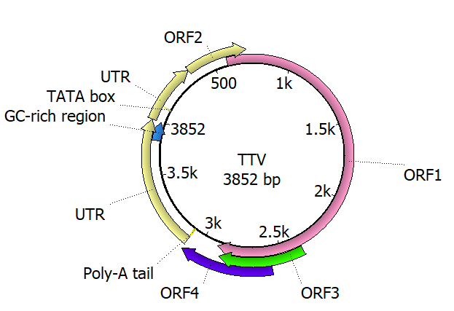





(a)
Dual-specificity phosphatase
TTV
Nucleocapsid
Arginine-rich N-terminus
Rep-like protein
(b)
TAIP
Nick
3’OH
5’
Synthesised strand
Rep
ori
Rep
DNAP
Rep
(A)
ori
(B)
(C)
ori
Cleave
Rep
(D)
(E)
ori
Displaced parental strand

Slide 10
(a)
Phosphatase
WX₇HX₃CXCX₅H motif
TTV
Capsid protein
Arginine-rich N-terminus
Rep-like protein
TAIP
Similar to VP3/apoptin in CAV

Slide 11
(a)
Nick
Synthesised strand
Cleave
Displaced parental strand
3’OH
5’
Rep
Rep
Rep
Rep
ori
ori
ori
DNAP
ori
(A)
(B)
(C)
(D)
(E)
(d)
Nick
(e)
+1
+8
CAV
+9
+1
(d)
TTV
174
207
1
34
(c)
Viral Family/
Replicon Type
(b)
+1
PCV
Nick
CAV
TTV
PCV
CDFV
SCSV
BBTV
Geminivirus
φX174
pC194
Anelloviridae
+9
Circoviridae
Nanoviridae
Geminiviridae
Microviridae
1739
13
Plasmid
Catalytic site
(f)
H
H
H
base
HUH
motif
U
base
U
base
U
M²⁺
M²⁺
M²⁺
3’
⁻
H
5’
H
H
base
O
base
O⁻
base
O
Y
Y
Y
ssDNA
Tan, C. (2021)

Slide 12
Virus
Virus
Infect new host
Zoonotic emergence
Virus
Efficient transmission
Virus
Adaptation to host
Virus
Poor transmission
Virus goes extinct
Tan, C. (2021)

