Slide 1
Anelloviruses – The Enigma
Cedric CS Tan
3rd year, BSc Molecular Biology

Slide 2
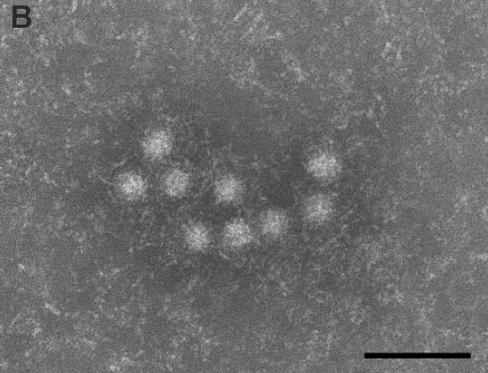
Introduction
Torque teno virus was first member discovered (Nishizawa et al., 1997)
No stable cell culture system
No animal models
~30nm, non-enveloped, icosahedral capsid
100nm
Itoh et al., 2000
Notes:
https://pubmed.ncbi.nlm.nih.gov/9405239/
https://pubmed.ncbi.nlm.nih.gov/11118351/

Slide 3
Introduction
Found in blood, semen, nasal secretions, saliva and feces
Viral load in saliva and nasal secretions > blood (Deng et al., 2000)
Infection occurs at early age
Notes:
https://pubmed.ncbi.nlm.nih.gov/9405239/
https://pubmed.ncbi.nlm.nih.gov/11118351/

Slide 4
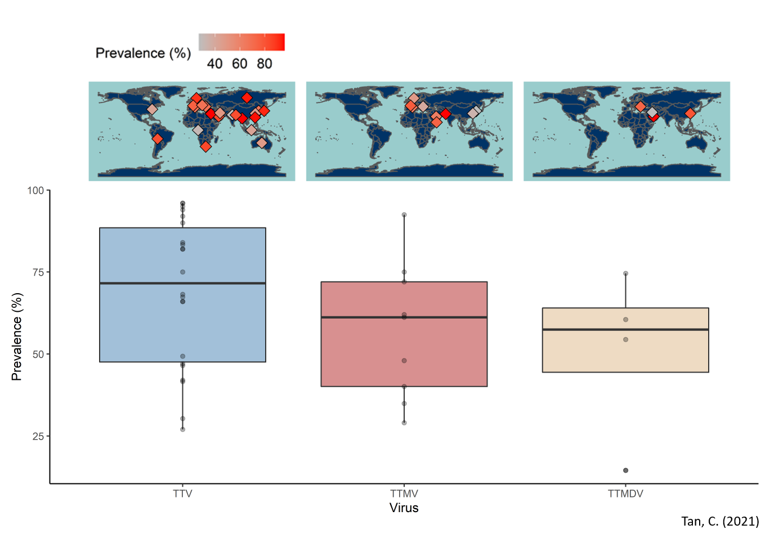
Prevalence
Notes:
https://pubmed.ncbi.nlm.nih.gov/9405239/
https://pubmed.ncbi.nlm.nih.gov/11118351/

Slide 5
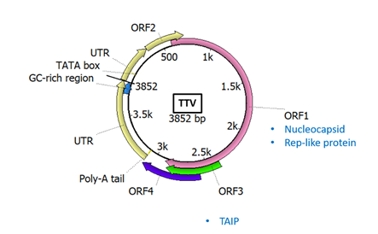
Genome Structure
Notes:
https://talk.ictvonline.org/ictv-reports/ictv_9th_report/ssdna-viruses-2011/w/ssdna_viruses/140/anelloviridae-figures

Slide 6
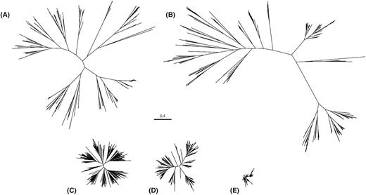
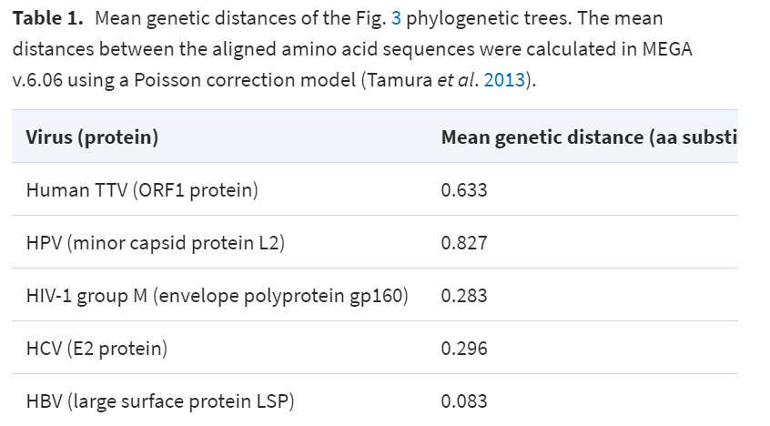
Genomic Diversity
Kaczorowska and van der Hoek (2020)

Slide 7
Mutation Rates

Slide 8
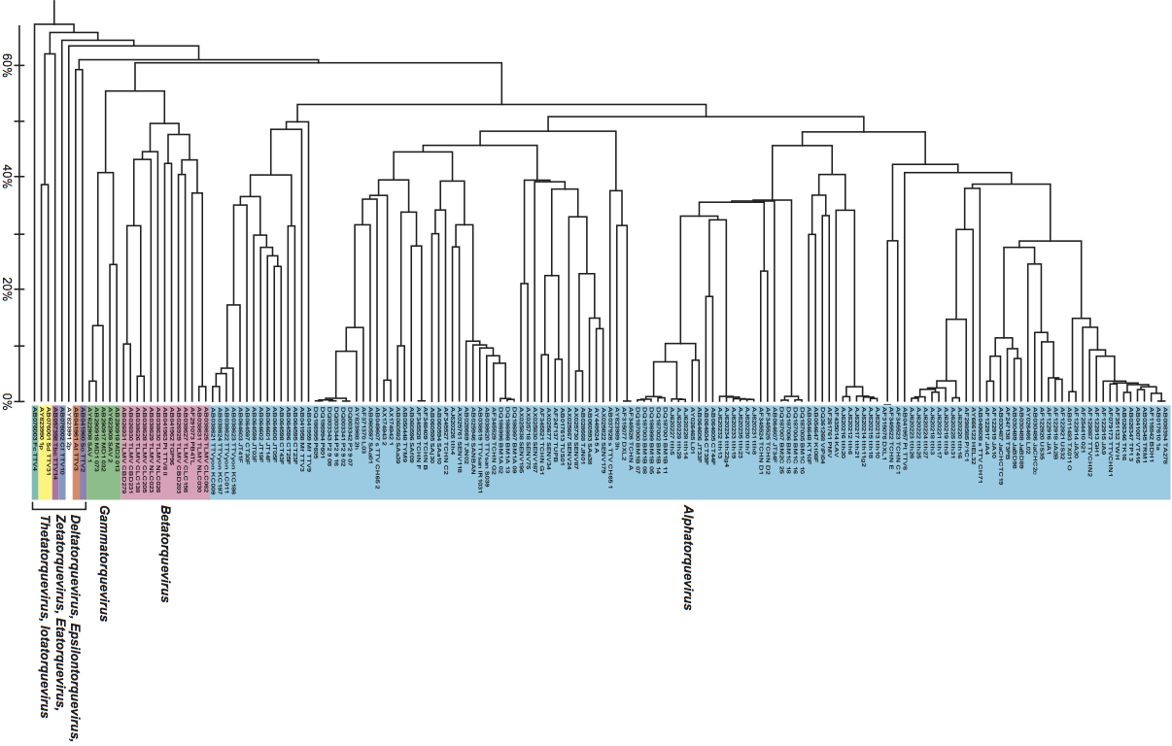
Family-wide Phylogeny
UPGMA; ORF1 (ICTV, 9th report)
Notes:
https://talk.ictvonline.org/ictv-reports/ictv_9th_report/ssdna-viruses-2011/w/ssdna_viruses/140/anelloviridae-figures

Slide 9
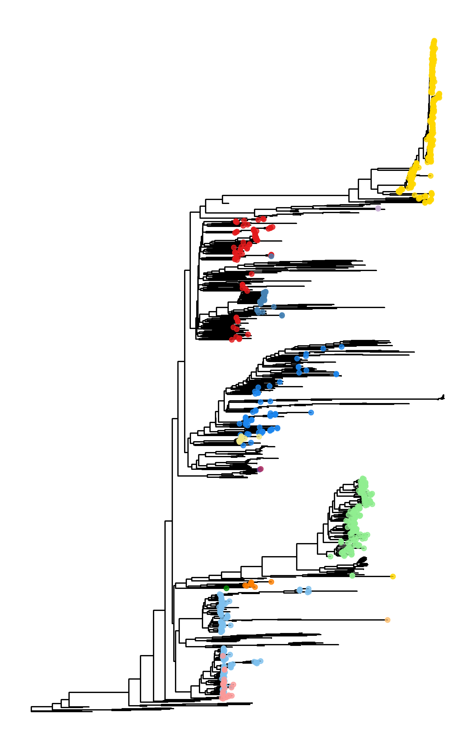
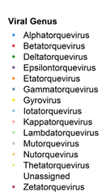
How to Align?
Accuracy of alignment falls steeply at high levels of divergence
Random DNA/RNA sequences can show up to 50% sequence identity when gaps are allowed
Rooted NJ-Mash
Notes:
https://talk.ictvonline.org/ictv-reports/ictv_9th_report/ssdna-viruses-2011/w/ssdna_viruses/140/anelloviridae-figures

Slide 10
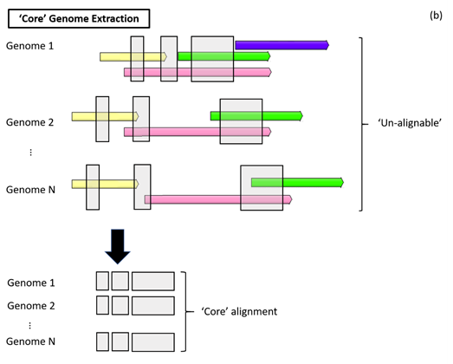
‘Core’ Genome Extraction
Notes:
https://talk.ictvonline.org/ictv-reports/ictv_9th_report/ssdna-viruses-2011/w/ssdna_viruses/140/anelloviridae-figures

Slide 11
Nomenclature
Alpha → Torque teno
Beta → Torque teno mini
Gamma → Torque teno midi
Delta → Torque teno tupaia
Epsilon → Torque teno tamarin
Zeta → Torque teno douroucouli
Eta → Torque teno felis
Theta → Torque teno canis
Iota → Torque teno sus
Kappa → Torque teno sus virus K2
Lambda → Torque teno zalophus
Mu → Torque teno equus
Nu → Torque teno seal
Notes:
https://talk.ictvonline.org/ictv-reports/ictv_9th_report/ssdna-viruses-2011/w/ssdna_viruses/140/anelloviridae-figures

Slide 12
Genome structure
(-)ssDNA
Circular (rolling-circle)
2-3.9kb (Kaczorowska et al., 2020)
Notes:
https://doi.org/10.1093/femsre/fuaa007

Slide 13
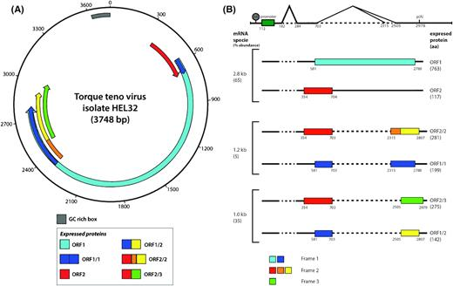
Genome structure
Alternative splicing
Kaczorowska et al., 2020
Notes:
https://doi.org/10.1093/femsre/fuaa007

Slide 14

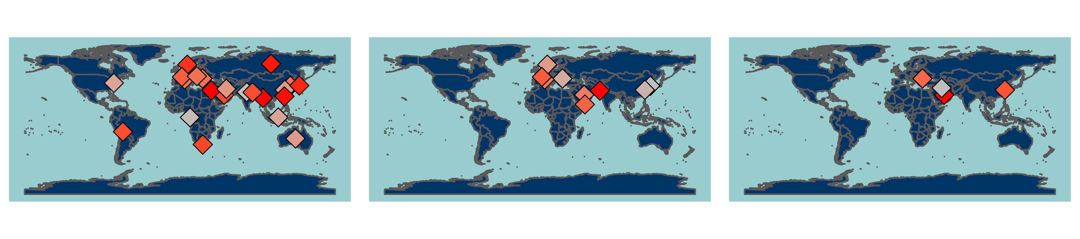
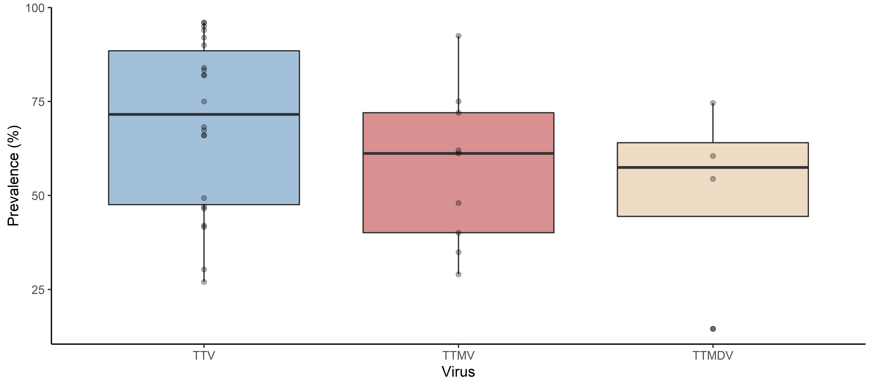
Prevalence
Prevalence estimates vary based on LOD of PCR primers and sample type

Slide 16
Host Range and Animal Reservoirs
De Souza et al. (2018)
Rodents (Criticidae)
Bats (Molossidae, Phyllostomidae)
Opossums (Didelphidae)
Nishiyama et al. (2014)
wood mice (Apodemus sylvaticus)
field voles (Microtus agrestis)
bank voles (Myodes glareolus)
Absent in Mus musculus
Notes:
https://www.sciencedirect.com/science/article/pii/S0042682217303732
https://pubmed.ncbi.nlm.nih.gov/24744300/
Methods for determining host range (one virus multiple hosts)

Slide 17
Host Range and Animal Reservoirs
Ng et al. (2009)
Sea lions (Zalophus californianus)
Agueda-Pinto et al. (2020)
Iberian Hares
Waits et al. (2018)
American dog ticks (Dermacentor variabilis)
Bigarre et al. (2005)
93% prevalence in French pigs
Amatya et al. (2017)
Lemur (Indri indri)
Notes:
https://www.microbiologyresearch.org/content/journal/jgv/10.1099/vir.0.008987-0
https://www.mdpi.com/1999-4915/12/3/340
https://link.springer.com/article/10.1007/s11262-017-1520-5
https://www.microbiologyresearch.org/content/journal/jgv/10.1099/vir.0.80573-0

Slide 18
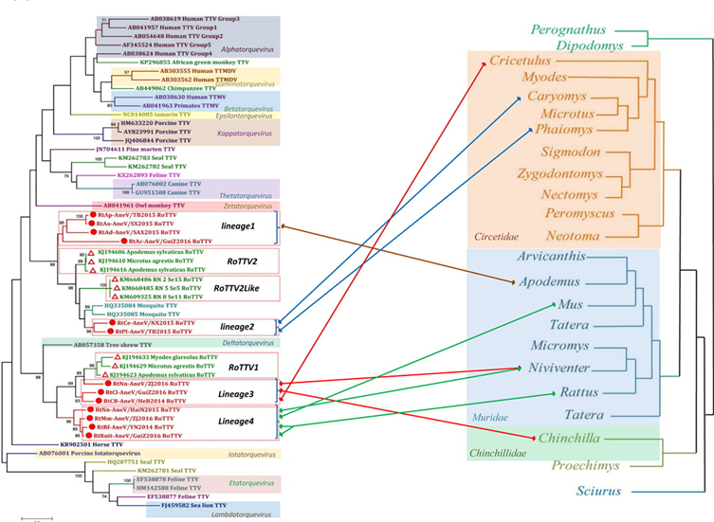
Genomic Surveillance
Du et al. (2018) collected rodents across 20 provinces in China
Du et al. (2018)
Notes:
https://www.tandfonline.com/doi/full/10.1038/s41426-018-0037-x
Look for anthroponosis

Slide 19
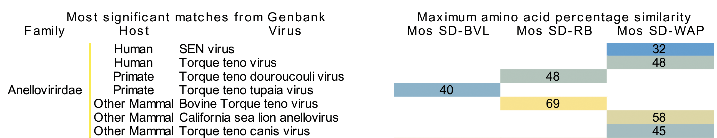
Genomic Surveillance
Modified Fig. 2
Ng et al. (2011) collected viral metagenomic samples of 3 locations in San Diego, CA
Notes:
https://journals.plos.org/plosone/article?id=10.1371/journal.pone.0020579#pone.0020579.s002

Slide 20
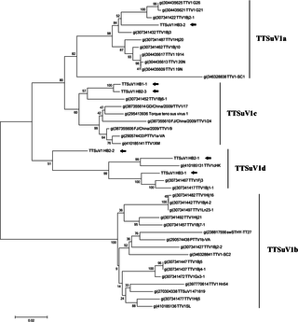

Genomic Surveillance
Shi et al. (2015) collected mosquito samples from pig farms in Hubei province, China
Potential vector for transmission of TTSuV-like viruses
Did not affirm persistence of infection in mosquitoes or transmission to humans
Notes:
https://doi.org/10.1371/journal.pone.0129845

Slide 21
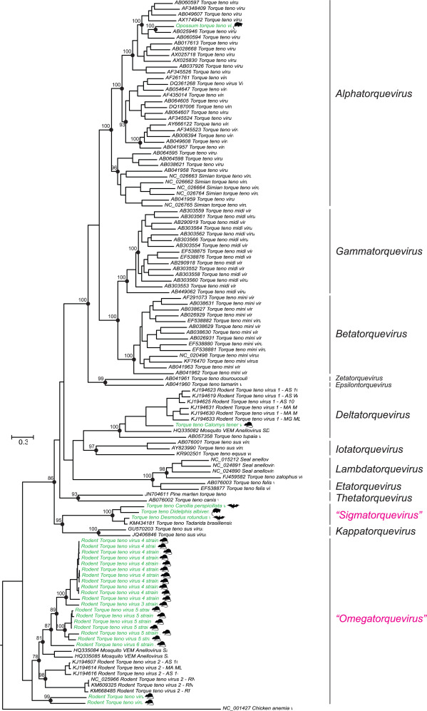

Slide 22
Zoonosis
https://www.nature.com/articles/s41598-019-42210-0
https://www.ncbi.nlm.nih.gov/pmc/articles/PMC7120144/
https://jvi.asm.org/content/80/7/3487
TTSUV found in humans https://www.nature.com/articles/srep26655

Slide 23
Zoonosis
could be spread through feather dust and dander in addition to the oral-fecal and vertical transmission routes.
https://www-sciencedirect-com.libproxy.ucl.ac.uk/science/article/pii/S0168170207004509
Human gyrovirus similar to CAV in skin https://jvi-asm-org.libproxy.ucl.ac.uk/content/85/15/7948.short
Gyrovirus in stool
https://www-sciencedirect-com.libproxy.ucl.ac.uk/science/article/pii/S1386653212002545
https://www-sciencedirect-com.libproxy.ucl.ac.uk/science/article/pii/S0042682213004935
Gyrovirus found in fowl and humans
https://www-ncbi-nlm-nih-gov.libproxy.ucl.ac.uk/pmc/articles/PMC4517707/
TTSuV in multiple hosts
https://www.sciencedirect.com/science/article/pii/S0378113517310581
Simian TTV in humans https://www.sciencedirect.com/science/article/pii/S1386634602002504?casa_token=QK3Xs9x2h0YAAAAA:XjvK71_0-ErtaYY1FiRfggoJoOEqyniHHG5ez_oLZM_yFlBofqWNQSHV-_RJNCr1_N7A5nNO3fA
https://www.ncbi.nlm.nih.gov/pmc/articles/PMC7129822/ bats-pig transmission (circovirus)
Japan wastewater TTV https://doi.org/10.1016/j.watres.2005.03.034
Human adenovirus from chimps and bonobo (recombination) https://www.ncbi.nlm.nih.gov/pmc/articles/PMC6714811/

Slide 24
ANTHROPONOSIS
Chimpanzees have been experimentally infected with human TTVs and a simian TTV was detected in a human host
chimpanzee TTVs (Pt-TTV6, s-TTV.CH65-1, s-TTV.CH65-2 and s-TTV.CH71) and chimpanzee TTMV (Pt-TTMV8-II) were interspersed with human TTVs and human TTMVs, respectively (https://www.microbiologyresearch.org/content/journal/jgv/10.1099/vir.0.007385-0).
one subject who tested positive for human TTV and TTMDV DNA was found to be co-infected with chimpanzee TTMDV
Reproducibility of the PCR assay was verified by repeated assays and the specificity of the assay was confirmed by sequence analysis of the amplicon
The present study corroborates the previous studies because human TTV sequences have been identified in samples obtained from captive chimpanzees (Cong et al., 2000; Okamoto et al., 2000a; Romeo et al., 2000),
TTV in swine and cattle
https://www.sciencedirect.com/science/article/pii/S0378113507003367#fig1

Slide 25
Pathogenicity
Seals and Sea Lions
Viral presence associated with mortality events in Sea lions (Ng et al., 2009). Found inflammation of lung tissue and high viral loads.
Pneumonia in mortality event in 21 pacific harbor seals (Ng et al. 2011).
Pigs
TTSuV + porcine circovirus 2 coinfection led to fatal postweaning multisystemic wasting syndrome. Monoinfected pigs had no clinical symptoms (Ellis et al., 2008).
Chicken
Chicken anemia virus targets erythroid and lymphoid progenitor cells in the bone marrow and thymus → severe anemia and increased mortality (Adair, 2000)
Immunosuppression (https://www-tandfonline-com.libproxy.ucl.ac.uk/doi/full/10.1080/03079450600717349)
Suboptimal protection by antibodies (https://virologyj.biomedcentral.com/articles/10.1186/1743-422X-9-189)
Notes:
https://www.microbiologyresearch.org/content/journal/jgv/10.1099/vir.0.008987-0
https://www.microbiologyresearch.org/content/journal/jgv/10.1099/vir.0.029678-0
https://doi.org/10.2460/ajvr.69.12.1608
https://www.sciencedirect.com/science/article/pii/S0145305X99000762?casa_token=lt5NOuORnCMAAAAA:W2Fn6zmYiarHxccRKf8Vu34nrtxi-XUI54IANWkz427SJkwW6HysorhmCgsjFrqpzgdU5qpij5E

Slide 26
Pathogenicity to Humans?
High TTV load (> 4 log₁₀copies/ml) associated with mortality in elderly (Hazard ratio = 4.78; Giacconi et al., 2018)
Low TTV load (< 4.2 log₁₀copies/ml) associated with kidney graft rejection within 2 years (Hazard ratio = 7.30; Solis et al., 2019)
Studies only demonstrate TTV as a marker of immune status rather than a pathogen
https://journals.plos.org/plosone/article?id=10.1371/journal.pone.0098819
APOPTIN FROM TTV https://www-microbiologyresearch-org.libproxy.ucl.ac.uk/content/journal/jgv/10.1099/vir.0.79790-0
TTV-VP3 Complements knockout CAV https://www-sciencedirect-com.libproxy.ucl.ac.uk/science/article/pii/S0042682208007113
APOPTIN does not trigger apoptosis in normal cells https://www-pnas-org.libproxy.ucl.ac.uk/content/94/11/5843.short
Notes:
https://doi.org/10.1016/j.exger.2018.09.003
10.1016/j.jinf.2019.05.010

Slide 27
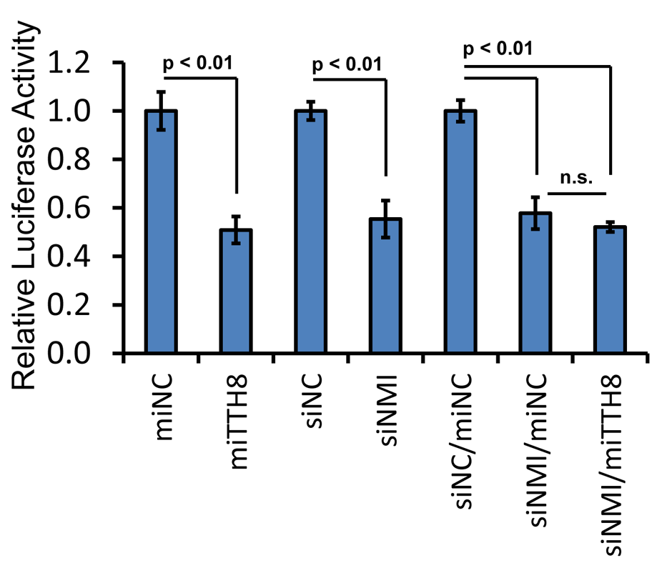
Host-Virus Interactions
TTV miRNA decreases interferon production
TTV miRNA promotes cell proliferation in response to interferon
Also, 40% decrease in ISG15
Kincaid et al., 2013
Notes:
https://journals.plos.org/plospathogens/article?id=10.1371/journal.ppat.1003818#ppat-1003818-g007
HEK293T (human embryonic kidney)

Slide 28
Host-Virus Interactions
TTV ORF2 downregulates NF-kappaB → inhibit transcription of proinflammatory IL-6, IL-8, COX-2 (Zheng et al., 2007)
TTSuV (Singh and Ramamoorthy, 2016)
Transfection of ORF1 into swine macrophage line induced early anti-viral response as part of host innate immunity
ORF1 upregulates SOCS-1, PD-1, IL-10, which are suppressors of T-cell mediated immunity
ORF2 downregulates IFN-β and IL-13, regulators of antiviral activity and inflammation, respectively
Notes:
10.1128/JVI.01101-07
https://www.sciencedirect.com/science/article/pii/S0168170216300892?casa_token=J9lhmEuHhmcAAAAA:bXpGbhNj7-3H_xnV-oWTkZyOAfhGV1iUoyEKIQMrdxO_3K40H8DFIJjybvaA1g8soD2JqNRepEQ

Slide 29
Host-Virus Interactions
https://www-sciencedirect-com.libproxy.ucl.ac.uk/science/article/pii/S0042682209005261
TLR9

Slide 30
Host-Virus Interactions
TTV isolate and look for potential binding site targets for human mRNA transcription factors using the online PROMO program, which recognizes transcription regulatory element binding sites from DNA sequences
44 dsDNA sequences, homologous to human DNA transcription regulatory protein target binding sites, were identified. Moreover, each homologous target sequence appeared multiple times (4 to 11 copies per target). Among these homologous targets on TTV-TA278 DNA were genetic elements for binding factors regulating synthesis of CREB (which plays an essential role in embryogenesis, cell differentiation, apoptosis, and proliferation), c-Jun (a proto-oncogene product with antiapoptotic activity), c-Myc (a proto-oncogene product that also regulates B cell proliferation), IRF2 (which competitively inhibits the IRF1-mediated transcriptional activation of IFNα and IFNβ), p53 (which has anticancer function and plays a role in apoptosis and genomic stability), STAT4 (which is required for the development of Th1 cells from naive CD4⁺ T cells and for IFNγ production in response to IL-12), FOXP3 (a lineage specification factor of Treg cells), and ATF3 (which represses the genes for IL-6, IL-12, and other cytokines downstream of TLR4, thereby providing a negative feedback to contain excessive inflammatory responses).

Slide 31
Lit Review Structure
Abstract
Intro
Genomic diversity of the Anelloviridae
Genome structure
Taxonomy
Mutation rate
Recombination
Host range and animal reservoirs
Host range
Pathogenicity in different hosts
Anthro
Genomic surveillance efforts
Host-pathogen interactions
Diagnostic potential of TTV
Notes:
Add interesting pointers at the start
Add mechanisms (host-pathogen)
Compare to similar mechanisms (wider phylogeny)

