Slide 1
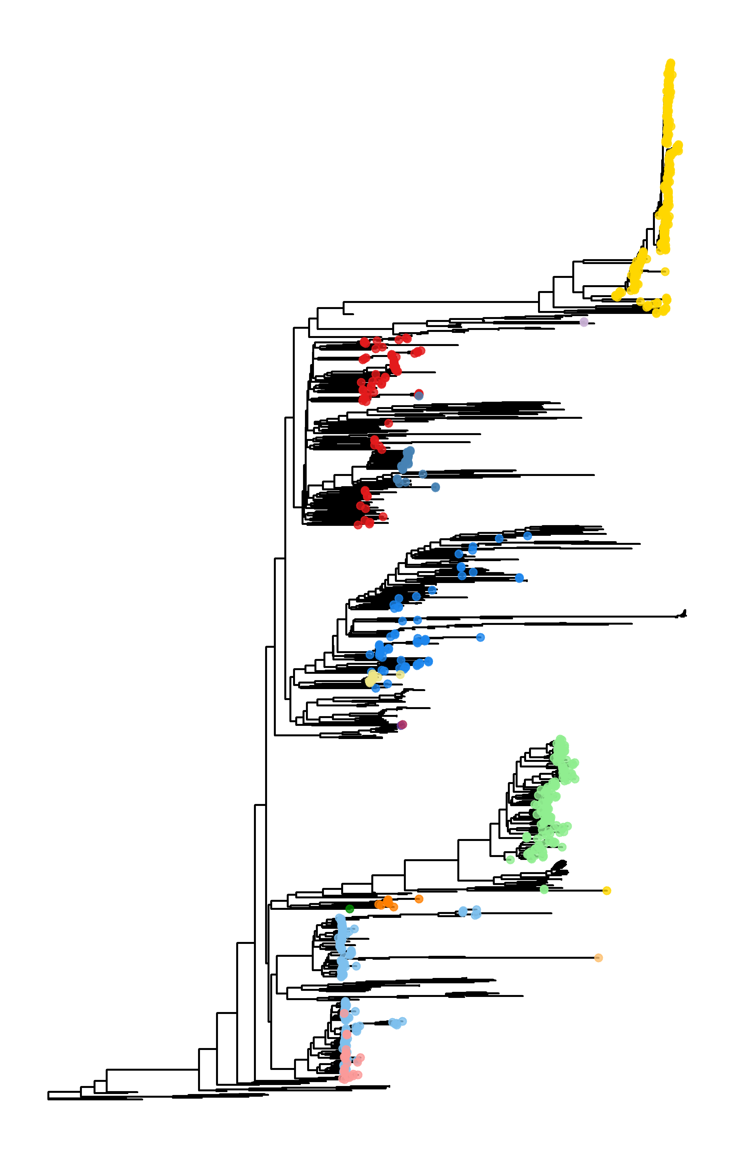
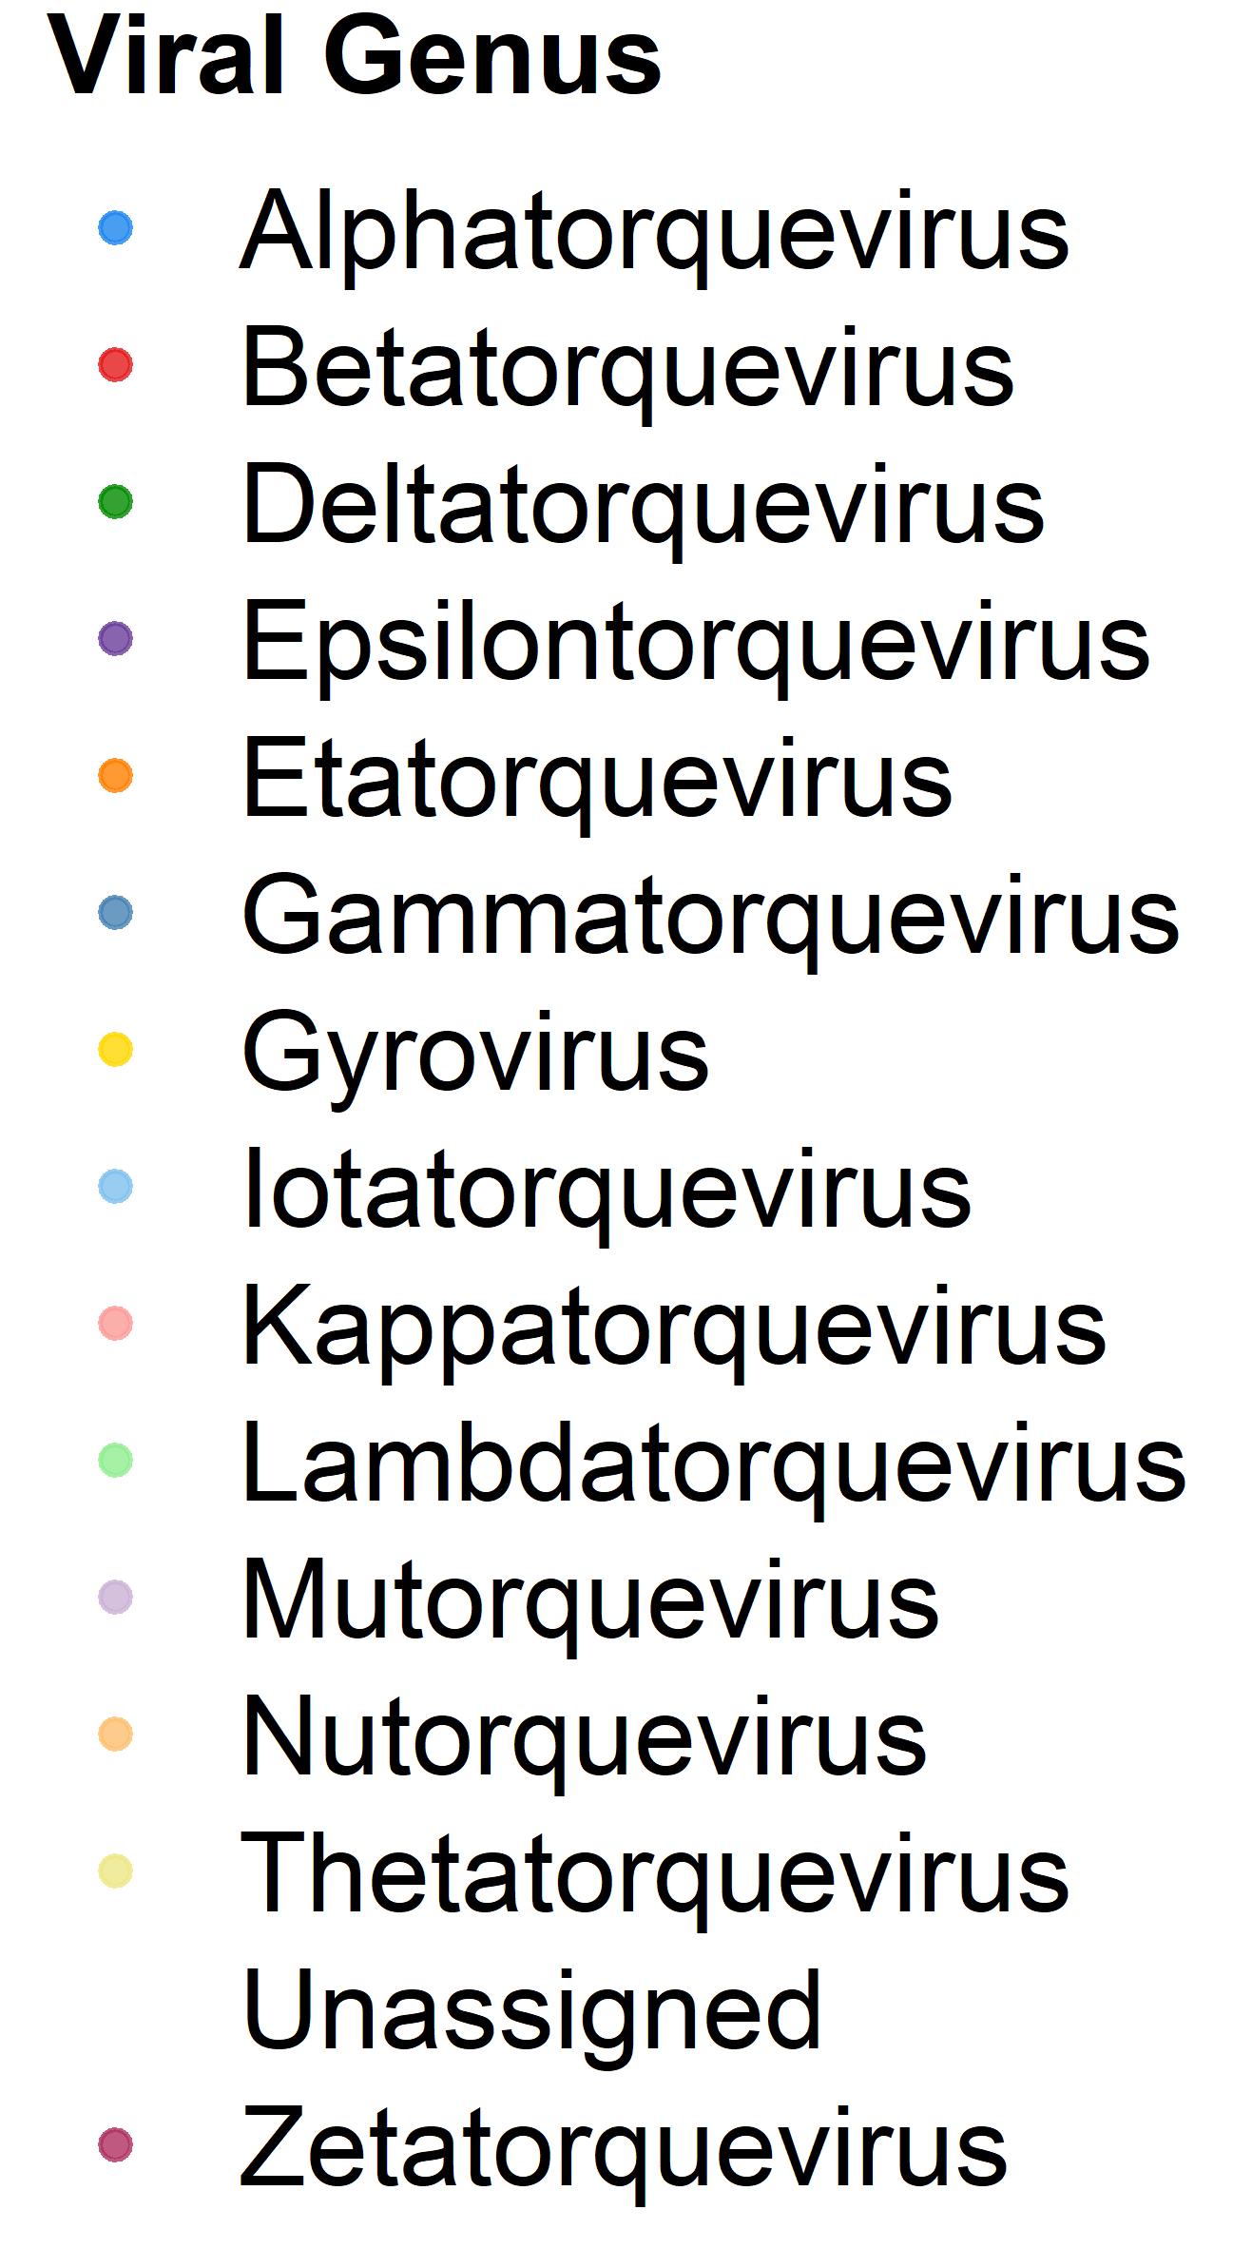

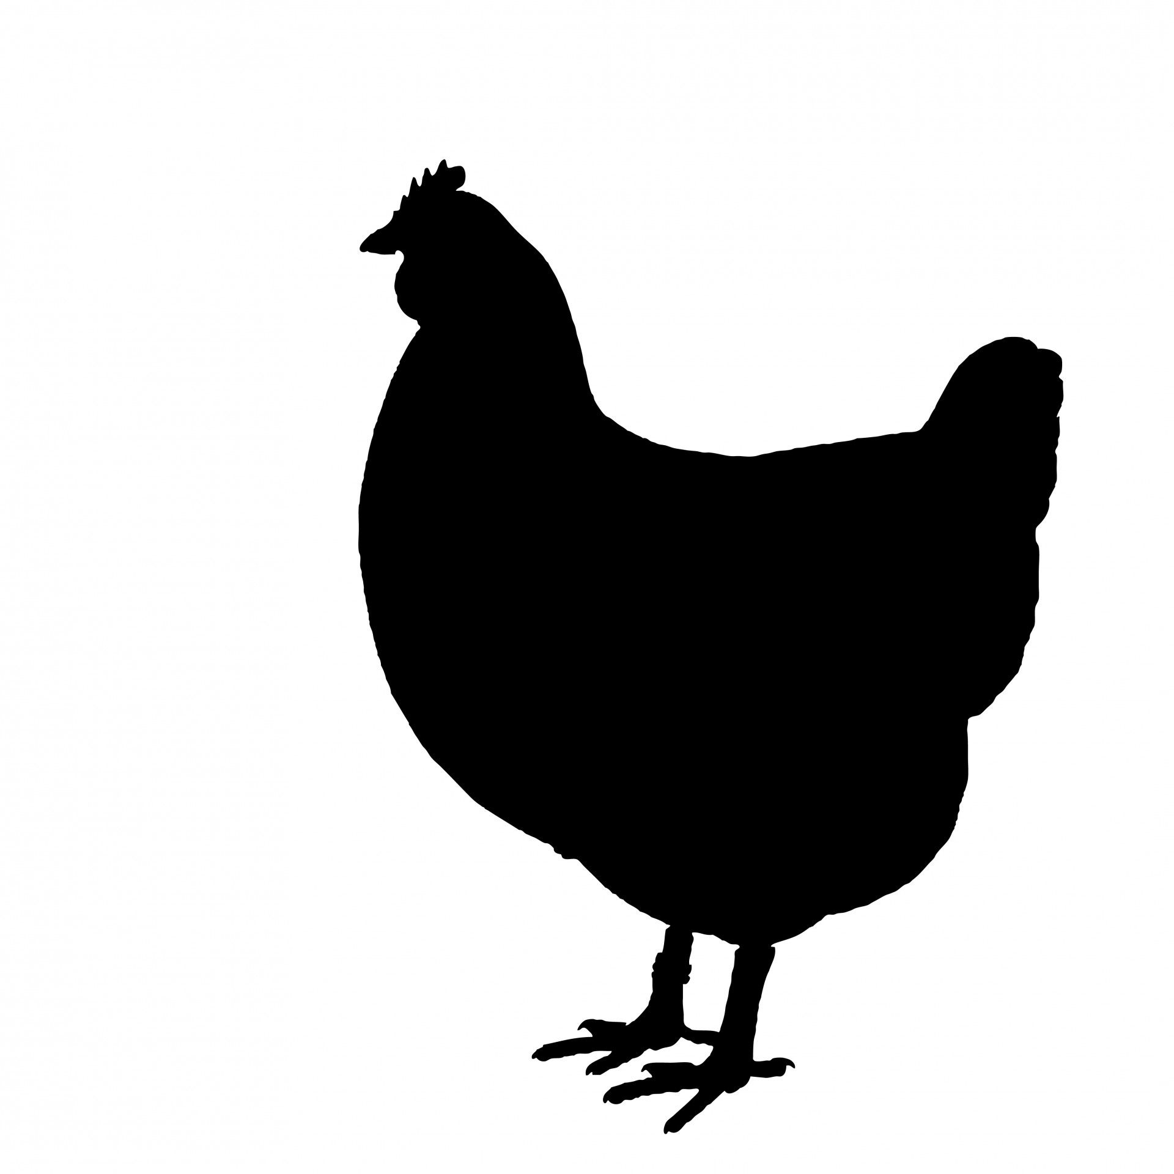


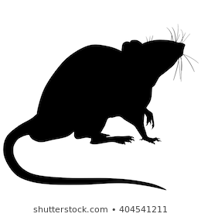
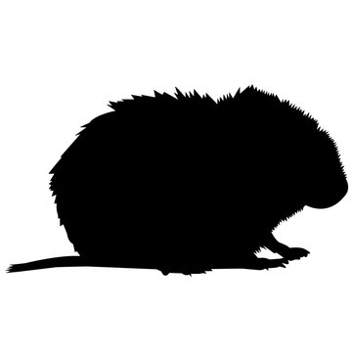

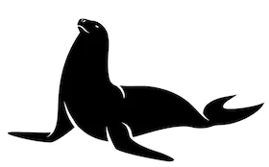


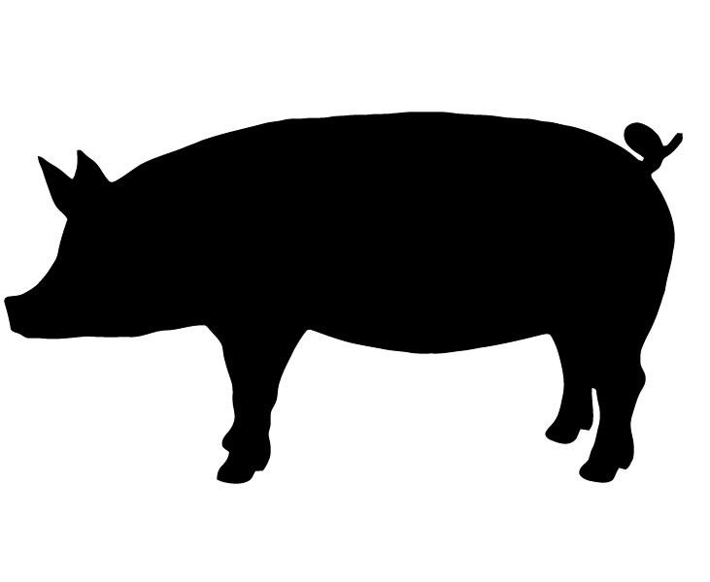

AGV2
TTMV
TTMDV
TTMV
TTV
RoTTV
TTSuV
TTSuV
Transmission type
Organism
Mice
Anthroponosis
Humans
Cats
Voles
Zoonosis
Swine
Monkeys
Animal-animal
Chicken
Pinnipeds
Chinchillas
Dogs
Bats
Opossums
Tan, C. (2021)
Notes:
Proteome-wide 40% PID merged

Slide 2

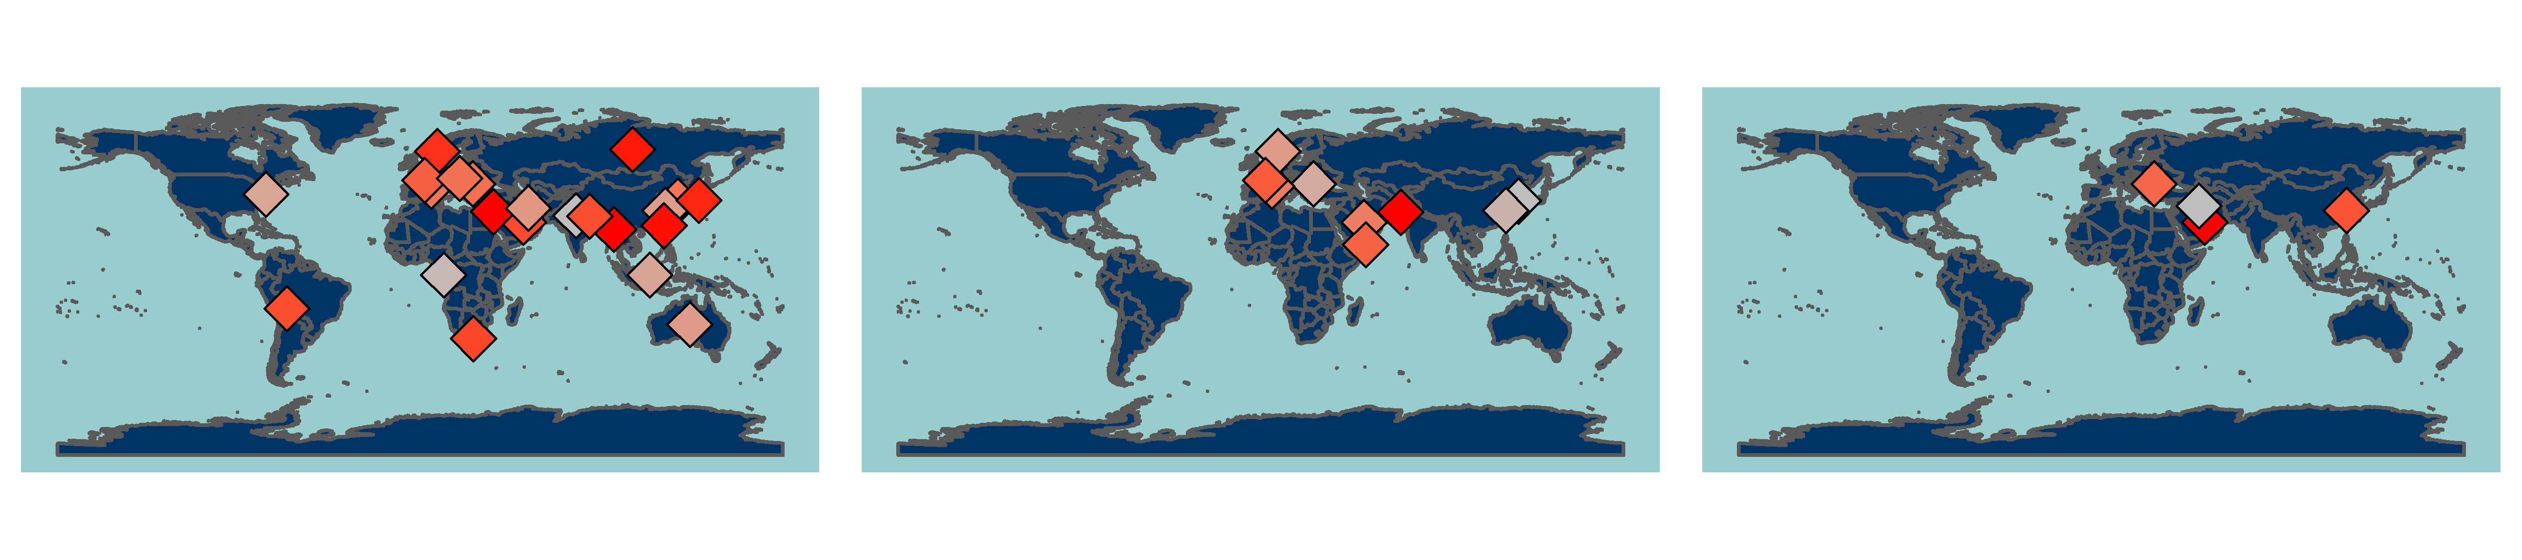
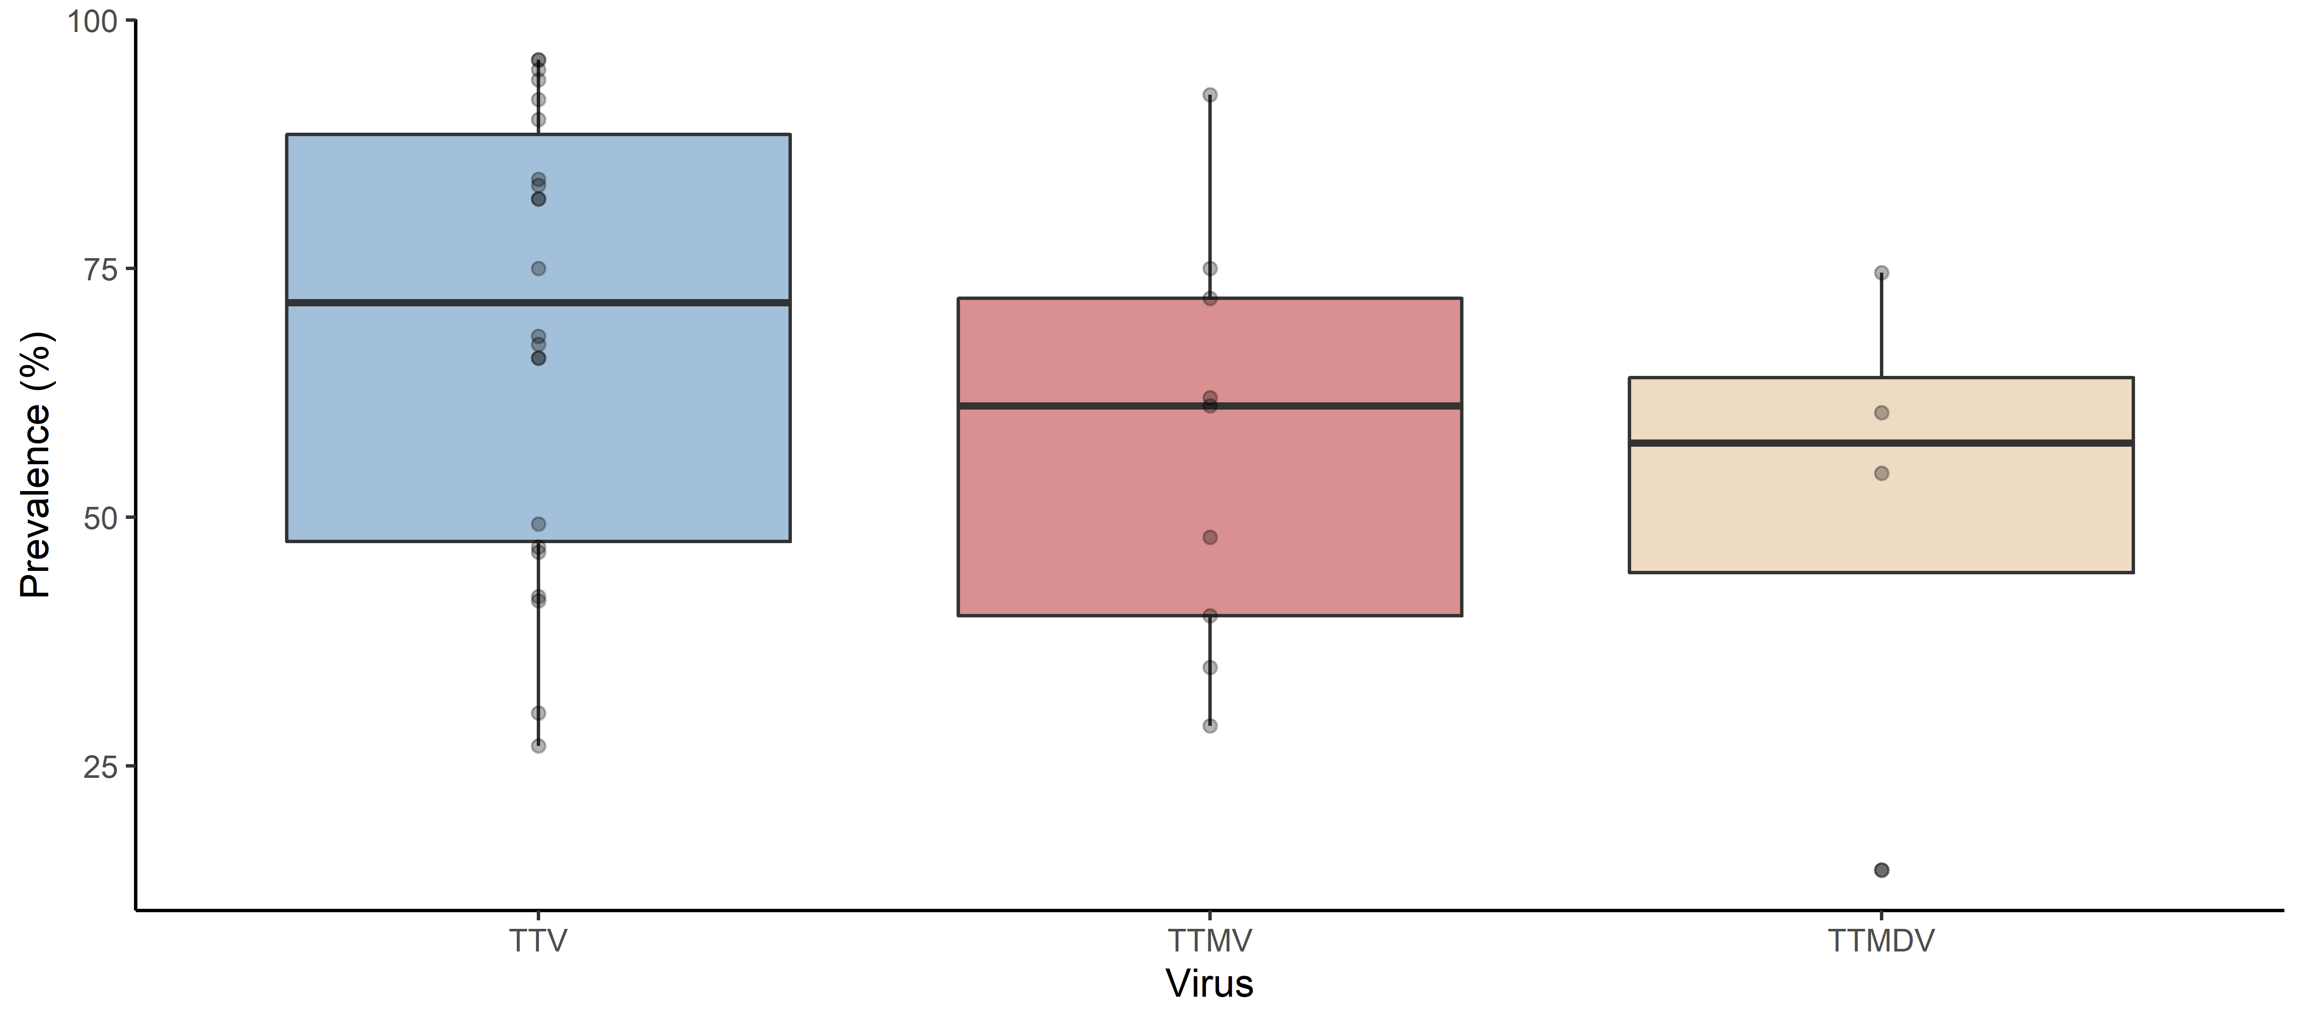
Tan, C. (2021)

Slide 3


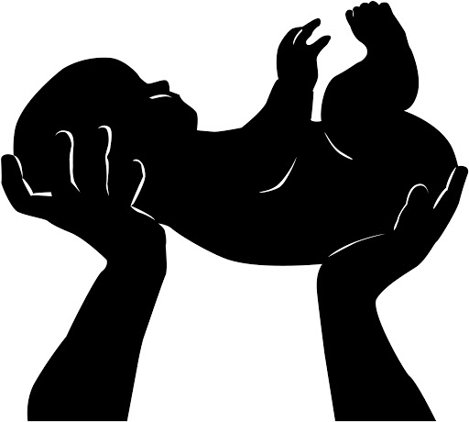





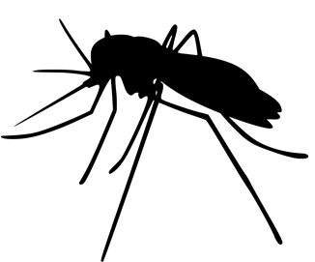


Prenatal
Cross placental barrier
Vertical
Perinatal
Maternal blood
Vaginal/cervical mucus
Postnatal
Breast milk
Horizontal
Fomites
Hospital air and surfaces
Feather dust
Laboratory reagents
Vaccines
Sexual
Semen
Vaginal/cervical mucus
Fecal-oral
Faeces
Blood
PBMC
Vector-borne
Vampire bats
Mosquitos
Waterborne
Rivers
Wastewater
Drinking water
Airborne
Saliva
Mucus
Tan, C. (2021)

Slide 4
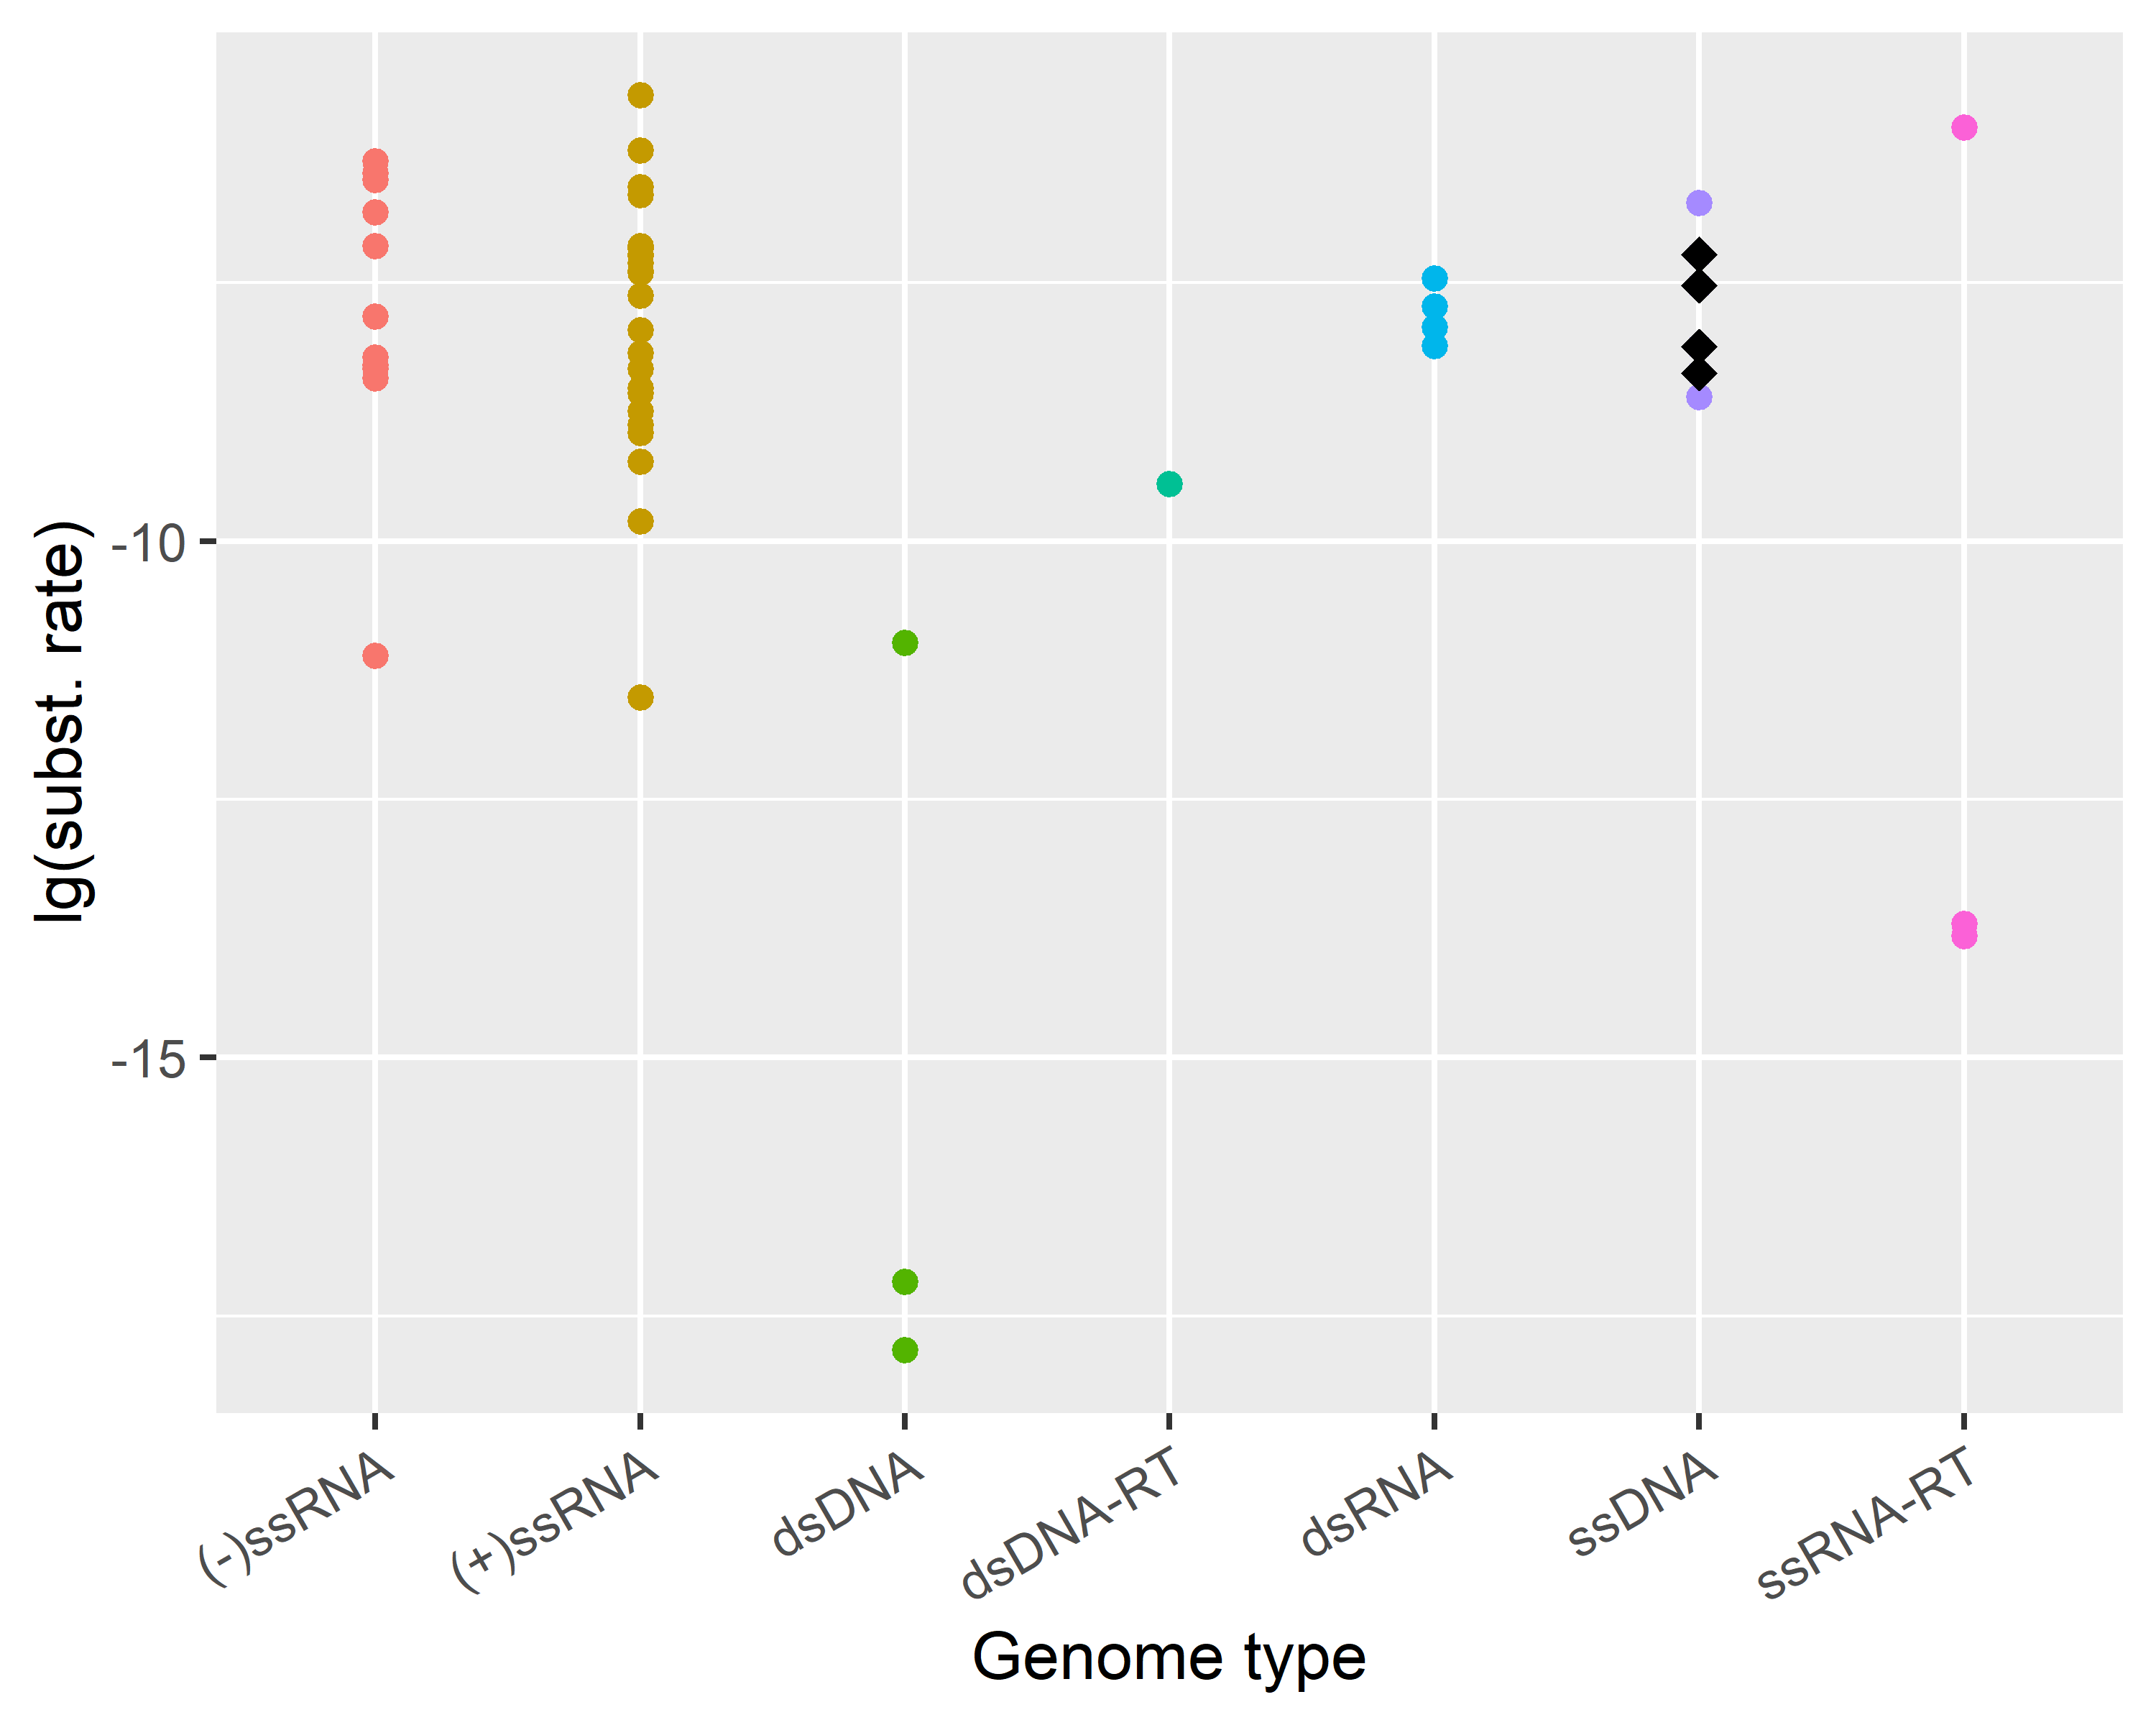
TTSuV
Human TTV (syn)
Human TTV
Feline TTV
Tan, C. (2021)

Slide 5
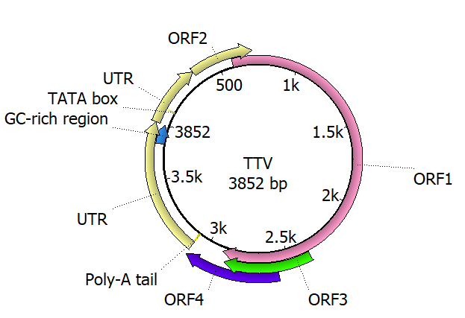
(a)
TTV
Nucleocapsid
Rep-like protein
‘Core’ Genome Extraction
TAIP
(b)
Genome 1
Genome 2
‘Un-alignable’
…
Genome N
Genome 1
Genome 2
‘Core’ alignment
Genome N
…
Tan, C. (2021)

Slide 6
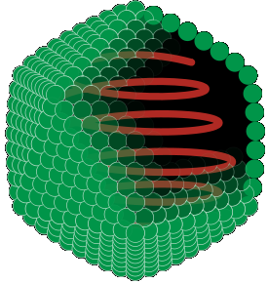
(a)
Proteoglycan
Chondroitin sulfate
1. Attachment
Core protein
Cell membrane
Encapsidated virus
Heparin sulfate
3. Uncoating
ssDNA genome
2. Endocytosis
Host cell
(b)
Human TTV
TTSuV
CAV
TTLwV
PCV

