Slide 1
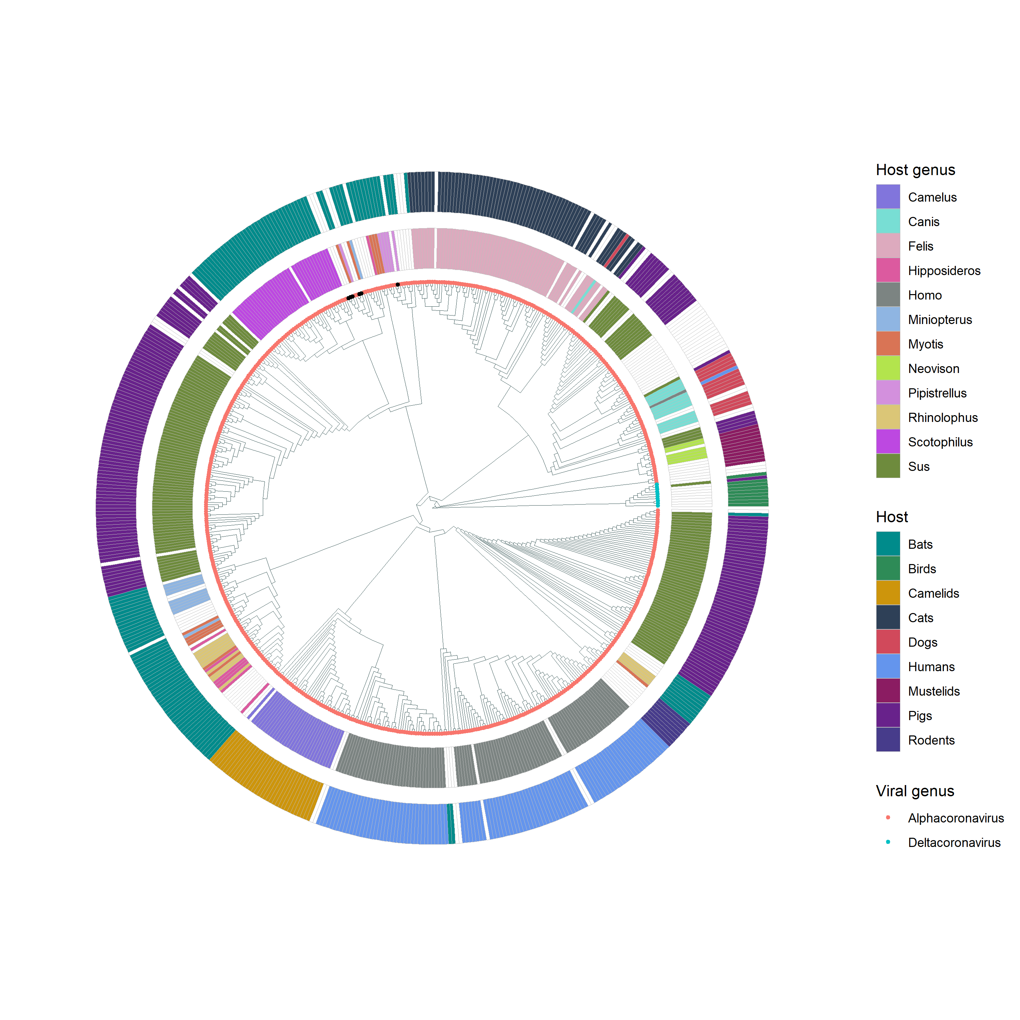





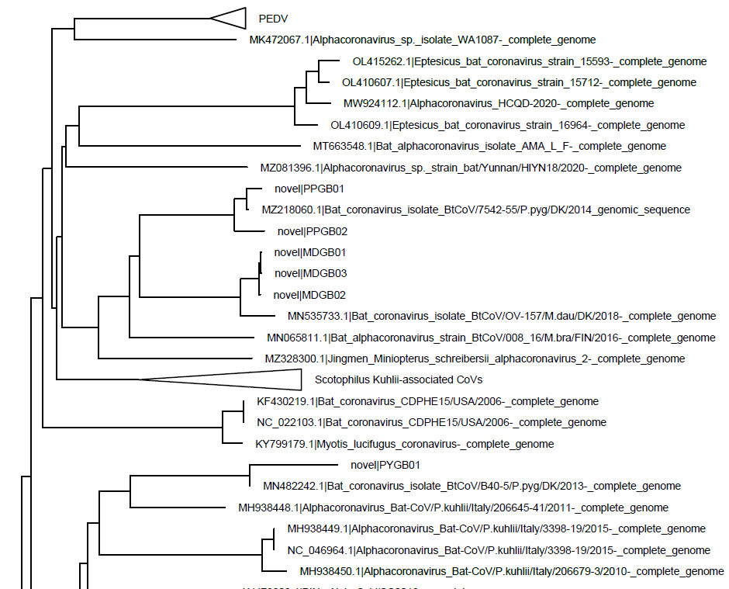
a
PPGB01
PPGB02
MDGB01 MDGB02 MDGB03
PYGB01
Feline CoV
SADS-CoV
PEDV
HCoV-229E
HCoV-NL63
b
Pipistrellus
Myotis
Pipistrellus

Slide 2
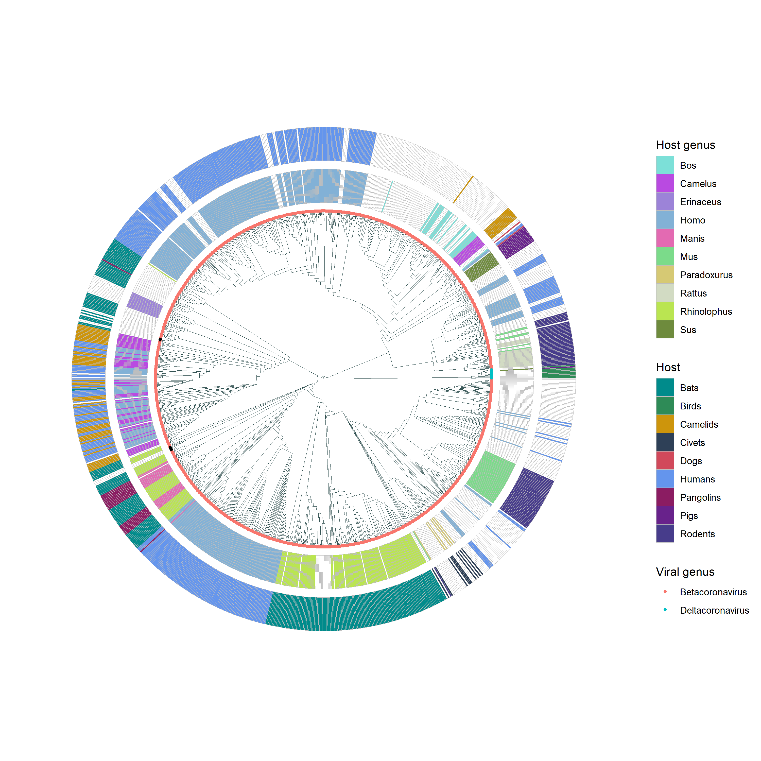
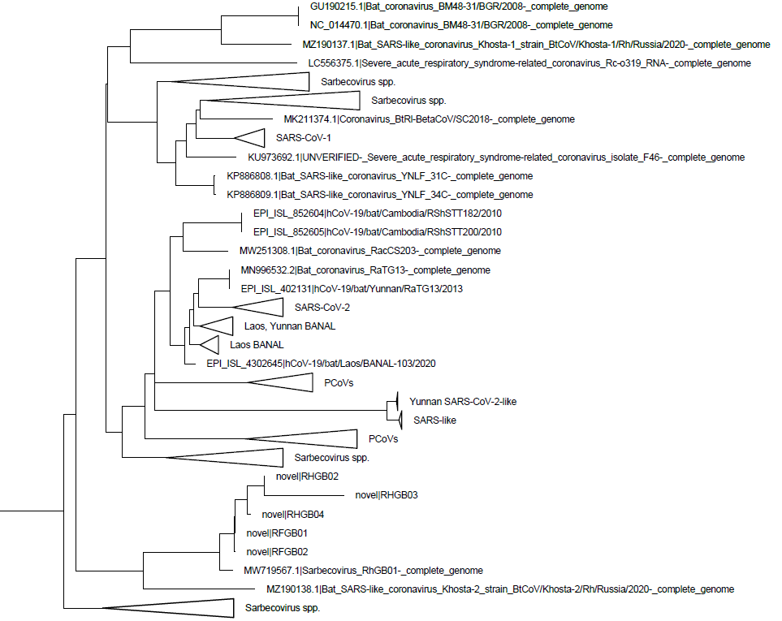


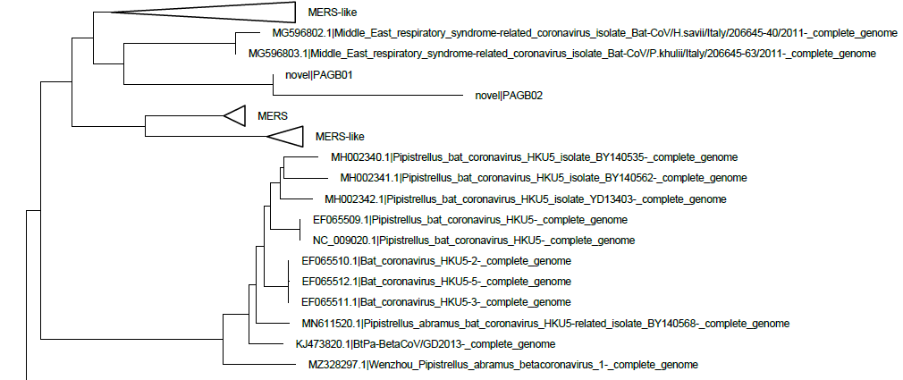
a
b
HCoV-OC43
HCoV-HKU1
PAGB01
PAGB02
MERS
RHGB02
RHGB03
RHGB04
RFGB01
RFGB02
Sarbecovirus spp.
SARS
SARS-like
SARS-CoV-2
c

Slide 3
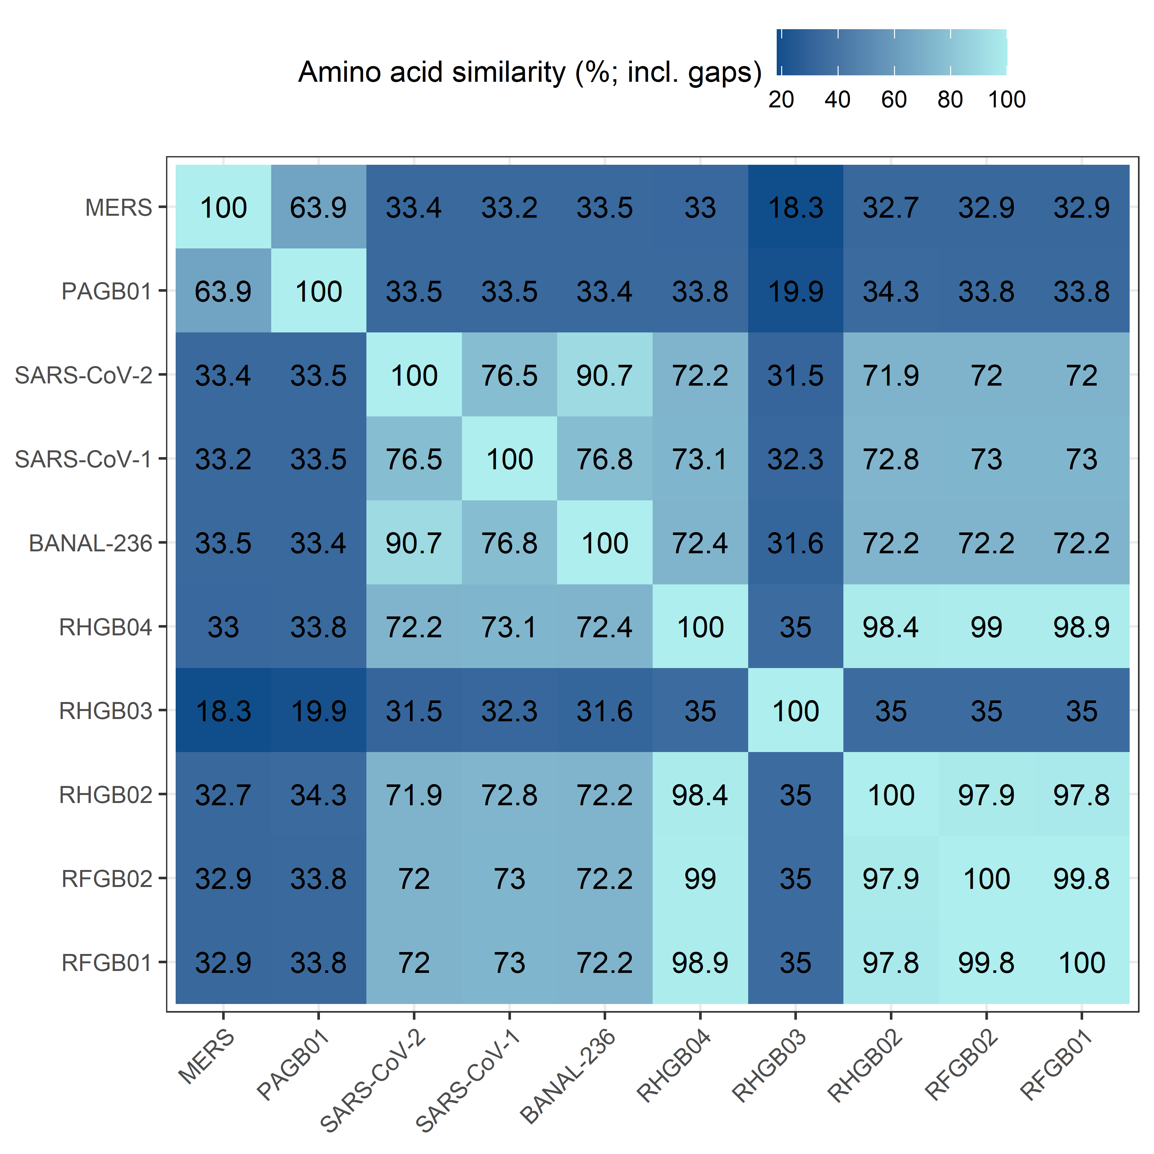
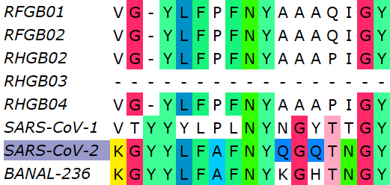
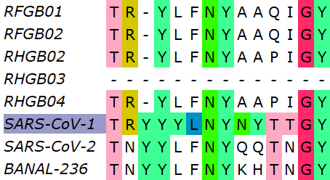

a
b
SARS-CoV-2 contact residues
SARS-CoV-1 contact residues
MERS contact residues

