Slide 1
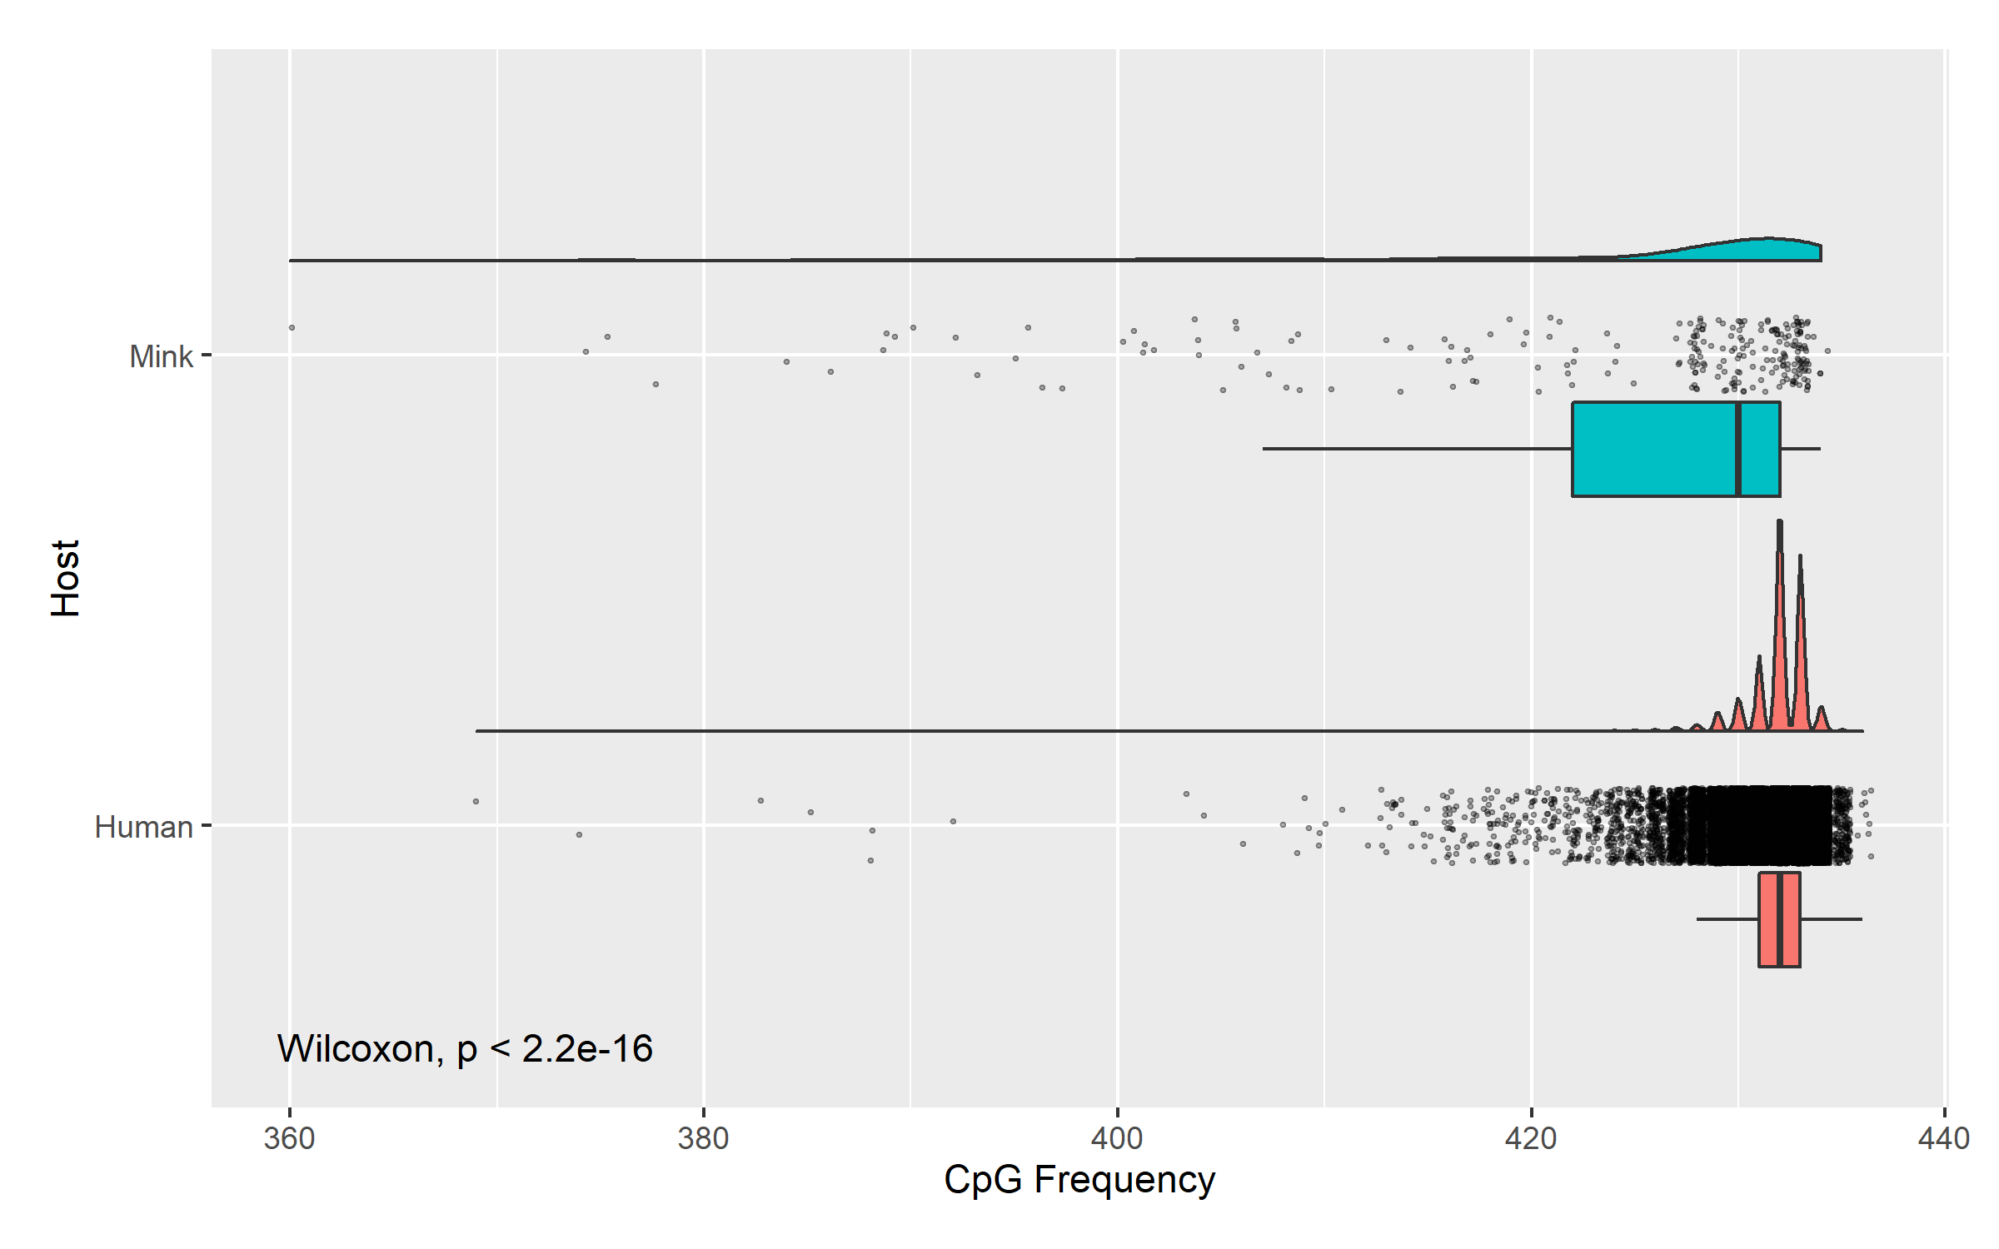
n = 240 , x̅ = 424
n = 54768, x̅ = 432

