Slide 1
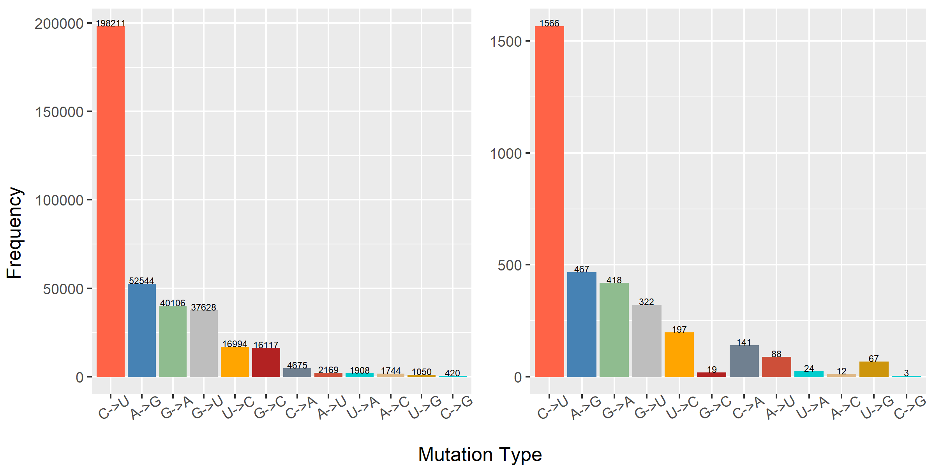
Human (n = 46721)
Mink (n = 240)
χ² = 958.2, p = 5e-4

