Slide 1

Building An Effective Red Team Function (2021 Edition)
Cedric Owens
GrimmCon 0x4
March 2021

Slide 2



Bio
Red Team Lead At
macOS post exploitation and infra automation
Husband and father
Based in Austin, TX
Past Blue Team Experience
Second time building a red team program
Fan of 80s and early 90s
@cedowens

Slide 3

Agenda
“State of the Union”
Ground Level
General Guidelines & Approaches
Roadmap Planning & Workflow
Metrics
Lessons Learned
Summary

Slide 4


STATE OF THE UNION

Slide 5

State of The Union
Corporate red teams: new kid on the block
Very little by way of standards
We are learning as we go
Share things I have learned along the way

Slide 6
GROUND LEVEL

Slide 7

Ground Level
Assumption:
Blue is in place before starting internal red team
My 10,000 ft view of red teaming
Effective red teams: drive positive change
Improvements in detection & response
Improvements in security controls
Help increase general awareness of security
How do we get there?
Suggestions for new internal corporate red team programs

Slide 8

Ground Level
Several Skills At Play
Planning/Process Development
Operator Skills
Tool Development
Infrastructure Automation
Project Management
Communication & Documentation
Social Engineering
Relationship Building (EMPATHY!)

Slide 9
Ground Level - Lots of Opportunities for Uplift
Detection & Response Improvement
Cloud Security Initiatives
Red Team
Corporate Security Initiatives
Customer Protection Initiatives
Business Processes
Security Awareness Training Content
Uplift Engineering and Build Pipeline Processes

Slide 10

Ground Level – New Red Teams
Common Challenges for New Red Team Programs
Redefining preconceived notions
Thoughtfully planning year 1 (critical)
Relationship building (especially with blue)
What processes and documentation to have in place?
How do you demonstrate impact?
What types of assessments do you run?
Thoughtfully conveying resource constraints
Workflow and cadence

Slide 11

Ground Level – New Red Teams
Q1 Recommendations
Relationships, relationships, relationships!
Helpful Documentation
Red Team Charter (who you are and what you do!)
Rules of Engagement (how you do what you do!)
Red Team Exercise Proposal Template
Purple Team Exercise Proposal Template
Roadmap
1-2 Years Out
How red team will evolve
Additional capabilities
Maturing Exercises (supply chain, upleveling, etc.)
Threat research and emulation
Additional resourcing needed to get there

Slide 12
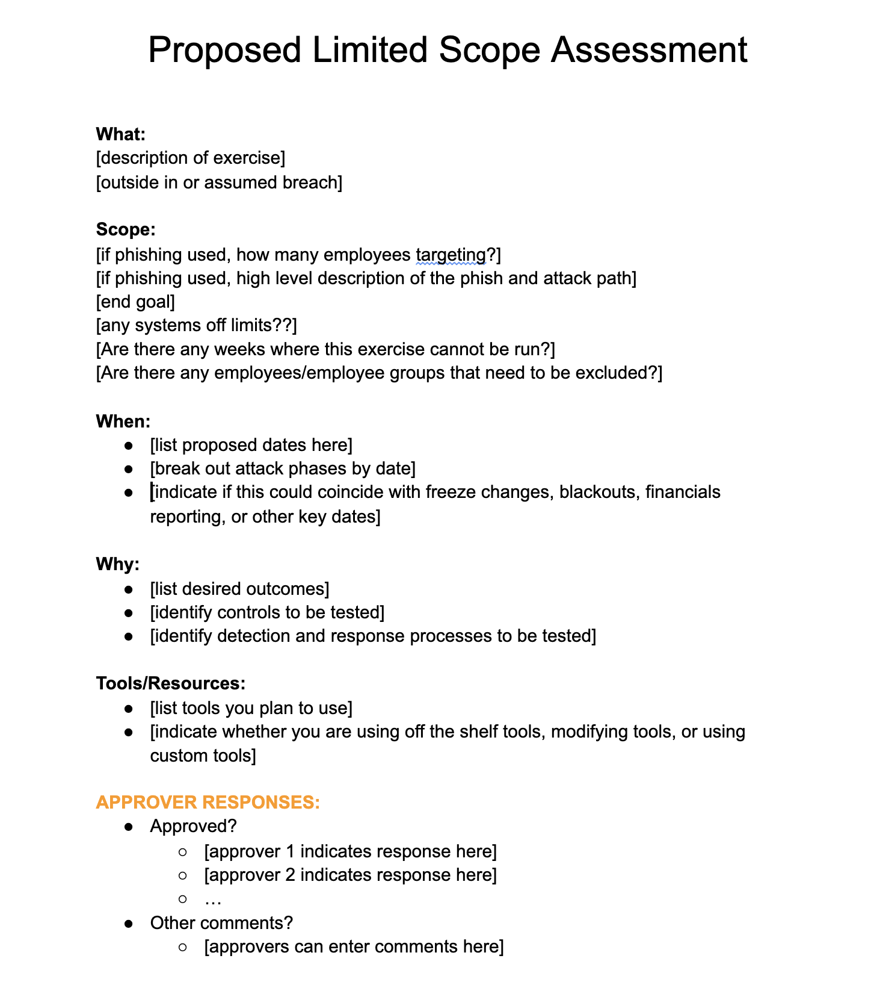
Sample Exercise Proposal Template

Slide 13
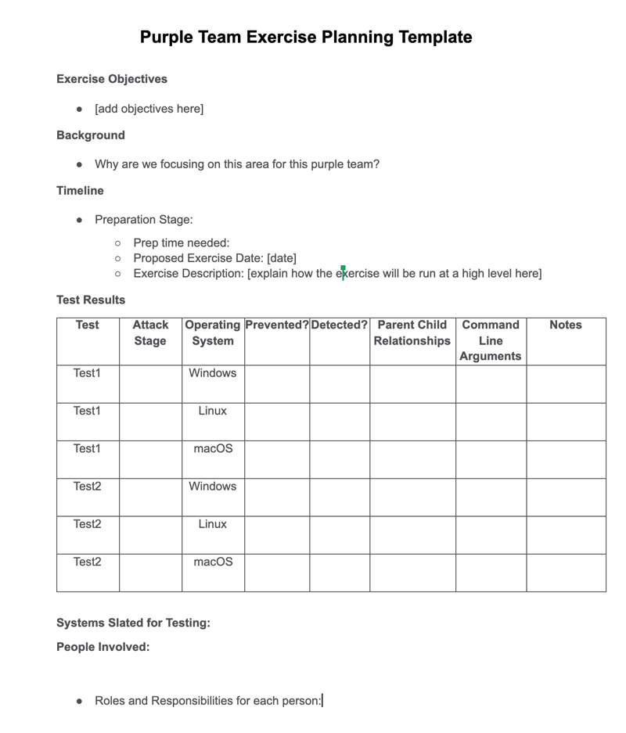
Sample Purple Team Planning Template

Slide 14

Ground Level – New Red Teams
Q1 Recommendations
In Q1 I also like:
Blind outside-in exercise before becoming “biased”
Short in duration (no more than 1 week)
Tightly scoped (clearly identified objectives)
Use low level TTPs. Ex:
2FA man in the middle on publicly facing login portal
Simple phish for endpoint access
Quickly helps get a feel for detection & response
Helps establish credibility in the org for red team

Slide 15

Ground Level – New Red Teams
Q2 Recommendations
Unit Testing Detections
MITRE ATT&CK by platform
C2 Matrix
Goals:
identify visibility and detection coverages and gaps
Build new high fidelity detections (and improve existing)
Initial Purple Team Exercise
Can use first blind outside-in assessment from the first quarter as input
Can repeat portions of attack that went undetected and work on high fidelity detections
Validation testing on new detections generated
Continue relationship building across teams
Share results from initial red team and purple team exercises
Continue building out red team docs and processes

Slide 16
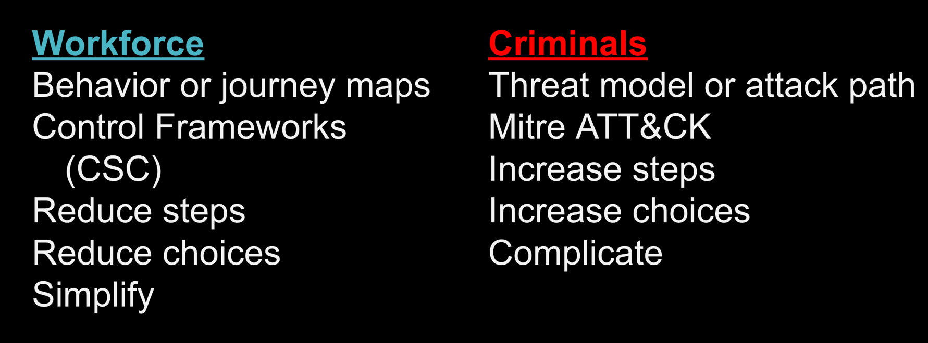
From Wolfgang Goerlich

Slide 17

Ground Level – New Red Teams
Q3 Recommendations
Continue Unit Testing Detections
Another tightly scoped red team exercise
Can be outside in or assumed breach
Impactful objectives
No more than 1 week in duration
Continue relationship building across teams
Share results from initial red team and purple team exercises
Learn from other teams (ex: intel, insider threat, security architecture, etc.)
Seek opportunities to share what the red team has been up to with other teams (including non-security teams)
Example: sharing for a few minutes at other teams’ all hands meetings

Slide 18

Ground Level – New Red Teams
Q4 Recommendations
Demonstrating impact in year 1
What has red team helped drive?
New high fidelity detections? New SIRT runbooks?
New security controls?
Helped other teams with strategic initiatives?
Any knowledge sharing? (ex: brown bags, other teams’ all hands meetings, etc.)
Refine Red Team Roadmap For Year 2
Additional capabilities planned, expanding red team exercises, threat research and emulation, additional headcount needed and why
Continue relationship building across teams (see the theme here?)

Slide 19
GUIDELINES AND APPROACHES

Slide 20

General Guidelines for Red Team Exercises
Think in terms of business processes
Data-driven vs system driven
Why would an executive care?
Tell a story:
What, why, how, etc.
As best as possible, identify attacker profile
Attack start -> accessed X -> accessed Y -> end result
Identify what made it hard (i.e., what controls worked)
Identify preventions that would have hindered the assessment
Give credit due for any detection and response procedures
Identify additional opportunities for betterments
Know your organization:
Are report documents or slide decks preferred in your org?
Bounce your recommendation suggestions off others
Sophistication Scale
LOW

Slide 21

Approaches To Red Team Exercises
Long Running Exercise
Lots of planning work and preparation up front
Often involves emulating a real world adversary
Outside-in
Goal is to remain undetected and retain access as long as possible in order to meet mission objectives
May include various access methods/vectors
Best suited for environments with mature blue and red teams where a lot of the basics in unit testing have been covered; also better for larger red teams

Slide 22
Approaches To Red Team Exercises
Linear Exercises
Use the same set of TTPs across exercises until those TTPs no longer work
Then modify TTPs or evolve to new TTPs
May keep the “loot” gained in a previous exercise
Simulates an attacker who only ”levels up” when absolutely required
Usually scoped and shorter in duration (ex: 1 week up through 1 month)
Essentially helps with follow through to ensure that detections and preventions are moved on
If used exclusively, this approach will limit the attack TTPs that blue is exposed to
= Red team exercise
Sophistication
attack path no longer working
attack path no longer working
Time

Slide 23

Approaches To Red Team Exercises
Non-Linear Exercises
Run different exercises that are individually scoped and do not have a direct connection to previous operations
Usually scoped and shorter in duration (ex: 1 week up through 1 month)
Helps blue team see a variety of TTPs
Depending on the cadence, could lead to ”squirrel effect” where blue jumps to another attack vector without fully building detections and response for previous TTPs they have seen

Slide 24

Approaches To Red Team Exercises
Unit Testing
Is often a good place for new red teams (or instances where detection coverage is unknown)
Ex: Run MITRE ATT&CK matrix TTPs and work collaboratively with blue to run tests to gauge detections
Helps provide immediate uplift to detections
By itself, does not fully test detection and response for an attack chain, where an attacker traverses multiple layers (some of which may not be present in the ATT&CK matrix currently)

Slide 25

Roadmap Planning
Exercise Planning
For new red teams, the reality is you probably will not run a long running exercise; however that can be a good ”north star”
Consider a mixture of linear and non-linear exercises
Ensure unit testing coverage for base TTPs by platform/OS
Find the right frequency/cadence
I personally like quarterly exercises
Gives time for R&D, planning, execution, and closeout
Also gives blue some time between ops
Find the cadence that works right for your environment
Leverage data inputs from other teams into scenario development
Clearly Identify Areas for Growth
Collaborative Exercises (let others help!)
Automation needs
Skillset gaps
Current headcount limitations
Any “peanut butter effect” presently?
What is not working well? How to improve it?

Slide 26

Example Red Team Workflow
Quarterly Red Team Exercise
Can be outside-in or assumed breach
Objectives should be impactful to the business
Can even talk to employees on other teams to get a feel of what data they deem important
Quarterly Purple Team Exercise
Replay steps from prior red team exercises that went undetected
Build and validate new detections
Semi-Annual Specific Assessment
Ex 1: Work together with developer to attack a particular system or application
Ex 2: Segmentation or availability testing
Dedicated R&D Time
Ex: 1-2 weeks per quarter
Build new capabilities
Infra automation
Annual SIRT Table Top Exercise Support
Help craft scenario from attacker perspective

Slide 27
METRICS

Slide 28

Metrics
Ideas for Metrics Tracking
Examples for tracking metrics specific to red team exercises
Dwell Time: Remediation Time – Initial Access Time
Time To Initial Access: Initial Access Time – Attack Start Time
Time To Detection: Initial Detection Time – Initial Access Time
Cyber Kill Chain Stage of Initial Detection
How far along in the kill chain was the red team detected
Recon -> Weaponization -> Delivery -> Exploitation -> Installation -> Command & Control -> Actions on Objectives
Time to Remediation: Remediation Time – Initial Detection Time
Cyber Kill Chain Stage Reached
How far the red team is able to advance during ops
These metrics require collaboration between red and blue

Slide 29
Metrics
These metrics will help answer:
How effective are our remediation processes?
How specifically have red team exercises helped improve our defenses and remediations?
How is the blue team trending across exercises?
Are things getting harder or easier over time for the red team?
What are we doing to shift our detections earlier in the attack life cycle?
The questions above help tell a story that can resonate more with management

Slide 30
WRAPPING IT UP

Slide 31

Lessons Learned
Flexibility is Key!
When starting a new red team, you may not do “red team” things 100% of the time
Ex: corporate phishing exercises, pen tests of a network segment, etc.
Note how any secondary tasks affect your ability to perform primary red team tasks, and share upward
Also offer ideas for solutions (ex: can I automate something and hand off to the appropriate team)
Foster Open Sharing
Hard for red team to have an impact if no one really knows who the red team is or what red team has been up to
Share what red team is doing, even with non-security teams
This will also help build allies across teams that could be beneficial down the road
If You Do Not Have A Vision For Red Team, Someone Else Does
Take time up front to think broadly about the red team program
Identify the direction, workflow, and key deliverables for red team
Proactively build out the roadmap, team charter, rules of engagement, etc

Slide 32

Lessons Learned
Fail Forward
We are all learning as we go when it comes to internal corporate red teams
Not trying is worse than trying with undesired results
Constantly solicit feedback from other teams and and adjust as needed
Blue Being Successful Is A Good Thing
End goal is to make things harder for attackers
Highlight the things that blue is doing well
Consider it a positive if blue prevents you from reaching exercise objectives
Clear Concise Reporting
The companies I have worked for prefer outbriefs that tell stories rather than long detailed reports
Become a good storyteller and describe each operation as if it were a story
Show the attack step by step
Have clear and actionable recommendations; this may require checking with other teams to see if a recommendation is even tenable in your environment
Relationship Building Is Important
Empathy Empathy Empathy!
Build relationships across security teams and non-security teams
Build relationships in the security community with others on red teams

Slide 33

Putting It All Together
Ground Level
Build relationships!
Roadmap, team charter, rules of engagement
At a minimum, think through what red team workflow looks like by quarter
Limited tightly scoped red team exercises to begin along with unit testing coverage for base TTPs by platform/OS
Red Team Exercise Considerations
Think in terms of the business (data vs system)
Tell a story that can be easily followed by others
Use both linear and non-linear exercises; long running op is ”north star”
Pick a cadence that your team can stick to and that makes sense for your environment
Reminders
Track meaningful metrics across exercises that can help tell a story
Fail forward – adjust as needed along the way
Foster open sharing with other teams

Slide 34
References
A Brief Look At Approaches To Red Team Operations: https://medium.com/red-teaming-with-a-blue-team-mentality/73bec371b50f
Helpful Red Team Operation Metrics: https://medium.com/red-teaming-with-a-blue-team-mentality/fabe5e74c4ac
Purple Team Candidates For Modern Tech Environments: https://medium.com/red-teaming-with-a-blue-team-mentality/69a78a125d38
Wolfgang Goerlich’s “Design Thinking For Blue Teams”
Other blogs on corporate red teams (Tim Malcomvetter, red team journal, etc.)

Slide 35

THANK YOU!

