Slide 1

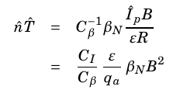





Input Parameters
Physics constants (P_{fus,} Q, f_{D}, n_{G}), geometry scalings (ε,δ,κ), profile peaking parameters
Limits
Power balance: P_{α} + P_{ext} = P_{cond} + P_{rad}
Beta definition
neglected
P_{α}=P_{fus}/λ
P_{ext}=P_{fus}/Q
P_{cond}=W/τ_{e}
Beta limit (Troyon)
Scaling laws f(I_{p}, R, B, P_{ext})
Greenwald
Tabulated f(T)
beta₂
Other limits:
Kink
Wall n loading
Wall heat loading
…
q_{a} from MHD limits
beta₁
Output Parameters: (R₀, B₀)

