Slide 1

English & Culture
Participants:
-Cedric Mea
-Sakina Ouisrani

Slide 2
English & Culture : What is it ? And Why ?
An application made by Telecom Nancy students
A powerful way to improve your english
Deal with 3 aspects of the english Language : writing ,listening and culture
It is funny (we hope so ☺ )

Slide 3
Let’s discover !

Slide 4
3 differents types of exercices
GRAMMAR : you can test you can test your grammar rules
LISTENNING : you have to listen and answer to question
CULTURE : Here we test hom much you know about english countries culture

Slide 5
What contains each exercice?

Slide 6
GRAMMAR
You can choose beetwen three levels of grammar exercice
BEGINNER
INTERMEDIATE
ADVANCED

Slide 7
LISTENNING
You can choose beetwen two levels of listenning exercice
Short recording
Long recording

Slide 8
GRAMMAR
You have the choice beetwen three categories,You zill hqve hqve for each category questions with pictures
Geopgraphy
History
Fun facts

Slide 9
Let’s see an example !

Slide 10
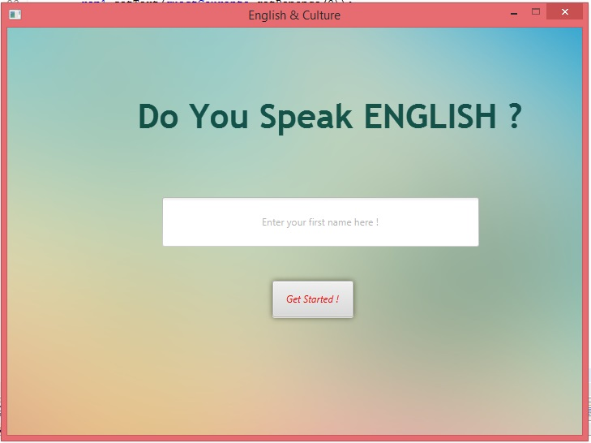
Welcome page

Slide 11
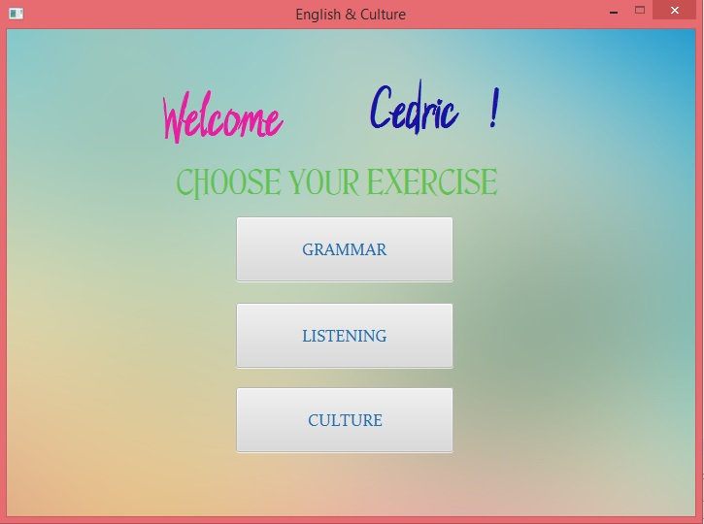
Choose your exercice

Slide 12
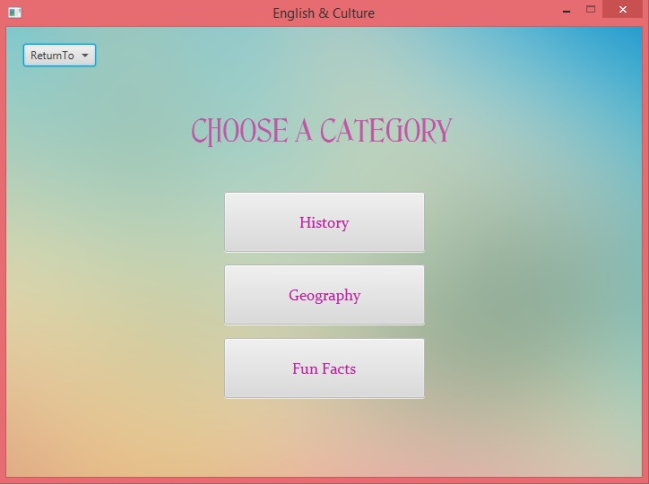
Choose your category

Slide 13
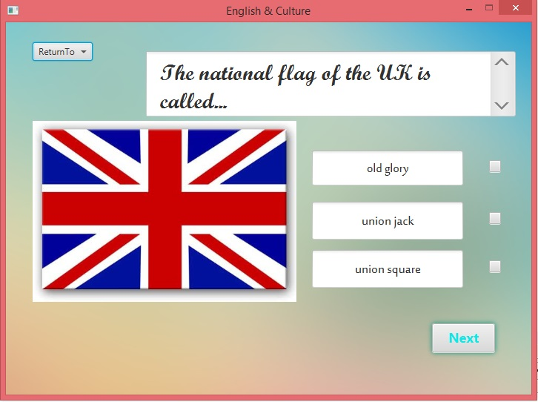
Answer to a question !

Slide 14
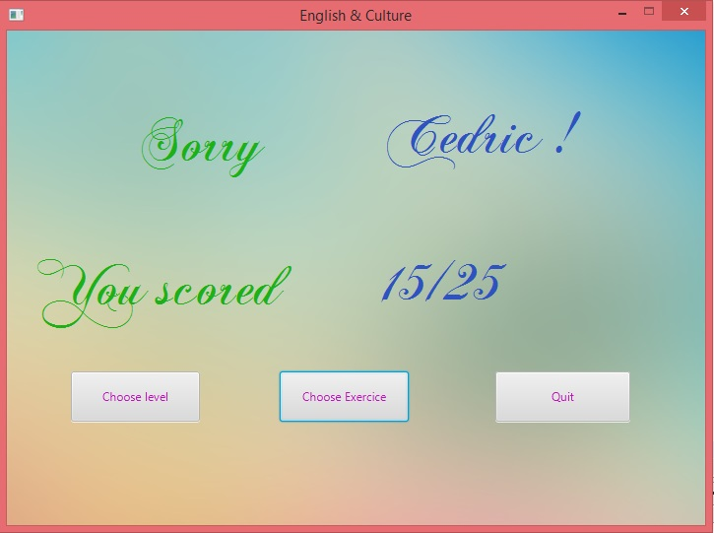
Get your score !

