Slide 1
UEFI and Linux
(Or: A Requiem for My Liver)
Matthew Garrett <mjg@redhat.com>

Slide 2
Just what is UEFI?
Replacement for legacy PC BIOS
BSD licensed core
Adds standardised support for new hardware features

Slide 3
Just what is UEFI?
Replacement for legacy PC BIOS
BSD licensed core
Adds standardised support for new hardware features
Utterly infuriating

Slide 4
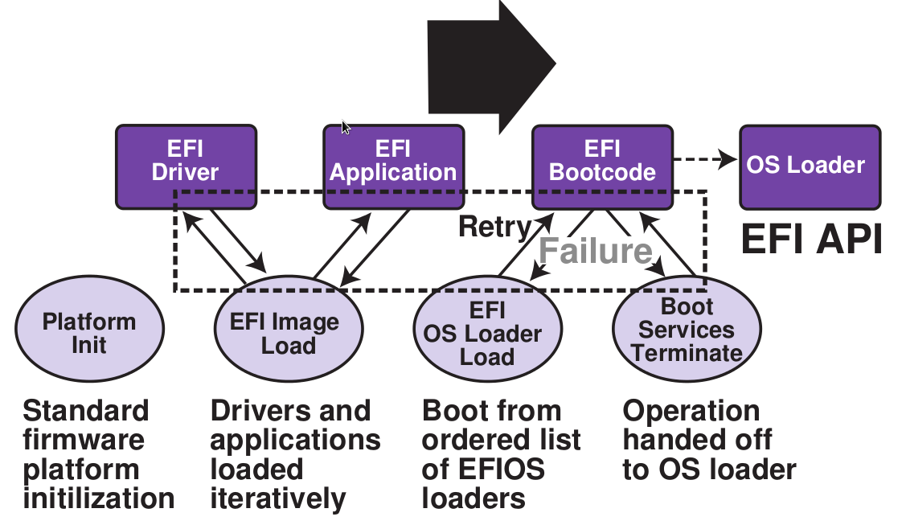

Slide 5
UEFI services
Boot services – rich set of interfaces with hardware
Runtime services – limited OS/firmware interaction

Slide 6
Boot Services
Memory allocation, timers, driver interaction, image loading and so on
OpenProtocol() with a GUID gives you a table of function pointers
Call those functions -> profit

Slide 7
Sample protocol definition
#define EFI_GRAPHICS_OUTPUT_PROTOCOL_GUID \
{0x9042a9de,0x23dc,0x4a38,0x96,0xfb,0x7a,0xde,\
0xd0,0x80,0x51,0x6a}
typedef struct EFI_GRAPHICS_OUTPUT_PROTCOL {
EFI_GRAPHICS_OUTPUT_PROTOCOL_QUERY_MODE QueryMode;
EFI_GRAPHICS_OUTPUT_PROTOCOL_SET_MODE SetMode;
EFI_GRAPHICS_OUTPUT_PROTOCOL_BLT Blt;
EFI_GRAPHICS_OUTPUT_PROTOCOL_MODE *Mode;
} EFI_GRAPHICS_OUTPUT_PROTOCOL;

Slide 8
Firmware/OS handover
OS (kernel or loader) calls ExitBootServices()
  Boot services code discarded
  Only runtime services available from here on
Kernel calls SetVirtualAddressMap()
  Firmware uses OS pagetables, so needs to know address map
OS makes sure runtime services code is executable
  NX gives problems otherwise…

Slide 9
Runtime services
Non-volatile variable store
  Contains boot data, system information, crash dumps
Time/alarm configuration
  OS doesn't need to know how wakeup or time hardware is implemented
Reset/power off system, pass updates to firmware, get a monotonic count for encrypted variables

Slide 10
GPT
GUID Partition Table
No practical restrictions on partition size
No practical restrictions on number of partitions
Provides more metadata about partition type and purpose

Slide 11
But?
This all sounds pretty good!

Slide 12
But?
This all sounds pretty good!
So why are you complaining?
Is there something we're not being told?

Slide 13
TianoCore
Intel reference UEFI implementation
Used as the basis of EFI Development Kit
Incorporated mostly unchanged into most vendor firmware
Made up of files

Slide 14
Files
7061 files

Slide 15
Files
7061 files
Containing >100MB of code

Slide 16
Files
7061 files
Containing >100MB of code
~10% the size of the whole Linux kernel

Slide 17
Files
7061 files
Containing >100MB of code
~10% the size of the whole Linux kernel
Bigger than the Linux kernel core

Slide 18
Files
Files contain code

Slide 19
Files
Files contain code
Code contains bugs

Slide 20
Files
Files contain code
Code contains bugs
UEFI contains bugs

Slide 21
So many bugs
Boot services aren't there after ExitBootServes()
So SetVirtualAddressMap() shouldn't call any, right?

Slide 22
So many bugs
Boot services aren't there after ExitBootServes()
So SetVirtualAddressMap() shouldn't call any, right?

Slide 23
So many bugs
Boot services aren't there after ExitBootServes()
So SetVirtualAddressMap() shouldn't call any, right?
(a-ha ha ha ha oh why is it all so awful)

Slide 24
Virtual memory is great!
Your contiguous physical addresses no longer have to be contiguous virtual addresses!
Firmware knows that, right?

Slide 25
Virtual memory is great!
Your contiguous physical addresses no longer have to be contiguous virtual addresses!
Firmware knows that, right?
  (Not if it's from Apple)
Four UEFI memory regions with contiguous physical addresses
Linux mapped them in non-contiguous virtual regions

Slide 26
Careless coding costs hardware
SetVariable() writes to flash
Apple took a virtual address and added an offset
That offset carried it over a region boundary
Those regions were contiguous on MacOS, not on Linux

Slide 27
Contiguous physical regions
Non-contiguous virtual regions

Slide 28
Adding a constant offset works if blocks are contiguous

Slide 29
Less well if non-contiguous

Slide 30
Less well if non-contiguous

Slide 31
Mine's a double, thanks
We wrote our boot entry into the middle of the system firmware
Oops.

Slide 32
Variables are hard!
One shipping machine wouldn't let us delete variables
Another reports the same variable multiple times

Slide 33
Rebooting's easy, right?
Vendor UEFI code tries to write directly to low addresses
This works badly if you're still using virtual addressing
Oops on reboot. Sigh.

Slide 34
It's worse.
That's just the bugs in runtime services.
Boot services contain massively more code.
The kernel has it easy.
(Shame I have to care about bootloaders too)

Slide 35
The moral:
UEFI is poorly tested in the real world
UEFI contains a lot of code
UEFI contains an incredible number of bugs

Slide 36
Look! A distraction!
So, secure boot, yeah?
Yeah.

Slide 37
Secure Boot
Firmware contains three types of key
PK is owned by the vendor
KEK is owned by any OS that can add to the whitelist
DB contains the whitelisted keys

Slide 38
Secure Boot
When attempting to execute code, firmware retrieves an encrypted hash from the binary
Firmware decrypts hash with the public key.
Firmware calculates hash of the binary
If the hashes match, execute. Otherwise, don't.

Slide 39
Easy, right?
OS knows it's been booted securely because SecureBoot variable is “1”
But reading that variable requires you to trust the firmware
Oops

Slide 40
All code with hardware access must be trusted
All firmware code
All bootloader code
All kernel code

Slide 41
All code with hardware access must be trusted
ALL KERNEL CODE

Slide 42
Secure boot gives us problems
Who gets the keys?
Does this match the licenses?
What happens to all the out of tree driver vendors?

Slide 43
Well.
(Maybe that last one's a benefit)

Slide 44
You've been a wonderful audience
Ask me things while I'm still lucid

