Slide 1

NVIDIA Corporation
2023-08-02

Slide 2
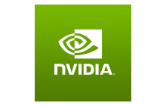
Company Information
NVIDIA Corporation provides graphics, and compute and networking solutions in the United States, Taiwan, China, and internationally. The company's Graphics segment offers GeForce GPUs for gaming and PCs, the GeForce NOW game streaming service and related infrastructure, and solutions for gaming platforms; Quadro/NVIDIA RTX GPUs for enterprise workstation graphics; vGPU software for cloud-based visual and virtual computing; automotive platforms for infotainment systems; and Omniverse software for building 3D designs and virtual worlds. Its Compute & Networking segment provides Data Center platforms and systems for AI, HPC, and accelerated computing; Mellanox networking and interconnect solutions; automotive AI Cockpit, autonomous driving development agreements, and autonomous vehicle solutions; cryptocurrency mining processors; Jetson for robotics and other embedded platforms; and NVIDIA AI Enterprise and other software. The company's products are used in gaming, professional visualization, datacenter, and automotive markets. NVIDIA Corporation sells its products to original equipment manufacturers, original device manufacturers, system builders, add-in board manufacturers, retailers/distributors, independent software vendors, Internet and cloud service providers, automotive manufacturers and tier-1 automotive suppliers, mapping companies, start-ups, and other ecosystem participants. It has a strategic collaboration with Kroger Co. NVIDIA Corporation was incorporated in 1993 and is headquartered in Santa Clara, California.
Company Name: NVIDIA Corporation
Sector: Technology
Industry: Semiconductors
Country: United States
City: Santa Clara
Number of employees: 26,196
Website: https://www.nvidia.com
Source: Yahoo Finance, Logos provided by Clearbit

Slide 3
SWOT Analysis of NVIDIA Corporation
S
1. Strong brand recognition and reputation in the semiconductor industry. 2. Dominant market position in the graphics processing unit (GPU) market. 3. Diversified product portfolio catering to various industries such as gaming, data centers, and automotive. 4. Strong financial performance with consistent revenue growth and profitability. 5. Robust research and development capabilities driving innovation and technological advancements.
1. Dependence on a few key customers for a significant portion of revenue. 2. Vulnerability to fluctuations in the global semiconductor market. 3. Limited presence in certain emerging markets and industries. 4. High competition from other semiconductor companies.
W
O
1. Growing demand for GPUs in artificial intelligence (AI) and machine learning applications. 2. Expansion into new markets such as autonomous vehicles and edge computing. 3. Increasing adoption of cloud computing and data centers. 4. Potential for partnerships and collaborations to enhance product offerings and market reach.
1. Intense competition from established players and new entrants in the semiconductor industry. 2. Potential impact of trade tensions and geopolitical uncertainties on global supply chains. 3. Rapid technological advancements leading to shorter product life cycles. 4. Regulatory and legal challenges in certain markets.
T
Source: GPT 3.5 LLM; Knowledge cut off date is September 2021

Slide 4
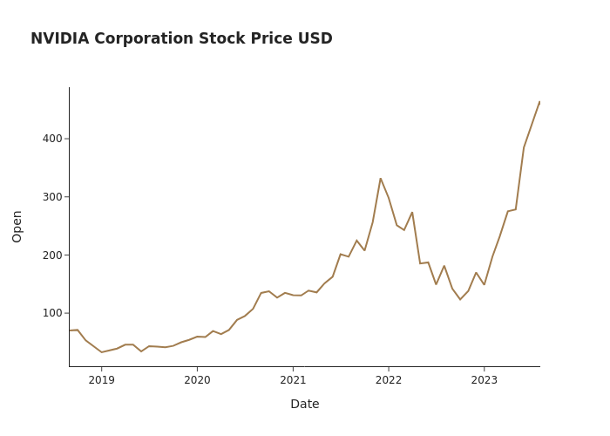
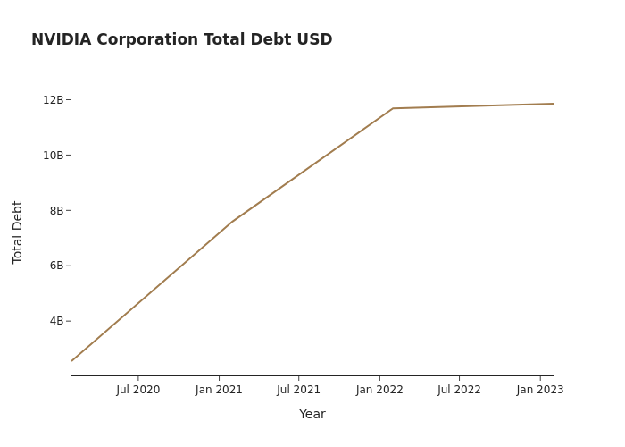
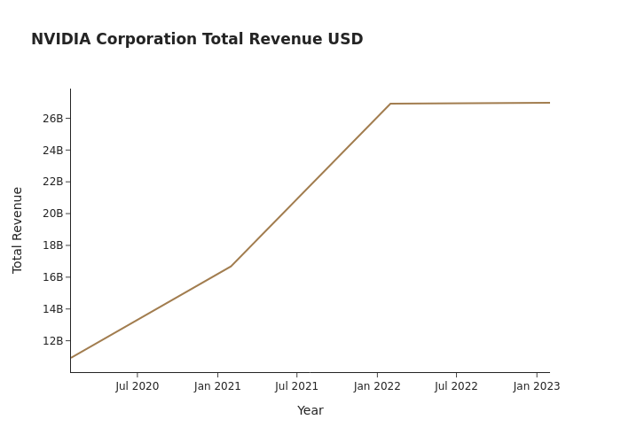
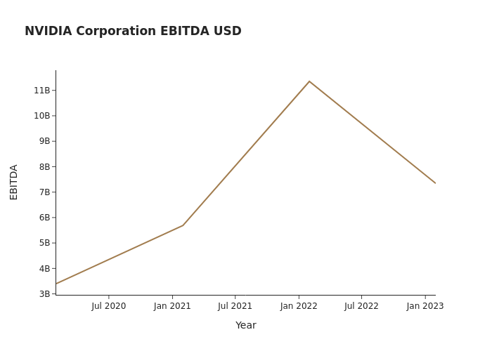
Source: Yahoo Finance

Slide 5
Value Proposition of Cloud Data Storage for NVIDIA Corporation
Pains
Gains
1. High costs and complexity of managing on-premises data storage infrastructure 2. Limited scalability and flexibility of existing data storage solutions 3. Concerns about data security and privacy
1. Cost savings through reduced infrastructure and maintenance expenses 2. Increased scalability and flexibility to accommodate growing data storage needs 3. Enhanced data security and privacy measures
Pain Relievers
Gain Creators
1. Cloud-based storage solution eliminates the need for on-premises infrastructure and reduces associated costs 2. Scalable and flexible storage options to meet changing business requirements 3. Robust security measures, including encryption and access controls, to protect sensitive data
1. Seamless integration with existing IT infrastructure and workflows 2. Advanced data analytics capabilities for improved decision-making 3. Reliable and high-performance data storage and retrieval
Source: GPT 3.5 LLM; Knowledge cut off date is September 2021

Slide 6
Key People at NVIDIA Corporation
Co-Founder, CEO, Pres & Director
Exec. VP & CFO
Exec. VP of Operations
Exec. VP, Gen. Counsel & Sec.
Name: Mr. Jen-Hsun Huang
Name: Ms. Colette M. Kress
Name: Ms. Debora Shoquist
Name: Mr. Timothy S. Teter
Age: 59
Age: 55
Age: 67
Age: 55
News and Corporate Events
Headline
Date
Description
Nvidia CFO Says Aware Of Reports That The U.S. Considering Further Controls That May Restrict Exports Of Our A800 And H800 Products To China
2023-06-28
June 28 (reuters) - nvidia corp <nvda.o>nvidia cfo aware of reports that the u.s. considering further controls that may restrict exports of our a800 and h800 products to china.nvidia cfo says do not anticipate such additional restrictions from us , if adopted, would have an immediate material impact on our financial results.nvidia cfo - over long-term, restrictions prohibiting sale of datacenter...
NVIDIA reports Q1 revenue USD 7,192 million
2023-05-24
May 24 (reuters) - nvidia q1 net income usd 2,043 million.
Source: Yahoo Finance

Slide 7
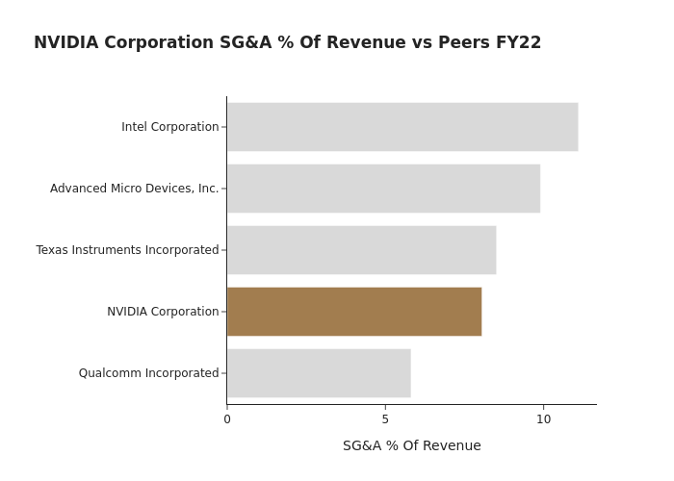


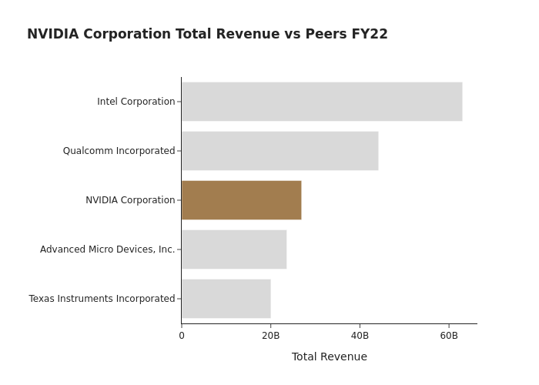


Advanced Micro Devices, Inc. operates as a semiconductor company worldwide.
Intel Corporation designs, develops, manufactures, markets, and sells computing and related products worldwide. It operates through Client Computing Group, Data Center and AI, Network and Edge, Mobileye, Accelerated Computing Systems and Graphics, Intel Foundry Services, and Other segments.
QUALCOMM Incorporated engages in the development and commercialization of foundational technologies for the wireless industry worldwide. It operates through three segments: Qualcomm CDMA Technologies (QCT); Qualcomm Technology Licensing (QTL); and Qualcomm Strategic Initiatives (QSI).
Texas Instruments Incorporated designs, manufactures, and sells semiconductors to electronics designers and manufacturers in the United States and internationally. It operates in two segments, Analog and Embedded Processing.
Source: Yahoo Finance, GPT 3.5 LLM, Logos provided by Clearbit

Slide 8
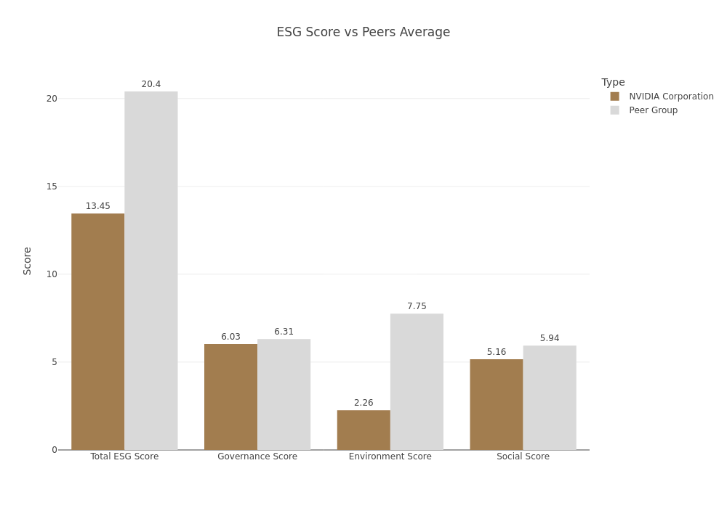
ESG Score NVIDIA Corporation vs Peer Group
Source: Yahoo Finance

Slide 9
Thanks for attention
Created by Oleksandr Arsentiev for Streamlit Summit Hackathon
Contact me at: LinkedIn Twitter GitHub

