Slide 1

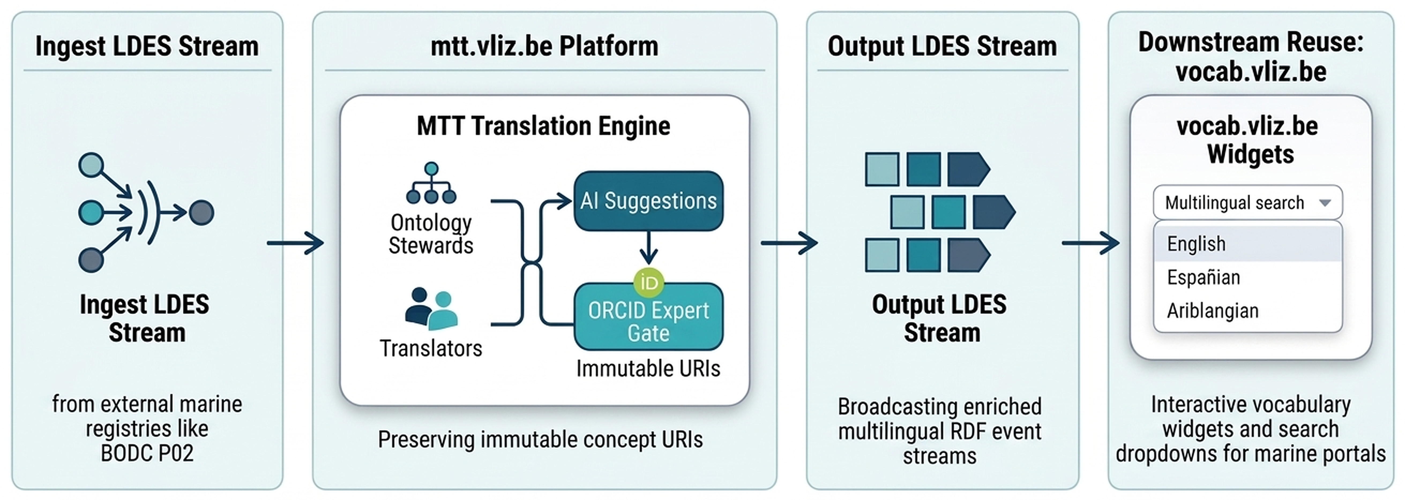

vliz.be
MULTILINGUAL MARINE VOCABULARIES | mtt.vliz.be | FOR TRANSLATORS & ONTOLOGY STEWARDS
Marine Term Translations (MTT): Continuous LDES Ingestion, Collaborative Multilingual Curation, and Downstream Vocabulary Widgets
Cedric Decruw
Flanders Marine Institute (VLIZ), InnovOcean Campus, 8400 Oostende, Belgium | cedric.decruw@vliz.be | ORCID: 0000-0001-6387-5988
Central Architecture: Continuous LDES Ingestion, MTT Curation & vocab.vliz.be Widgets
Figure 1: Continuous semantic pipeline: Upstream LDES ingestion → mtt.vliz.be translation workbench (AI suggestions + ORCID peer gate) → Outgoing LDES publication → Live reuse in vocab.vliz.be widgets.
1. For Ontology Stewards: Ingestion & Sync
Operational Context:
• Marine registries (e.g. BODC P02, SeaDataNet) publish authoritative terms in English.
• Static snapshot downloads cause sync latency, manual drift, and URI churn.
Research Question (RQ):
• How to ingest ontologies and enrich them multilingually while preserving concept identities?
Hypothesis & Prediction:
• Streaming LDES ingestion with decoupled concept modeling eliminates sync lag without URI churn.
Platform Value for Stewards:
2. For Translators: Curation & Credit
The Translation Bottleneck:
• Domain experts are deterred by complex semantic tools (Protégé, raw RDF) and unstructured spreadsheets.
• Linguistic translations often go uncredited in academic pipelines.
The mtt.vliz.be Workbench:
3. Outgoing LDES & vocab.vliz.be Widgets
Downstream Delivery Pipeline:
Outgoing LDES Stream Broadcast
Approved translations emitted as immutable RDF event feeds, eliminating bulk snapshot downloads.
1. Side-by-Side Comparison UI
Distraction-free browser interface comparing source terms directly with translations.
vocab.vliz.be Widgets Endgoal
Curated terms power drop-in autocomplete and search widgets across marine portals.
2. AI-Assisted Candidate Drafting
Contextual suggestions accelerate initial drafting velocity by 2× across batches.
Empirical Results (BODC P02 Beta):
Continuous LDES Ingestion
Ingests upstream LDES event feeds, tracking term updates incrementally without bulk downloads.
25%
P02 Translated
2×
Drafting Speed
3. Human-in-the-Loop Review Gate
Machine suggestions remain provisional until validated by domain specialists.
• Supported Hypothesis: Zero URI churn; continuous sync proven.
• 1 Study Limitation: Throughput bounded by reviewer bandwidth.
• Actionable Future Direction: Deploy automated confidence triage.
Zero Concept URI Churn
Persistent concept URIs remain immutable as multilingual labels evolve, ensuring stable references.
4. Citable ORCID Attribution
Every approved label is bound to ORCID, guaranteeing citable academic credit.
Institutional Data Sovereignty
100% self-hostable open stack (React, Node.js, PostgreSQL) deployable on local infrastructure.
Governance: Role-aware permissions and complete version audit logs.
Test the Live Platform & Widgets (Scan QR Code)
Standards-Based Interoperability
Dual export pathways: CSV, SKOS, JSON-LD, and continuous Linked Data Event Streams.
Community Participation & Impact
Translators: Review and curate terminology in your native language.
Stewards: Register ontologies for automated continuous ingestion.
mtt.vliz.be | https://mtt.vliz.be/
References: [1] Wilkinson et al. (2016). Sci. Data. [2] BODC (2024). NERC P02. [3] Van de Vyvere et al. (2022). LDES.
AI Disclosure: Assisted with language polish and schematic layout; system design and evaluation by the author.
Flanders Marine Institute (VLIZ)
mtt.vliz.be | vocab.vliz.be

