Slide 1

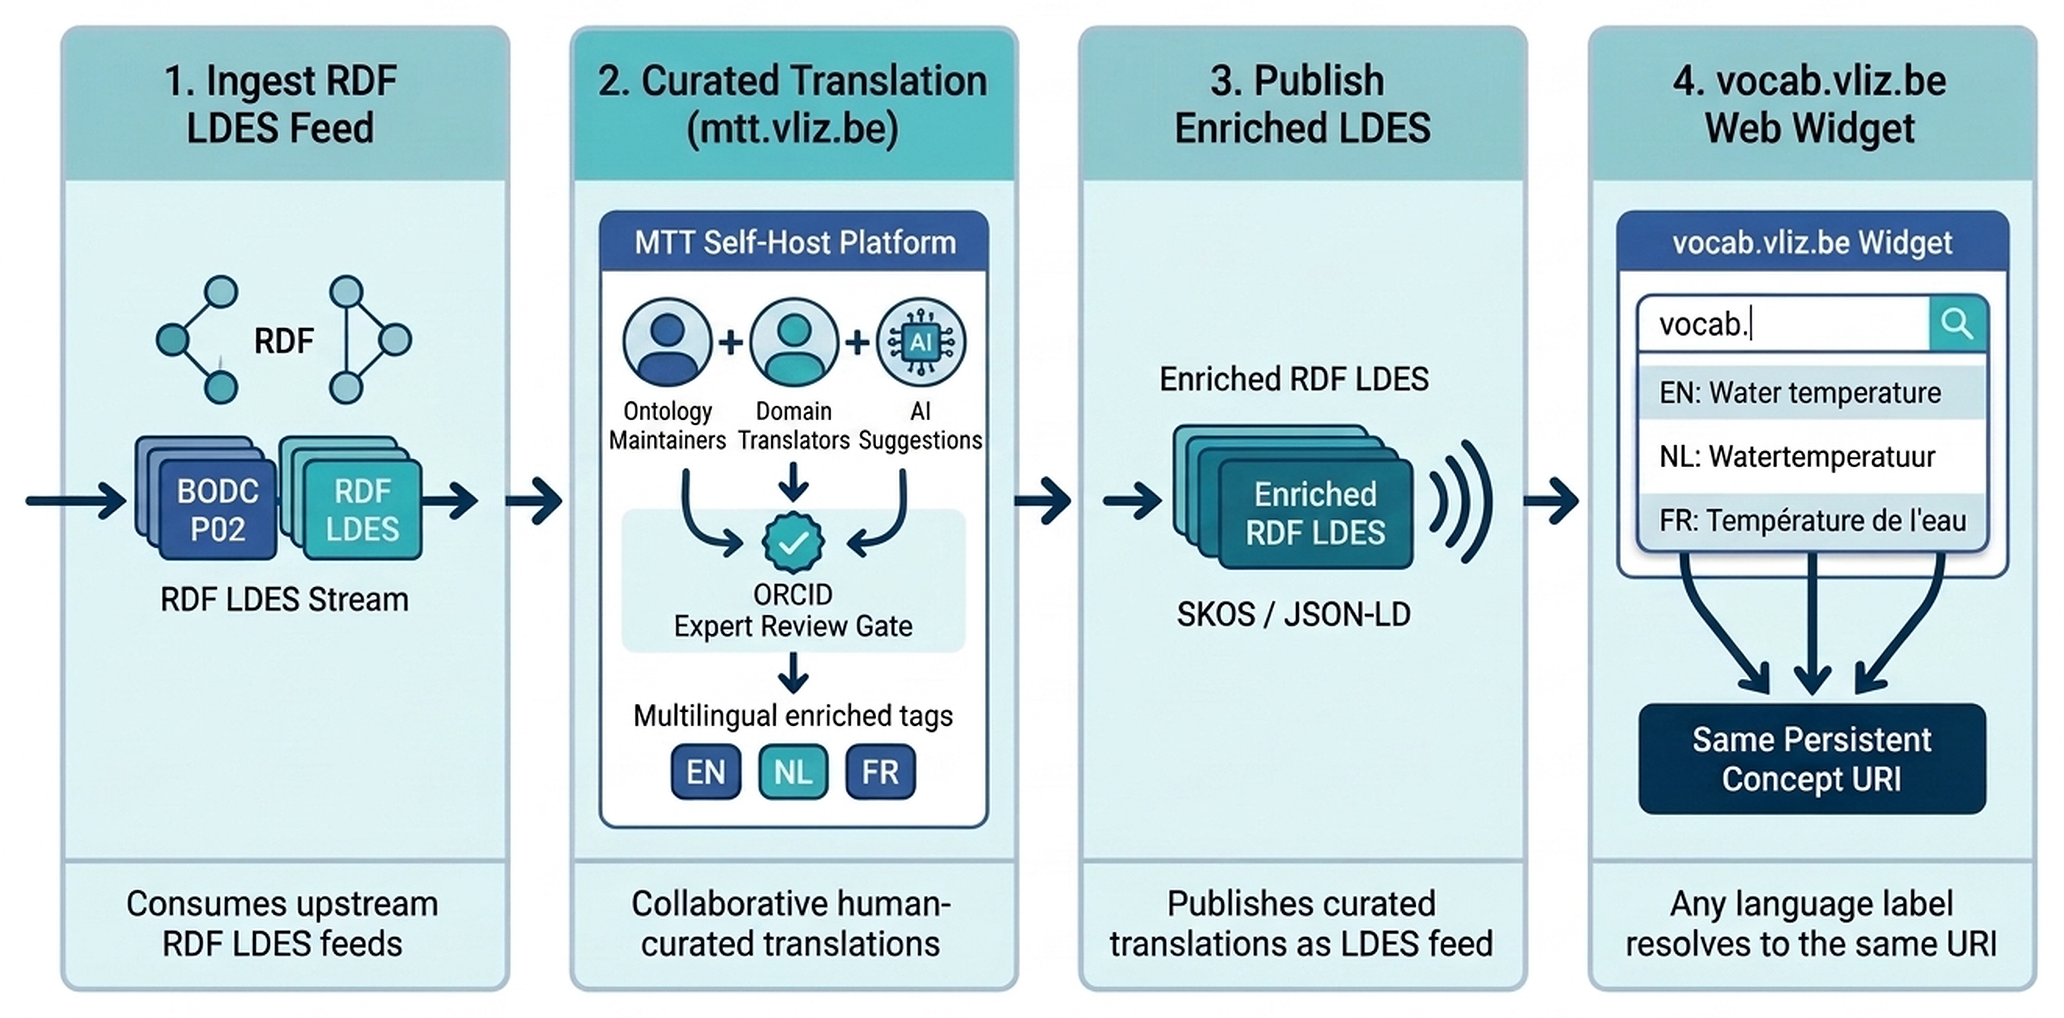
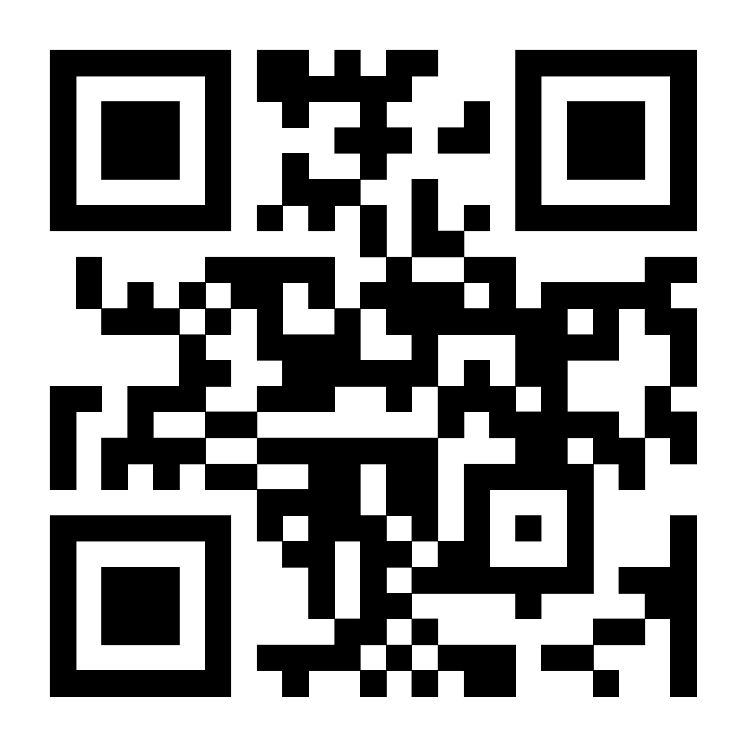
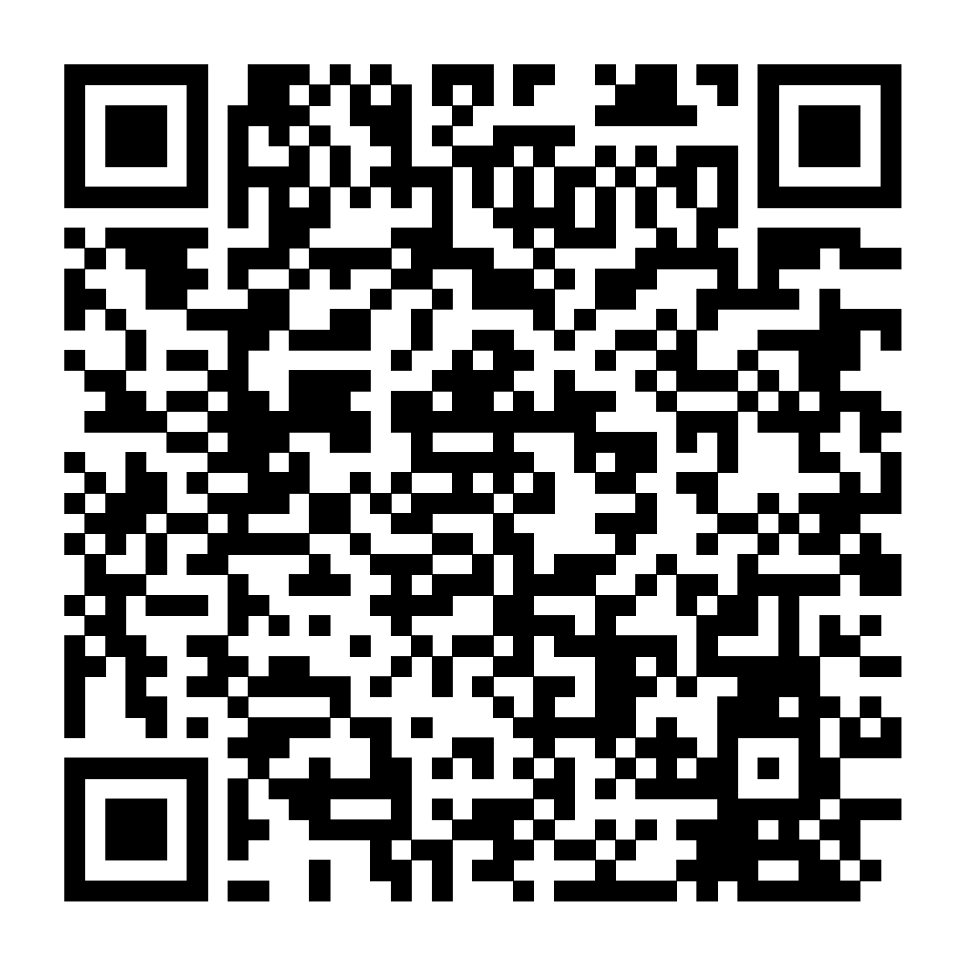
[ IMDIS 2026 Logo ]
Reserved Conference Logo Space
vliz.be
IMDIS 2026 | mtt.vliz.be | FOR DOMAIN TRANSLATORS & ONTOLOGY MAINTAINERS
[ IMDIS 2026 Logo ]
Reserved Conference Logo Space
Marine Term Translations (MTT): A Self-Hosted Platform for Multilingual Marine Terminology Interoperability
Cedric Decruw
Flanders Marine Institute (VLIZ), InnovOcean Campus, Ostend, Belgium | cedric.decruw@vliz.be | ORCID: 0000-0001-6387-5988
1. Context, Research Question & Hypothesis
Operational Gap in Marine Vocabularies:
• Marine infrastructures (SeaDataNet, EMODnet, BODC NVS) maintain authoritative terms in English, while translations rely on disconnected spreadsheets.
• Periodic full-snapshot downloads cause sync lag and URI drift.
2. Empirical Evaluation (Beta test)
Observed Beta Performance Metrics:
28%
P02 in NL & FR terms translated
658
Terms translated
18
Contributors
Research Question (RQ)
How can institutions run a sovereign multilingual terminology workflow that engages domain experts and publishes machine-actionable updates?
Discussion, Limitation & Future Direction
• Supported Hypothesis: End-to-end LDES stream sync proven on BODC P02 without URI churn.
• 1 Study Limitation: Review velocity remains bounded by domain-expert reviewer bandwidth.
• Actionable Future Direction: Deploy automated confidence triage to prioritize expert review queues.
Hypothesis & Prediction
Decoupling persistent concept URIs from language labels in an ORCID-governed, LDES-enabled web platform eliminates sync lag without URI churn.
Figure 1: MTT consumes upstream RDF LDES streams (e.g. BODC P02), supports human-curated translations with AI drafting and ORCID review, re-publishes enriched RDF LDES feeds, and powers vocab.vliz.be widgets where any multilingual label resolves to the same persistent Concept URI.
3. For Ontology Maintainers & Domain Translators
For Ontology / Vocabulary Owners & Maintainers:
4. Downstream Widget Reuse & Digital Access
Sovereign Self-Host Stack
Open-source React, Node.js & PostgreSQL (mtt-self-host-platform).
LDES + SKOS / JSON-LD
Incremental RDF event streams plus deterministic CSV, SKOS & JSON-LD.
Downstream Reuse in vocab.vliz.be Web Widgets
Consuming tools ingest MTT's outgoing LDES feed to render multilingual autocomplete widgets: users select labels in English, Dutch, or French while resolving to the exact same Concept URI.
For Domain Experts & Term Translators:
Live Platform (QR Code)
IMDIS 2026 Paper PDF
Side-by-Side UI + AI
Distraction-free web comparison with contextual AI candidate suggestions.
ORCID Review & Credit
Human-in-the-loop approval gate binding every translation to ORCID.
Governance & Auditability
Role-aware transitions (Draft → Reviewed → Published) prevent unverified machine translations from leaking into production feeds.
mtt.vliz.be
Full IMDIS Paper
Open-Source Code: github.com/marine-term-translations/mtt-self-host-platform
References: [1] Wilkinson et al. (2016). Sci. Data. [2] BODC (2024). NERC P02. [3] Colpaert et al. (2021). LDES. [4] Decruw (2024). MTT GitHub.
AI Disclosure: Assisted with language polish and schematic layout; system design and evaluation by the author.
[ Partner / Funder Logo 1 ]
[ Partner / Funder Logo 2 ]

