Slide 1

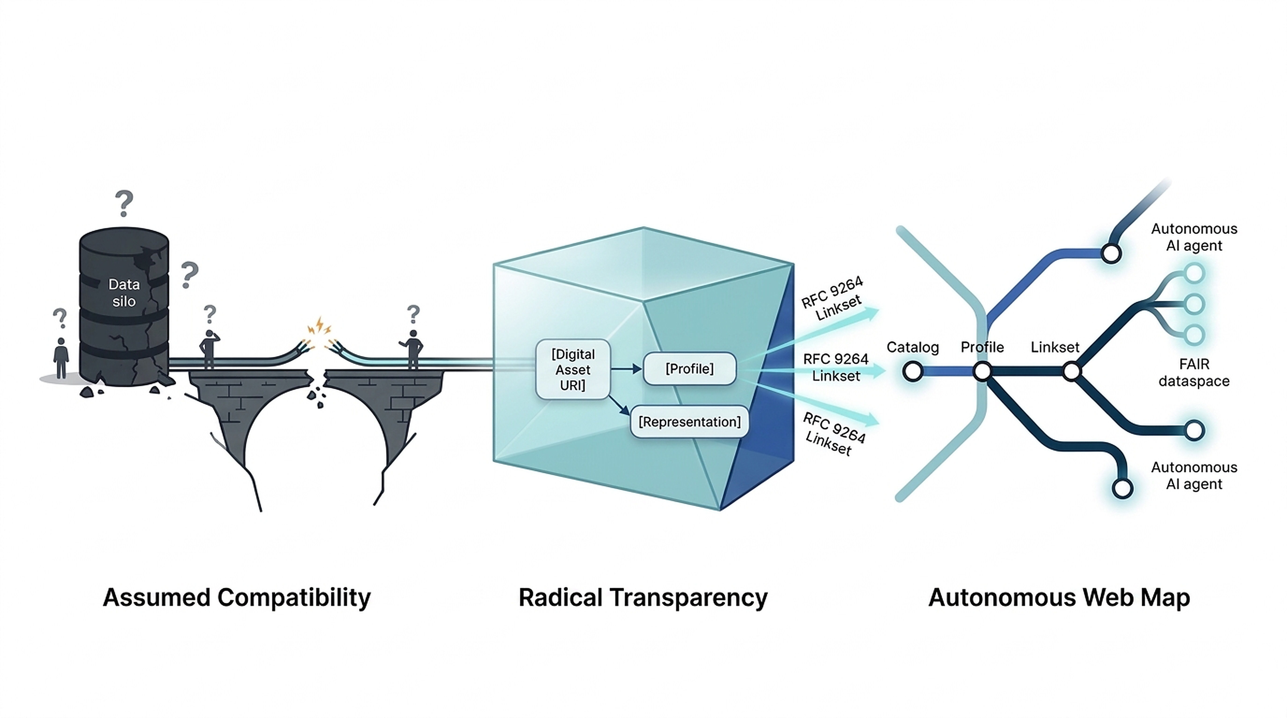


vliz.be
OPEN SCIENCE & SEMANTIC INTEROPERABILITY | LINKSET USAGE PATTERNS
Radical Transparency: A Vision for Scalable Interoperability
Marc Portier*, Bram Ulrichts, Cedric Decruw, Hamideh Baggali, Joachim Nielandt, Joanna Goley, Laurian Van Maldeghem, Katrina Exter, Cyrielle Delvenne, Lennert Tyberghein
Flanders Marine Institute (VLIZ), InnovOcean Campus, Ostend, Belgium | *Corresponding Author: marc.portier@vliz.be | open-science.vliz.be
1. Context, Research Question & Hypothesis
2. Paradigm Shifts & Empirical Metrics
The Interoperability Bottleneck in Open Science:
• Distributed data sharing stalls on assumed compatibility—unproven guesses that endpoints share implicit schemas and APIs.
• Discovery remains trapped in HTML pages; autonomous agents cannot navigate without machine signposts.
• Data stewards spend up to 80% of their time on manual data cleaning and schema translation.
From Hope-Based Integration to Measurable ROI:
80%
Time Reclaimed
10
Core Patterns
0
Bottlenecks
Max
Boredom
Research Question (RQ)
How can distributed data ecosystems achieve scalable interoperability without enforcing brittle custom APIs or burdensome consumer-side guesswork?
Measurable ROI & Collapsing Integration Costs
Replaces "hope-based integration" with quantifiable data metrics. Declaring conformance operates as a minimal local "transaction tax" to collapse global integration overhead.
Hypothesis & Core Proposition
Shifting the architectural burden from consumer inference to producer declaration via RFC 9264 Linksets and explicit conformity profiles enables autonomous web-scale discovery.
Discussion, Limitation & Future Direction
• Supported Hypothesis: Typed linksets externalize graph navigation into standard HTTP headers.
• 1 Study Limitation: Adoption velocity depends on community alignment across dataspaces.
• Future Direction: Formalize 10 EOSC-if Linkset Usage Patterns in Q3 2026 with wrx tooling.
Figure 1: Radical Transparency shifts the architectural burden from consumer inference to producer declaration. Moving from fractured data silos and assumed compatibility (left), digital assets declare explicit conformity profiles via RFC 9264 linksets (center), enabling autonomous AI agents and FAIR dataspaces to navigate web resources like an interconnected transit network (right).
3. The 4 Strategic Pillars (2025–2030)
4. Web Navigation & Digital Access
Concrete Workplan for Scalable Interoperability:
1. Linkset Usage Patterns
10 documented patterns (RFC 9264/8288) solving Broken Chains & Semantic Drift.
2. Cross-Org Alignment
Shared lightweight bootstrap uniting EOSC-if, CDIF, OGC, RO-Crate, and ODIS.
The London Tube Navigation Analogy
At any web resource, local linksets map out the direct neighborhood. Typed link relations act as map symbology and color legends, telling autonomous agents exactly where to go next.
3. Practical Toolchain
Reference tools (wrx, stitch, rdf-webcomponents) for automated discovery.
4. Open Profile Market
Federated, DNS-like open profile registers replacing centralized monopolies.
Paper PDF (QR Code)
Patterns (QR Code)
Core Separation of Concerns: Servers provide machine-actionable typed links; clients and autonomous agents handle contextualization, customization, and user interaction.
open-science.vliz.be
EOSC-if Proposals
Open Solution Proposals: github.com/eosc-semantic-interop/if-solutions-proposals
References: [1] Wilde & Van de Sompel (2022). Linkset: RFC 9264. [2] Nottingham (2017). Web Linking: RFC 8288. [3] Simonis et al. (2026). OGC 26-021. [4] Portier et al. (2026). Radical Transparency.
AI Disclosure: Conceptual synthesis assisted by Agentic AI; system vision and Linkset patterns by authors. | VLIZ Open Science Team 2026

