Slide 1

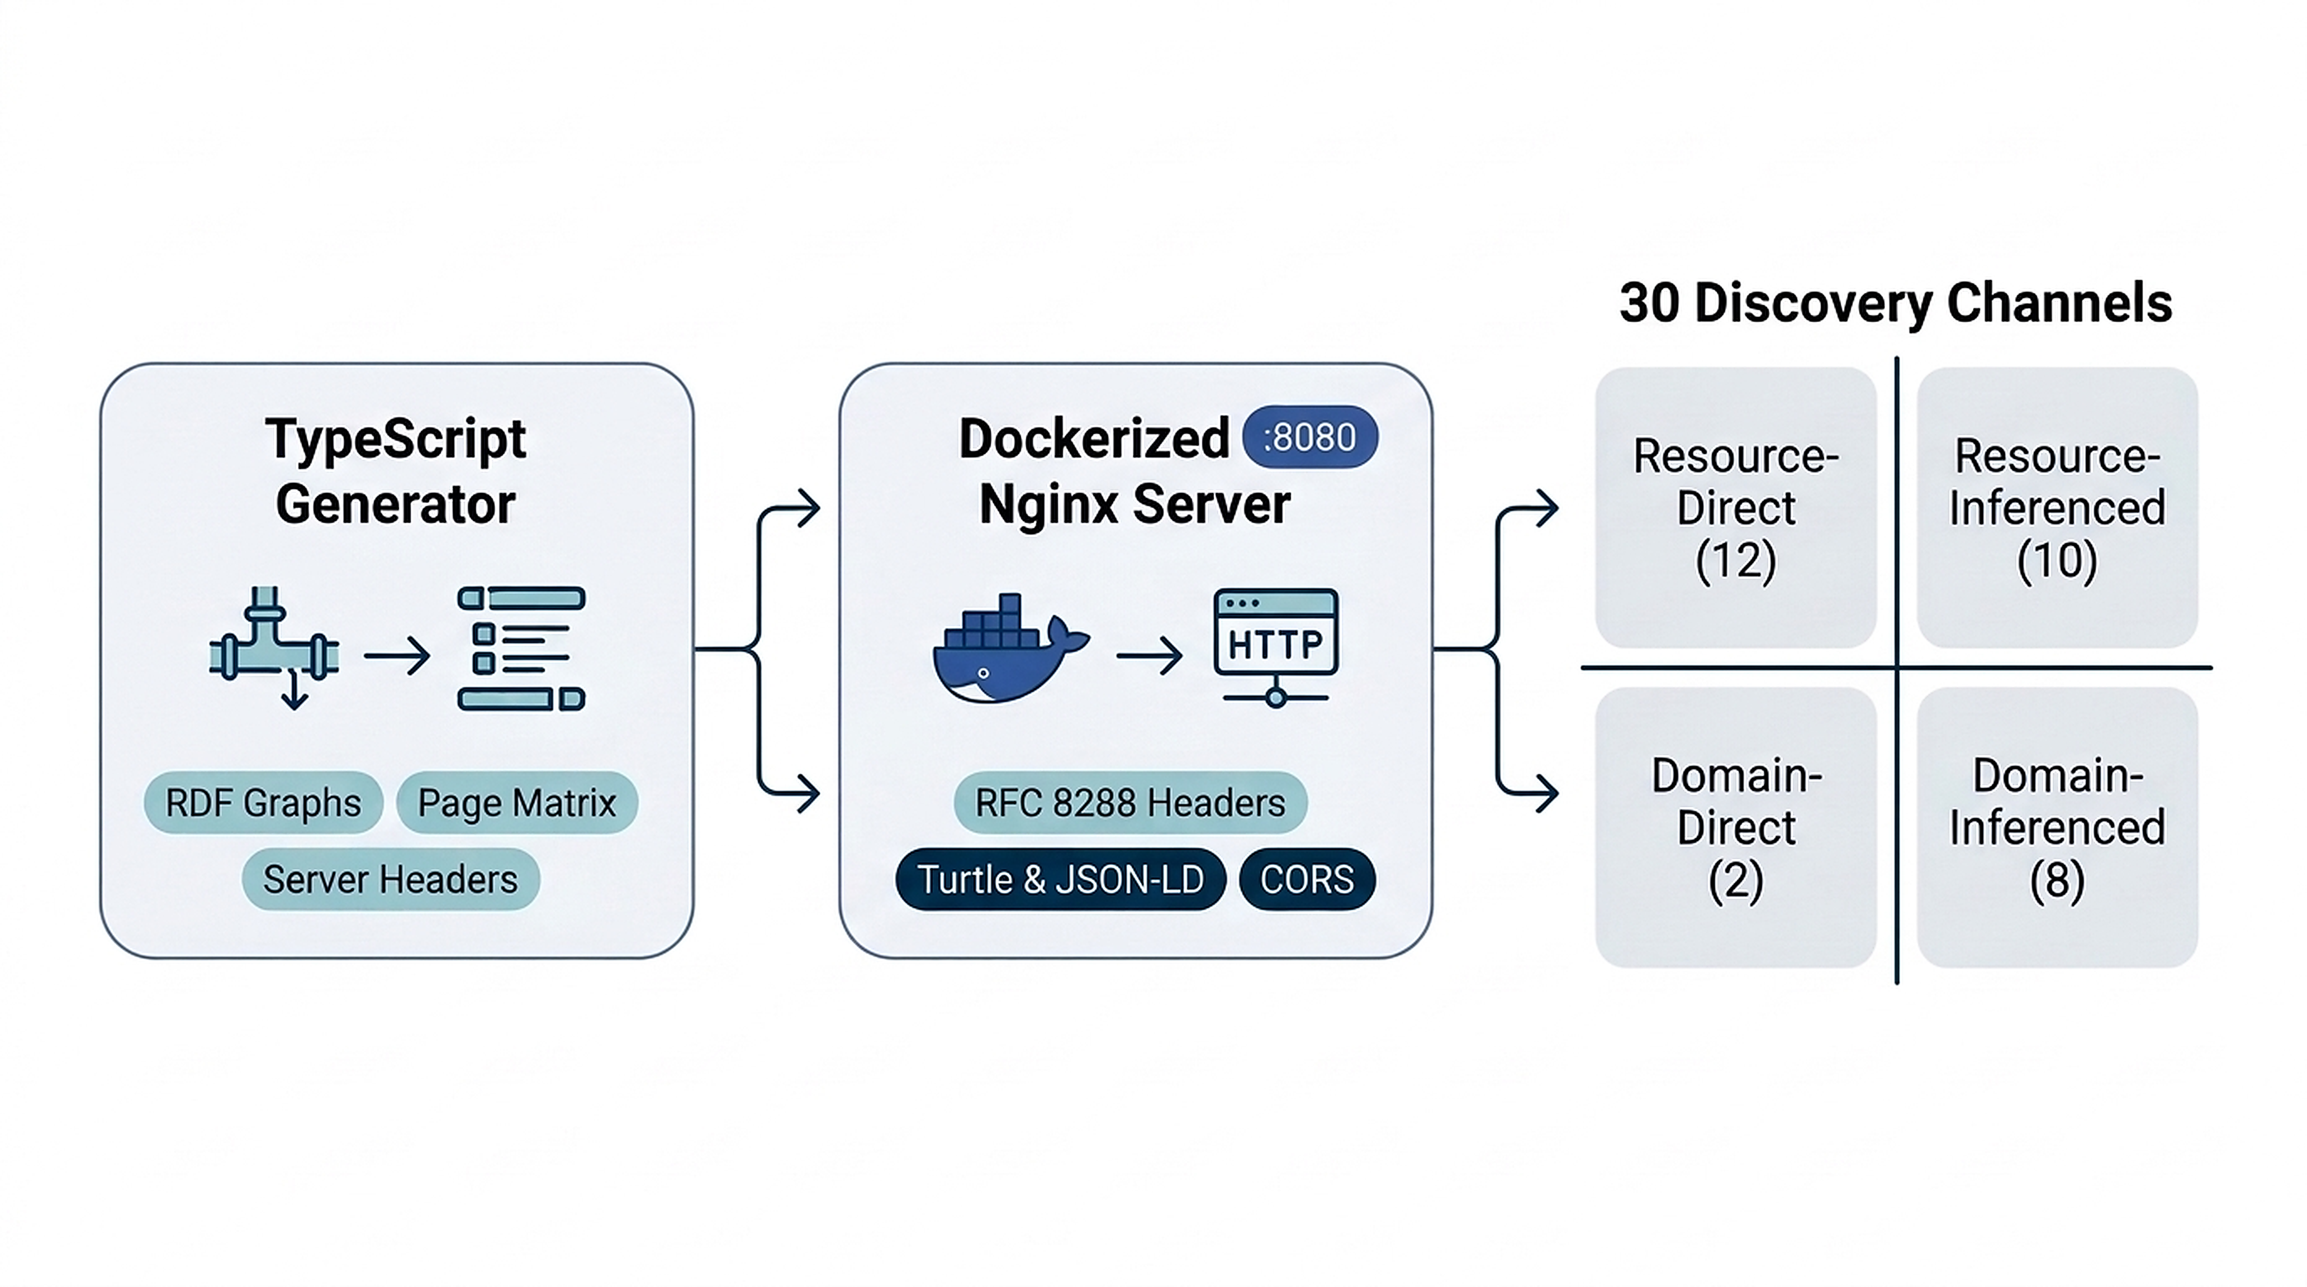

vliz.be
OPEN SCIENCE & WEB ARCHITECTURE | 30 DISCOVERY CHANNELS | DOCKER TESTBED
LOD Docker Webserver: A Multi-Channel Testbed for Linked Data Discovery
Cedric Decruw*,
Flanders Marine Institute (VLIZ), InnovOcean Campus, Ostend, Belgium | *Corresponding: cedric.decruw@vliz.be
Multi-Channel Testbed Architecture & 2×2 Discovery Taxonomy
Figure 1: Multi-channel LOD testbed architecture uniting TypeScript generator, containerized Nginx, and 30-channel taxonomy.
1. Context & Problem Formulation
2. The 4 Strategic Pillars
Discovery Gap
Linked Data fails when machines must guess where RDF graphs and relation types are exposed [1].
Crawler Fragility
Harvesters rely on brittle heuristics and domain guessing rather than formal RFC signposts [2].
Zero Benchmarks
No unified testbed previously isolated and cross-evaluated channels under controlled semantics [3].
1. Generator Pipeline
Staged TypeScript build compiling 150 synthetic pages with alternate RDF serializations.
2. Container Delivery
Minimal Dockerized Nginx stack on port 8080 exposing explicit CORS, MIME, and Link headers.
3. Dual-Axis Taxonomy
2x2 matrix categorizing 30 channels across Location (Resource/Domain) and Extraction.
4. Topology Validation
Complex graph simulations evaluating cyclic loops, pagination, and reciprocal backlinks.
Research Question (RQ): How can containerized server semantics and multi-channel signposting be unified into an inspectable testbed?
Hypothesis & Prediction: A dual-axis matrix (Resource/Domain x Direct/Inferenced) in an Nginx Docker testbed provides deterministic benchmarking.
First-Class HTTP Semantics: Discoverability is a server protocol concern. Typed links, header relations, and explicit MIME mappings eliminate crawler guessing.
3. Empirical Discovery Metrics
4. Discussion & Digital Access
30
Channels Classified
4
Discovery Quadrants
150
Synthetic Pages
100%
Deterministic Stack
Discussion, Limitations & Outlook
• Verdict: Supported. The testbed provides a reproducible environment for evaluating LOD crawler completeness and FAIR compliance.
• 1 Study Limitation: Automated client crawler scoring logic is not yet fully executed across every synthesized channel.
• 1 Actionable Future Direction: Implement automated compliance test suites that benchmark real-world harvesters against the 30 testbed channels.
Digital Companion
open-science.vliz.be
github.com/vliz-be-opsci
Verifiable Multi-Channel Discovery
The testbed confirms that direct RDF channels provide high-confidence semantic acquisition without heuristic parsing, while inferenced channels supply essential catalog discovery and fallback harvesting across domain roots.
References: [1] Berners-Lee (2009). Linked Data Design Issues. W3C. [2] Nottingham (2017). Web Linking: RFC 8288. IETF. [3] VLIZ Open Science Team (2026). LOD Discovery Testbed: github.com/vliz-be-opsci/lod_docker_webserver.
AI Disclosure: Conceptual synthesis assisted by Agentic AI; system vision and testbed by author. | VLIZ Open Science Team 2026
Open Science Standards Alignment
W3C RDF
RFC 8288
RFC 9264
OAI-ORE
FAIR

