Slide 1
Music Streaming Provider Churn Prediction
This project is based on a Kaggle competition where KKBOX, an Asian leading music streaming company, is interested in learning from their customer behavior to prevent them from churning.

Slide 2
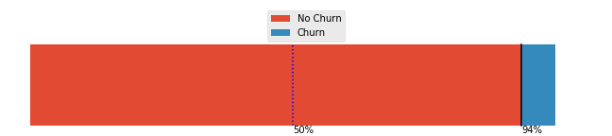
Problem Description
A customer has churned if he/she didn’t renew his membership 30 days after it expired.
Attracting new customer is costly.
Customer Retention can be assessed through modeling.
Class imbalanced ratio of 15:1 (Most customers maintain their subscription)

Slide 3
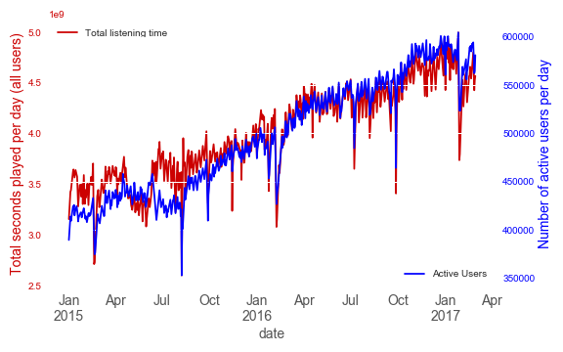
Data FROM Jan-2015 to March-2017
Transaction history (1.5GB):
Most customers opt for a monthly plan
Most customers chooses automatic renewal
Payment method 41 (unknown here) is the most popular
Activity log (30 GB):
Customers tend to listen to music a few minutes a day or by 15 min increment.
Customer engagement drops during holidays (especially Chinese New Year, see figure to the right)

Slide 4
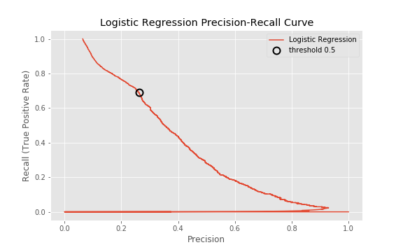
Model
Model include 19 fundamental features based on transactions and listening activity.
Identifying churn correctly is more important (less costly!) than label a no churn as churn (False Positive).
Given our Logistic regression threshold of 0.5, we maximize recall=69% and comprise on precision=26%.
In order to limit the number of churn misidentification (high cost), we will have to include customers who were not going to churn in our results.

