Slide 1

Interpretability, stability and
algorithmic fairness
01
01
02
Presented by :
Salerno Marco
Jamai Mamoun
Lafarguette Pierre
Digua Mehdi
Kire Cédric
Sijelmassi Iliass
03
04

Slide 2
Summary
01
03
02
04
The project
Interpretability, fairness
01
Dataset and problem
Surrogate modeling
Global interpretability
Local interpretability
Performance / Predictions drivers
02
Black box model
Conclusion
03
Data preparation
LGBM Model
Performance and stability
Algorithmic fairness
Findings
Recommendations
04
Notes:
jbkjgkkhlknl

Slide 3
01
The Project
September-2025
01
02
03
Dataset and problem
Surrogate modeling
04

Slide 4
Key Concepts
01
Usefulness of
Stability,
Interpretability,
fairness
02
03
04

Slide 5
Dataset and problem
Predict Loan Default: The goal is to classify borrower risk using a large-scale, real-world lending dataset.
01
An Existing Black-Box Model: The dataset includes Predicted probabilities from a model whose logic is unknown.
02
Chronological Data Structure: The data is ordered by loan issue date (issue_d)
03
We will first interpret and analyze this existing model, then develop and validate our own model.
04

Slide 6
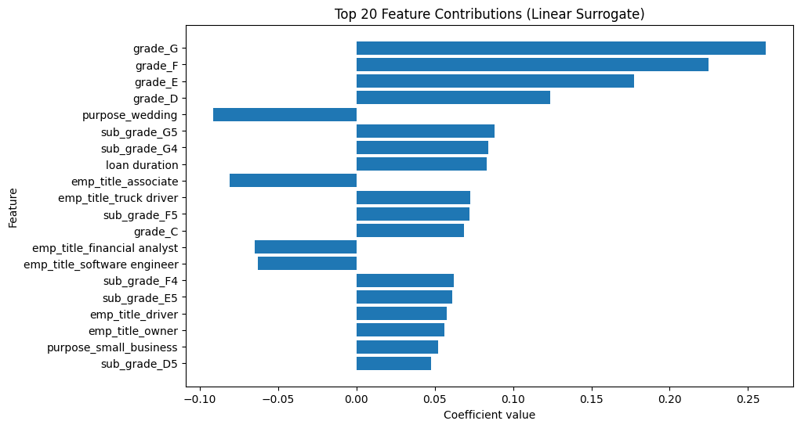
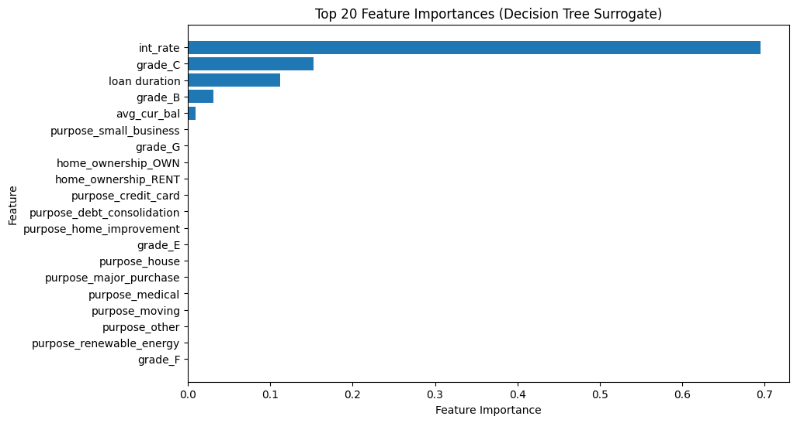
Surrogate Model
Linear models capture global linear relationships, while decision trees capture non-linear interactions, resulting in different feature importance outcomes.
The linear model approximates the unknown model’s predictions more accurately, suggesting the grade feature’s significant role, as it reflects credit risk assessment.
01
Linear regression
Decision Tree (Depth = 3)
02
Linear Regression Surrogate R² on test set: 0.9643
Linear regression Surrogate MSE on test set: 0.000464
Decision Tree Surrogate R² on test set: 0.7355
Decision Tree Surrogate MSE on test set: 0.003437
03
04
Figure 1: Top Feature Contributions for LR
Figure 2 : Top Feature Contributions for Decision Tree

Slide 7
Development of a Proposed Model
02
September-2025
01
02
Data preparation
LGBM Model
Performance and stability
03
04

Slide 8
Data Preparation
Objective: To develop our own model to predict the target.
Time-Based Split for Performance Evaluation Using the issue_d column, we created a primary dataset to train our model on past data (2012-2015) and test its performance on future data (2016).
Dedicated Datasets for Stability Analysis To test for stability, a second, completely separate dataset from a later period (2017-2020) was created with train and test split . (The proportion of default is approximately the same in each split)
Model Selection: We chose LightGBM (LGBM) as our model.
01
02
03
04

Slide 9
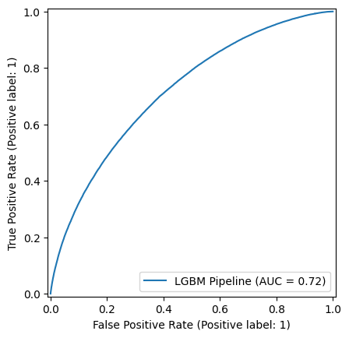
Performance analysis
Objective: We want to quantify the predictive performance of our LGBM model.
01
Result: Our model achieved an AUC of 0.7177, outperforming the other model's AUC of 0.7109.
02
03
04
Figure 3: ROC AUC on the 2016 test set

Slide 10
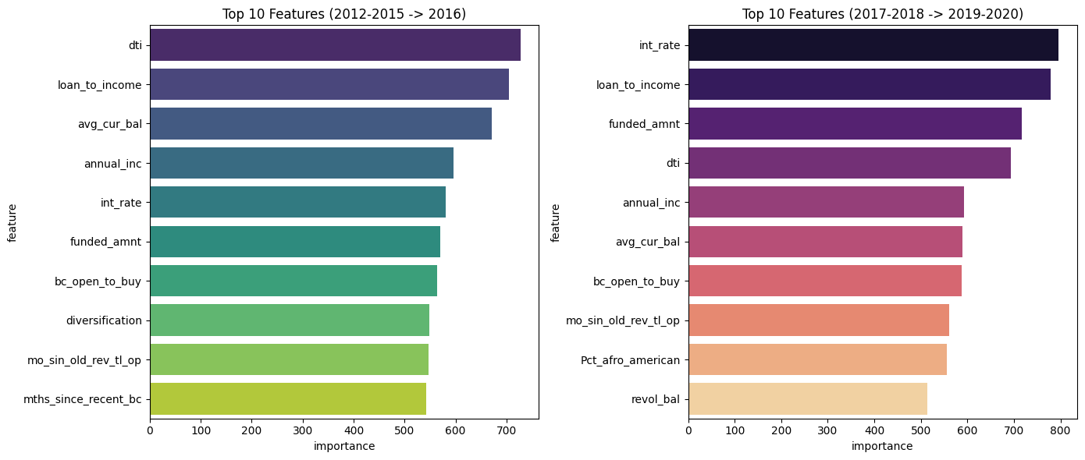
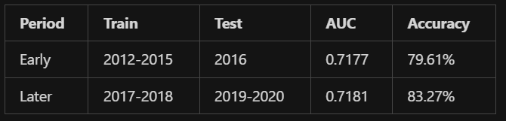
Stability analysis
Objective: We train the model on the other split of the data that we didn’t touch for now
Results: Pearson correlation between feature importances is 0.9657. The top 10 keeps almost all the same features.
01
02
03
Figure 4 : AUC and Accuracy over the datasets
Figure 5 : Top 10 features over the datasets
04

Slide 11
03
Interpretability
01
02
03
Global interpretability
Local interpretability
Performance / Predictions drivers
04

Slide 12
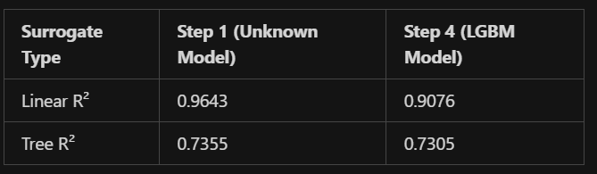
Global interpretability
Methodology: Training of surrogate models (Linear Regression, Decision Tree) to predict the output for our trained model and compare it to the surrogate models of the unknown model
Results:
01
Unknown Model: Linear surrogate captures 96.43% of variance → suggests simpler, linear decision boundary
LGBM Model: Linear surrogate captures 90.76% of variance → more complex, non-linear relationships
The tree R2 is approximately the same for the surrogate of both models
02
03
Figure 6 : Linear and Tree R2 across models
04

Slide 13
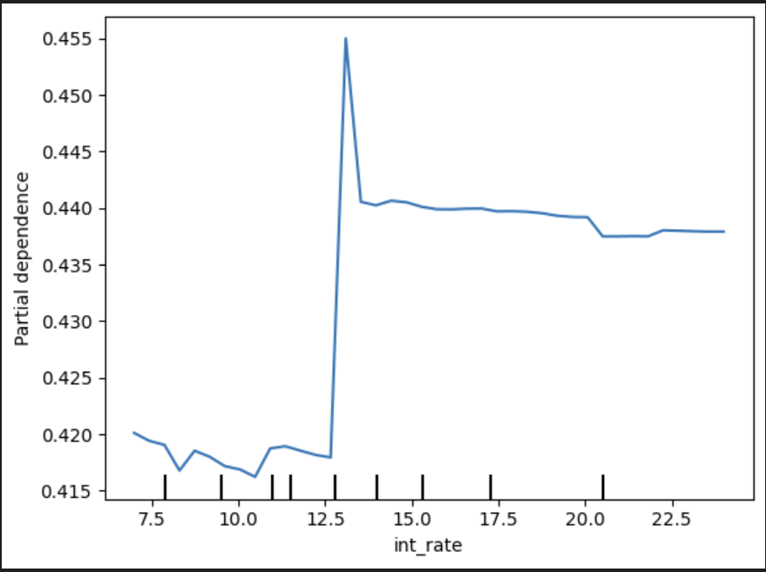
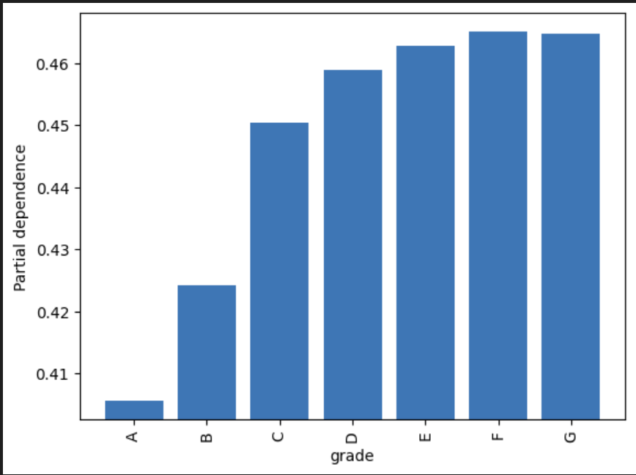
Global interpretability
Using partial dependence plots to gain a better understanding of the average effect of each feature on the predicted outcome :
01
02
03
04

Slide 14
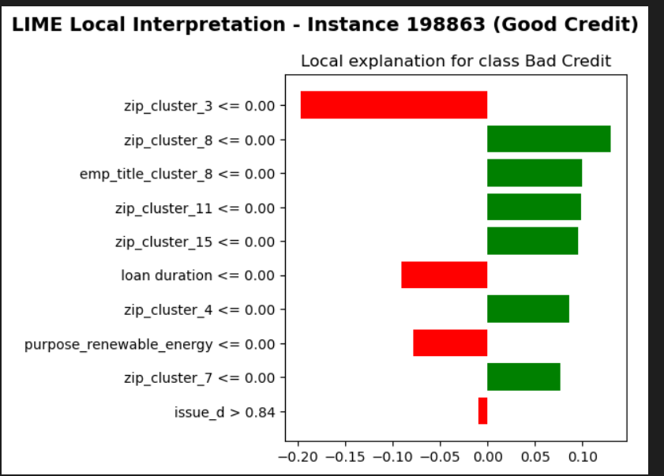
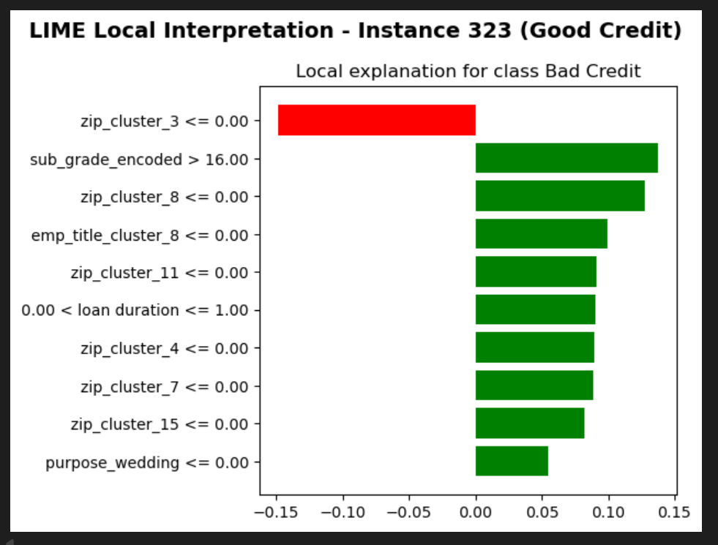
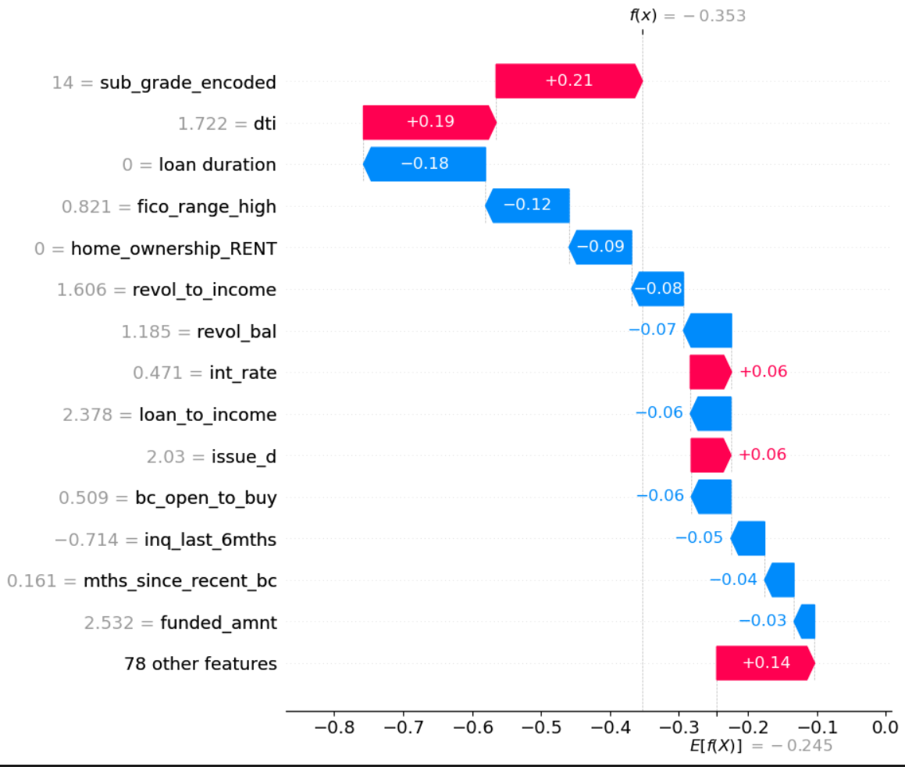
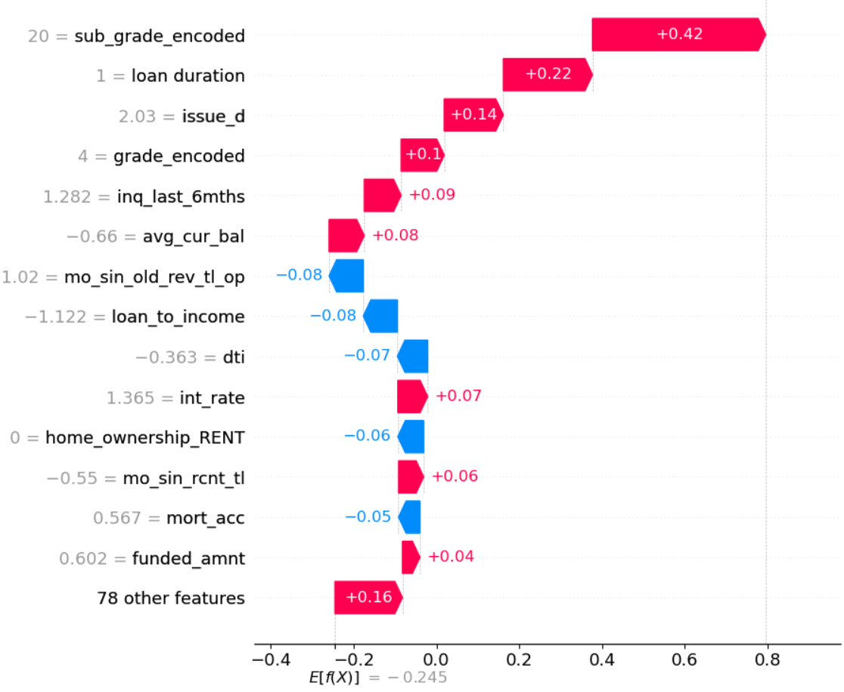
Local interpretability
Approach: Use global interpretability results and compare True Positive & False Negative records
From PDP: Annual incomes above 120k, interest rates, and sub-grades
01
02
SHAP
SHAP
03
04
Notes:
Instance 16: income=$150,000, rate=12.99%, grade=C2, target=Good
Instance 323: income=$200,000, rate=19.99%, grade=E1
Instance 198868: income=$65,000, rate=15.99%, grade=C5
Instance 141: income=$56,000, rate=19.99%, grade=E1

Slide 15
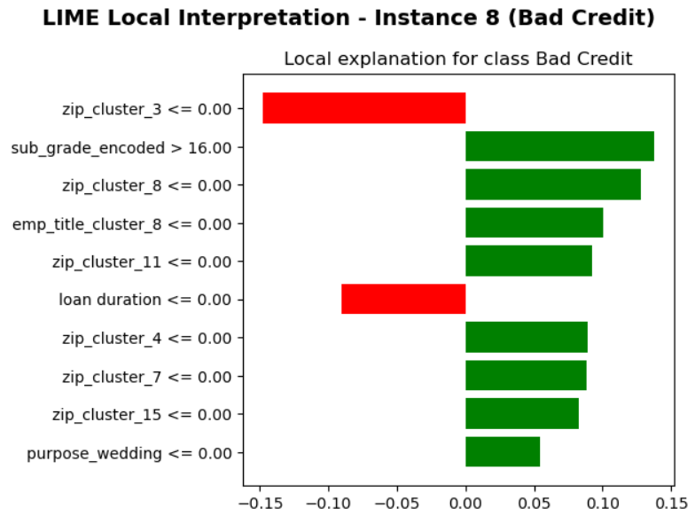
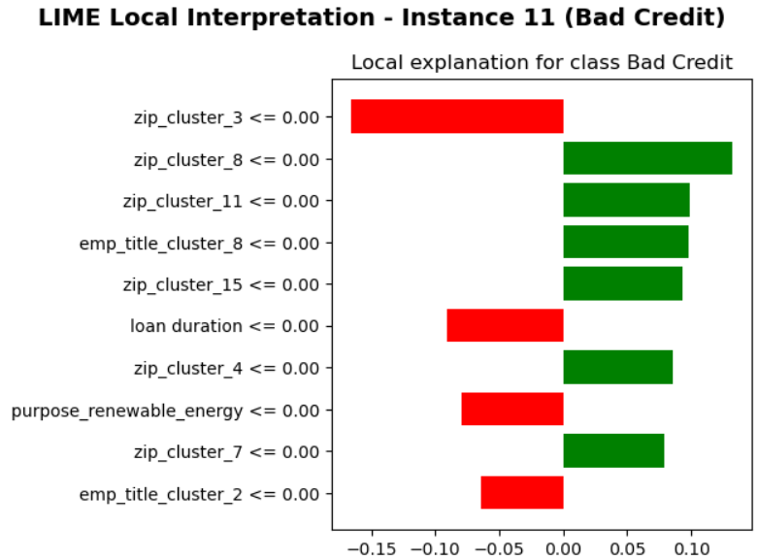
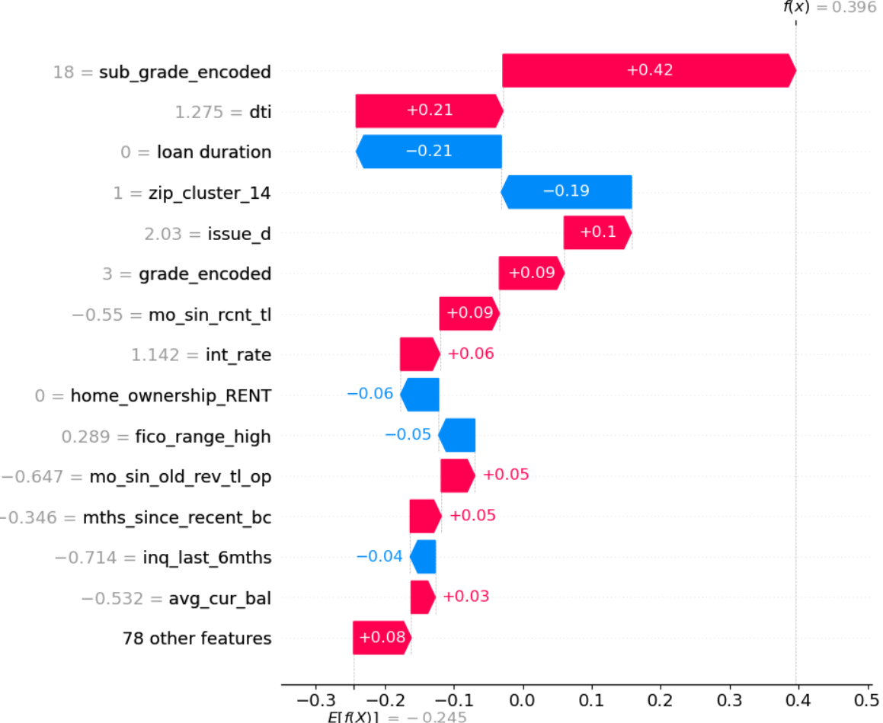
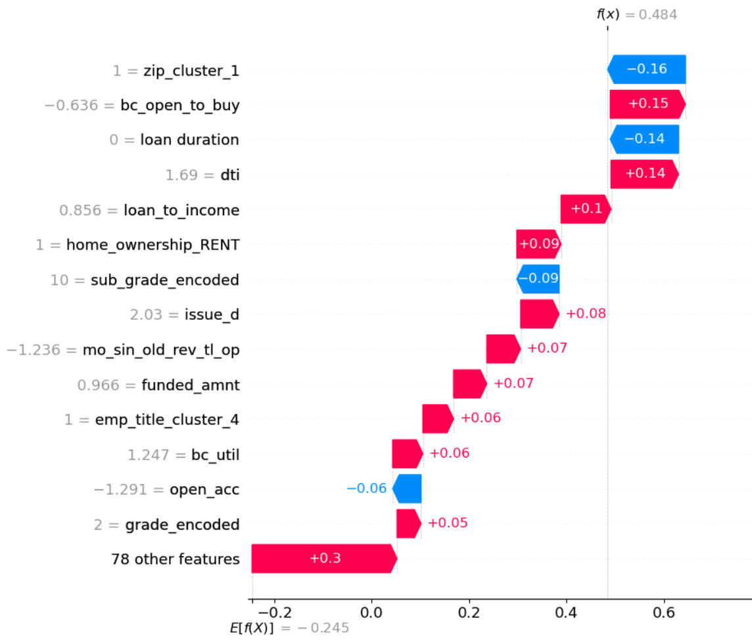
Local interpretability
Approach: Use global interpretability results and compare True Positive & False Negative records
True Positive and False negative
01
02
SHAP
SHAP
03
04

Slide 16
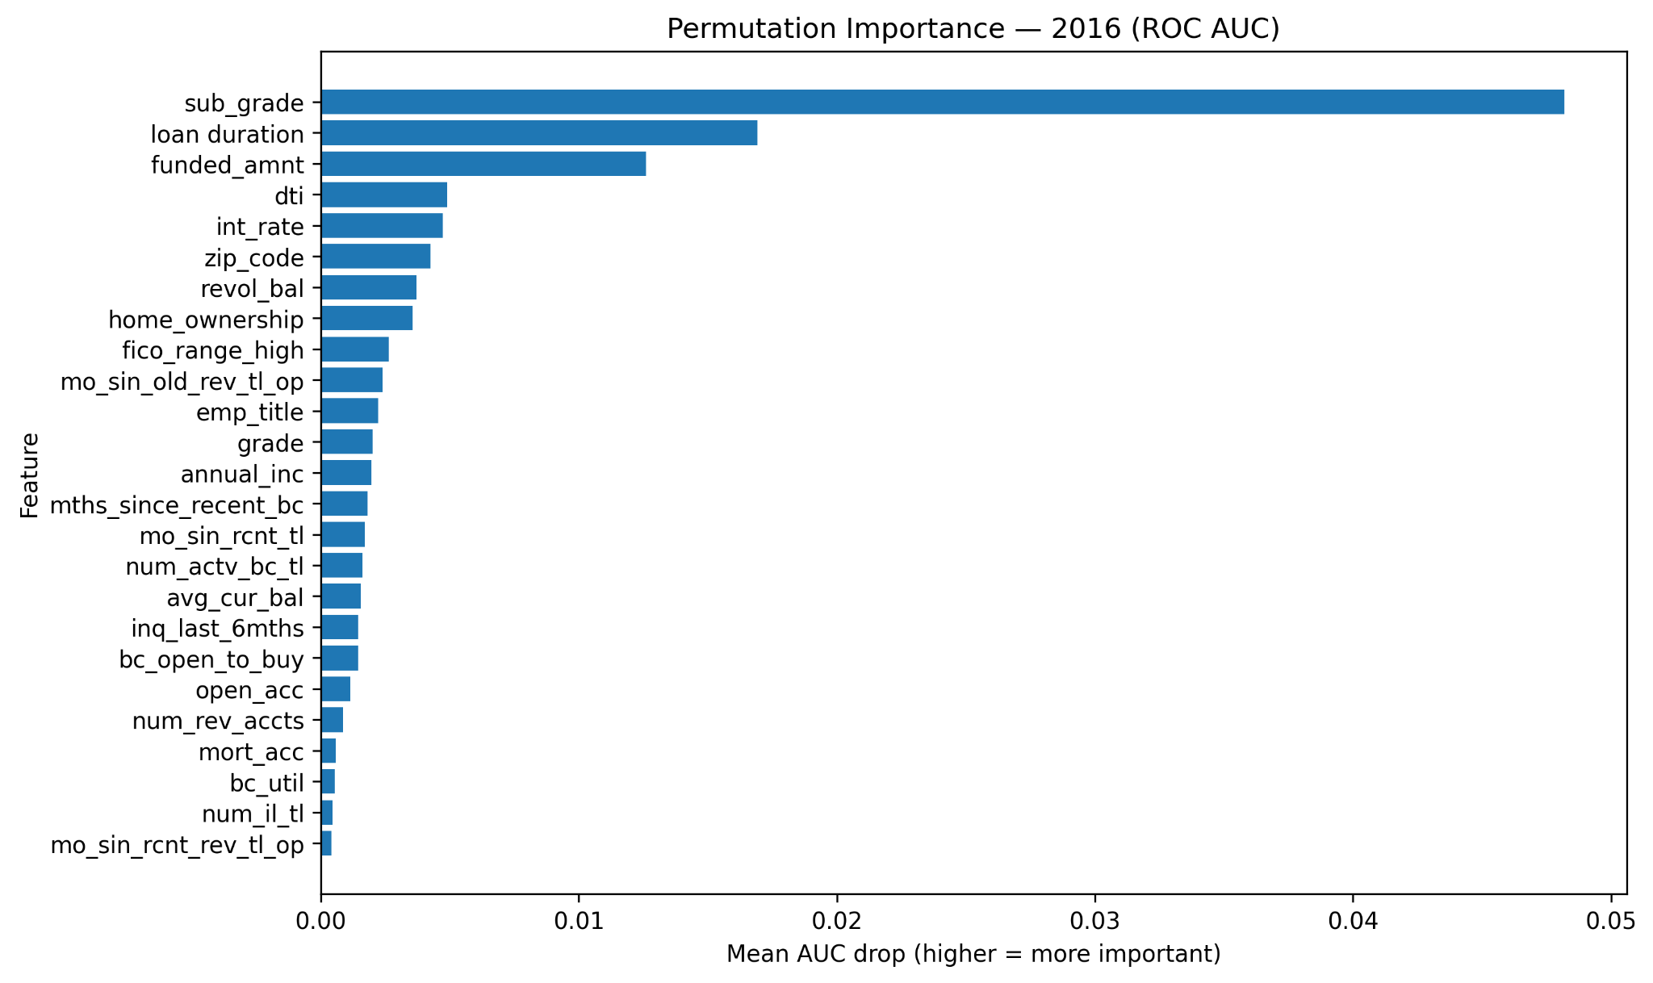
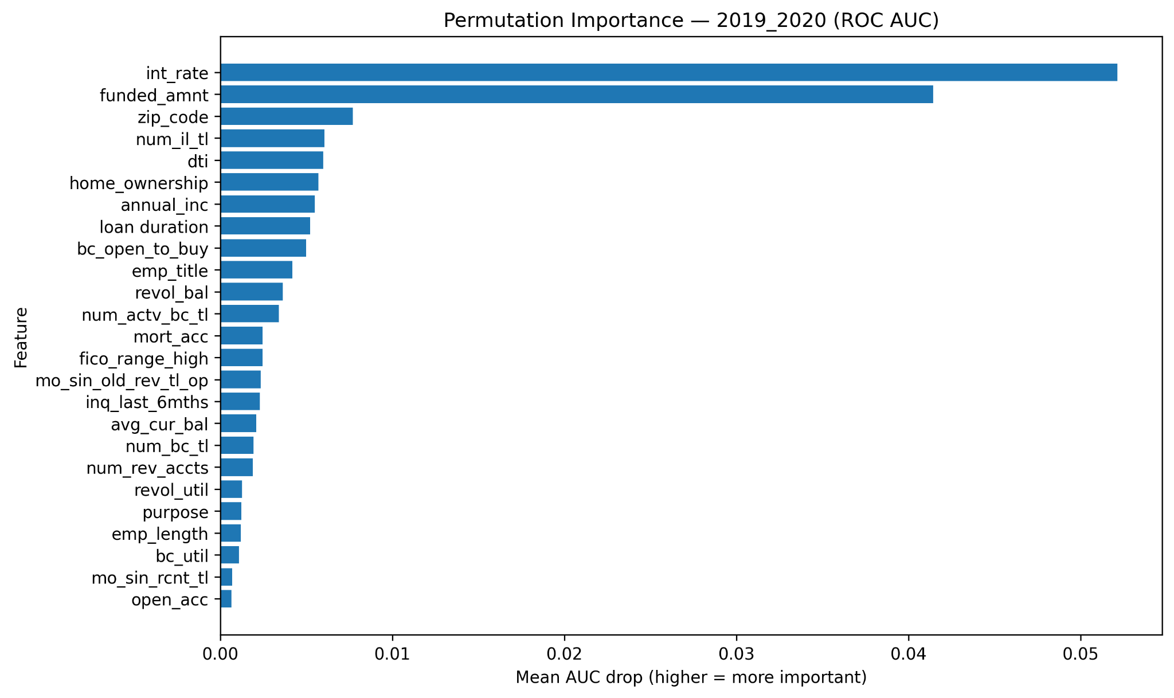
Performance Interpretability (Permutation Importance)
aaaaaa
Shuffled features in the test set to measure drop in AUC (importance = performance impact).
Key findings:
2016: sub_grade is the top performance driver; loan_duration and funded_amnt follow
2019–20: int_rate and funded_amnt dominate
Shift over time: loan_duration matters much less later (0.017 → 0.005), while num_il_tl enters the top drivers in 2019–20
01
02
03
04

Slide 17
Fairness and Conclusion
04
September-2025
01
02
Challenges & Solutions Conclusion & Takeaways
03
04

Slide 18
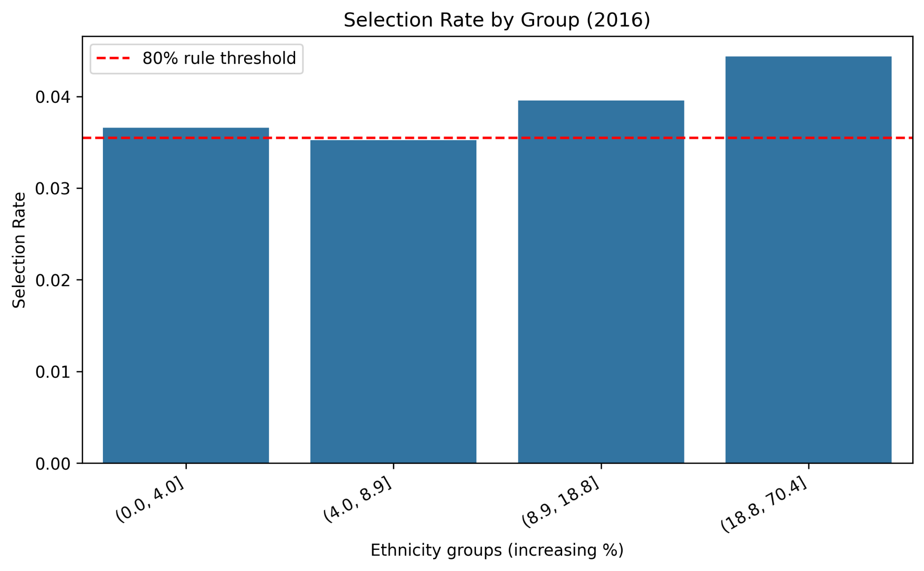
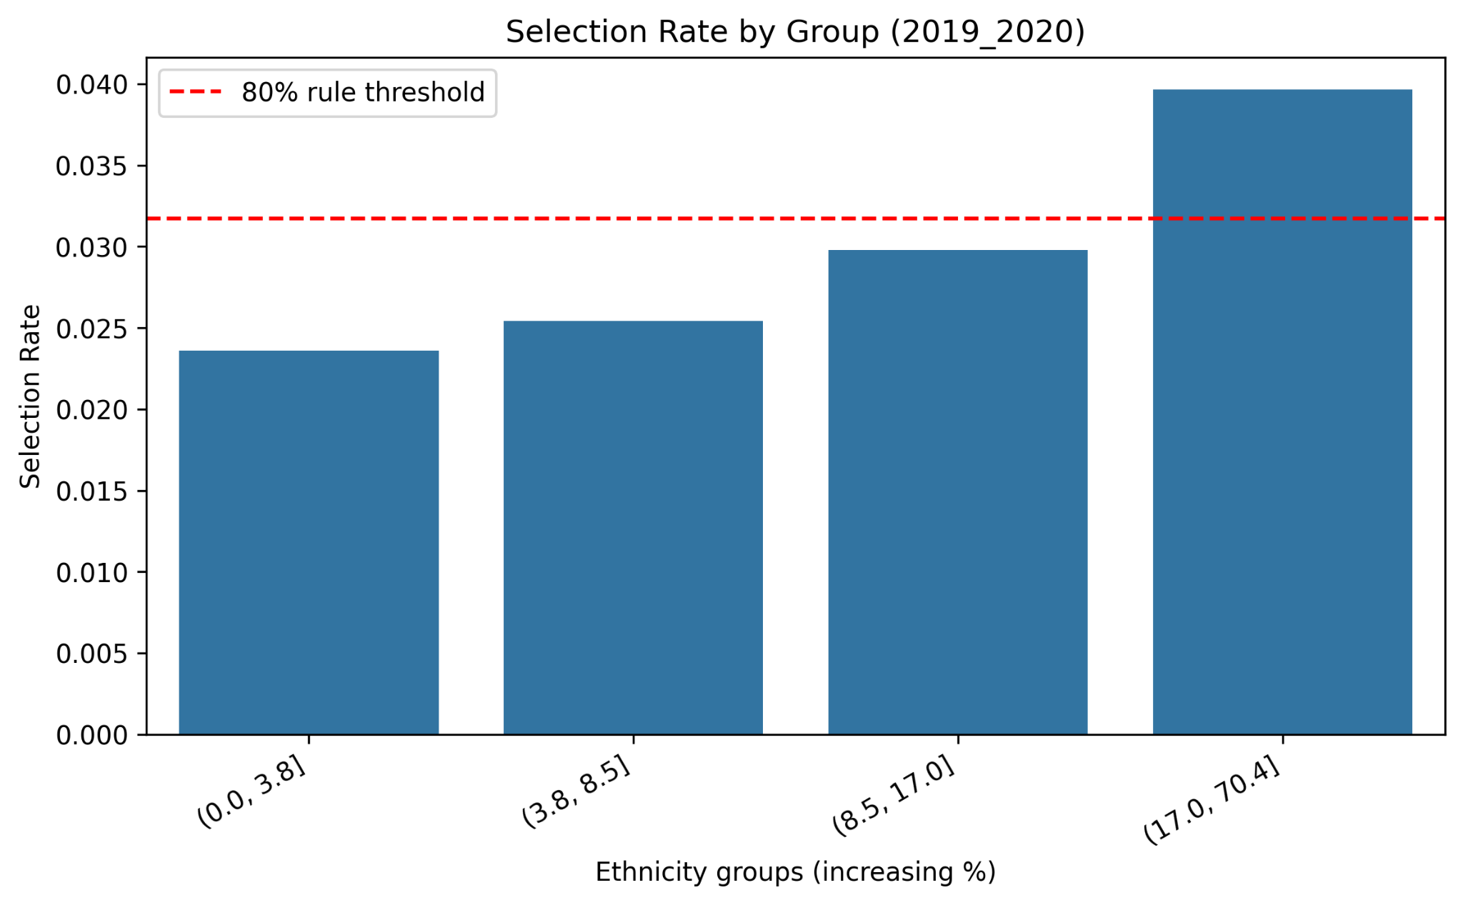
Fairness Assessment (Ethnicity)
Grouped Pct_afro_american into 4 quantiles per period
Audited at deployed threshold 0.78 (selection rate = reject rate)
80% rule: 2016 ratio 0.794 (borderline fail); 2019–20 ratio 0.595 (clear fail)
01
02
03
04

Slide 19
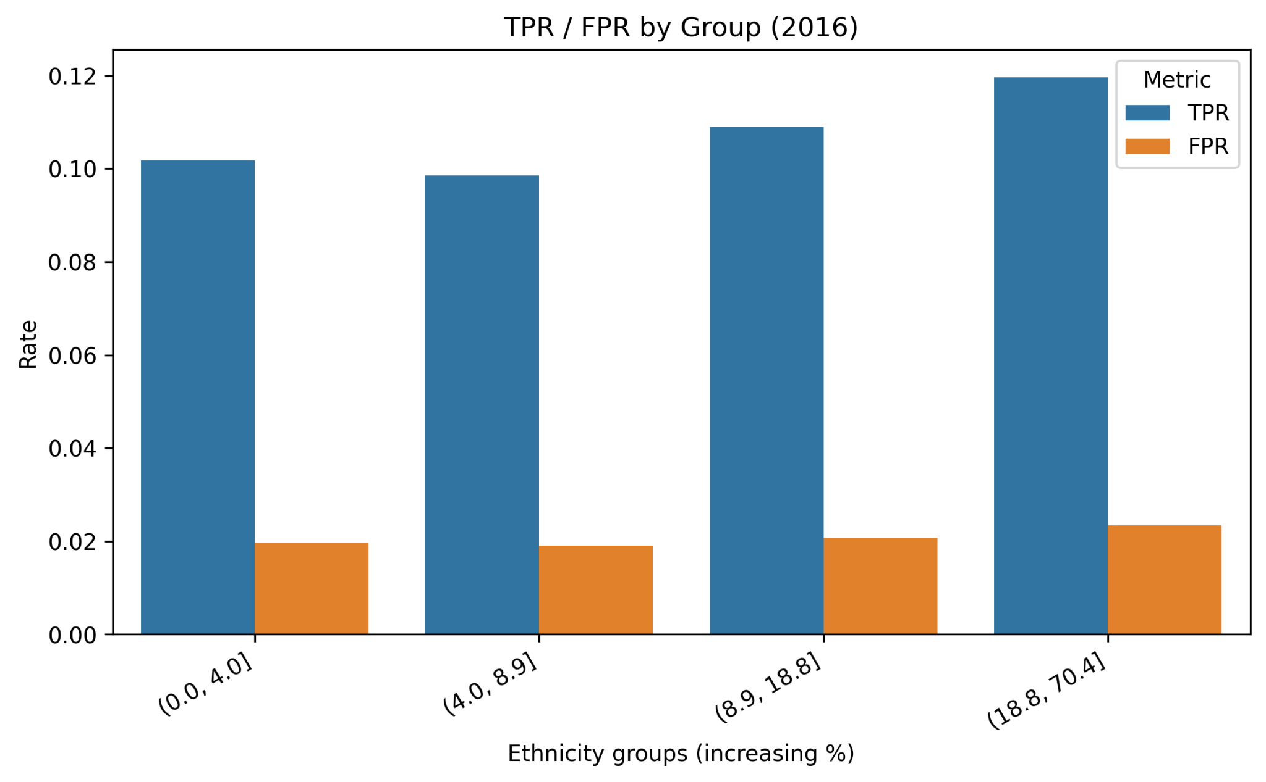
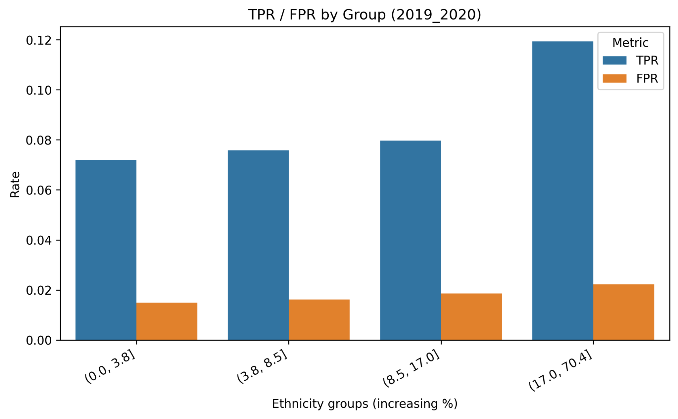
Key Insights
AUC stable across groups in both periods (≈0.71–0.73): similar ranking quality
Error rates rise with higher % African American: Equalized Odds not satisfied
80% rule (selection-rate ratio) fails and worsens over time: 2016 = 0.794, 2019–20 = 0.595
01
02
03
04

Slide 20
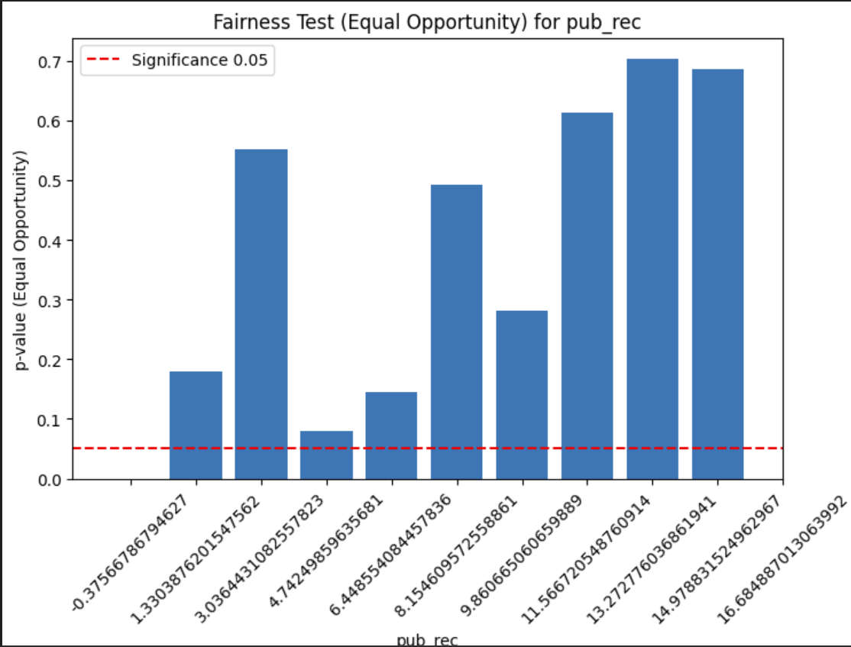
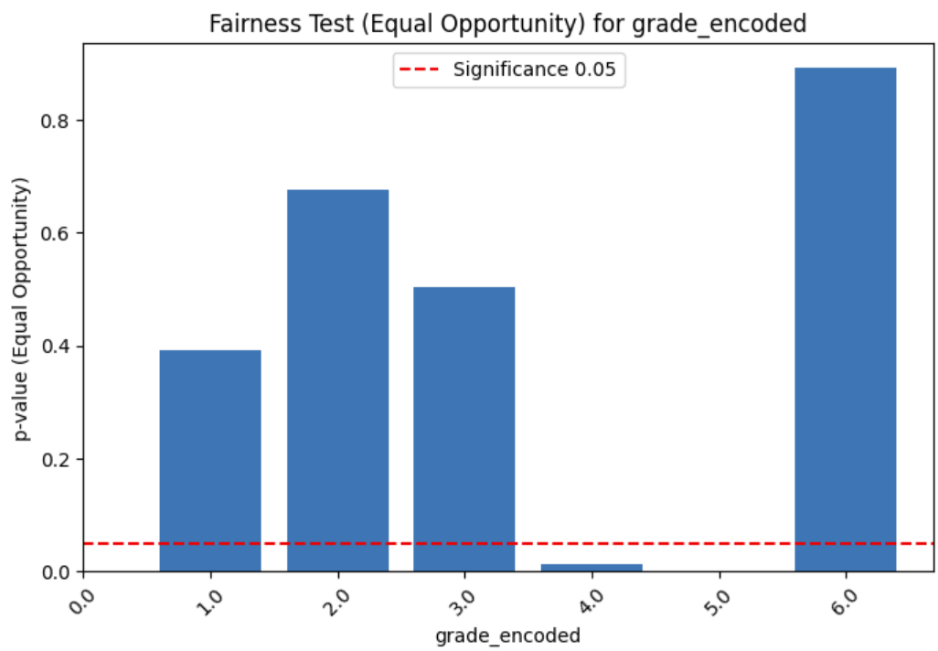
FPDP using equality of opportunity
September-2025
01
02
03
04
Notes:
ajouter ce qui est fait, les limites, et les ameliorations

