Slide 1

CEP146 CURRENT EVENT
AI coding
agents
How software development
is changing
Wumaier Kutelike
Sebastian Gonzalez
Notes:
Speaker: Wumaier Kutelike
SCRIPT
Hello, our names are Wumaier and Sebastian. Today, we will explain how AI coding agents are changing software development, including their practical uses, potential benefits, and risks.
SOURCES AND CONTEXT (not spoken)
Cover: AI-generated decorative illustration. It is not evidence of a real event.
Accessed 17 October 2026 UTC.

Slide 2
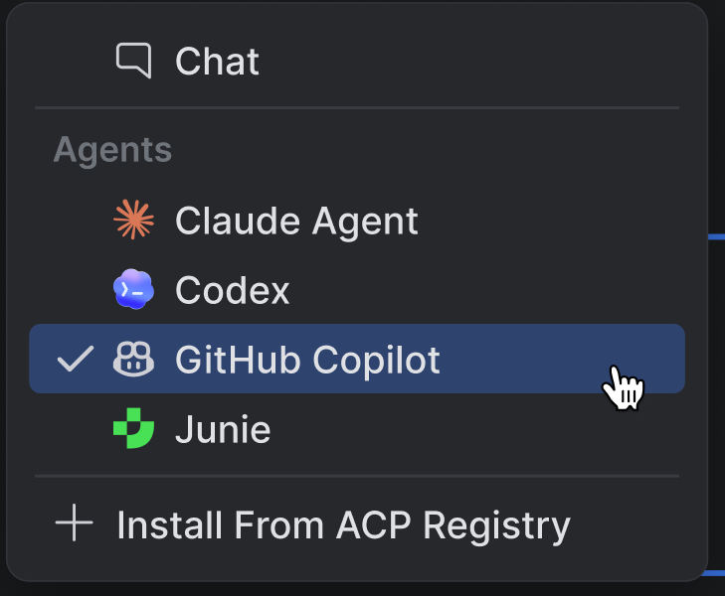
Copilot in JetBrains
30 June 2026
Copilot becomes a native
AI Assistant agent option
Choose a supported model
and adjust reasoning depth
inside the same AI chat.
Why it matters
Multistep coding work stays in the IDE.
Sources: GitHub Changelog (30 June 2026) and JetBrains product screenshot
Notes:
Speaker: Wumaier Kutelike
SCRIPT
On June 30, 2026, GitHub announced that Copilot Agent became available inside JetBrains AI Assistant. According to GitHub, developers can select Copilot from the agent picker, choose a supported model, and adjust the reasoning level. The agent can examine a project, propose changes, run commands, and work through multistep tasks.
SOURCES AND CONTEXT (not spoken)
GitHub Changelog, 30 June 2026. https://github.blog/changelog/2026-06-30-copilot-agent-is-now-available-in-jetbrains-ai-assistant/
JetBrains, June 2026. https://blog.jetbrains.com/ai/2026/06/github-copilot-now-an-integrated-agent/
Screenshot: https://admin.blog.jetbrains.com/wp-content/uploads/2026/06/image-24.png
The event is native integration, not Copilot’s first availability in JetBrains. It previously existed through a plugin and ACP. The significance statement summarizes the announced IDE workflow, not a measured productivity effect.
Accessed 17 October 2026 UTC.

Slide 3
Autocomplete and coding agents
An agent uses project context and tools to pursue a programming goal
Feature | Autocomplete | Coding agent
Main request | Continue the code | Complete a programming task
Typical output | Suggests a line or block | May edit files and run tools
Developer role | Accepts or edits suggestions | Sets limits and reviews work
Both workflows still require developer judgment
Source: GitHub Docs, Using agent mode in your IDE
Notes:
Speaker: Wumaier Kutelike
SCRIPT
For this presentation, an AI coding agent means an AI tool that uses project context and development tools to complete several steps toward a programming goal. It goes beyond simply suggesting the next line of code.
SOURCES AND CONTEXT (not spoken)
GitHub Docs. https://docs.github.com/en/copilot/how-tos/copilot-in-your-ide/use-copilot-agents/use-agent-mode
https://docs.github.com/en/copilot/how-tos/copilot-in-your-ide/chat-with-copilot/chat-in-ide
Comparison concerns inline autocomplete and an agent task workflow. Both can use context. Tool access and permissions vary by editor and settings.
Accessed 17 October 2026 UTC.

Slide 4
A bug-fix task in practice
Illustrative request
Fix a crash when the input is empty.
Add a test so it does not happen again.
1
Inspect
Read relevant files and locate the failing path
2
Propose
Draft a focused change and a regression test
3
Check
Run the checks and revise after feedback
Developer verifies behavior before accepting the change
Illustrative workflow based on GitHub Docs. This is not a recorded demonstration or benchmark.
Notes:
Speaker: Wumaier Kutelike
SCRIPT
For example, a developer can ask an agent to fix a small bug. The agent may inspect the project, suggest a change, run relevant commands, and revise its work after receiving feedback.
SOURCES AND CONTEXT (not spoken)
GitHub Docs. https://docs.github.com/en/copilot/how-tos/copilot-in-your-ide/use-copilot-agents/use-agent-mode
The empty-input crash and regression test form an illustrative example created for explanation. No such bug fix was executed or measured by this presentation. An agent may propose commands, subject to its configured permissions.
Accessed 17 October 2026 UTC.

Slide 5
Potential benefits in everyday work
A useful starting point still needs verification
Task | Possible advantage | Human check
Bug fixes | A draft to investigate | Does behavior match the requirements?
Tests | Less repetitive test setup | Are assertions and edge cases correct?
Documentation | A first draft inside the IDE | Does it match the actual code?
Time savings depend on the task and review effort
Sources: GitHub Docs. Benefits are potential, not a measured productivity improvement.
Notes:
Speaker: Wumaier Kutelike
SCRIPT
Agents may also help with refactoring, writing tests, and updating documentation.
These capabilities may reduce repetitive work, provide developers with a useful starting point, and reduce switching between tools. However, these are potential benefits, not guaranteed improvements.
HANDOVER: continue directly to Sebastian’s risk section. No extra handover sentence is needed.
SOURCES AND CONTEXT (not spoken)
GitHub Docs. https://docs.github.com/en/copilot/how-tos/copilot-in-your-ide/use-copilot-agents/use-agent-mode
https://docs.github.com/en/copilot/how-tos/copilot-in-your-ide/chat-with-copilot/chat-in-ide
The possible benefits are reasoned implications of supported workflows. They are not universal guarantees or a quantified speedup.
Accessed 17 October 2026 UTC.

Slide 6
Sources for the opening section
GitHub Changelog
Copilot integration announcement, 30 June 2026
github.blog/changelog/2026-06-30-copilot-agent-is-now-available-in-jetbrains-ai-assistant/
JetBrains Blog
Native integration and the official product screenshot, June 2026
blog.jetbrains.com/ai/2026/06/github-copilot-now-an-integrated-agent/
GitHub Docs
Agent workflow, tool use and developer review
docs.github.com/en/copilot/how-tos/copilot-in-your-ide/use-copilot-agents/use-agent-mode
GitHub Docs
Tests, fixes and documentation workflows
docs.github.com/en/copilot/how-tos/copilot-in-your-ide/chat-with-copilot/chat-in-ide
Sources checked 17 October 2026 UTC. Full links and image credits appear in the slide notes.
Notes:
Speaker: Wumaier Kutelike
SCRIPT
REFERENCE APPENDIX: hidden during slide show. No narration. When combining with Sebastian’s slides, keep this source page at the end of the final deck.
SOURCES AND CONTEXT (not spoken)
https://github.blog/changelog/2026-06-30-copilot-agent-is-now-available-in-jetbrains-ai-assistant/
https://blog.jetbrains.com/ai/2026/06/github-copilot-now-an-integrated-agent/
https://docs.github.com/en/copilot/how-tos/copilot-in-your-ide/use-copilot-agents/use-agent-mode
https://docs.github.com/en/copilot/how-tos/copilot-in-your-ide/chat-with-copilot/chat-in-ide
https://admin.blog.jetbrains.com/wp-content/uploads/2026/06/image-24.png
Cover image: AI-generated decorative art. JetBrains owns its product screenshot. No AI-generated voice is included.
Accessed 17 October 2026 UTC.

