Slide 1
Skinbit
AutoFocus & Cedric
https://github.com/cedricq/AutoFocus

Slide 2
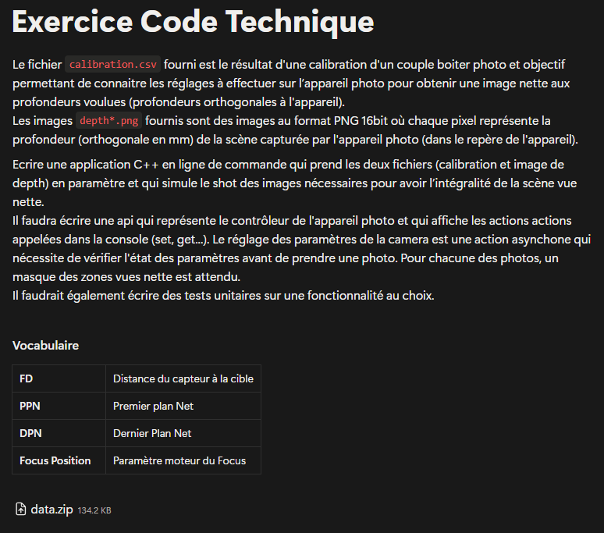

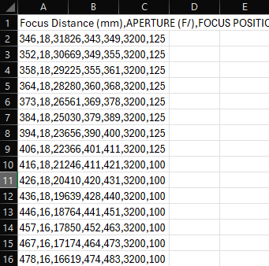

Exercice: 1st reading on my phone
=> Ok… I need my PC

Slide 3
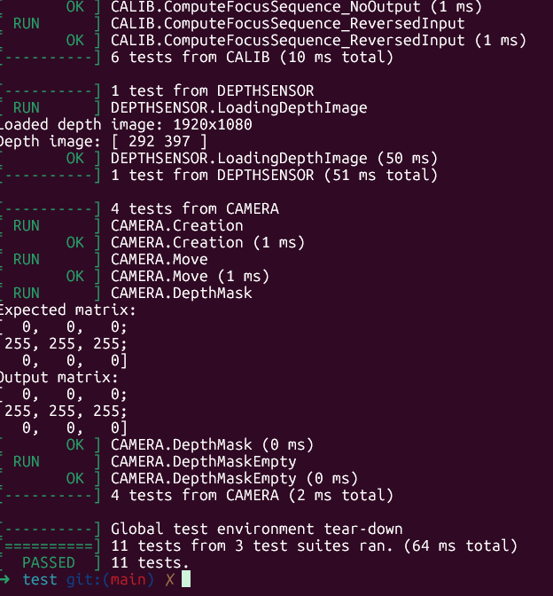
Start by components
I start an empty project: cmake, c++, github, gtest
I decide to go « TDD », component by component
CalibrationData
DepthSensor
Camera + Focus motor
OpenCV : for matrices computations
Github CI in place with Docker

Slide 4
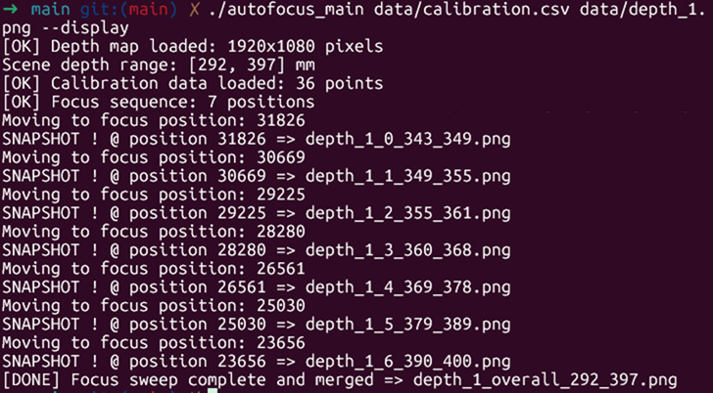
Integration phase
Main app, integrating all components together
Simulating a « real » scenario with Depth1&2.png

Slide 5

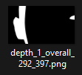

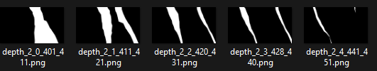


Outputs
Masks output 1st seemed hard to mentally combine

Slide 6
Extra stuff for fun
Modularity: Composition => CalibData part of Camera. Each Camera instance could have its own calibration data.
Optimization: Within min/max range, take picture only of the ranges there are points in.
-- display option to visualize the snapshots to make it nicer at run time.
CI running on self-hosted VM instead of Github default

Slide 7
What could still be done
Isolate components cmake wise to make it more modular & testable.
Automatize the Integration testing : mathematical input depth rather than real ones => Pass/Fail
Create a dedicated thread to simulate better the control of the camera
Add unit_test coverage capability to CI (eg. gcovr), static code analysis (eg. Cppcheck, …)
Deploy: automatize software release deploy CI/CD, report generation, (eg. Nexus, …)

Slide 8
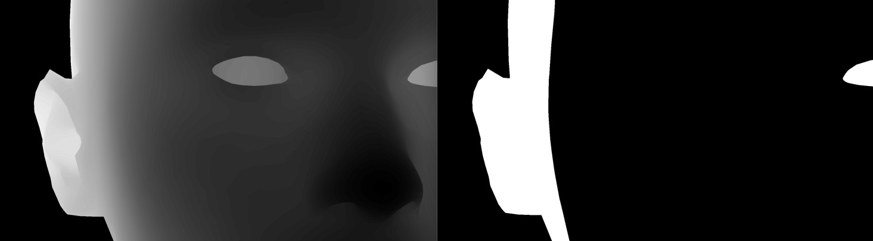

Thanks for listening !

