Slide 1
Skinbit & Cedric

Slide 2

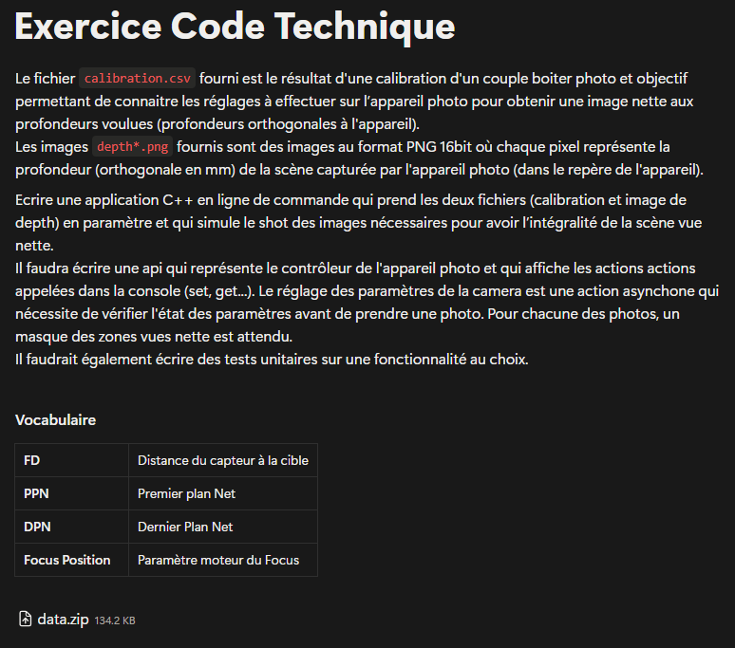
Exercice: 1st look

Slide 3
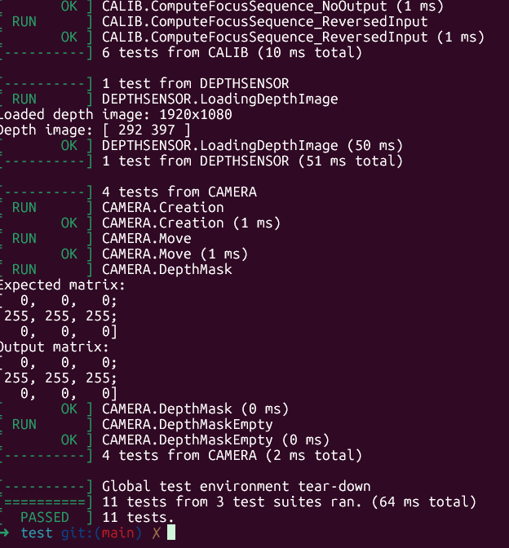
1st start
I start an empty project: cmake, c++, github
I decide to go TDD, component by component
CalibrationData
DepthSensor
Camera + Focus
OpenCV : for matrices computations

Slide 4
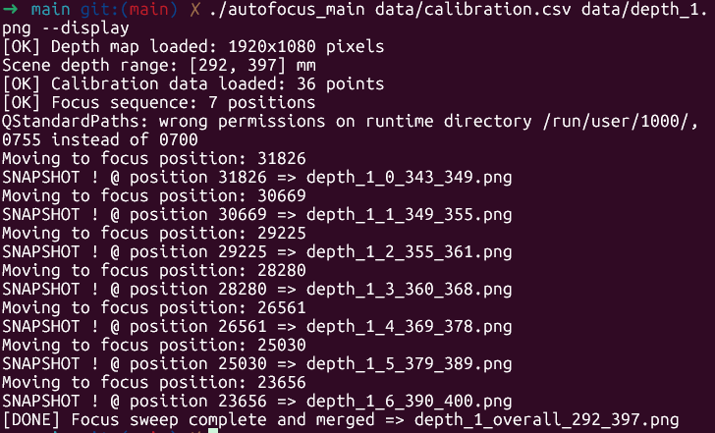
1st integration
Main app, integrating all components
Simulating a « real » scenario with Depth1&2.png

Slide 5

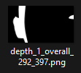

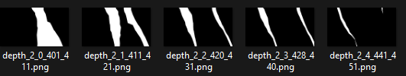


1st « weird » outputs
Masks output seemed hard to mentally combine

