Slide 1
DASC 41103 - Project 1
By Andrew Mendez, Cedric Strobel

Slide 2
Part 1 – Preprocessing (“project_adult.csv”)
Missing Value Implementation | Encoding Implementation | Scaling Implementation
All observation that contained a NA were dropped All observations that contained a “?” were dropped | Label encoding was used to for all categorical features using sklearn “LabelEncoder” Income was specifically mapped to 0 (<$50k) and 1 (>$50k) | All numerical features were standardize using sklearn “StandardScaler”

Slide 3
Part 1 – Preprocessing (“project_validation_inputs.csv”)
Missing Value Implementation | Encoding Implementation | Scaling Implementation
All observation that contained a NA were dropped All observations that contained a “?” were dropped | Label encoding mappings function for each col from the original dataset “project_adult.csv” were applied to this dataset Income was specifically mapped to 0 (<$50k) and 1 (>$50k) | All numerical features were standardize using the same StandardScaler function used in the original dataset “project_validation_inputs.csv”

Slide 4
Part 2 - Perceptron and Adaline Algorithms
Perceptron | Adaline
Used Perceptron class given in past homework’s Trained using (eta=0.1, n_iter=50) | Used Adaline class given in pass homework’s. Only change was to convert it to SGD Trained using (eta=0.00001, n_iter=50)

Slide 5
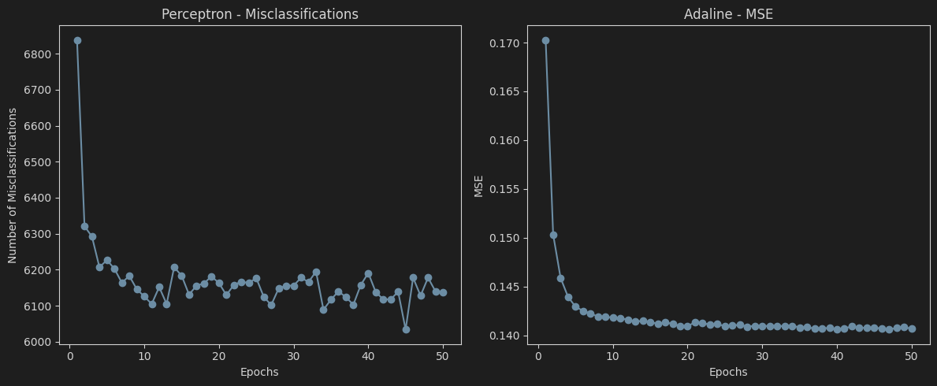
Part 2 - Perceptron and Adaline Algorithms

Slide 6
Part 2 - Perceptron and Adaline Best Algorithms
Perceptron Best Model | Adaline Best Model
Grid search using a 80 20 split to determine accuracy etas = [0.1, 0.01, 0.001, .0001, .00001] n_iters = [10, 25, 50] Best Params: eta=0.0001, n_iter=50 Misclassified=919, Accuracy=0.8098 | Grid search using a 80 20 split to determine accuracy etas = [0.1, 0.01, 0.001, .0001, .00001] n_iters = [10, 25, 50] Best Params: eta=0.00001, n_iter=10 Misclassified=947, Accuracy=0.8040

Slide 7
Part 2 - Perceptron and Adaline Best Scikit-Learn
Perceptron Best Model | Adaline Best Model
Grid search using cv of 5 and accuracy for scoring etas = [0.1, 0.01, 0.001, .0001, .00001] max_iters = [10, 25, 50, 100] Best Params: {'eta0': 0.1, 'max_iter': 100} Best CV Accuracy: 0.810 | Grid search using cv of 5 and accuracy for scoring etas = [0.1, 0.01, 0.001, .0001, .00001] max_iters = [10, 25, 50, 100] Best Params: {'eta0': 0.0001, 'max_iter': 100} Best CV Accuracy: 0.809

Slide 8
Part 3 – Logistic Regression and Support Vector Machine Best Scikit-Learn
Logistic Regression Best Model | Support Vector Machine Best Model
Grid search using cv of 5 and accuracy for scoring C = [.001, .01, .1, 1, 10, 100] max_iters = [10, 25, 50, 100, 500] Best Params: {'C': 0.1, 'max_iter': 500} Best CV Accuracy: 0.82 | Grid search using cv of 5 and accuracy for scoring C = [.001, .01, .1, 1, 10, 100] max_iters = [10000, 20000] Kernel = ['linear', 'poly', 'rbf', 'sigmoid’] gamma = ['scale', 'auto'] Best Params: {'C': 1, 'gamma': 'auto', 'kernel': 'rbf', 'max_iter': 20000} Best CV Accuracy: 0.84

Slide 9
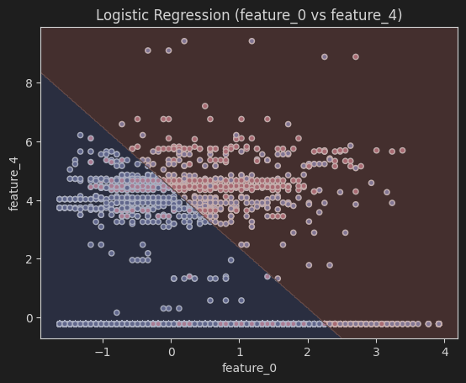
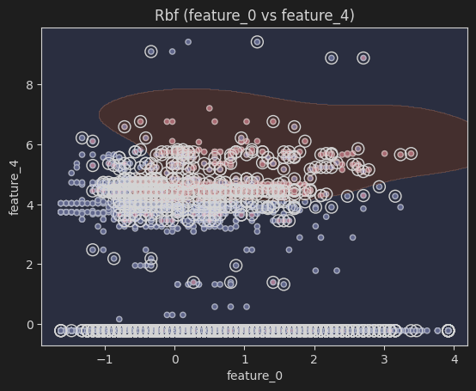
Part 3 – Logistic Regression and Support Vector Machine Decision Boundary (Age and Capital-Loss)

Slide 10
Part 4 – Why is feature scaling is important for gradient-based algorithms
Balances feature influence: prevents large scale features from dominating updates
Stabilizes gradients: ensures weight updates reflect true importance, not raw scale
Faster convergence: scaled features help gradient descent reach minima more efficiently
Fair comparison: puts all features on the same footing ("apples to apples")
Improves model performance: reduces risk of skewed or biased learning

Slide 11
Part 4 – Explain the difference between batch gradient descent and stochastic gradient descent
Batch Gradient Descent
Uses the entire dataset to compute the loss
Updates weights based on the gradient of all samples combined
Typically more stable but slower per update
Repeated for multiple epochs until convergence
Stochastic Gradient Descent (SGD)
Uses one sample at a time to compute the loss
Updates weights after each individual sample
Faster per update but introduces more noise
Iterates through all samples, repeated for multiple epochs

Slide 12
Part 4 – Why does scikit-learn Perceptron and Adaline algorithms outperform book code
Vectorized operations: Uses NumPy’s highly optimized C and Fortran backend, allowing large datasets to be processed much faster than naive Python loops in book code.
Adaptive learning schedules: Instead of a fixed learning rate, scikit-learn can adjust the rate over time, helping with convergence stability.
Convergence criteria: Implements tolerance-based stopping rules that prevent unnecessary iterations once the model has converged.
Built-in regularization: Supports L1 (lasso), L2 (ridge), and elastic-net penalties that improve generalization and reduce overfitting.
Numerical stability: Avoids issues like exploding weights or division by zero that can arise in naive implementations.
Parallelization: Takes advantage of multicore CPUs for faster training

Slide 13
Part 4 – Compare the decision boundaries of LogisticRegression and SVM
Logistic Regression
Produces a linear boundary (line in 2D, hyperplane in higher dimensions)
Based on predicted probability = 0.5
Easy to interpret since coefficients link directly to feature odds
Support Vector Machines (SVM)
Boundary maximizes margin from nearest support vectors
Linear kernel → straight line/hyperplane
Non-linear kernels (RBF, polynomial) → complex curved boundaries
More flexible for non-linear data

Slide 14
Part 4 – What is the role of Regularization in preventing overfitting
Prevents excessively large weights: Keeps the model stable by discouraging extreme parameter values.
Reduces reliance on a few features: Ensures the model distributes importance more evenly instead of overfitting to specific inputs.
Adds a penalty term to the loss function: Increases cost when weights grow too large, encouraging smaller and more balanced coefficients.
Encourages better generalization: Improves performance on unseen data by limiting model complexity.

Slide 15
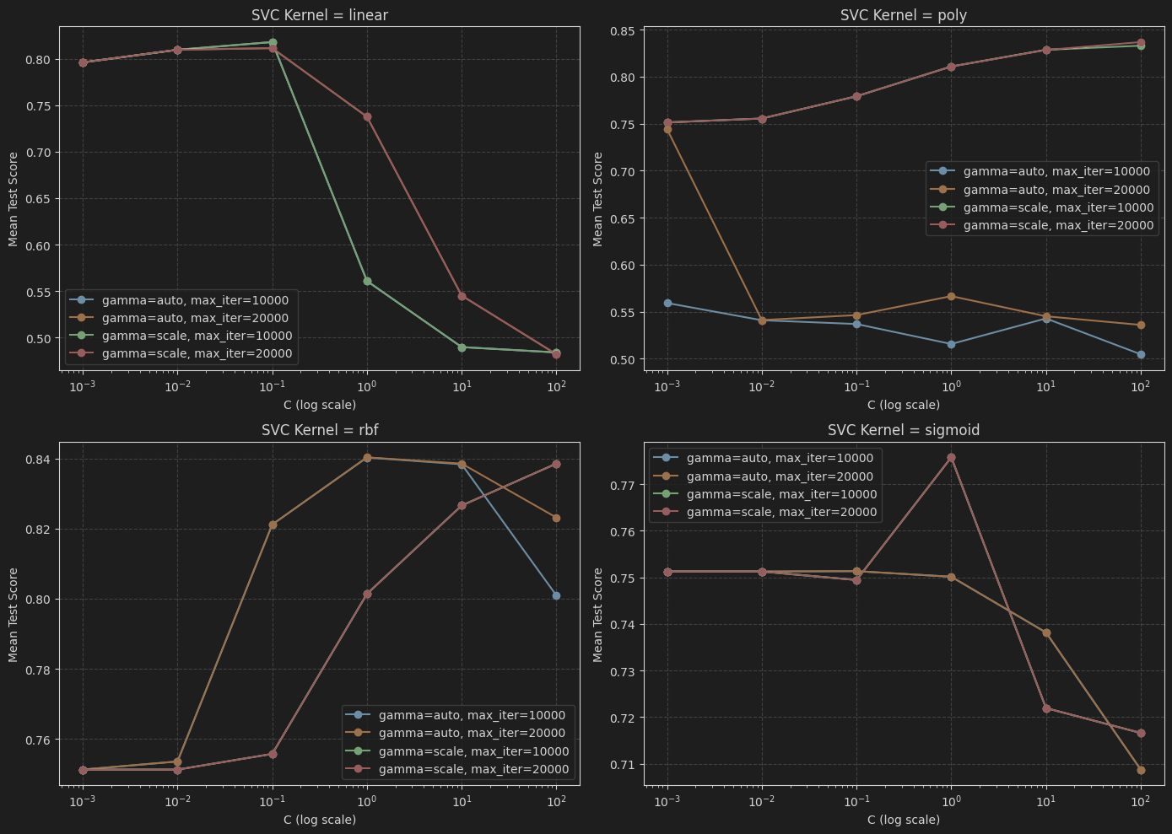
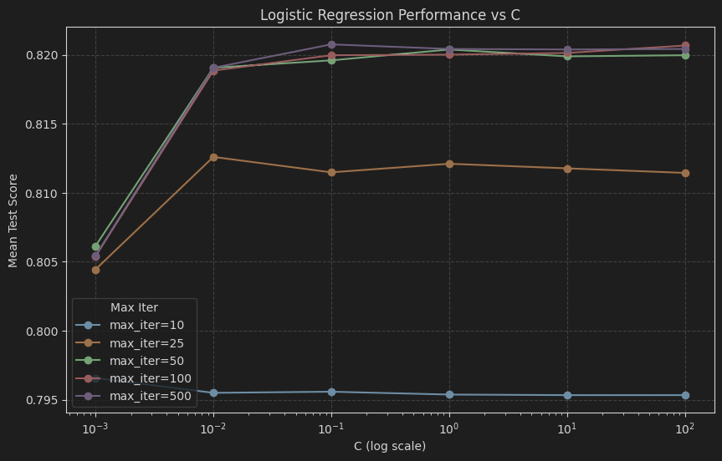
Part 4 – Vary the C values of the scikit-learn LogisticRegression and Linear SVC models with [0.01, 1, 100]

Slide 16
Objectives Learned
Lesson Objective Alignment:
Design and implement machine learning models using Python. - Develop machine learning algorithms for practical applications - Understand and implement perceptron and Adaline algorithms - Apply logistic regression and support vector machines using scikit-learn
Evaluate model performance and decision boundaries.
Work with real-world datasets and apply feature preprocessing.

