Slide 1
DASC 41103 - Project 2
By Andrew Mendez, Cedric Strobel

Slide 2
Part 1 – Dataset Development
How it was collected | Split
Collected images manually from Google Images and Etsy Used keywords like “Arkansas Razorback logo,” “Razorback,” “Arkansas hog logo.” Also, Google image search for the official logo | Split between 35 Hogs and 25 No_Hogs images. Slightly biased Hogs due to it being the images were trying to classify specifically

Slide 3
Part 1 – Preprocessing
Basic Transformation | Test Transformation | Validation Transformation | CV of K-Fold 5
Train and Validation datasets were all resized to 500x500 | Random Horizontal flips Random Rotation Random resized crop Random Color jitter Normalization | Normalization | StratifiedKFold(n_splits=5) Preserved class proportions in every fold Created 5 training/validation splits

Slide 4
Part 2 – CNN Model Candidates
Model 1 | Model 2
Out Channel of 16 and linearly increases for each Conv block Batch Size of 5 and 40 epochs Loss Function uses Cross Entropy Loss Optimizer we use Adam with a learning rate of 0.001 and weight decay of 0.0001 5 Conv blocks each with a filter of 3 and padding of 1 using ReLU. End of each block includes a 2D Pooling of 2 Flatten Layer which leads to a FC layer of 1024 using ReLU and dropout of 0.5 Final layers is a FC of 1024 to 2 | Out Channel of 16 and expontinally increases for each Conv block Batch Size of 5 and 40 epochs Loss Function uses Cross Entropy Loss Optimizer we use Adam with a learning rate of 0.001 and weight decay of 0.0001 4 Conv blocks each with a filter of 3 and padding of 1 using ReLU. Each block includes a Batch Norm. End of each block includes a 2D Pooling of 2 Next block we use is a Global Avg Pool so we can get it down to a 1x1 before we pass through FC layer Flatten Layer which leads to a FC layer of 128 using ReLU and dropout of 0.5 Final layers is a FC of 128 to 2

Slide 5
Part 2 – CNN Model Candidates
Model 3 | Model 4
Out Channel of 16 and expontinally increases for each Conv block Batch Size of 8 and 40 epochs Loss Function uses Cross Entropy Loss Optimizer we use Adam with a learning rate of 0.001 and weight decay of 0.0001 4 Conv blocks each with a filter of 3 and padding of 1 using ReLU. Each block includes a Batch Norm. End of each block includes a 2D Pooling of 2 Next block we use is a Global Avg Pool so we can get it down to a 1x1 before we pass through FC layer Flatten Layer which leads to a FC layer of 128 using ReLU and dropout of 0.5 Final layers is a FC of 128 to 2 | Out Channel of 16 and expontinally increases for each Conv block Batch Size of 2 and 40 epochs Loss Function uses Cross Entropy Loss Optimizer we use Adam with a learning rate of 0.001 and weight decay of 0.0001 4 Conv blocks each with a filter of 3 and padding of 1 using ReLU. Each block includes a Batch Norm. End of each block includes a 2D Pooling of 2 Next block we use is a Global Avg Pool so we can get it down to a 1x1 before we pass through FC layer Flatten Layer which leads to a FC layer of 128 using ReLU and dropout of 0.5 Final layers is a FC of 128 to 2

Slide 6
Part 2 – Model Diagnosis Validation Mean Accuracy
Model 1 | Model 2 | Model 3 | Model 4
Mean Accuracy: 78% | Mean Accuracy: 88% | Mean Accuracy: 81% | Mean Accuracy: 85%

Slide 7
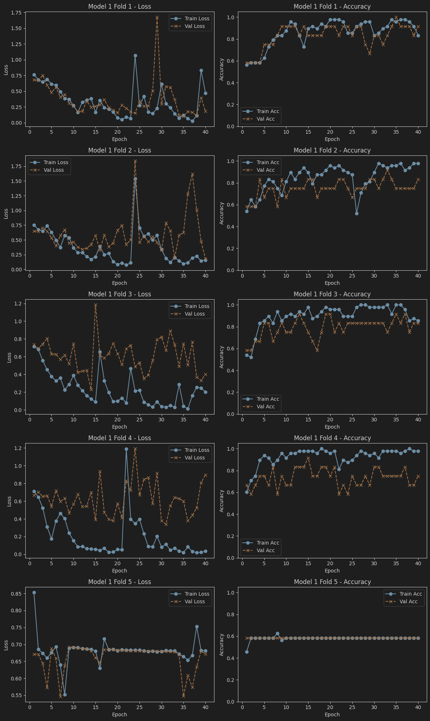
Part 2 – Model 1 Diagnosis

Slide 8
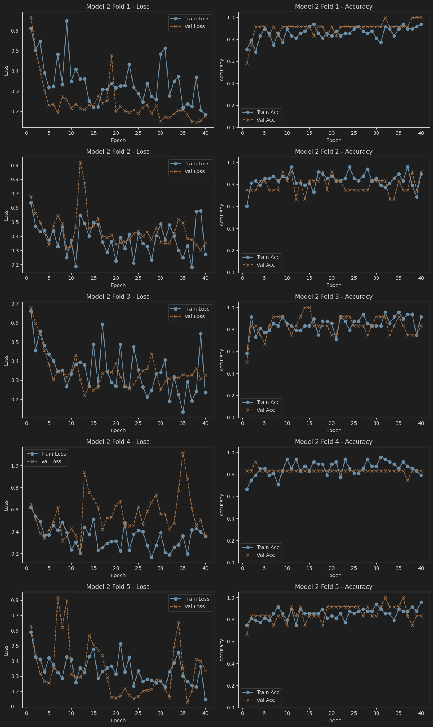
Part 2 – Model 2 Diagnosis

Slide 9
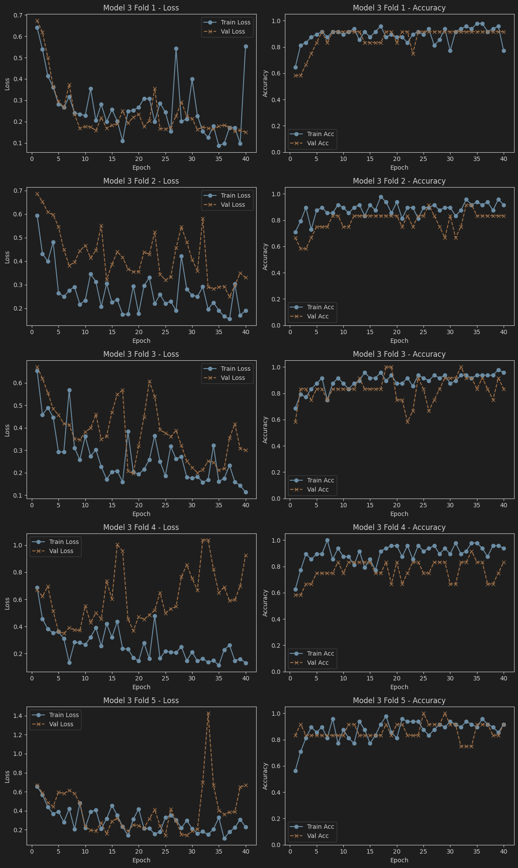
Part 2 – Model 3 Diagnosis

Slide 10
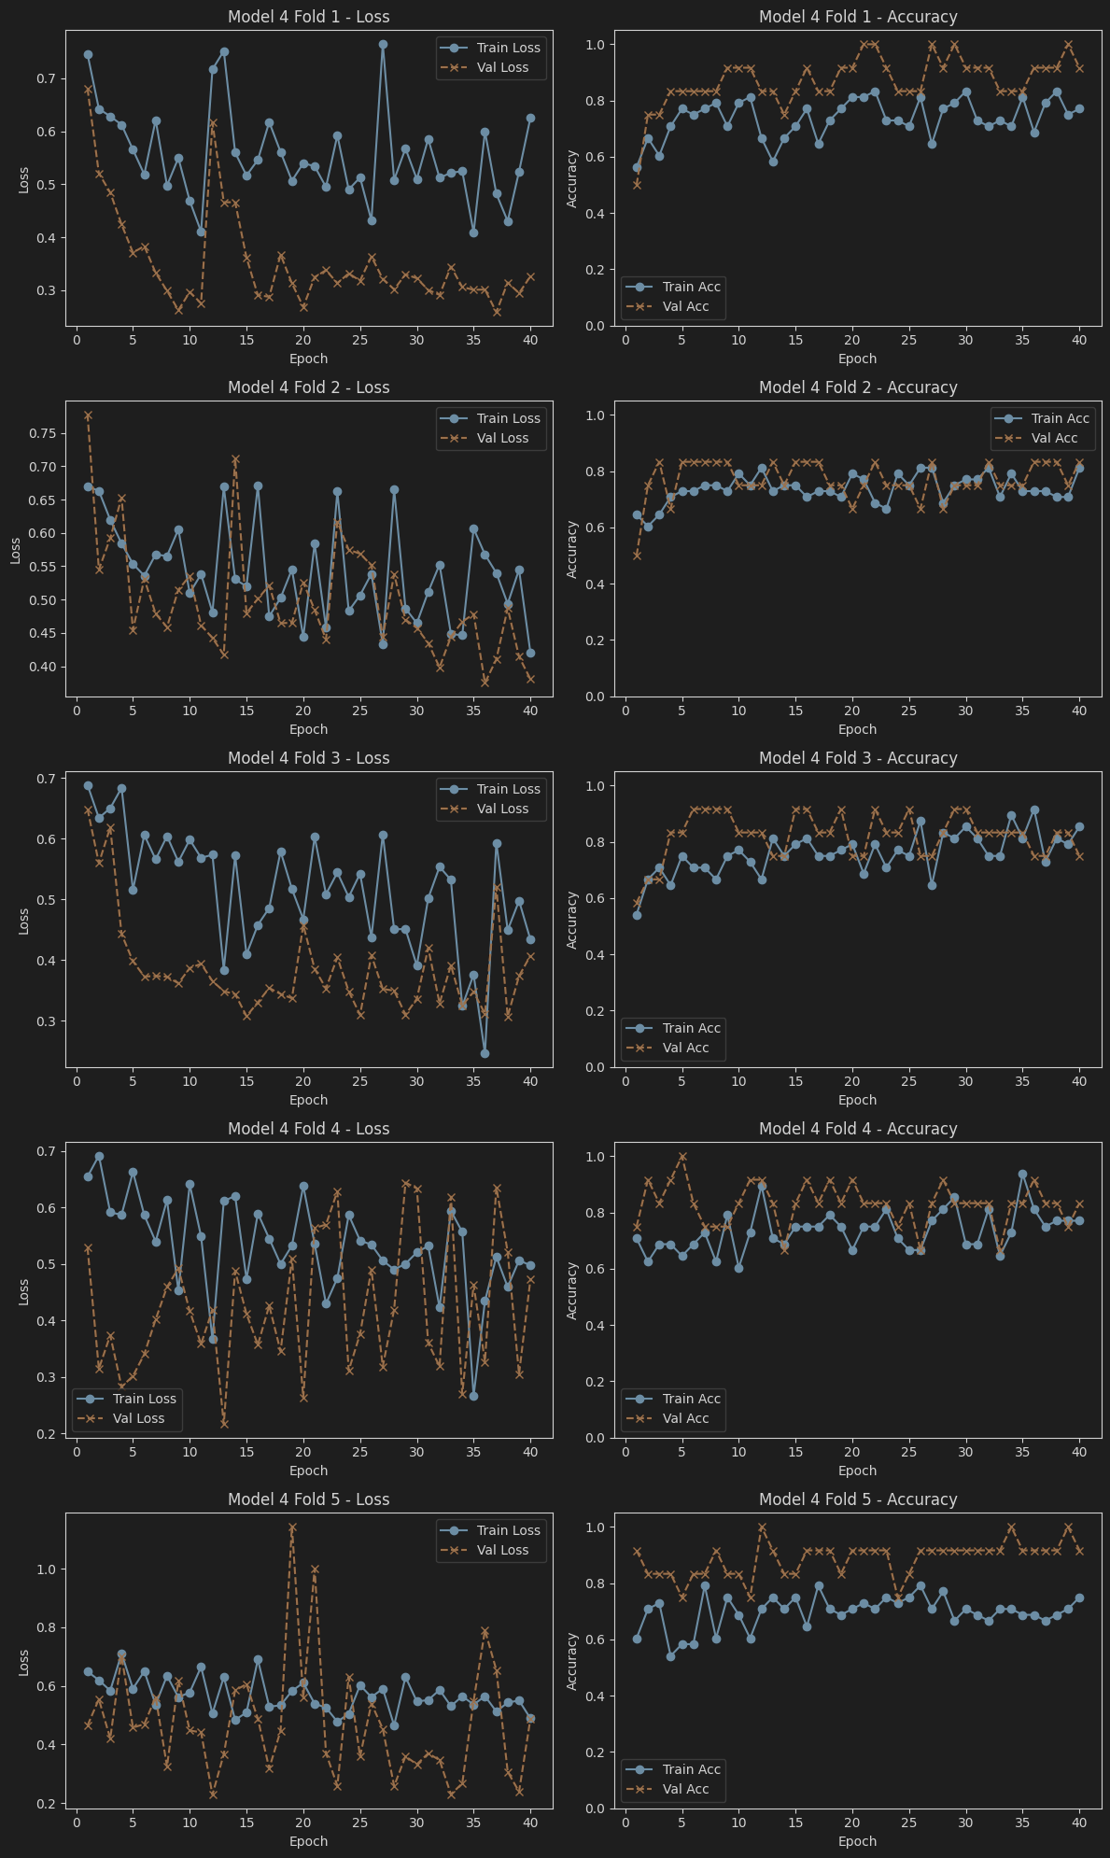
Part 2 – Model 4 Diagnosis

Slide 11
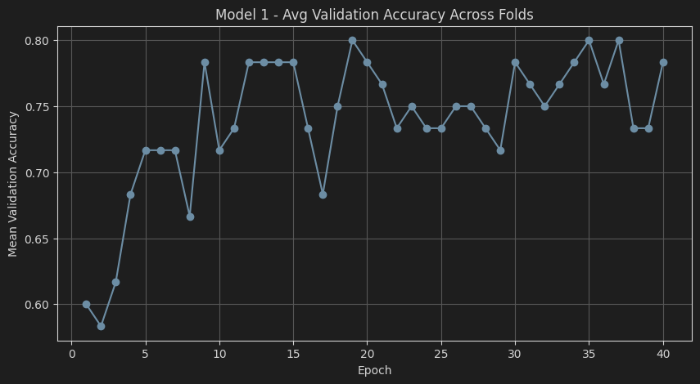
Part 2 – Model 4 Average Validation Accuracy

Slide 12
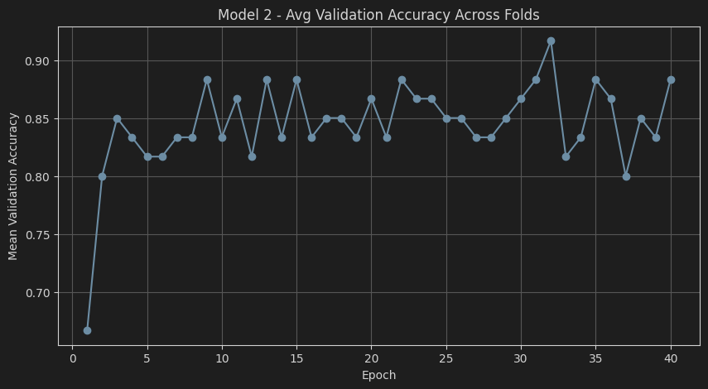
Part 2 – Model 4 Average Validation Accuracy

Slide 13
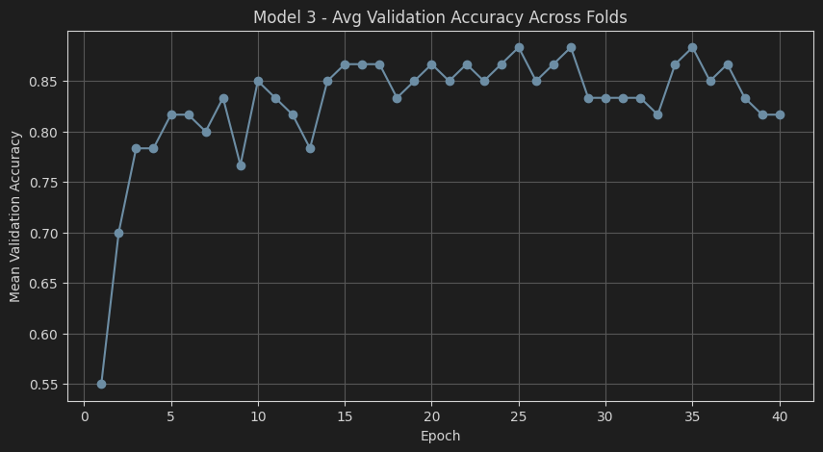
Part 2 – Model 4 Average Validation Accuracy

Slide 14
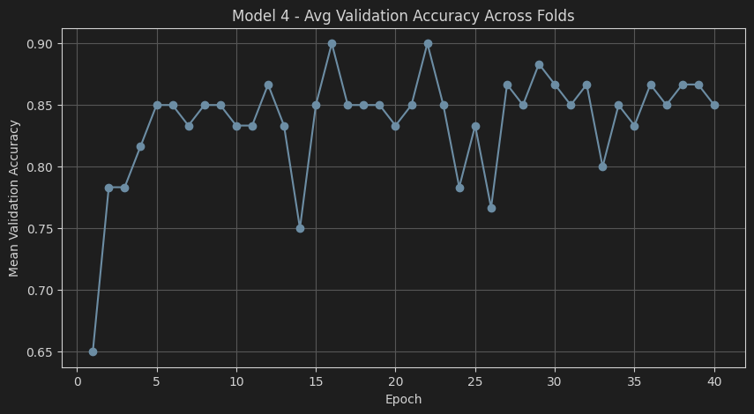
Part 2 – Model 4 Average Validation Accuracy

Slide 15
Part 2 – Model Diagnosis Validation Best Epoch Mean Accuracy
Model 1 | Model 2 | Model 3 | Model 4
Best Epoch: 19 | Best Epoch: 32 | Best Epoch: 25 | Best Epoch: 16
Mean Accuracy: 80% | Mean Accuracy: 92% | Mean Accuracy: 88% | Mean Accuracy: 80%

Slide 16
Part 2 – Most Promising Model
Most promising Model was Model 2
Decided to do a full train run on all of the data using the training pre processing as mentioned before using 32 epochs

Slide 17
Part 3 - How did you create your dataset and determine split of official logo versus not official logo?
Manually collected images from Google Images and Etsy
Two labels: Includes official Razorback logo vs. Does not include logo
Organized into two folders for ImageFolder loading
Final split was 58% Hog / 42% Non-Hog
Slight imbalance intentional since the model focuses on detecting the official logo
Used StratifiedKFold (5 folds) to preserve class proportions and avoid sampling bias

Slide 18
Part 3 - Why did you choose the specific architecture for the final model?
Model 2 had the highest and most stable accuracy across all folds (92%)
Included BatchNorm: more stable gradients & better generalization
Used Global Average Pooling: fewer parameters, less overfitting
Added Dropout in the classifier for regularization
Best generalization occurred around epoch 32, confirming architecture choice

Slide 19
Part 3 - How did you monitor and mitigate overfitting?
Compared training vs. validation accuracy and loss across 40 epochs
Applied strong data augmentation (flips, rotations, crops, color jitter)
Included BatchNorm, Dropout, and weight decay
Used Stratified 5-fold cross-validation to evaluate on multiple validation sets
Chose epoch 32 as the best stopping point based on peak mean validation accuracy

Slide 20
Part 3 - What future efforts could improve performance?
Add more diverse Hog and Non-Hog images to expand dataset
Use stronger augmentation (Cutout, Mixup, AutoAugment)
Implement transfer learning (ResNet, MobileNet, EfficientNet)
Add learning rate scheduling and early stopping

