Slide 1
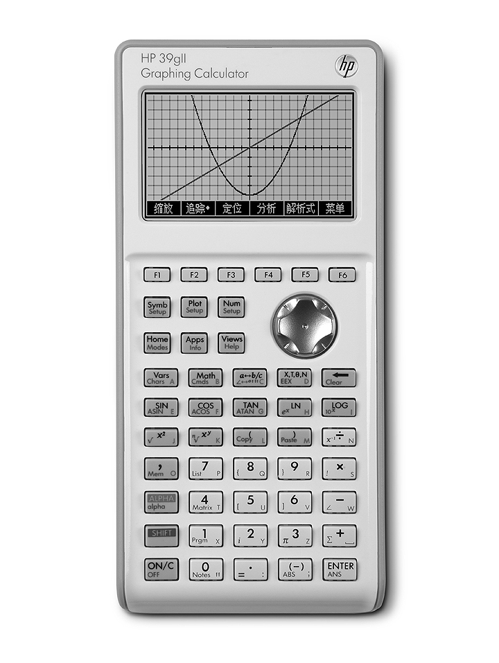

HP 39gll Graphing Calculator
Transform your classroom
©2012 HP Calculators
Version 1.1

Slide 2
Agenda
Intuitive UI: Apps
Performance: Adaptive Graphing
Intelligent Design: Systems Architecture
Assurance: HP Support & Durability
Advanced Features: Programming

Slide 3
Meet the 39gll
Intelligent design for the intelligent student
Shift between graphic, symbolic and numeric view with the touch of a button
6 Menu Keys:
Menu Keys streamline entry
Chinese User Interface
USB connector enables unit-to-unit and unit-to-PC connectivity.
14 HP Apps:
3 Solver Apps
3 Explorer Apps
8 Mathematical Applications
Flexible editors for matrices, lists, notesand programming

Slide 4
Apps
Intuitive UI
Mathematical Applications | Solvers | Explorers
Function | Linear | Linear Explorer
Solve | Triangle | Quadratic Explorer
Sequence | Finance | Trig Explorer
Polar
Parametric
Statistics 1-Var
Statistics 2-Var
Inference
Notes:
each solver is very specific
solve is general
this is HP's strong suit
we help people who want to solve problems
so the solvers are very specific" finance is a solver for TVM and amortization problems
triangle solver solves triangle problems
linear solver solves systems of 2x2 and 3x3 linear solvers
SOLVE is general - you define it
you enter the equation to solve
emoticon!
11:55 AMWells, Julia
he he
11:55 AMSpringer, Gt
equation or equations
i kno, right?
11:57 AMWells, Julia
sorry
okay so it shouldnt really be categorized under solvers
b/c it is more basic
11:58 AMSpringer, Gt
yes
11:58 AMWells, Julia
okay
11:59 AMSpringer, Gt
that is why the QSG has 1) HP Apps, 2) Solvers, and 3) Explorers
all are really HP apps, but...
11:59 AMWells, Julia
and is there a larger category for polar, parametic, sequence and function?
11:59 AMSpringer, Gt
yes, but has no name currently
it is for polar, parametric, function, sequence, stats1V, stats 2V, and inference
whoops and solve
data streamer too
I just call them HP Apps now
it is a little confusing currently
but think of it this way
12:02 PMWells, Julia
i am calling them mathmatical function apps
based on qsg
12:02 PMSpringer, Gt
HP apps use SYMB, PLOT, NUM and their setups (SHIFTS
Solvers use just numeric view (except Finance)
Explorers just use plot view
12:03 PMWells, Julia
okay great
that is very helpful
can i call the rest mathmatical function apps
12:04 PMSpringer, Gt
solvers and explorers have limited views because their scope defines the views they use
the HP Apps are for more open-ended exploration
so they need multiple views
but those views are all consistent app-2-app
cannot call them mathematical function apps
mathematical relations is ok, but not really good
mathematical subjects or topics is really closer
i will go with topics then
topics may literally be too small
but subject areas is about curriculum, not the math

Slide 5
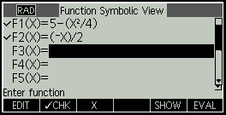
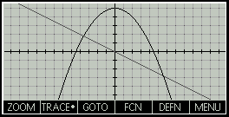
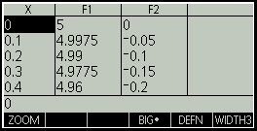
Mathematical App Overview
Mathematical Applications
Intuitive UI
All Mathematical Apps can be displayed in three views:
Symbolic
Graphic
Numeric
Benefits:
Enhance student comprehension
Utilize calculator to build on earlier lessons
Encourage students to think flexibly about mathematical problems
Provide alternative views of concepts to satisfy different learning styles
Symbolic
Graphic
Numeric

Slide 6
Mathematical App Overview
Mathematical Applications
Intuitive UI
Apps and Functionality:
Function: Define functions and explore graphs and table of values
Solve: Enter equations and solve for unknown variables
Sequence: Define sequences and explore graphs and tables of values
Polar: Define polar equations and explore their graphs and tables of values
Parametric: Define parametric equations and explore their graphs and tables of values
Statistics 1-Var: Define 1-variable analyses, compute summary statistics and explore statistical plots
Statistics 2-Var: Define 2-variable analyses, compute summary statistics and explore statistical plots
Inference: Compute and explore hypothesis tests and confidence intervals
Notes:
each solver is very specific
solve is general
this is HP's strong suit
we help people who want to solve problems
so the solvers are very specific" finance is a solver for TVM and amortization problems
triangle solver solves triangle problems
linear solver solves systems of 2x2 and 3x3 linear solvers
SOLVE is general - you define it
you enter the equation to solve
emoticon!
11:55 AMWells, Julia
he he
11:55 AMSpringer, Gt
equation or equations
i kno, right?
11:57 AMWells, Julia
sorry
okay so it shouldnt really be categorized under solvers
b/c it is more basic
11:58 AMSpringer, Gt
yes
11:58 AMWells, Julia
okay
11:59 AMSpringer, Gt
that is why the QSG has 1) HP Apps, 2) Solvers, and 3) Explorers
all are really HP apps, but...
11:59 AMWells, Julia
and is there a larger category for polar, parametic, sequence and function?
11:59 AMSpringer, Gt
yes, but has no name currently
it is for polar, parametric, function, sequence, stats1V, stats 2V, and inference
whoops and solve
data streamer too
I just call them HP Apps now
it is a little confusing currently
but think of it this way
12:02 PMWells, Julia
i am calling them mathmatical function apps
based on qsg
12:02 PMSpringer, Gt
HP apps use SYMB, PLOT, NUM and their setups (SHIFTS
Solvers use just numeric view (except Finance)
Explorers just use plot view
12:03 PMWells, Julia
okay great
that is very helpful
can i call the rest mathmatical function apps
12:04 PMSpringer, Gt
solvers and explorers have limited views because their scope defines the views they use
the HP Apps are for more open-ended exploration
so they need multiple views
but those views are all consistent app-2-app
cannot call them mathematical function apps
mathematical relations is ok, but not really good
mathematical subjects or topics is really closer
i will go with topics then
topics may literally be too small
but subject areas is about curriculum, not the math

Slide 7
Function App
Mathematical Applications
Intuitive UI
Functionality
Symbolic view
Enter up to ten functions
Toggle a function off or on for graphing and table-building
Plot view
Zoom in or out just by pressing + or –
Find roots, intersections, slope, extrema, and signed area
Symbolic
Graphic
Numeric
Enter and edit function definitions.
Built-in menu key to easily type in X
Tracer is on automatically. Just press the left or right arrow keys to trace along the function. Use up and down to switch functions.
Enter any value for X and the table will automatically re-configure. Zoom in or out on a row in the table, just like zooming in or out on a point on a graph.

Slide 8
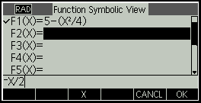
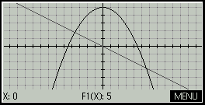
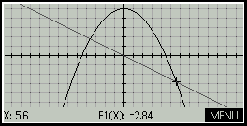
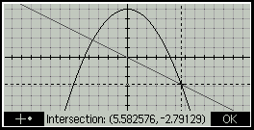
Function App: Sample Problem
Mathematical Applications
Intuitive UI
Sample Problem
Solution Steps
HP 39gII Display
Can you find the intersection of Y=5-X²/4 and Y=-X/2?
1
Launch the Function App:
Press Apps, select Function, and press the START menu key.
2
Define the functions in F1(X) and F2(X):
Press 5 – X X² ÷ 4 OK to enter F1(X)
Press (-) X ÷ 2 OK to enter F2(X
3
Press Plot to see the graphs
4
Use the right-arrow key to move the tracer near an intersection.
5
Press MENU, FCN, select Intersection and press OK OK to see the intersection point.
Press the + menu key to show the location more clearly. Press OK to exit and return to tracing.

Slide 9
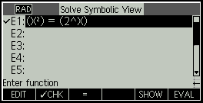
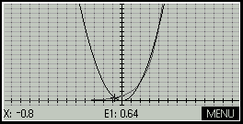
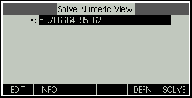
Solve App
Mathematical Applications
Intuitive UI
Functionality
Symbolic view
Enter up to ten equations
Toggle an equation on for solving (only one equation can be solved at a time)
Plot view
Zoom in or out just by pressing + or –
Find an approximate value of the solution for which you are looking
Symbolic
Graphic
Numeric
Enter and edit equations.
Built-in menu key to easily type in =.
Tracer is on automatically. The left and right sides of the equation are plotted as separate functions. Trace near an intersection to approximate a solution.
Press NUM to enter the solver. The approximate solution (X=-0.8) is the current value of X and will be used as the initial value. Press the SOLVE menu key to find the best numerical approximation of the solution.

Slide 10
Solve App: Sample Problem
Mathematical Applications
Intuitive UI
Sample Problem
Solution Steps
HP 39gII Display
How many solutions are there to the equation
?
1
Launch the Solve App:
Press Apps, select Sequence, and press the START menu key.
2
Enter the equation in E1:
X x^{y} 2 = 2 x^{y} X ENTER
3
Press Plot to see the graph. Trace to the left until the tracer is near the first intersection (X=-0.8).
4
Press Num to enter the solver. Your value of X is the current value and will be used as its initial value for solving. Press the SOLVE menu key to see the best numerical approximation of the solution,
X=-0.766664695962…
5
Repeat Steps 3 and 4 to find the other intersections:
X=-0.766664695962
X=2 (by inspection)
X=4

Slide 11
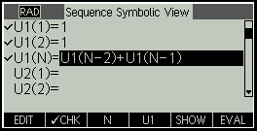
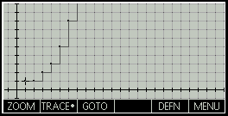
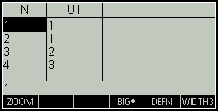
Sequence App
Mathematical Applications
Intuitive UI
Define up to ten sequences, either recursively or in terms of n
View stairstep or cobweb plot of sequences
Explore a table of sequence values
Symbolic
Graphic
Numeric
Enter and edit function definitions.
Built-in menu key to easily type in N, U1, etc.
Tracer is on automatically. Just press the left or right arrow keys to trace along the graph. Use up and down to switch between sequences.
Enter any value for N and the table will automatically re-configure.

Slide 12
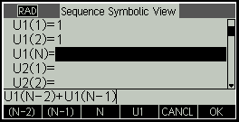
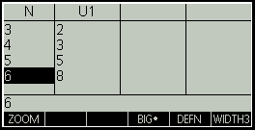
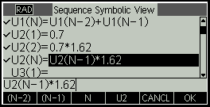
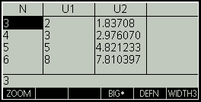
Sequence App: Sample Problem
Mathematical Applications
Intuitive UI
Sample Problem
Solution Steps
HP 39gII Display
Can you approximate the Fibonacci sequence with a geometric sequence?
1
Launch the Sequence App:
Press Apps, select Sequence, and press the START menu key.
2
Define the Fibonacci sequence in U1:
U1(1)=1 so press 1 OK
U1(2)=1 so press 1 OK
U1(N)=U1(N-2)+U1(N-1) so use the menu keys to enter this expression.
3
Press NUM to see the sequence
4
Press SYMB to return to the symbolic view and enter a geometric sequence in U2:
U2(1)=0.7 so press .7 OK
U2(2)=0.7*1.62 so enter this and press OK
U2(N)=U2(N-1)*1.62, so use the menu keys to enter this expression.
5
Press NUM to compare the sequences.
Use the up and down arrow keys to explore.
To see the 20th terms of the sequences, move to the N column and enter 20.

Slide 13
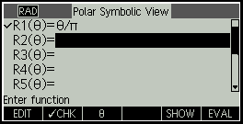
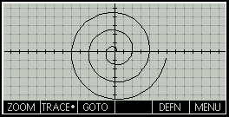
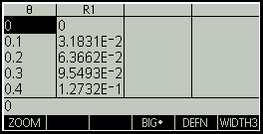
Polar App
Mathematical Applications
Intuitive UI
Functionality:
Create and edit equations that define R in terms of θ
Zoom in or out on the graph just by pressing + or -
View tables of values of R and θ
Symbolic View
Graphic View
Numeric
Enter and edit function definitions.
Built-in menu key to easily type in θ.
Tracer is on automatically. Just press the left or right arrow keys to trace along the graph. Use up and down to switch between graphs.
Enter any value for θ and the table will automatically re-configure. Zoom in or out on a row in the table, just like zooming in or out on a point on a graph.

Slide 14

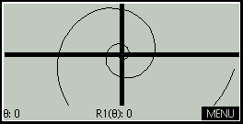
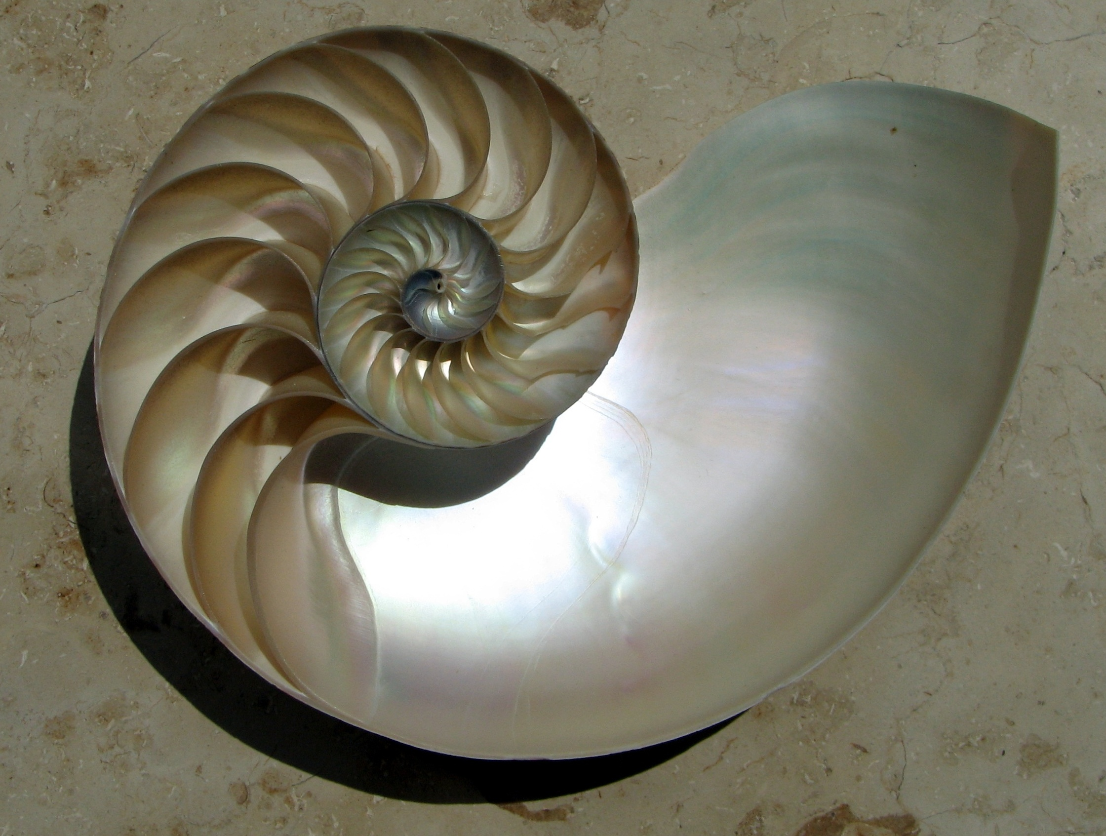
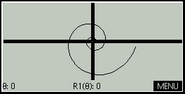
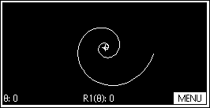
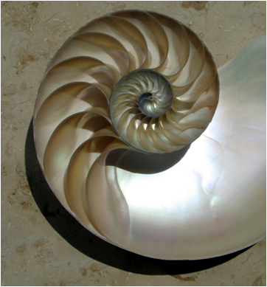
Polar App: Sample Problem
Mathematical Applications
Intuitive UI
Sample Problem
Solution Steps
HP 39gII Display
Can you approximate the spiral of a nautilus shell with a polar graph?
1
Launch the Polar App:
Press Apps, select Polar, and press the START menu key.
2
Define the polar graph R1(θ)=θ⁷:
Press the θ menu key, then x^{y} 7 OK
3
Press Plot to see the graph
4
Press + and – to zoom in and out on the center until you get the view you want.

Slide 15
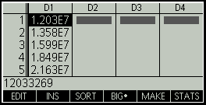
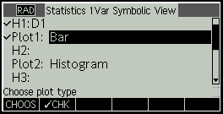
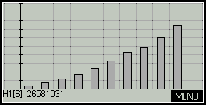
Statistics 1Var App
Mathematical Applications
Intuitive UI
Functionality:
Enter a set of numerical data
Choose the column(s) to use for statistical analyses
Calculate summary statistics for your data set
See a histogram of your data set or any of a number of other graphical representations
Numeric
Symbolic
Graphic
Enter and edit numerical data. View 1, 2, 3 or 4 columns at a time. Press the STATS menu key to see summary statistics for your data.
Define which column(s) of data to use in your analysis. Choose the type of statistical plot you want to see.
The tracer is on automatically. Press the left and right arrow keys to trace the graph. Press the MENU key to see a menu of graphing options.

Slide 16
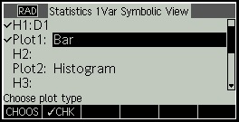
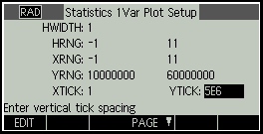

Statistics 1Var App: Sample Problem
Mathematical Applications
Intuitive UI
Sample Problem
Solution Steps
HP 39gII Display
The table below shows China’s GDP in 100 million CNY for the years 2002-2011, according to China’s NBS. What does a bar plot of this data tell you?
1
Launch the Statistics 1Var App:
Press Apps, select Statistics 1Var, and press the START menu key. Enter the GDP data from the table in D1.
Year | GDP
2002 | 12,033,269
2003 | 13,582,276
2004 | 15,987,834
2005 | 18,493,737
2006 | 21,631,443
2007 | 26,581,031
2008 | 31,404,543
2009 | 34,090,281
2010 | 40,151,280
2011 | 47,156,370
2
Press SYMB to enter the Symbolic view. For H1, set the data column to D1. Then use the CHOOS menu key and the down arrow key to choose the BAR graph for Plot1.
3
Press Shift Plot to enter the Plot Setup.
Set both HRNG and XRNG to [-1, 11] to show the y-axis and 10 data points.
Set YRNG to [10000000, 60000000] to show the GDP data.
Set YTICK to 5000000.
4
Press Plot to see the graph.
Visual inspection of the bar graph indicates exponential growth.

Slide 17
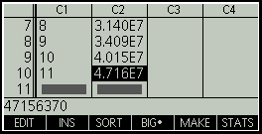
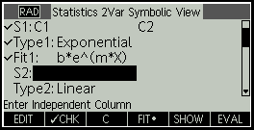
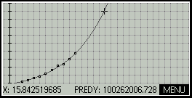
Statistics 2Var App
Mathematical Applications
Intuitive UI
Functionality:
Enter sets of numerical data
Choose the columns to use for statistical analyses
Calculate summary statistics for your data set
See a scatter plot of your data sets and calculate a fit for your data sets
Numeric
Symbolic
Graphic
Enter and edit numerical data. View 1, 2, 3 or 4 columns at a time. Press the STATS menu key to see summary statistics for your data.
Define which column(s) of data to use in your analysis. Choose the type of fit for your data sets.
The tracer is on automatically. Press the left and right arrow keys to trace the graph. Press the down arrow key to switch from the scatter plot to the fit.

Slide 18
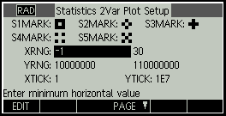
Statistics 2Var App: Sample Problem
Mathematical Applications
Intuitive UI
Sample Problem
Solution Steps
HP 39gII Display
Using the data from the previous problem, find an exponential fit for the data. The GDP of the USA in 2010 was 97,810,759 CNY. Use your model to find the year in which the GDP of China surpasses 100,000,000 CNY.
1
Launch the Statistics 2Var App:
Press Apps, select Statistics 2Var, and press the START menu key. Enter the years from 2000 in C1. Then from the Home view, enter D1 STO▶ C1 (use the F1 menu key for STO▶).
2
Press SYMB to enter the Symbolic view. For S1, set the independent data column to C1 and the dependent column to C2. Then use the CHOOS menu key and the down arrow key to choose the Exponential fit for Fit1.
Year | GDP
2002 | 12,033,269
2003 | 13,582,276
2004 | 15,987,834
2005 | 18,493,737
2006 | 21,631,443
2007 | 26,581,031
2008 | 31,404,543
2009 | 34,090,281
2010 | 40,151,280
2011 | 47,156,370
Press Shift Plot to enter the Plot Setup.
Set XRNG to [-1, 30] to show the y-axis and the data points.
Set YRNG to [10,000,000, 110,000,000] to show the GDP data.
Set YTICK to 10,000,000.
3
4
Press Plot to see the graph. If necessary, press the FIT menu key to fit an exponential equation to the data. Press the down arrow key to move the trracer from the scatter plot to the exponential fit. Use the right arrow to trace along the fit to find a y-value greater than 100,000,000. The figure to the right indicates that China’s GDP will surpass 100,000,000 CNY sometime in the year 2015.
Press Num to return to the Numeric view and press the STATS menu key. The correlation coefficient (r) is shown as 0.99855….

Slide 19
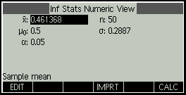
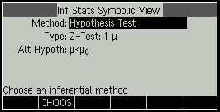
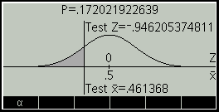
Inference App
Mathematical Applications
Intuitive UI
Imports summary statistics from the Statistics 1Var and 2Var apps
Choose between hypothesis test or confidence interval
Choose from Z- and t-distributions
See results numerically or graphically
Numeric View
Symbolic View
Graphic View
Enter the sample data or import it from the Statistics 1Var or 2Var apps, then press the CALC menu key to see your test results or confidence interval numerically.
Choose a method (test or interval), a type (1 mean, 2 mean, proportion, etc.) and –for a test- choose your alternative hypothesis.
See your test results or confidence interval presented graphically. Press the α menu key to see and change your alpha level.
Notes:
Confidence intervals and hypothesis tests contain default values that correspond to the online help sections WHAT??

Slide 20
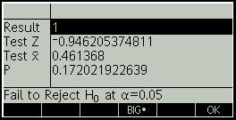
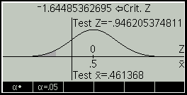
Inference App: Sample Problem
Mathematical Applications
Intuitive UI
Sample Problem
Solution Steps
HP 39gII Display
A graphing calculator generates 50 random numbers between 0 and 1. This set of numbers has a mean of 0.461368. Assuming a true mean of 0.5 and a standard deviation of 0.2887, is this calculator working properly?
1
Launch the Inference App:
Press Apps, select Inference, and press the START menu key.
2
We will test the null hypothesis (that the calculator is working properly) against the alternative that the random numbers are too small. We shall test at the α=0.05 level.
3
Press NUM to enter the sample data. Note that thos data is the default data for the app, so nothing needs to be entered.
4
Press the CALC menu key to see the results numerically. The p-value indicates that the mean is within the 5% alpha level region and so the null hypothesis should not be rejected. The calculator is working properly. Press the OK menu key to exit.
5
Press Plot to see the same results presented graphically. Press the α menu key to see an alternate representation showing the critical and test values. Use the up and down arrow keys to change the α level.

Slide 21
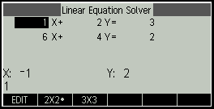
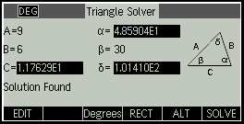
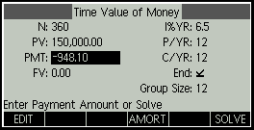
Solver App Overview
Solver Applications
Intuitive UI
There are three Solver apps
Finance for TVM and amortization problems
Linear Solver for 2x2 and 3x3 systems of linear equations
Triangle Solver for problems involving lengths of sides and measure of angles of triangles
Solver Apps use the Numeric view
Finance also uses plot views
Linear Solver
Triangle Solver
Finance
Choose a 2x2 or 3x3 system solver
Choose degrees or radians, choose right or general triangle solvers, find alternate solutions and solve.
Use SOLVE to solve TVM problems or AMORT to view an amortization table. Press Plot to see the amortization graph
Notes:
each solver is very specific
solve is general
this is HP's strong suit
we help people who want to solve problems
so the solvers are very specific" finance is a solver for TVM and amortization problems
triangle solver solves triangle problems
linear solver solves systems of 2x2 and 3x3 linear solvers
SOLVE is general - you define it
you enter the equation to solve
emoticon!
11:55 AMWells, Julia
he he
11:55 AMSpringer, Gt
equation or equations
i kno, right?
11:57 AMWells, Julia
sorry
okay so it shouldnt really be categorized under solvers
b/c it is more basic
11:58 AMSpringer, Gt
yes
11:58 AMWells, Julia
okay
11:59 AMSpringer, Gt
that is why the QSG has 1) HP Apps, 2) Solvers, and 3) Explorers
all are really HP apps, but...
11:59 AMWells, Julia
and is there a larger category for polar, parametic, sequence and function?
11:59 AMSpringer, Gt
yes, but has no name currently
it is for polar, parametric, function, sequence, stats1V, stats 2V, and inference
whoops and solve
data streamer too
I just call them HP Apps now
it is a little confusing currently
but think of it this way
12:02 PMWells, Julia
i am calling them mathmatical function apps
based on qsg
12:02 PMSpringer, Gt
HP apps use SYMB, PLOT, NUM and their setups (SHIFTS
Solvers use just numeric view (except Finance)
Explorers just use plot view
12:03 PMWells, Julia
okay great
that is very helpful
can i call the rest mathmatical function apps
12:04 PMSpringer, Gt
solvers and explorers have limited views because their scope defines the views they use
the HP Apps are for more open-ended exploration
so they need multiple views
but those views are all consistent app-2-app
cannot call them mathematical function apps
mathematical relations is ok, but not really good
mathematical subjects or topics is really closer
i will go with topics then
topics may literally be too small
but subject areas is about curriculum, not the math

Slide 22
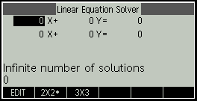
Linear Solver App: Sample Problem
Solver Applications
Intuitive UI
Solves 2x2 and 3x3 systems of linear equations within a single view
Solution statement changes in real time to reflect the current values each equation
Sample Problem
Solution Steps
HP 39gII Display
A 2x2 linear system of equations is such that the coefficients of each equation form arithmetic sequences. What is the solution of such a system?
1
Launch the Linear Solver App:
Press Apps, select Linear Solver, and press the START menu key.
2
Press the 2x2 menu key to switch from the 3x3 solver to the 2x2 solver. Enter the coefficients of the equations:
1 ENTER 2 ENTER 3 ENTER
Note: The solution changes in real-time as you enter the coefficients.
8 ENTER 6 ENTER 4 ENTER
3
The final solution is (-2, 1). The result is the same regardless of the sequences used! Surprised?
Notes:
Solves 2x2 and 3x3 systems of linear equations within a single view
Solution statement changes in real time to reflect the current values each equation

Slide 23
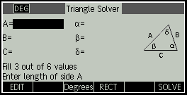
Triangle Solver App: Sample Problem
Solver Applications
Intuitive UI
Solves geometric and trigonometric problems involving triangles.
Measures angles in both degrees and radians
Solves general and right triangles
Shows all alternate solutions for indeterminate cases
Sample Problem
Solution Steps
HP 39gII Display
A triangle has consecutive sides of lengths 9 and 6. The angle opposite the second side measures 30°.
Find the length of the third side.
1
Launch the Triangle Solver App:
Press Apps, select Triangle Solver, and press the START menu key. If necessary, press the Radians menu key to change to Degrees angle measure.
2
Enter the known values:
A=9, so press 9 ENTER
B=6, so press 6 ENTER
β=30, so use the arrow keys to highlight β and press 30 ENTER
3
Press the SOLVE menu key to see:
Side C has a length of 11.76
Angle α has a measure of 48.59°
Angle δ has a measure of 101.41°
Notes:
Solves 2x2 and 3x3 systems of linear equations within a single view
Solution statement changes in real time to reflect the current values each equation

Slide 24
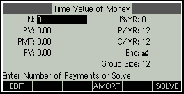
Finance Solver App: Sample Problem
Solver Applications
Intuitive UI
Solves TVM and amortization problems
Plot view shows an amortization graph
Sample Problem
Solution Steps
HP 39gII Display
You finance the purchase of a house with a 30-year loan at 6.5% annual interest. The cost of the house is $180,000 and you make a down payment of $30,000. How much are the required monthly payments? Assume payments start at the end of the first period.
1
Launch the Finance App:
Press Apps, select Finance, and press the START menu key.
2
Enter the known values:
N=360 (30 years with 12 payments per year)
I%YR=6.5
PV=150,000 (180,000-30,000 down payment)
FV=0
3
Press the SOLVE menu key to see the payment would be $948.10 per month. The payment is negative to indicate it is money you pay ot.
Notes:
Solves 2x2 and 3x3 systems of linear equations within a single view
Solution statement changes in real time to reflect the current values each equation

Slide 25
Explorer Apps Overview
Explorer Applications
Intuitive UI
Overview:
Students manipulate a graph and observe the change in the equation parameters
Students can also change each parameter ad observe the effect on the graph
Designed to facilitate explorations of function families
Test your skill functionality
Views:
Plot View
EQ View
Test Mode
Apps and Functionality:
Linear Explorer: explore linear functions of the form y=ax and y=ax+b
Quadratic Explorer: explore quadratic functions of the form y=ax², y=x²+c, and y=a(x-h⁾²+v
Trig Explorer: explore sine and cosine equations
Notes:
each solver is very specific
solve is general
this is HP's strong suit
we help people who want to solve problems
so the solvers are very specific" finance is a solver for TVM and amortization problems
triangle solver solves triangle problems
linear solver solves systems of 2x2 and 3x3 linear solvers
SOLVE is general - you define it
you enter the equation to solve
emoticon!
11:55 AMWells, Julia
he he
11:55 AMSpringer, Gt
equation or equations
i kno, right?
11:57 AMWells, Julia
sorry
okay so it shouldnt really be categorized under solvers
b/c it is more basic
11:58 AMSpringer, Gt
yes
11:58 AMWells, Julia
okay
11:59 AMSpringer, Gt
that is why the QSG has 1) HP Apps, 2) Solvers, and 3) Explorers
all are really HP apps, but...
11:59 AMWells, Julia
and is there a larger category for polar, parametic, sequence and function?
11:59 AMSpringer, Gt
yes, but has no name currently
it is for polar, parametric, function, sequence, stats1V, stats 2V, and inference
whoops and solve
data streamer too
I just call them HP Apps now
it is a little confusing currently
but think of it this way
12:02 PMWells, Julia
i am calling them mathmatical function apps
based on qsg
12:02 PMSpringer, Gt
HP apps use SYMB, PLOT, NUM and their setups (SHIFTS
Solvers use just numeric view (except Finance)
Explorers just use plot view
12:03 PMWells, Julia
okay great
that is very helpful
can i call the rest mathmatical function apps
12:04 PMSpringer, Gt
solvers and explorers have limited views because their scope defines the views they use
the HP Apps are for more open-ended exploration
so they need multiple views
but those views are all consistent app-2-app
cannot call them mathematical function apps
mathematical relations is ok, but not really good
mathematical subjects or topics is really closer
i will go with topics then
topics may literally be too small
but subject areas is about curriculum, not the math

Slide 26
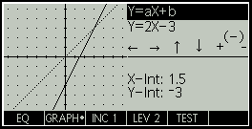
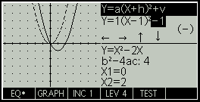
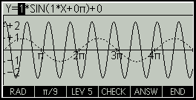
Explorer Apps Overview
Explorer Applications
Intuitive UI
Graph Mode
translate and dilate the graph directly and see the resulting effects on the values of the equation parameters as you manipulate the graph.
EQ Mode
change the parameters of the equation directly and observe the effect on the shape of the graph.
Test View
test your skill at matching an equation to the graph shown.
GRAPH Mode
EQ Mode
Test View

Slide 27
Agenda
Intuitive UI: Apps
Performance: Adaptive Graphing
Intelligent Design: Systems Architecture
Assurance: HP Support & Durability
Advanced Features: Programming

Slide 28
Programming
Overview
The HP 39gII is fully programmable and has its own program catalog and editor
User-defined functions
Define and export new functions & functions will appear in the Math menu
Each HP app has its own program of the same name that can be used to customize the app
The views of each HP app can be customized in a similar way
App Functions
Certain apps have functions that expose their functionality

Slide 29
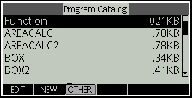


Program Catalog & Program Editor
Advanced Features
Steps
HP 39gII Display
1
Enter the Program Catalog
Press SHIFT 1 to open the Program Catalog. The menu keys are:
EDIT: Open the Program Editor to edit the selected program
NEW: Name a new program and edit it in the Program Editor
OTHER: Open another menu with options to SAVE a program with a new name, DELETE the selected program, or CLEAR all programs from the catalog
Once a new program exists, you will see these other menu keys:
SEND: Send the selected program to another HP 39gII
DEBUG: Debug the selected program step-by-step
RUN: Run the selected program
2
Start the Program Editor
Press the NEW menu key and enter a name for your program using the ALPHA key. Press ALPHA twice to lock it and a third time to quit Alpha mode. Enter your program name and press the OK menu key twice to start editing your new program. The Program Editor automatically creates a template for your program, with the Export command at the top and a BEGIN…END; structure. Most of your program will be entered within the BEGIN…END; pair.
3
Enter the commands for your program
Press the CMDS menu key to enter common branches or loops. Press ON to return from the CMDS menu. Or press SHIFT Math (also CMDS) to use the full Commands catalog. You can also use the Vars and Math menus to enter variables and math commands into your program.

Slide 30



User-defined Functions: Example
Advanced Features
Program Comments
The Program FG
Program display
EXPORT so FG shows up in the Cmds menu
BEGIN marks the start of the program
RETURN contains the formula for FG(X)
END marks the end of the program
EXPORT FG(X)
BEGIN
RETURN X^2+1
END;
How to use your new function
Program result
Press SHIFT Math to open the CMDS menu
Press the USER menu key to see user-defined functions in programs
Select the FG program on the left column
Select the FG function in the right column
Note: a program could have multiple user-defined functions in it
Press the OK menu key
Press (3) ENTER
The result is 3²+1 = 10
OR just enter FG(3) directly in the Home view!

Slide 31


Utilizing Graphics Commands
Advanced Features
This simple example uses RECT() to clear the display and ARC() to draw a circle.
Program Comments
The Program DRAWCIRCLE
Program display
EXPORT to show up in the Cmds menu
BEGIN marks the program beginning
RECT() erases the display
ARC draws a circle
Freeze the display until a key is pressed
End marks the program end
EXPORT DRAWCIRCLE()
BEGIN
RECT();
ARC_P(G0,127,63,50);
FREEZE;
END;
How to run your new program
Program result
From the Home view:
Press SHIFT Math to open the CMDS menu
Press the USER menu key to see user-defined functions in programs
Select the DRAWCIRCLE program on the left column
Select the DRAWCIRCLE function in the right column
Note: a program could have multiple user-defined functions in it
Press the OK menu key
Press () ENTER
The result is shown on the display
From the Program Catalog:
Press SHIFT 1 (Prgm) to open the Program Catalog
Press the up and down arrows to select DRAWCIRCLE
Press the RUN menu key
Press () ENTER
The result is shown on the display

Slide 32


Utilizing Loops
Advanced Features
This example uses For…Next loops and the PIXON command to color each pixel in the display. It also declares local variables that will not be visible outside the program.
Program Comments
The Program DRAWPATTERN
Program display
EXPORT to show up in the Cmds menu
BEGIN…END: pair contains your program
LOCAL declares three LOCAL variables
STARTAPP Starts the Function App
RECT() clears the display
Makes xinc the width of one pixel
Makes yinc the height of one pixel
For every pixel column…
And for every pixel row…
Calculate FLOOR(X^2 + Y^2) MOD 4 and color the pixel using that value (0=black, 1=dark grey, 2=light grey, 3=white)
END goes to the next pixel in the column
END goes to the next pixel column
Freeze the display until a key is pressed
END finishes the program
EXPORT DRAWPATTERN()
BEGIN
LOCAL xinc, yinc, color;
STARTAPP(“Function”);
RECT();
xinc:=(Xmax-Xmin)/254;
yinc:=(Ymax-Ymin)/110;
FOR X FROM Xmin TO Xmax STEP xinc DO
FOR Y FROM Ymin TO Ymax STEO yinc DO
FLOOR(X^2 + Y^2) MOD 4▶color;
PIXON(X,Y,color);
END;
END;
FREEZE;
END;
Program result

Slide 33


App Functions
Advanced Features
Some of the HP Apps have functions which expose their functionality to the user. These are all found in the Commands menu, under the APP menu key.
To use an App Function
App Commands Menu
Press SHIFT Math to open the CMDS menu
Press the APP menu key to see app functions
Select the App on the left column
Select the function in the right column
Press the OK menu key
Complete the function syntax and press ENTER
The result is displayed
OR- if you know the app function name- just enter the function directly in the Home view!

Slide 34



HP App Function Examples
Advanced Features
Some of the HP Apps have functions which expose their functionality to the user. These are all found in the Commands menu, under the APP menu key.
App Function Example
HP App Function
Example Syntax and Result
The Function App has an app function named ROOT. The syntax is ROOT(expression, value), where expression is an expression in X and value is an initial number to use for finding the nearest root.
The Triangle Solver App has a function called SAS. The syntax is SAS(S1, A3, S2), where S1 and S2 are the lengths of 2 consecutive sides of a triangle and A3 is the measure of the included angle. This function returns the length of the third side and the measures of the other two angles.

Slide 35
Agenda
Intuitive UI: Apps
Performance: Adaptive Graphing
Intelligent Design: Systems Architecture
Assurance: HP Support & Durability
Advanced Features: Programming

Slide 36
Graphing Technologies
Performance
Adaptive –Samples along the entire length of the graph and adjusts as necessary to produce a very accurate graph.
Fixed-step segment – Moves from left to right and connects points with line segments. This is the “classic” way of plotting a graph.
Fixed-step dot – Similar to the fixed-step segment, except is does not connect the points with segments

Slide 37





Preserve Mathematical Fidelity
Performance
Example: y=sin(e^{x})
1989 Technology
2011 Technology
Fixed-Step Dot
Fixed-Step Segment
Adaptive
Example: x(t)=cos(7*t) and y(t)=sin(4*t)
Fixed-Step Segment
Adaptive

Slide 38
Agenda
Intuitive UI: Apps
Performance: Adaptive Graphing
Intelligent Design: Systems Architecture
Assurance: HP Support & Durability
Advanced Features: Programming

Slide 39
Zoom
Intelligent Design
Intuitively pan and scroll in graphic mode with the touch of a button
Seamlessly zoom into a row in a table
Identify limit of a function
Determine if a function is undefined

Slide 40
Non-Tokenization of commands
Intelligent Design
What is Tokenization?
Example:
How can it inhibit learning?
HP design solution:
Process of replacing input commands with unique symbols that replace the command.
To find the determinant of a matrix, some solutions require you to select the DET command from a list and then go find the matrix name from another list.
Requires students to search through extensive lists of commands to find what they want, rather than enabling the flexibility of finding the token or typing the command.
Work the way you want. Either type in a command (e.g., DET(M1)) or search through menus for a token.

Slide 41
Agenda
Intuitive UI: Apps
Performance: Adaptive Graphing
Intelligent Design: Systems Architecture
Assurance: HP Support & Durability
Advanced Features: Programming

Slide 42
Support Materials
Assurance
User Guide
Web-based
Based on HP39gs User Guide
Quick Start Guide
Comprehensive getting started guide
Includes complete App summary with all apps and respective views
Online Help
Full Translation
Fully contextual and provides help each app, view and menu

Slide 43
Famous HP Durability
Assurance
“I had a Truck run over my HP-11C and it worked fine for several years…”
-Souza, Tim. 7 JUL 01. hpmuseum.org
“I would routinely toss my HP 6 feet away to the hard brick of "red square" to demonstrate its durability”
-Brogger, Paul. 2 APR 00. hpmusuem.org.
“I bought my HP-15C when I was a sophomore EE in 1984. Its built-in imaginary number capability was a real time-saver in linear circuits. I used it heavily through my undergraduate years and often since then. The amazing thing is that it is still running on the batteries that were in it when I bought it. Previously, I had used cheap calculators that I had to throw away after a year or two, but this is the last calculator I ever had to buy.”
-Yount, Chuck. 1 SEP 00. hpmuseum.org.

Slide 44
Questions?
?

Slide 45
Thank You

