Slide 1
MRT problem
Cedric Yau

Slide 2
Problem 1:Generating Underlying mrt network (one dimension)
Main Idea:
Start from any station A
From that station, find 2 stations that are closest (smallest travelling time) to that station A. The 2 stations are now the neighbours to station A in the network.
Move either left of right to the new neighbouring stations and repeat steps 1:2, until network is complete
1
2
3
A
B
A
C
B
A
C
D

Slide 3
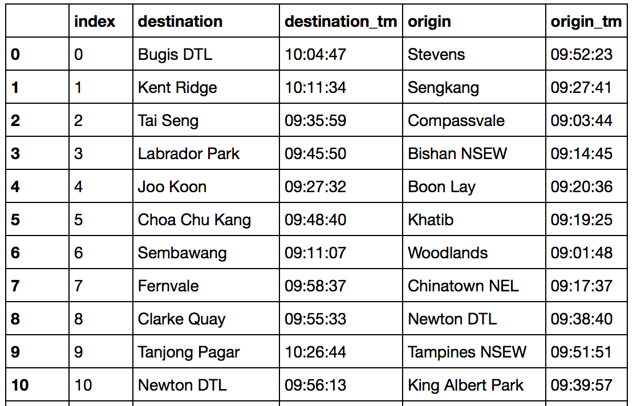
Step 1
Read data using Pandas Dataframe
Removed “CCL’, “DTL’, etc from the ends of the name of stations
Removed data with same destination and origins

Slide 4
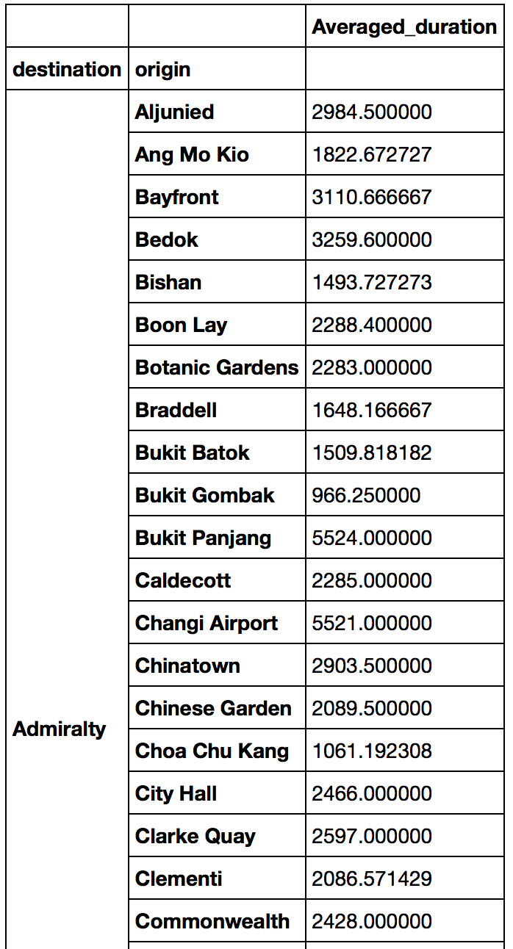
Step 2
Calculated Average duration of travel for each commute for 2 particular stations

Slide 5
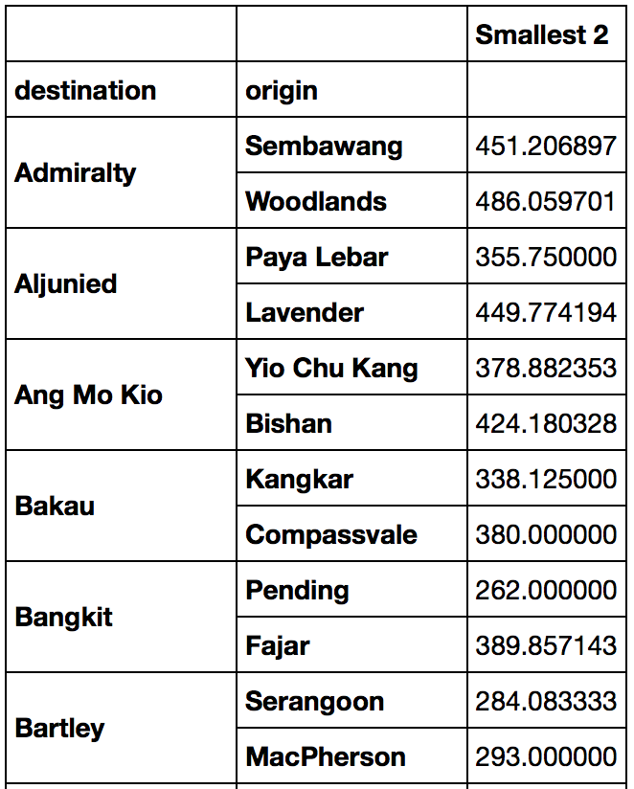
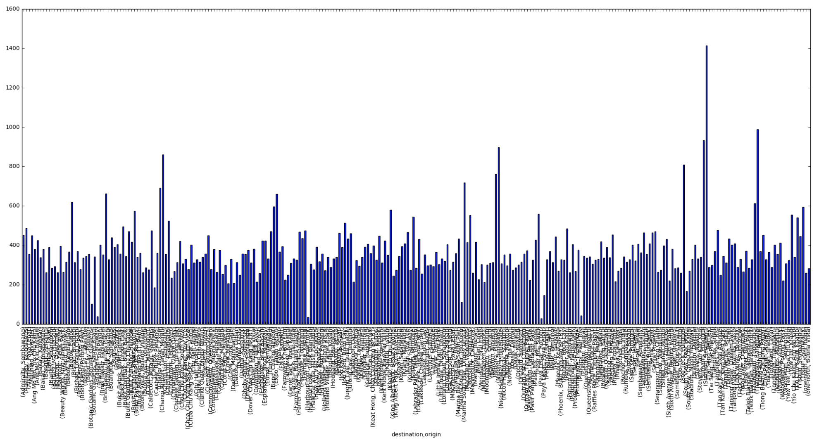
Creating 2D network
Determine average time and standard deviation for all stations from the 2 closest stations.
Mean | Standard Deviation
365.75 | 141.23
Plot of stations and the 2 shortest times

Slide 6
Idea for 2d network
Start from any station A
From that station, find 4 stations that are closest (smallest travelling time) to that station A.
Check if the last 2 stations are within mean + 2 * std dev away from station A
if time is within the range, could indicate the that the stations are 1 stop away and do belong to another line
Else: just take 2 nearest stations and proceed as with the 1D case

Slide 7
Problem 2
Idea:
Using Network map generated, first remove data entries from the dataset that do not pass by the 2 stations.
Using the dataset, find average time taken for a train to travel from station to station.
Starting from the data entry with the origin furthest away from Station A, estimate the time to reach Station A from the origin.
Numbering this train as Train 1

Slide 8
Problem 2
Idea:
Assumption: On average, trains are 3 mins apart from each other
Repeat the steps earlier for different data entries, checking times are 3 mins apart:
If 3 mins apart, add to the count of trains
Else ignore this train and proceed with next entry.

