Slide 1
Visualising Ant Colony Optimisation
Chris Edwards
Major Project 2015

Slide 2
Overview
Provide a visual representation of Ant Colony Methods
Nodes, Agents, Pheromone, Agent movement, Best route, …
Enable user interaction
Modify parameters
Start/stop execution
Generate new problems
Load/save problem configurations
Educational Objectives
Teaching tool
Explore any potential extensions

Slide 3
Research
ACO behaviours
Algorithm types
Basic Ant System, Elitist Ant System, …
How do they operate?
Pheromone, probabilistic
Existing solutions
What do they provide?
Good? Bad?
Improve upon them

Slide 4
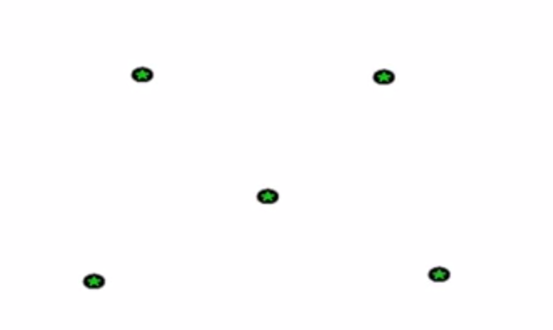
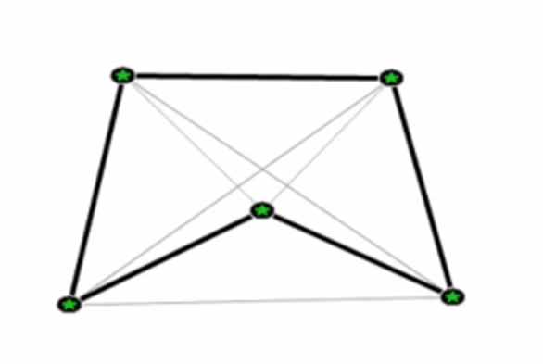
Example Solution
Click ‘Run’
No intermittent steps
Little user feedback
Doesn’t really educate
Solution from: https://www.youtube.com/watch?v=QZnvRXRsHHg

Slide 5
Existing solutions
Pros
Simplistic view and representation
Cons
No agent visualisation
No indication of movement
‘instant’ solving
No parameter modification
No pheromone visualisation
No choice of algorithm type or modifiers
There are better/worse solution available this is just one example

Slide 6
Implementation
Implement underlying ACO algorithm
Initially focus on Basic Ant System
‘hard coded’ problem representation and parameters
Get a solution working first
Link model and view
Adhere to MVC principles
Enable the view to modify the model
Edit parameters
Render the problem
Several complications were encountered

Slide 7
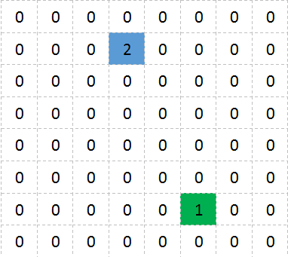
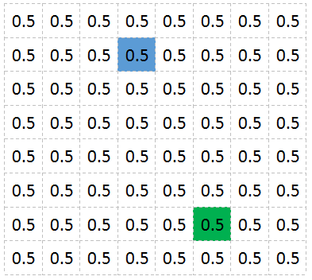
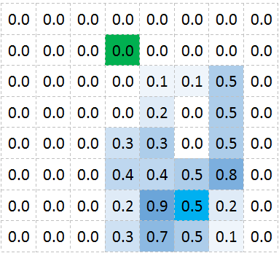
Initial problem representation
Initial pheromone representation
Initial pheromone visualisation

Slide 8
Representation
Previous implementation had several complications
Difficult to direct agents
Not very customisable
Incomplete graph
Easy to mentally picture the optimal path
A change of representation is needed…

Slide 9
Travelling Salesman Problem(TSP)
ACO is commonly applied to the TSP
This representation has several advantages over the initial choice
Customisable
User defined number of city locations
Modify the weighting of edges
Randomise city locations
Load configurations from a file
Etc…
However, this may be a difficult concept to grasp for new users…

Slide 10
Pheromone and distance data structures
Both data structures are scalable and easily accessed
Two-dimensional array
Size of each array depends on the # of cities
Easy to access elements
Each element corresponds to an edge
E.g. Element [x][y]
Refers to the edge from city x to city y
DistanceMatrix[x][y] holds the length of this edge
Pheromone[x][y] holds the pheromone data for this edge

Slide 11
Probability
Probabilistic node selection
Initially implementation has no random factor
Agents would always select the node with the highest probability
Algorithm got stuck in local solutions
Reused/modified the implementation provided by Thomas Jungblut[1]
Proven to be functional
Saved time
Enabled more progress to be made
[1]http://codingwiththomas.blogspot.co.uk/2011/08/ant-colony-optimization-for-tsp.html

Slide 12
Concurrency
Automated execution process is resource intensive
Caused GUI to ‘hang’ until completion
Executed on the same Thread as the GUI
Rendered the application unusable
Need to implement concurrent behaviours…
Java only allows UI updates on the Event Dispatch Thread
Difficult to multithread and communicate with Swing UI elements
SwingWoker
doInBackground()
Correctly handles Swing UI communication

Slide 13
Complications - Rendering
The rendering of the algorithms current state is far from trivial
The application must display;
The city locations
The paths + pheromone concentrations between cities (edges)
Agent location
Agents movement
Current best route
All must be done in ‘real time’
Every intermittent step will be shown
Existing solutions often just ‘skipped’ to the solution

Slide 14
Rendering - Paths
A path represents an edge connecting two nodes
Given the location of these nodes (cities) is known;
A path from each city can be drawn to every other city
These edges must also model pheromone
The best way to model this is to modify line opacity
The higher the edge pheromone the darker the path
Pheromone levels for an edge are scaled by 2000
This is to correctly model smaller values and provide a wider range of opacity values
Line opacity will be: edgePhero * 2000 or 255 which ever is smaller

Slide 15
This is the general case, it may vary depending on parameter values
Eventually…
Initially all edges have the same pheromone
‘shortest’ paths have more pheromone: darker lines
‘longest’ paths have less pheromone: lighter lines

Slide 16
Rendering – Best Route
Displaying the best route is slightly more complex than initially thought
The best route is stored as a list of city indexes
E.g. [0,2,9,3,6,4,1,8,7,6]
Must iterate through this list in pairs
Drawn a line between each pair
The end of the previous line is the start of the next one
E.g 0 and 2, 2 and 9, 9 and 3 ….
Each line will join to create the best path…

Slide 17
1
3
1
3
Converges to…
Best route:
[2,1,3,0,4]
0
0
4
4
2
2
1
3
1
3
1
3
1
3
0
0
0
0
4
4
4
4
2
2
2
2
2 to 1
1 to 3
3 to 0
0 to 4

Slide 18
Rendering - Movement
Most solutions offer no visualisation of the agents movement
This is a difficult task
Given the agents starting city index and its next probable location
The path it took can be extracted
Once the path taken is known;
This can be highlighted to the user
Currently uses Liner Interpolation
Is this the best method
What is meant by highlighting…
Colours, images, …

Slide 19
0
1
0
1
No indication of movement
Agent seems to ‘teleport’
This is a trivial example, with more cities/agents its even more of a problem
There must be a way to visualise this movement…

Slide 20
0
µ = 0.5
0
µ = 0.5
1
1
(10,5)
(10,5)
(15,6)
(20,7)
(20,7)
Target_{x} = (0.x * (1 - µ) + 1.x * µ) Target_{x} = (10 * (0.5) + 20 * 0.5) = 15
Target_{y} = (0.y * (1 - µ) + 1.y * µ) Target_{y} = (5 * (0.5) + 7 * 0.5) = 6
µ = 0.25
0
µ = 0.5
µ = 0.75
1
(10,5)
(12.5,5.5)
(15,6)
(17.5,6.5)
(20,7)
Shows agents movement
Spacing between ‘ellipsis’ is relevant to path length
Doesn’t show a direction
Good starting point

Slide 21
Weighted Paths
The user can enable or disable the generate of weighted (uphill) paths
These will cost twice their normal cost
Double the corresponding distance matrix value
Easy to implement
Currently randomly generated
Difficult to visualise without cluttering the view
A basic separate view has been created…

Slide 22
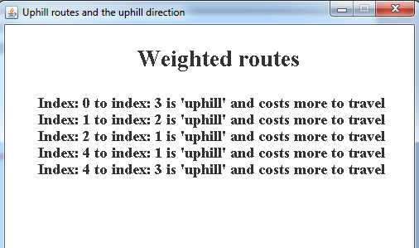
Very basic
Easy to comprehend
Doesn’t impact the main display

Slide 23
Step-based iteration
Automated solving is not always what the user wants
A way to solve the problem on a step-by-step basis was implemented
Slight modification to the existing algorithm
Removed while loops to iterative if/for conditionals
The user can execute this at their own pace
During step mode;
The user cant load or modify parameters once they have started execution
The UI will be temporary disabled to prevent this
This will be available once the current execution stops
The algorithm will ‘step’ once and pause
Lets the user study what just happened
Predict next step

Slide 24
User Interface
Simple
To understand and use
Tasks must be clearly identified
Only allow access to relevant features
Suitable user responses
Errors and correct actions
Accessible by the vast majority
Visual impairments, hearing impairments, …

Slide 25
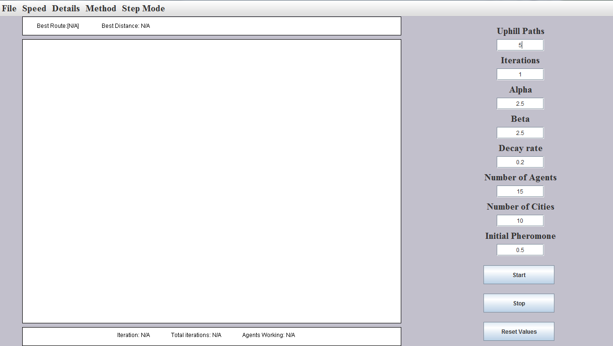

Slide 26
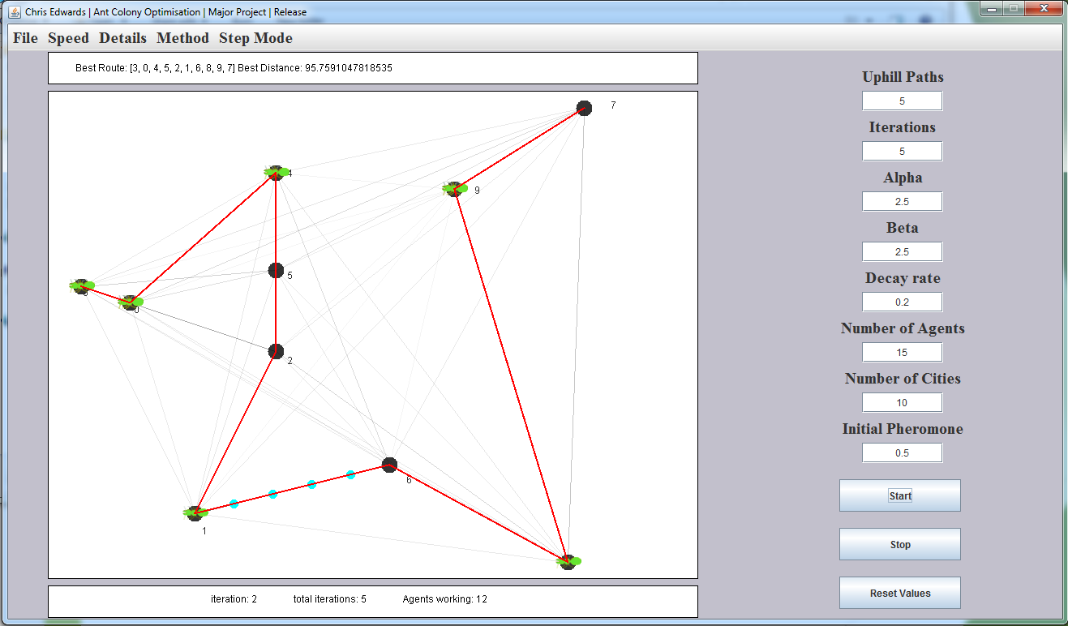

Slide 27
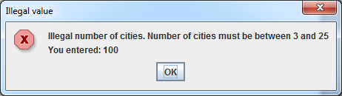
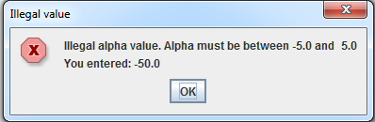
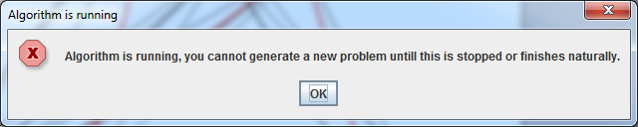

Slide 28
Elitist Ant System
Added so users can compare algorithm execution
One of the first proposed improvements to the Basic Ant System
Retains knowledge of the current best across interactions
User defined number of ‘best’ routes retained
Portion of pheromone deposited along the retained best routes
There needs to be a way to store this data sensibly…

Slide 29
Elitist Ant System - Storage
As pheromone needs to be deposited on the best route, the best route must be stored
The distance of each route is also stored
Used to compare if a new route Is better than the current x number stored
This is the only data that is needed
Rather than storing the x number of Agents we can simple store only the route and distance belonging to the agent
Less overheads, more efficient
Can then iterate through the x stored best
Deposit pheromone
Update the current elite if we find better

Slide 30
Future Work
Implement more algorithm variations
Allow graph generation for incomplete graphs
Support other algorithm types
Bee Colony Algorithms
A*, Dijkstra's algorithm, Depth-first, Breadth-first
Improve the ant movement visualisation
Show direction
Explore additional problem representations
Double bridge, nest/food, …

Slide 31
Evaluation
The current application provides a solution to the problem
Improves on features provided by competitors
Better visualisation, step-based iteration
Simplistic to understand and use
Would like to add additional algorithm types
Room for improvement
Framework can be reused to support other algorithm types

